Slide 1
Database Optimization
Lecture 12
Indexes Non-natural keys Denormalization
Notes:
2007-11-14 (GK): In databases, the plural “indexes” is preferred.
2011-02-23 (NB): Trim down the Indexes part to half a lecture, add another half of real-world outlook.
2013-02-24 (NB): Replace the real-world outlook with another half lecture on synthetic keys and denormalization

Slide 2
Lab: Stuck waiting for grading of Task X?
“We can not continue with Task X+1 before Task X is accepted, and the TA is taking too long!!”
TAs are also people with busy schedules and a lot of work.
No need to wait until Task X is accepted to start working on Task X+1
Any changes required for Task X must be applied to Task X+1 too, but hopefully those will be minimal

Slide 3
Task 5: procedure
Show your finished Task 5 before or in the last lab session
Prepare your demo, make it go smooth
Anticipate that you need to make changes, don’t wait until last minute
Only submit Task 5 to Fire after TA’s approval
Mention “seen by <TA’s name>” in submission note
Submit directly after TA approval
Demo deadline: Friday 15 December 2016
Fire deadline: Monday 17 December 2016

Slide 4
Why use Views from JDBC
Security
Separate permissions on VIEW (e.g. read-only, potentially enforced with trigger)
Hide data
Tables may contain sensitive data that not everyone needs access to (e.g. credit card numbers)
Hide complexity
Queries may be complicated with joins, unions, subqueries, etc. This complexity can be hidden with a view
Support legacy code
Refactoring a table may break a lot of code. A view can preserve the original look of a table while the latter changes in the background.

Slide 5
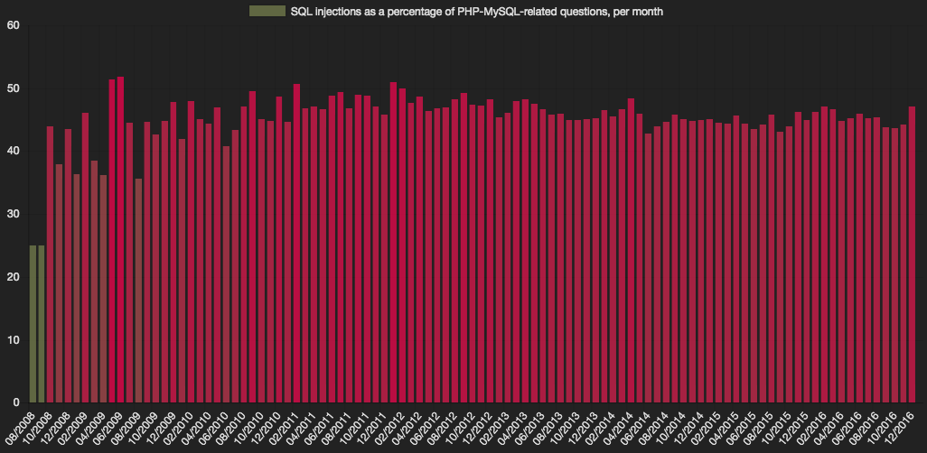
Why you should not blindly copy/paste from Stackoverflow
± 45% contains SQLi
Source: https://laurent22.github.io/so-injections/

Slide 6
"We should forget about small efficiencies, say about 97% of the time: premature optimization is the root of all evil“
- Donald Knuth, 1974
This does not imply: do not optimize,
But instead: focus on functionality first, and then optimize
Notes:
2013-02-24 (NB): New slide added.

Slide 7
Quiz!
How costly is this operation (naive solution)?
course | per | weekday | hour | room
TDA356 | 2 | VR | Monday | 13:15
TDA356 | 2 | VR | Thursday | 08:00
TDA356 | 4 | HB1 | Tuesday | 08:00
TDA356 | 4 | HB1 | Friday | 13:15
TIN090 | 1 | HC1 | Wednesday | 08:00
TIN090 | 1 | HA3 | Thursday | 13:15
n
SELECT * FROM Lectures WHERE course = ’TDA357’ AND period = 3;
Go through all n rows, compare with the values for course and period = 2n comparisons
Notes:
2007-11-14 (GK): Aligned SQL.

Slide 8
Quiz!
Can you think of a way to make it faster?
SELECT * FROM Lectures WHERE course = ’TDA357’ AND period = 3;
If rows were stored sorted according to the values course and period, we could get all rows with the given values faster (O(log n) for tree structure).
Storing rows sorted is expensive, but we can use an index that given values of these attributes points out all sought rows (an index could be a hash map, giving O(1) complexity to lookups).
Notes:
2007-11-14 (GK): Aligned SQL.

Slide 9
Index
When relations are large, scanning all rows to find matching tuples becomes very expensive.
An index on an attribute A of a relation is a data structure that makes it efficient to find those tuples that have a fixed value for attribute A.
Example: a hash table gives amortized O(1) lookups.

Slide 10
Quiz!
Asymptotic complexity (O(x) notation) is misleading here. Why?
The asymptotic complexity works for data structures in main memory. But when working with stored persistent data, the running time of the data structure, once in main memory, is negligible compared to the time it takes to read data from disk. What really matters to get fast lookups in a database is to minimize the number of disk blocks accessed (could use asymptotic complexity over disk block accessing though).
Indexes help here too though. If a relation is stored over a number of disk blocks, knowing in which of these to look is helpful.
Notes:
2007-11-14 (GK): In databases, the plural “indexes” is preferred.

Slide 11
Disk and main memory
Disk
Main memory
Program
read()
input()
x =
y =
write()
output()
Cheap!
Costly!
Notes:
2012-12-06 (GK): New slide
2013-02-24 (NB): Added ”Cheap!” and ”Costly!”

Slide 12
Typical costs
Some (over-simplified) typical costs of disk accessing for database operations on a relation stored over n blocks:
Query the full relation: n (disk operations)
Query with the help of index: k, where k is the number of blocks pointed to (1 for key).
Access index: 1
Insert new value: 2 (one read, one write)
Update index: 2 (one read, one write)

Slide 13
Example:
SELECT * FROM Lectures WHERE course = ’TDA357’ AND period = 3;
Assume Lectures is stored in n disk blocks. With no index to help the lookup, we must look at all rows, which means looking in all n disk blocks for a total cost of n.
With an index, we find that there are 2 rows with the correct values for the course and period attributes. These are stored in two different blocks, so the total cost is 3 (2 blocks + reading index).
Notes:
2007-11-14 (GK): Aligned SQL.

Slide 14
Quiz!
How costly is this operation?
SELECT * FROM Lectures, Courses WHERE course = code;
Lectures: n disk blocks
Courses: m disk blocks
No index:
Index on code in Courses:
Go through all n blocks in Lectures, compare the value for course from each row with the values for code in all rows of Courses, stored in all m blocks. The total cost is thus n * m accessed disk blocks.
Go through all n blocks in Lectures, compare the value for course from each row with the index. Since course is a key, each value will exist at most once, so the cost is 2 * n + 1 accessed disk blocks (1 for fetching the index once).
Notes:
2007-11-14 (GK): Aligned SQL.

Slide 15
CREATE INDEX
Most DBMS support the statement
CREATE INDEX index name ON table (attributes);
Example:
Statement not in the SQL standard, but most DBMS support it anyway.
Primary keys are given indexes implicitly (by the SQL standard).
In PostgreSQL, use \di to list indexes
CREATE INDEX courseIndex ON Courses (code);
Notes:
2007-11-14 (GK): In databases, the plural “indexes” is preferred.

Slide 16
Important properties
Indexes are separate data stored by itself.
Can be created
on newly created relations
on existing relations
- will take a long time on large relations.
Can be dropped without deleting any table data.
SQL statements do not have to be changed
a DBMS automatically uses any indexes.
Notes:
2007-11-14 (GK): In databases, the plural “indexes” is preferred.
2007-12-09 (GK): “On existing data” changed to “on existing relations”. First sub-point rewritten. “SQL-statements does” changed to “SQL statements do”. Last point rewritten.

Slide 17
Quiz!
Why don’t we have indexes on all (combinations of) attributes for faster lookups?
Indexes require disk space.
Modifications of tables are more expensive.
Need to update both table and index.
Not always useful
The table is very small.
We don’t perform lookups over it (Note: lookups ≠ queries).
Using an index costs extra disk block accesses.
Notes:
2007-11-14 (GK): In databases, the plural “indexes” is preferred.
2007-12-09 (GK): “values changed to “attributes”. “an extra disk block access (most often)” changed to “extra disk block accesses”. Points revised and reordered.

Slide 18
Real world
The examples given here are very simplified! In reality, many more factors matter:
Data layout on disk, storage schemes
Size of disk blocks
Size of main memory
Disk latency, bus speed, …
Indexes can be arbitrarily large!
Not uncommon for index to be larger than the data set.
Different index schemes also matter.
Notes:
2013-02-25 (NB): Slide added.

Slide 19
Summary – indexes
Indexes make certain lookups and joins more efficient.
Disk block access matters.
Multi-attribute indexes
CREATE INDEX
Usage analysis
What are the expected operations?
How much do they cost?
Σ(cost of operation)x(proportion of operations of that kind)
Notes:
2007-11-14 (GK): In databases, the plural “indexes” is preferred.
2007-12-09 (GK): Added point about dense, sparse, multi-level and secondary indexes. Added final line with summation.
2008-12-04 (GK): Re-phrased to refer to “proportion of operations”.

Slide 20
Natural keys
A natural key is a key consisting of attributes in the domain model.
In some cases, no suitable natural key exists.
No suitably unique natural candidate key.
Natural candidate key ”too large”.
Natural candidate key ”not stable”.
…
Notes:
2013-02-24 (NB): New slide added.

Slide 21
Artificial key
Extra attribute added to a table with the purpose of being the key.
Does not exist in ”reality”
Can be verified for correctness
Can be distinguished from artificial keys on other tables in database.
Examples:
Personal numbers, car registration numbers, course codes, etc.
Notes:
2013-02-24 (NB): New slide added.

Slide 22
Surrogate key
System-generated key to replace the actual key behind the covers.
AUTO_INCREMENT, SEQUENCE, IDENTITY, …
Totally unrelated to domain.
NOT exposed to user modification – database consistency would be at great risk!
Remember: From the database perspective, application programmers count as users!
Example: post/comment IDs managed by Wordpress.
Notes:
2013-02-24 (NB): New slide added.

Slide 23
Exposed locators
Unholy mix of artificial and surrogate keys:
System-generated, non-verifiable value with no relation to data model (like a surrogate key).
… but exposed to user (like an artificial key).
”[Exposed locators] are handy for lazy, non-RDBMS programmers who do not want to research or think! This is the worst way to program in SQL.”
Joe Celko, SQL programming guru
http://www.informationweek.com/software/business-intelligence/celko-on-sql-natural-artificial-and-surr/201806814
Notes:
2013-02-24 (NB): New slide added.
2013-02-25 (GK): Extended.

Slide 24
BEWARE!
In parts of industry, there is an exaggerated belief in using surrogates, or even exposed locators.
Don’t believe it! There is no one-size-fits-all solution to picking keys. Think for yourselves! You are better than them!
”In the real world, outside of school, it is considered insanity to have more than an integer as key.”
Old student
Notes:
2013-02-24 (NB): New slide added.

Slide 25
Advantages
Non-natural keys can be more compact.
Smaller references, smaller indexes.
Faster comparisons, faster joins.
Non-natural keys are immutable.
Not tied to data in domain, so changes of the data will not cause key to change.
(Recall: Oracle does not support ON UPDATE CASCADE)
Applications never lose their reference to a particular row in the database.
…
Notes:
2013-02-24 (NB): New slide added.

Slide 26
Disadvantages
Non-natural keys may degrade performance.
An extra key on a table requires an extra index to handle external lookups on the natural key
extra disk space to store index
modifications become more costly
Reference to non-natural key means external lookups on the natural key in referencing table requires one or more extra joins.
Non-natural keys may make maintenance harder.
Harder to spot errors, in keys and in references.
…
Notes:
2013-02-24 (NB): New slide added.

Slide 27
Quiz!
Find all lectures for course TDA357 in period 3. How costly is this operation?
Courses(code, …)
GivenCourses(course, period, …) course -> Courses.code
Lectures(course, period, weekday, …) (course, period) -> GivenCourses.(course, period)
Indexes for primary keys
SELECT * FROM Lectures WHERE course = ’TDA357’ AND period = 3;
Costs k + 1 where
k is the number of blocks holding rows matching the values
1 for reading index
Notes:
2013-02-24 (NB): New slide added.

Slide 28
Quiz!
Find all lectures for course TDA357 in period 3. How costly is this operation?
Courses(cid, code, …)
GivenCourses(gcid, course, period, …) course -> Courses.cid
Lectures(lid, gcourse, weekday, …) gcourse -> GivenCourses.gcid
Indexes for primary and natural keys
Costs k + m + 1 + 3 where
k is the number of blocks holding matching lectures
m is the number of blocks holding matching given courses
1 is the block holding the matching code (natural key so only one)
3 for reading three separate indexes
SELECT * FROM Lectures, GivenCourses, Courses WHERE gcourse = gcid AND course = cid AND code = ’TDA357’ AND period = 3;
Notes:
2013-02-24 (NB): New slide added.

Slide 29
Words of (my) advice
Use natural keys.
If none available, find or create an artificial key.
For (strong and weak) entities only: all tables representing relationships will have natural (composite) keys.
Also do this if natural key not suitably immutable.
If, and ONLY if, you notice a performance problem, surrogate keys might help.
Remember to mark natural keys unique.
Remember to create index for natural key lookups, if needed.
Use views to hide the surrogate keys from users. Avoid exposed locators.
Never include surrogates in e.g. E-R diagram – they are an implementation detail.
Notes:
2013-02-24 (NB): New slide added.

Slide 30
Denormalization
”Re-compose” decomposed tables or attributes, to avoid joining.
Can think of this as pre-computing joins
Trade-off: query speed vs. redundancy
Are updates frequent?
”NULLs approach” for sub-entities and many-to-at-most-one is a special case – both composed tables have the same key, so less data will be stored.
Notes:
2013-02-24 (NB): New slide added.
2013-02-25 (GK): Extended.

Slide 31
Summary – optimization
Indexes
(often) speed up queries and joins
make modifications more costly
Natural keys, artificial keys, surrogate keys
Avoid exposed locators!
Know when to use what.
Denormalization
Can be a worthwhile trade-off.
Notes:
2013-02-24 (NB): New slide added.
2013-02-25 (GK): I think de-normalization should be presented more positively (can suit OLAP better than transaction systems).

