Slide 1
Database design IV
Lecture 4
Normal Forms:
Summary

Slide 2
”We want a database that we can use for scheduling courses and lectures. This is how it’s supposed to work: …”
Problem description
code
day
hour
roomNr
Functional dependencies
Decomposition using normal forms to remove anomalies
name
Fix errors
Add constraints
Course
Of
Lecture
In
Room
name
dept
building
responsible
ER diagram
Courses(code, name, dept, examiner)
Rooms(roomNr, name, building)
Lectures(roomNr, day, hour, course)
roomNr -> Rooms.roomNr
course -> Courses.code
Relational database
schema
Notes:
2016-11-03 (SVA) Added slide to explain design process

Slide 3
Work flow
DRAW your diagram of the domain.
TRANSLATE to relations forming a schema
IDENTIFY dependencies from domain!
RELATE the dependencies to the schema, to find more constraints, and to validate your design.

Slide 4
Last time
Functional dependencies (FDs) X → A
X⁺ = Closure of X = all derivable (from X) attributes
F⁺ = Closure of F = all implied (from F) FDs
Superkeys, keys and primary keys
Boyce-Codd Normal Form (BCNF):
  The LHS (X) of every non-trivial FD (X → A) must be a superkey
Decomposition:
  Split up relations until normal form (e.g. BCNF) holds
  Make sure to preserve recovery!!! No lossy joins allowed

Slide 5
Normal Forms?!
Use normal forms to detect anomalies (e.g. Redundancy)
Use decomposition to remove anomalies
1NF + ... = 2NF
2NF + ... = 3NF
3NF + ... = BCNF (3.5NF)
BCNF + ... = 4NF
4NF + ... = 5NF
5NF + ... = 6NF
6NF ⊆ 5NF ⊆ 4NF ⊆ BCNF ⊆ 3NF ⊆ 2NF ⊆ 1NF
Stronger
Requirements
In this course
(e.g. a database in 6NF is also in 5NF, etc.)

Slide 6
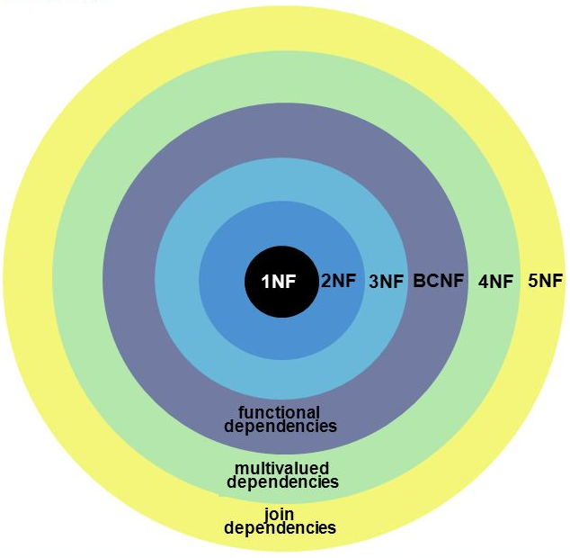
Normal Forms?!
In this course

Slide 7
BCNF Example
Decompose Courses into BCNF.
Courses(code, period, name, teacher)
code → name
code, period → teacher
Violates BCNF, so we will kick it out of the relation
{code}⁺ = {code, name}
Courses1(code, name)
Create new relation
Courses2(code, period, teacher)
code -> Courses1.code
Remove ‘name’ from old relation
and add reference
No BCNF violations left, so we’re done!
Notes:
2016-11-03 (SVA): After decomposition, renamed Courses to Courses1, and GivenCourses to Courses2

Slide 8
Tricky example of BCNF decomposition:
Decompose:
GivenCourses(course, period, teacher)
course -> Courses.code
Two keys:
{course, period}
{teacher, period}
course, period → teacher
teacher → course
Violation!
Teaches(teacher, course)
course -> Courses.code
GivenCourses(period, teacher)
teacher -> Teaches.teacher
Quiz: What just went wrong?
Notes:
2016-11-03 (SVA) this example assumes that a teacher only gives 1 course

Slide 9
Teaches(teacher, course)
course -> Courses.code
GivenCourses(period, teacher)
teacher -> Teaches.teacher
teacher | course
Niklas Broberg | TDA357
Graham Kemp | TDA357
per | teacher
2 | Mickey
2 | Tweety
course | per | teacher
TDA357 | 2 | Mickey
TDA357 | 2 | Tweety
course, period → teacher ??
Notes:
2009-01-28, NB: Updated the values to match the current situation.
2016-11-03 (SVA) there are no invalid entries in the database, yet the FD is violated. The problem is that the FD can not be enforced because no relation holds all the attributes needed to do so

Slide 10
Third Normal Form (3NF)
3NF is a weakening of BCNF that handles this situation.
  An attribute is prime in relation R if it is a member of any key of R.
    e.g. keys: {course, period}{teacher, period}
    Prime attributes: {course, period, teacher}
X → A is in BCNF
iff either:
X → A is a trivial FD
X is a superkey
X → A is in 3NF
iff either:
X → A is a trivial FD
X is a superkey
A-X has only prime attributes
Notes:
2016-11-03 (SVA) Describe how 3NF and BCNF relate instead of using double negatives describing how the violations relate

Slide 11
Different algorithm for 3NF
Given a relation R and a set of FDs F:
  Compute the minimal basis of F.
    Minimal basis means F⁺, except remove A → C if you have A → B and B → C in F⁺.
  Group together FDs with the same LHS.
  For each group, create a relation with the LHS as the key.
  If no relation contains a key of R, add one relation containing only a key of R.

Slide 12
Example:
Decompose:
Courses(code, period, name, teacher)
code → name
code, period → teacher
teacher → code
teacher → name
Two keys:
{code, period}
{teacher, period}
Prime attributes:
{code, period, teacher}
Courses(code, name)
GivenCourses(course, period, teacher)
course -> Courses.code
teacher -> Teaches.teacher
Teaches(teacher, course)
course -> Courses.code
GivenCourses contains a key for the original Courses relation, so we are done.

Slide 13
Earlier tricky example revisited:
Since all attributes are members of some key, i.e. all attributes are prime, there are no 3NF violations. Hence GivenCourses is in 3NF.
GivenCourses(course, period, teacher)
course -> Courses.code
Two keys:
{course, period}
{teacher, period}
course, period → teacher
teacher → course
Quiz: What’s the problem now then?
Notes:
2016-11-03 (SVA) the problem is redundancy, which BCNF decomposition would have removed but 3NF decomposition did not

Slide 14
One 3NF solution for scheduler
Courses(code, name)
GivenCourses(course, period, #students, teacher)
course -> Courses.code
Rooms(name, #seats)
Lectures(course, period, room, weekday, hour, teacher)
(course, period, teacher) ->
GivenCourses.(course, period, teacher)
room -> Rooms.name
(room, period, weekday, hour) unique
(teacher, period, weekday, hour) unique
Quiz: What’s the problem now then?
Notes:
2016-11-03 (SVA) teacher is highlighted to note the difference with the BCNF solution for Scheduler on slide 15. This addition to the Lectures relation allows us to enforce the extra constraint, so 3NF decomposition had a purpose
2016-11-03 (SVA) Again, the problem with 3NF decomposition is redundancy!

Slide 15
Redundancy with 3NF
GivenCourses is in 3NF. But teacher → course violates BCNF, since teacher is not a key. As a result, course will be redundantly repeated!
GivenCourses(course, period, teacher)
course -> Courses.code
Two keys:
{course, period}
{teacher, period}
course, period → teacher
teacher → course

Slide 16
3NF vs BCNF
Three important properties of decomposition:
    Recovery (loss-less join)
    No redundancy
    Dependency preservation
3NF guarantees 1 and 3, but not 2.
BCNF guarantees 1 and (almost) 2, but not 3.
  3 can sometimes be recovered separately through ”assertions” (costly). More on this later.

Slide 17
Almost?
Example:
Courses(code, name)
code → name
LecturesIn(code, room, teacher)
code -> Courses.code
code | room | teacher
TDA357 | VR | Mickey
TDA357 | VR | Tweety
TDA357 | HC1 | Mickey
TDA357 | HC1 | Tweety
code | name
TDA357 | Databases
These two relations are in BCNF, but there’s lots of redundancy!
Notes:
2009-01-28, NB: Updated the values to match the current situation.

Slide 18
Let’s start from the bottom…
code | room
TDA357 | HC1
TDA357 | VR
code | teacher
TDA357 | Mickey
TDA357 | Tweety
code | room | teacher
TDA357 | VR | Mickey
TDA357 | VR | Tweety
TDA357 | HC1 | Mickey
TDA357 | HC1 | Tweety
No redundancy before join
The two starting tables are what we really want to have
Notes:
2009-01-28, NB: New slide, with the idea to introduce INdependencies (instead of MVDs).

Slide 19
Compare with E/R
name
LecturesIn(code, teacher, room)
code -> Courses.code
room -> Rooms.name
teacher -> Teachers.name
Teacher
code
name
LecturesIn
Course
Room
Before decomposition
After decomposition
name
Gives
LecturesIn(code, room)
code -> Courses.code
room -> Rooms.name
Gives(code, teacher)
code -> Courses.code
teacher -> Teachers.name
Teacher
name
LecturesIn
Course
Room
code
Notes:
2009-01-28, NB: New slide, comparing independency in relations and E/R-style relationships.

Slide 20
break

Slide 21
Quiz TIME!!

Slide 22
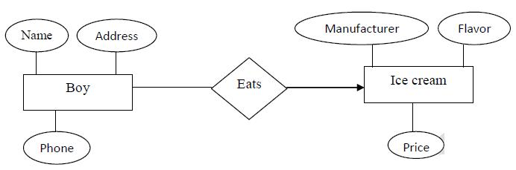
Q1: How many icecreams does one boy eat?
Notes:
SOL: Exactly 1

Slide 23
Q2: How many boys can eat one ice cream?
Notes:
SOL: N

Slide 24
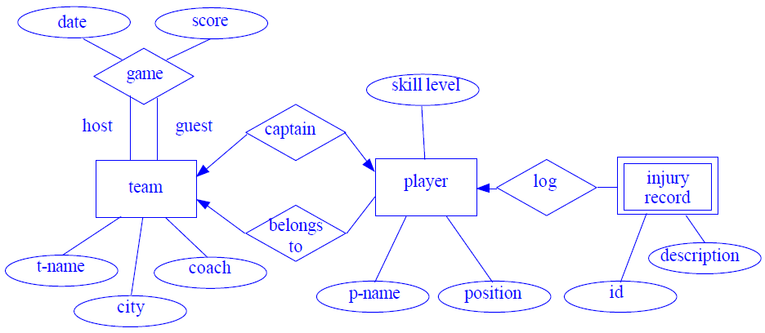
Q3: How many captains can a team have?
Notes:
SOL: Exact. 1

Slide 25
Q4: Can a player be a captain without belonging to that team?
Notes:
SOL: 1-to-1 relationships usually used for performance of the database. For instance there are rarely used attributes and we split tables

Slide 26
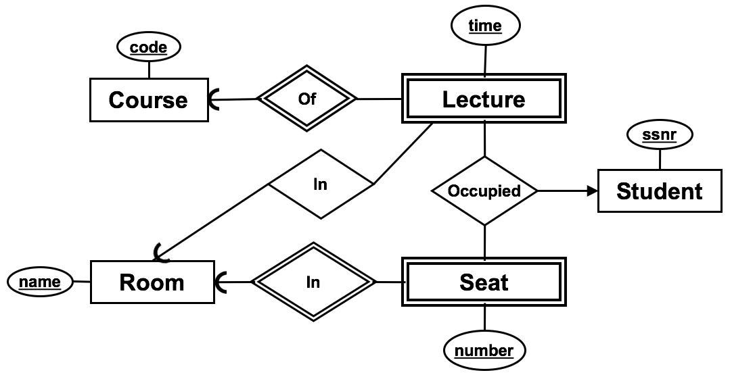
Q5: How many lectures can be held in a room?
Notes:
SOL: N

Slide 27
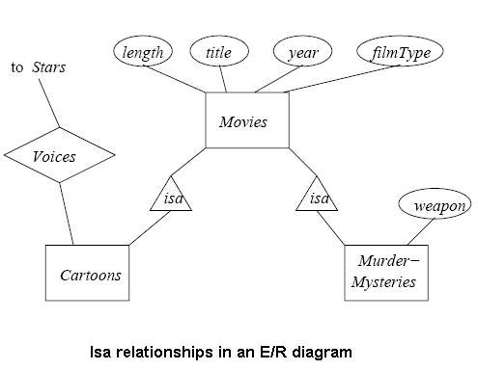
Q6: what is “cartoons”?
Notes:
SOL: Type of movie

Slide 28
Q7: Draw the ER diagram
A person has a name, birthday and SSN.
Names and birthdays are not unique
name
name
birthdate
ssn
Person
ssn
Person
(A)
(B)
name
birthdate
name
birthdate
ssn
Person
ssn
Person
(C)
(D)
Notes:
SOL: C

Slide 29

Q8: Draw the ER diagram
A person has a name, birthday and SSN.
Names and birthdays are not unique
A person can create many paintings
but paintings are created by exactly one person
name
birthdate
name
birthdate
name
birthdate
ssn
Person
ssn
Person
ssn
Person
Creates
Creates
Creates
Painting
Painting
(A)
Painting
(B)
(C)
Notes:
SOL: B

Slide 30
Q9: Create the relational scheme
Person(ssn, name, birthdate)
Painting(name, painter)
painter -> Person.ssn
(A)
Person(ssn, name, birthdate)
Painting(name)
createdBy(work, painter)
work -> Painting.name
painter -> Person.ssn
(B)
name
birthdate
ssn
Person
Creates
Person(ssn, name, birthdate)
Painting(name)
createdBy(work, painter)
work -> Painting.name
painter -> Person.ssn
(D)
name
Person(ssn, name, birthdate)
Painting(name)
createdBy(work, painter)
work -> Painting.name
painter -> Person.ssn
(C)
Painting
Notes:
SOL: A

Slide 31
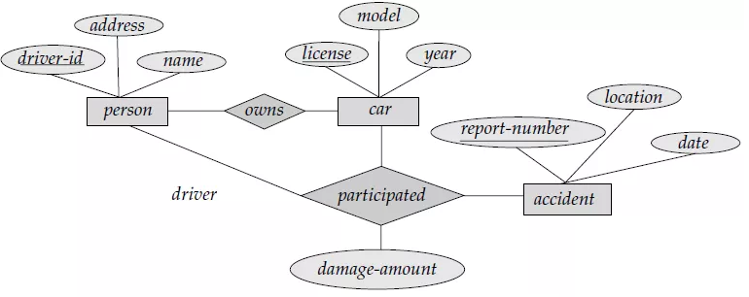
Q10: Create the relational scheme for the entities only
person (id, name, address)
car (license, year, model)
accident (reportnum, date, location)
(B)
person (id, name, address)
car (license, year, model)
accident (reportnum, date, location, personid, car)
(A)
person (id, name, address)
car (license, year, model, owner)
accident (reportnum, date, location, personid, car)
(C)
Notes:
SOL: B

Slide 32
Q11: Create the relational scheme
Person(name, age)
Painter(name, age, salary)
Painting(name, value)
owns(work, painter)
work -> Painting.name
painter -> Person.name
(A)
Person(name, age, salary)
salary can be NULL
Painting(name, value)
owns(work, painter)
work -> Painting.name
painter -> Person.name
(B)
Person(name, age)
Painter(name, salary)
name -> Person.name
Painting(name, value)
owns(work, painter)
work -> Painting.name
painter -> Person.name
(C)
age
Person
ISA
name
Owns
Painter
name
value
salary
Painting
Notes:
SOL: C
We use a JOIN to retrieve also the painter’s age

Slide 33
Q12: which BCNF decomposition is correct?
R(a, b, c, d, e)
  a → b, c
  c → d, e
R1(a, b, c)
  a → b, c
R2(d, e)
  d → e
(A)
R1(a, b, c, d, e)
  a → b, c
R2(c)
  c -> R1.c
(B)
R1(a, b, c)
  a → b, c
R2(c, d, e)
  c → d, e
  c -> R1.c
(C)
Notes:
SOL: C

Slide 34
Q13: what are the keys of R?
R(a, b, c, d, e, f)
  a → b
  a → c
  c, d → e, f
  b → e
  c → a, b
  {a, d}
  {a, c}
  {a, d, c}
  {c, d}
Notes:
{a,d}+ = {a,b,c,e,d,f}
{a,c}+={a,b,e}
{a,d,c}+={a,b,c,d,e,f}
{c,d}+={a,b,c,d,e,f}

Slide 35
Q14: What is the normal form of this relation? Why?
R = { A , B, C, D, E, F , G, H, I, J, K , M }
FD1: A → {J,K}
FD2: B →{D,E}
FD3: F →{G,H}
FD4: I →{C}
Notes:
This relation is in 1 NF because all attribute values are single and atomic.
FD1 and FD2 are partial dependencies; hence the relation is not in 2NF.
For example
attribute J in FD1 is functionally dependent on A only (Not A, B and C)

Slide 36
Q15: Decompose relation R until satisfying the highest normal form.
R = { A , B, C, D, E, F , G, H, I, J, K , M }
FD1: A → {J,K}
FD2: B →{D,E}
FD3: F →{G,H}
FD4: I →{C}
The resulting decomposition of the relation R is:
R11(#A, J, K)
R12(#B, D, E)
R22(#F, G, H)
R31(#A, #B, F, #I, M) attribute I becomes part of the PK as I determines C that is removed
R32(#I, C)
Notes:
2. A decomposition to 2 NF is
R11(#A, J, K)
R12(#B, D, E)
R13(#A, #B, #C, F, G, H, I, M)
3.FD3 violates 3NF as it is a transitive FD. Note that FD4 does not violate 3 NF because C is part of the PK.
A decomposition to 3NF is
R21(#A, #B, #C, F, I, M)
R22(#F, G, H)
4. FD4 violates BCNF as I is not a superkey. (R21(A, B, C, F, I, M)) A decomposition into BCNF is
R31(#A, #B, F, #I, M)
R32(#I, C)
SOL: The resulting decomposition of the relation R is:
R11(#A, J, K)
R12(#B, D, E)
R22(#F, G, H)
R31(#A, #B, F, #I, M) attribute I becomes part of the PK as I determines C that is removed
R32(#I, C)

Slide 37
Independencies (INDs)
Some attributes are not uniquely defined (as with FDs), but are still independent of the values of other attributes.
  In our example: code does not determine room, there can be several rooms for a course. But the rooms a course uses is independent of the teachers on the course.
X ↠ Y | Z states that from the point of view of X, Y and Z are independent.
  Just X ↠ Y means that X’s relationship to Y is independent of all other attributes.
(INDs are called Multivalued Dependencies (MVDs) in the book,
but no need to remember that name)
Notes:
2009-01-28, NB: MVDs → INDs. Also emphasize the X ->> Y | Z way of presenting it, since that makes the independency component more important.

Slide 38
Independent how?
An IND X ↠Y is an assertion that if two tuples of a relation agree on all the attributes of X, then their components in the set of attributes Y may be swapped, and the result will be two tuples that are also in the relation.
If (for some X) all values of Y (for that X) can be combined with all values of Z (for that X), then (from X) Y and Z are independent.
Notes:
2009-01-28, NB: Partly rewritten, added second paragraph.

Slide 39
Picture of IND X ↠Y | Z
X Y Z
equal
exchange
If two tuples have the same value for X, different values for Y and different values for the Z attributes, then there must also exist tuples where the values of Y are exchanged, otherwise Y and Z are not independent!
Notes:
2009-01-28, NB: Added Z instead of ”others”, again to emphasize the X ->> Y | Z

Slide 40
Implied tuples
Courses(code, name, room, teacher)
code → name
code ↠ room | teacher
If we have:
code | name | room | teacher
TDA357 | Databases | VR | Mickey
TDA357 | Databases | HC1 | Tweety
we must also have:
TDA357 | Databases | HC1 | Mickey
TDA357 | Databases | VR | Tweety
otherwise room and teacher would not be independent!
Notes:
2009-01-28, NB: Updated the values to match the current situation.

Slide 41
Compare with joining
code | room
TDA357 | HC1
TDA357 | VR
code | teacher
TDA357 | Mickey
TDA357 | Tweety
code | room | teacher
TDA357 | VR | Mickey
TDA357 | VR | Tweety
TDA357 | HC1 | Mickey
TDA357 | HC1 | Tweety
Joining two independent relations yields a relation with all combinations of values!
Notes:
2009-01-28, NB: Updated the values to match the current situation.

Slide 42
Another example
Name | Hobby | Lang | LangSkill
Alice | Gaming | Dutch | A
Alice | Gaming | French | B
Alice | Gaming | English | A
Alice | Gaming | Swedish | C
Alice | Cooking | Dutch | A
Alice | Cooking | French | B
Alice | Cooking | English | A
Alice | Cooking | Swedish | C
Alice | Hiking | Dutch | A
Alice | Hiking | French | B
Alice | Hiking | English | A
Alice | Hiking | Swedish | C
Bob | Fish | English | A
Bob | Skate | English | A
Name | Hobby | Lang, LangSkill
Alice | Gaming Cooking Hiking | Dutch, A French, B English, A Swedish, C
Bob | Fish Skate | English, A
name ↠ hobby | lang, langskill
For a given name, hobby and {language, langskill} are independent
For a given name, all combinations of hobby and {lang, langskill} must be able to exist

Slide 43
FDs are INDs
Every FD is an IND (but of course not the other way around). Compare the following cases:
  If X ↠ Y holds for a relation, then all possible values of Y for that X must be combined with all possible combinations of values for ”all other attributes” for that X.
  If X → A, there is only one possible value of A for that X, and it will appear in all tuples where X appears. Thus it will be combined with all combinations of values that exist for that X for the rest of the attributes.
Notes:
2009-01-28, NB: MVDs → INDs. Added ”Compare the following cases:”

Slide 44
Example:
code | name | room | teacher
TDA357 | Databases | VR | Mickey
TDA357 | Databases | VR | Tweety
TDA357 | Databases | HC1 | Mickey
TDA357 | Databases | HC1 | Tweety
There are four possible combinations of values for the attributes room and teacher, and the only possible value for the name attribute, ”Databases”, appears in combination with all of them.
There are two possible combinations of values for the attributes name and room, and all possible values of the attribute teacher appear with both of these combinations.
There are two possible combinations of values for the attributes name and teacher, and all possible values of the attribute room appear with both of these combinations.
code ↠ name
code ↠ teacher
code ↠ room
Notes:
2009-01-28, NB: Updated the values to match the current situation.

Slide 45
IND rules ≠ FD rules
Complementation
  If X ↠ Y, and Z is all other attributes, then
  X ↠ Z.
Splitting doesn’t hold!!
  code ↠ room, #seats
    code ↠ room does not hold, since room and #seats are not independent!
None of the other rules for FDs hold either.
Notes:
2009-01-28, NB: MVD → IND, emphasized the difference from FDs already in the title.

Slide 46
Example:
code | name | room | #seats | teacher
TDA357 | Databases | VR | 216 | Mickey
TDA357 | Databases | VR | 216 | Tweety
TDA357 | Databases | HC1 | 126 | Mickey
TDA357 | Databases | HC1 | 126 | Tweety
code ↠ room, #seats
We cannot freely swap values in the #seats and room columns, so neither
or
holds.
code ↠ room
code ↠ #seats
Notes:
2009-01-28, NB: Updated the values to match the current situation.

Slide 47
Fourth Normal Form (4NF)
The redundancy that comes from IND’s is not removable by putting the database schema in BCNF.
There is a stronger normal form, called 4NF, that (intuitively) treats IND’s as FD’s when it comes to decomposition, but not when determining keys of the relation.
Notes:
2009-01-28, NB: MVD → IND

Slide 48
Fourth Normal Form
4NF is a strengthening of BCNF to handle redundancy that comes from independence.
  An IND X ↠ Y is trivial for R if
    Y is a subset of X
    X and Y together = R
  Non-trivial X → A violates BCNF for a relation R if X is not a superkey.
  Non-trivial X ↠ Y violates 4NF for a relation R if X is not a superkey.
    Note that what is a superkey or not is still determined by FDs only.
Notes:
2009-01-28, NB: MVD → IND

Slide 49
BCNF Versus 4NF
Remember that every FD X → Y is also a IND, X ↠Y.
Thus, if R is in 4NF, it is certainly in BCNF.
  Because any BCNF violation is a 4NF violation.
But R could be in BCNF and not 4NF, because IND’s are “invisible” to BCNF.
Notes:
2009-01-28, NB: MVD → IND

Slide 50
INDs for validation
Remember that FDs can:
  Allow you to validate your schema.
  Find ”extra” constraints that the basic structure doesn’t capture.
INDs ONLY validate your schema.
  No extra dependencies to be found.
  If your E-R diagram and translation are correct, INDs don’t matter.

Slide 51
Example
R(code, name, period, room, seats, teacher)
  code → name
  code, period → room, teacher
  room → seats
  code, period ↠ room, seats
  code, period ↠ teacher
(on blackboard)

Slide 52

Example:
E-R does not imply BCNF
time
code
Course
Of
Lecture
ssnr
In
Occupied
Student
In
name
Room
Seat
number

Slide 53
time
code
Course
Of
Lecture
ssnr
In
Occupied
Student
Students(ssnr)
Courses(code)
Rooms(name)
Lectures(course,time,room)
course -> Courses.code
room -> Rooms.name
Seats(room,number)
room -> Rooms.name
Occupied(course,time,room,number,student)
(course,time) -> Lectures.(course,time)
(room,number) -> Seats.(room,number)
student -> Students.ssnr
Room
In
Seat
name
number
Redundancy!
Quiz: What just went wrong?

Slide 54
Fix attempt #1
Students(ssnr)
Courses(code)
Rooms(name)
Lectures(course,time,room)
course -> Courses.code
room -> Rooms.name
Seats(room,number)
room -> Rooms.name
Occupied(course,time,number,student)
(course,time) -> Lectures.(course,time)
student -> Students.ssnr
(room,number) -> Seats.(room,number) ??
We broke the reference! Now we could (in theory) book seats that don’t exist in the room where the lecture is given!
Notes:
2016-11-07 (SVA) the partial key “room” was removed from Occupied

Slide 55
Fix attempt #2
Students(ssnr)
Courses(code)
Rooms(name)
Lectures(course,time,room)
course -> Courses.code
room -> Rooms.name
Seats(room,number)
room -> Rooms.name
Occupied(course,time,number,room,student)
(course,time) -> Lectures.(course,time)
(room,number) -> Seats.(room,number)
student -> Students.ssnr
Same? We can’t say!
Same? We can’t say!
No longer part of key!
No guarantee that the room where the seat is booked is the same room that the lecture is in!
… and redundancy (3NF solution)
Notes:
2016-11-07 (SVA) changed confusion mentions of “hall” and “movie” to “room” and “lecture”

Slide 56
Fix attempt #3
Students(ssnr)
Courses(code)
Rooms(name)
Lectures(course,time,room)
course -> Courses.code
room -> Rooms.name
Seats(room,number)
room -> Rooms.name
Occupied(course,time,number,room,student)
(course,time,room) ->
Lectures.(course,time,room)
(room,number) -> Seats.(room,number)
student -> Students.ssnr
Same? We can’t say!
Same!
Still redundancy though (3NF solution). Possibly the best we can do though.
Notes:
2016-11-07 (SVA) room is added to the reference, so that both room attributed must now match in both Occupied and Lectures

Slide 57
Next time, Lecture 5
Database Construction –
SQL Data Definition Language

