Slide 1
Course on Computer Communication and Networks
Lecture 14
Summary - flashback
EDA344/DIT 420, CTH/GU

Slide 2
Important for the exam
When/where: wednesday March 18, 14.00-18.00, M
You may have with you:
English-X dictionary
no calculators, PDAs, etc (if/where numbers matter, do rounding)
Grading
30-40, 41-50, 51-60 (out of 60)= 3, 4, 5 (CTH)
30-44, 45-60 (out of 60) = G, VG (GU)
To think during summary-study
Overview; critical eye; explain, ask yourselves: why is this so? / How does it work?

Slide 3
Flashback

Slide 4
Principles, Organisation
Network Problems (in the order faced in the 1st intro):
producer-consumer problems, flow and error control,
manage access to shared (broadcast) transmission media ,
routing,
congestion,
connecting transparently different networks,
serving different types of traffic,
performance,
mobility
security
Layering : principle, why

Slide 5
Highlights
Software-defined networks
network security issues
TCP/IP, LAN protocol stack
delays performance
routing, also with mobility
multiple access protocols (wired, wireless)
reliable data transfer
datagram vs VC
congestion control

Slide 6
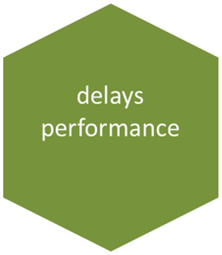
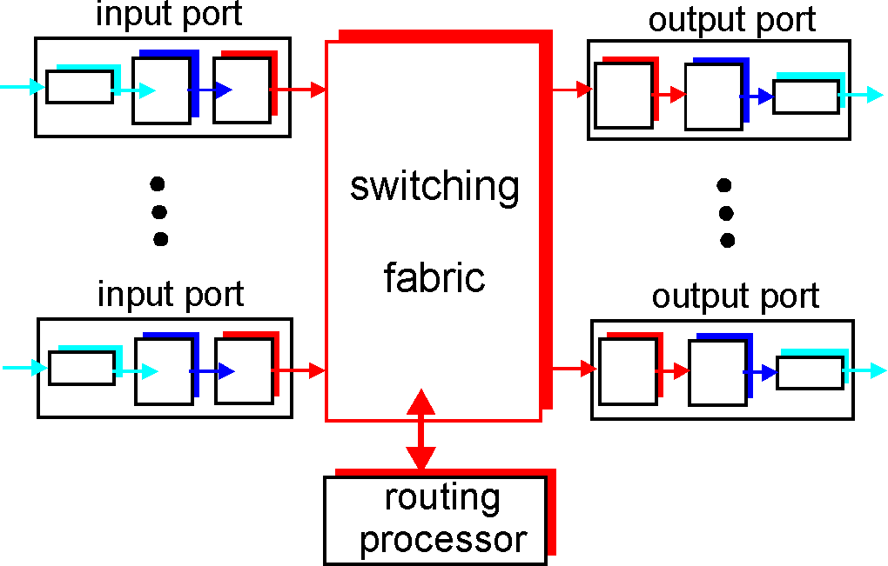
Types of delay; performance
Propagation, transmission, queueing, processing
Throughput -- effective bandwidth
Utilization -- efficiency
Packet-switching: impact of store&forward
TCP’s slow start
Sliding windows performance
transmission
A
propagation
B
nodal
processing
queuing

Slide 7
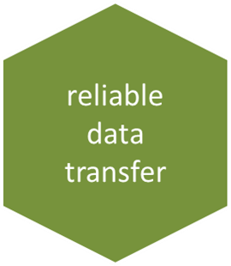
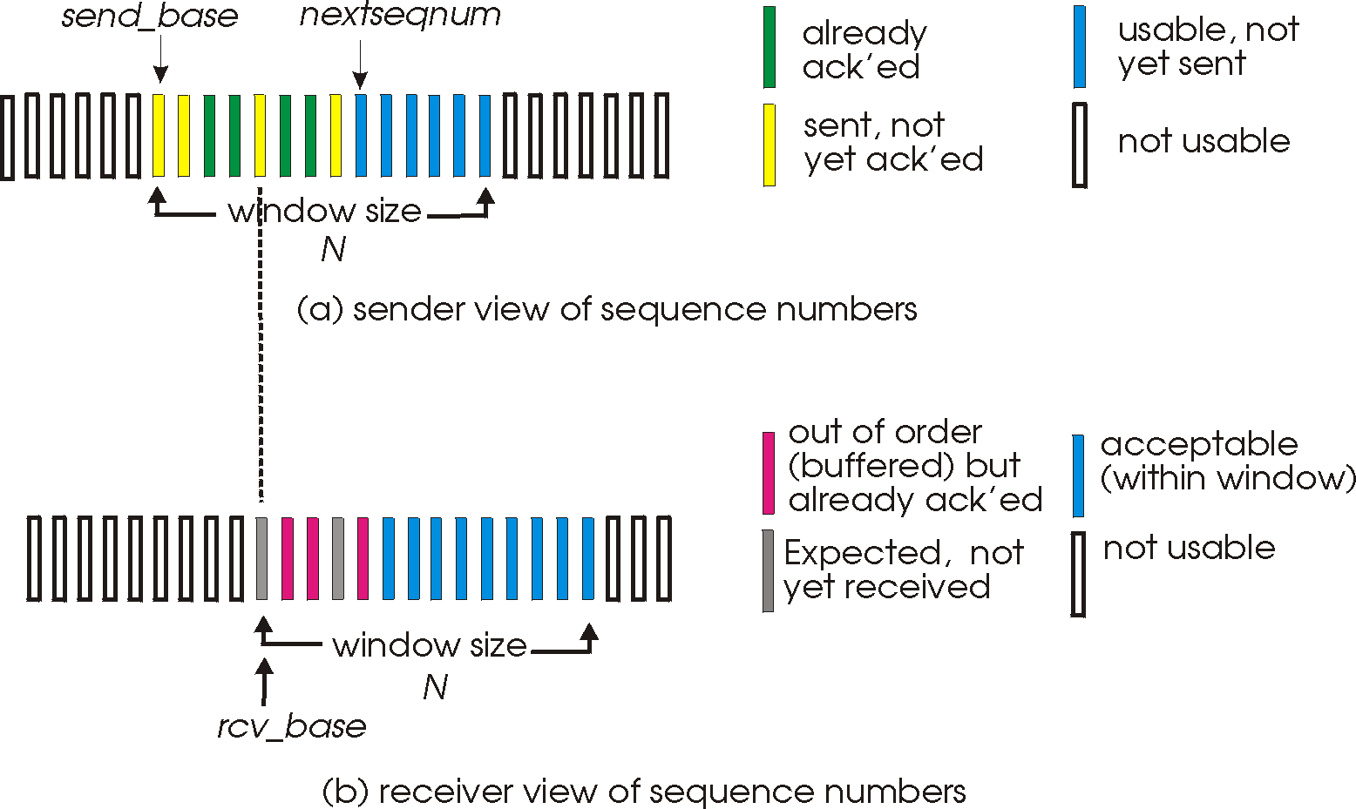
Reliable data transfer
Guaranteed, in-order, correct delivery:
  stop&wait
  sliding windows
  sequence numbers
  window sizes
  dynamic windows (TCP)
  performance
  Flow control
Error detection: checksums, CRC
Error control: go-back-n, selective repeat, FEC methods

Slide 8
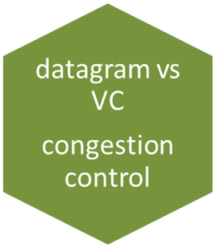
Datagram vs VC end-to-end comm.
Congestion
Control
RT traffic/streaming

Slide 9
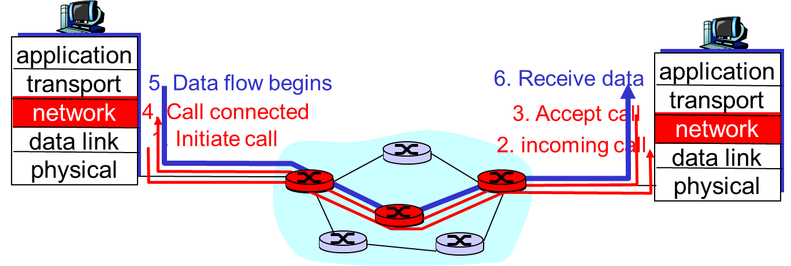
Datagram vs VC end-to-end communication
Conceptual differences
Decisions, comparison

Slide 10
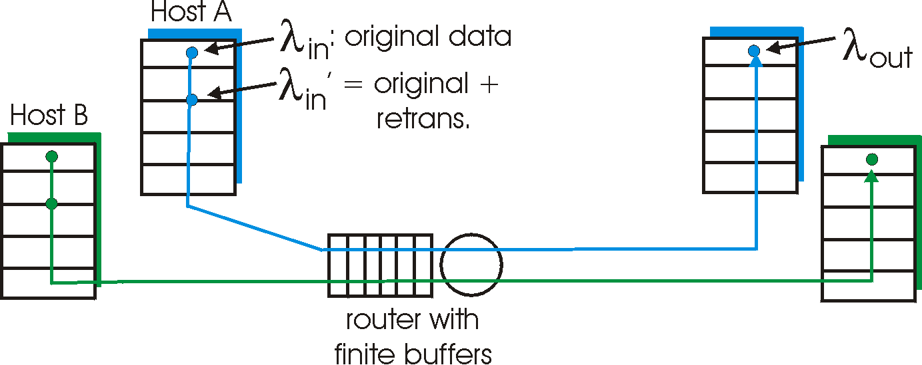
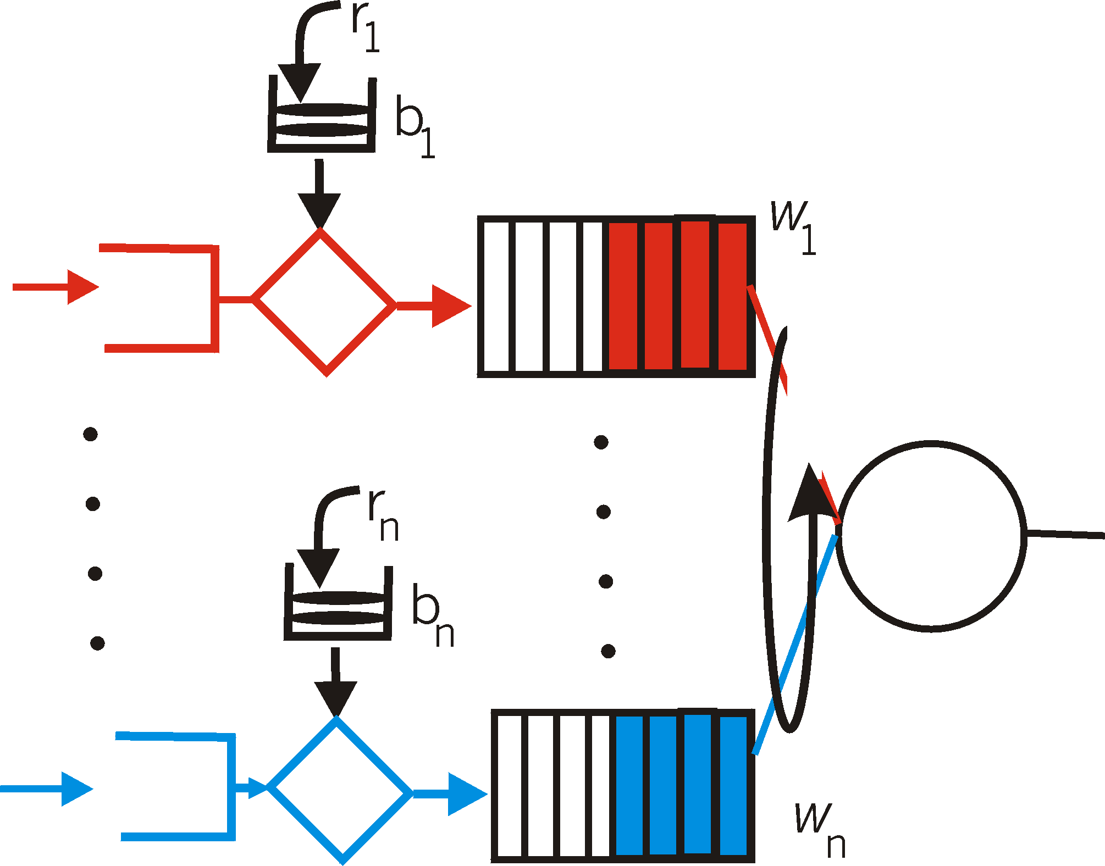
Congestion control (CC)
why, how congestion occurs
CC in TCP and performance; implied weaknesses
CC in other ways, e.g. VC-based networks
  Real-time (RT)-traffic resource reservation:
    traffic shaping and policing
  rate-based

Slide 11
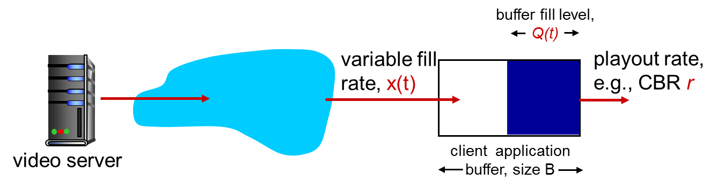
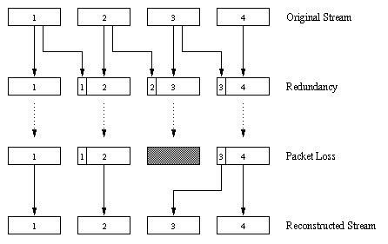
RT/streaming traffic
Internet context
Application-level solutions (FEC, playout delay, caching-CDN)
Intserv, Diffserv
Conceptual needs:
packet/flow marking
Admission control
Traffic shaping & policing
Packet scheduling

Slide 12
Highlights
Software-defined networks
network security issues
TCP/IP, LAN protocol stack
delays performance
routing, also with mobility
multiple access protocols (wired, wireless)
reliable data transfer
datagram vs VC
congestion control

Slide 13
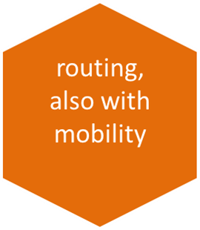

Routing, also with mobility
Routing algorithms, protocols
Forwarding in routers
Resource, policy issues
Addressing mobility, tunneling
5
B
3
C
2
5
A
2
1
F
3
1
2
D
E
1
Mobile
Switching
Center
Public telephone
network, and
Internet
Complementary video links
- IP addresses and subnets http://www.youtube.com/watch?v=ZTJIkjgyuZE&list=PLE9F3F05C381ED8E8&feature=plcp
- How does BGP choose its routes http://www.youtube.com/watch?v=RGe0qt9Wz4U&feature=plcp
Mobile
Switching
Center

Slide 14
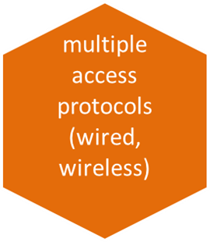
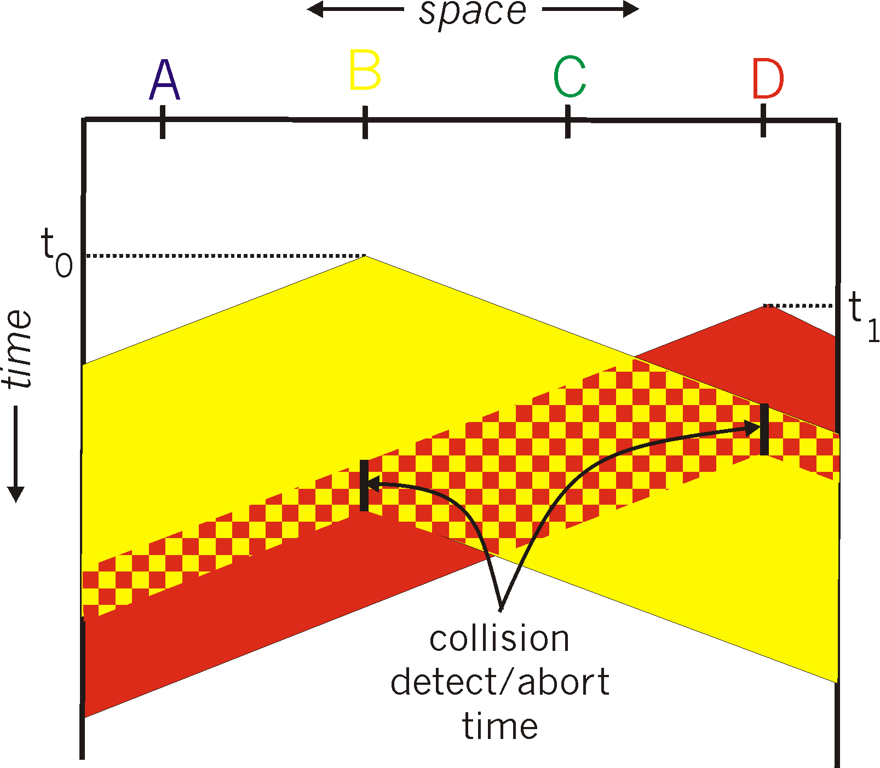

Medium access: multiple access methods
Strategies: (functionality, appropriateness)
Contention-based (random access), wired/wireless:
  Aloha, CSMA(CD/CA)
Collision-free:
  Channel partitioning: TDMA, FDMA, CDMA
  Taking turns: e.g. tokens, reservation-based
A
B
C
A’s signal
strength
C’s signal
strength
space

Slide 15
Highlights
Software-defined networks
network security issues
TCP/IP, LAN protocol stack
delays performance
routing, also with mobility
multiple access protocols (wired, wireless)
reliable data transfer
datagram vs VC
congestion control

Slide 16
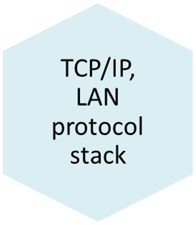
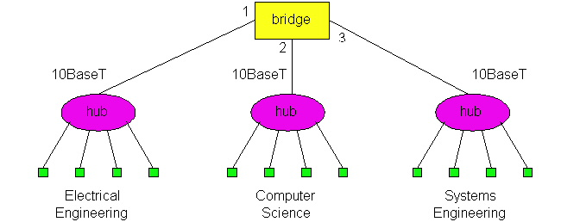
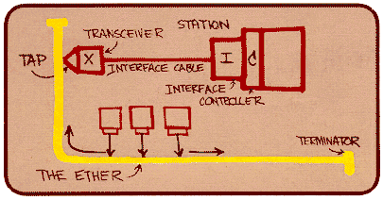
LANs & related link technologies
Protocol Examples: wired, wireless
  Ethernet, 802.11 (+ 802.16 wimax), GSM:
    Functionality, performance under low/high load
Connecting devices;
  functionalities and differences (Hubs, switches)
  Algorithms for switch-”routing”: learning& forwarding of packets
ARP
switch

Slide 17
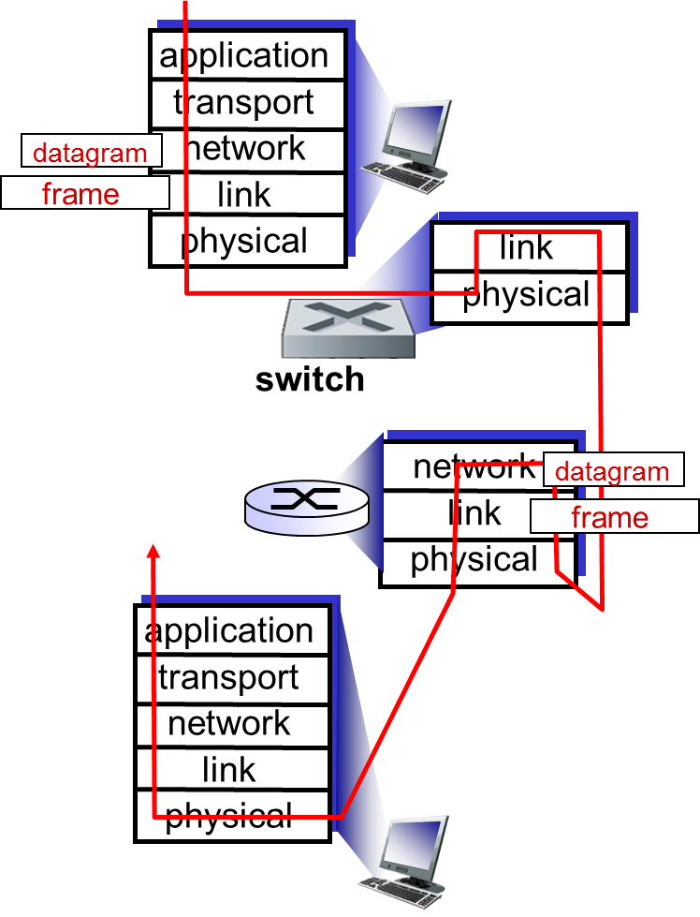
TCP/IP protocol stack, applications, evolution
Instantiation of network- solutions
(Routing, Congestion Control, Flow & error control, applications, link layer technologies)
Advantages, limitations, updates
New types of applications and how they function given the existing state of Internet: multimedia/streaming applications, CDNs, P2P applications, overlays

Slide 18
Highlights
Software-defined networks
network security issues
TCP/IP, LAN protocol stack
delays performance
routing, also with mobility
multiple access protocols (wired, wireless)
reliable data transfer
datagram vs VC
congestion control

Slide 19
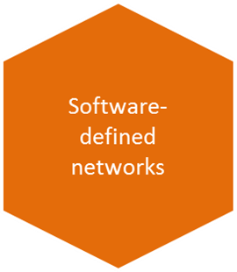
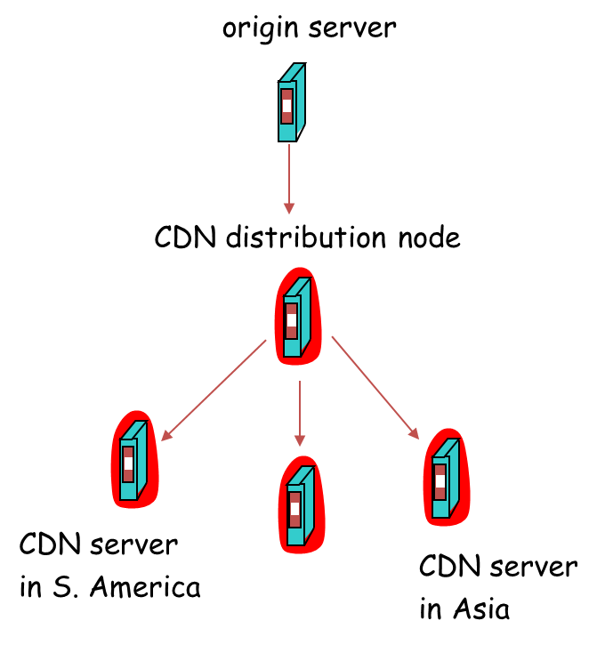
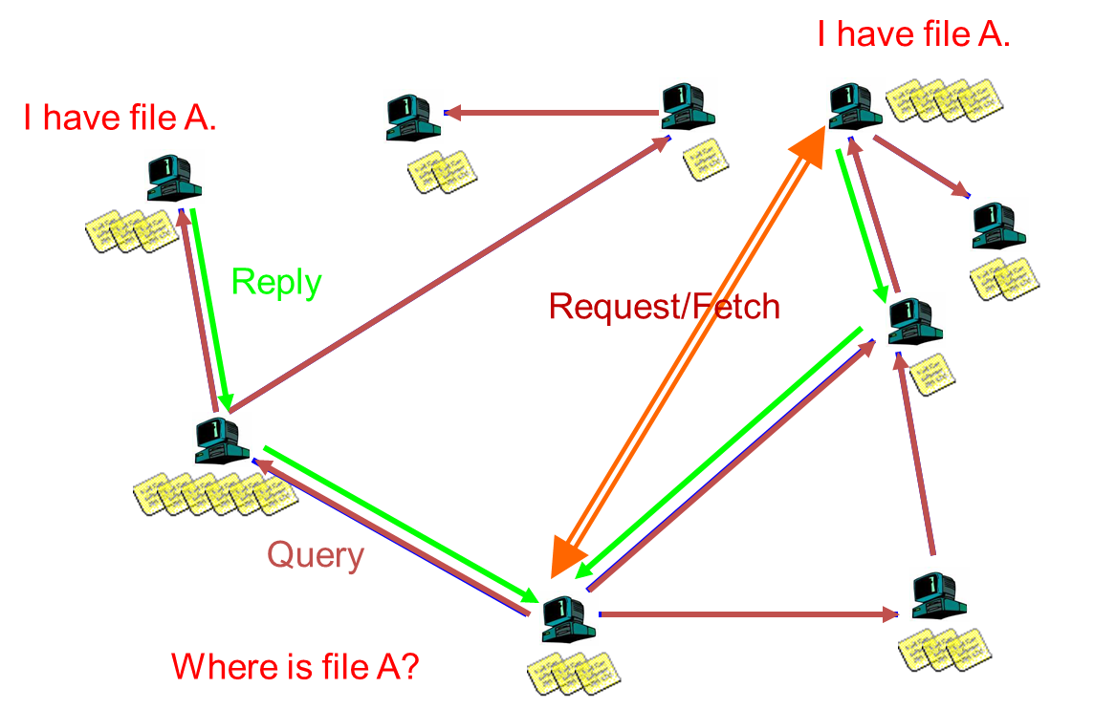
Overlays, software-defined networks
P2P applications
multimedia/streaming application-infrastructure
… complement the networking infrastructure …
…taking advantage of the network resources at the edge of the network…

Slide 20




Security issues
C, I, A and methods to achieve them
  Threats
  The language of cryptography
  Message integrity, signatures
Instantiation in Internet: SSL, IPsec
Alice
Bob
channel
data, control messages
secure
sender
s
data
secure
receiver
data
Trudy

Slide 21
Synthesis: a day in the life of a web request
putting-it-all-together: synthesis!
  goal: identify, review protocols (at all layers) involved in seemingly simple scenario: requesting www page
  scenario: student attaches laptop to campus network, requests/receives www.google.com

Slide 22


A day in the life …. : scenario
browser
DNS server
Comcast network
68.80.0.0/13
school network
68.80.2.0/24
web page
web server
Google’s network
64.233.160.0/19
64.233.169.105

Slide 23
A day in the life… connecting to the Internet
DHCP
DHCP
UDP
IP
Eth
Phy
connecting laptop needs to get its own IP address: use DHCP
DHCP
DHCP
DHCP
DHCP
DHCP request encapsulated in UDP, encapsulated in IP, encapsulated in Ethernet
DHCP
DHCP
UDP
IP
Eth
Phy
DHCP
DHCP
DHCP
DHCP
Ethernet frame broadcast (dest: FFFFFFFFFFFF) on LAN, received at router running DHCP server
router
(runs DHCP)
Ethernet demux’ed to IP demux’ed to UDP demux’ed to DHCP

Slide 24
A day in the life… connecting to the Internet
DHCP
DHCP
UDP
IP
Eth
Phy
DHCP server formulates DHCP ACK containing client’s IP address (and also IP address of first-hop router for client, name & IP address of DNS server)
DHCP
DHCP
DHCP
frame forwarded (switch learning) through LAN, demultiplexing at client
DHCP
DHCP
UDP
IP
Eth
Phy
DHCP
DHCP
DHCP
router
(runs DHCP)
DHCP client receives DHCP ACK reply
DHCP
Client now has IP address, knows name & addr of DNS
server, IP address of its first-hop router

Slide 25
A day in the life… ARP (before DNS, before HTTP)
DNS
UDP
IP
Eth
Phy
before sending HTTP request, need IP address of www.google.com: DNS
DNS
DNS
DNS
ARP
ARP query
DNS query created, encapsulated in UDP, encapsulated in IP, encasulated in Eth. In order to send frame to router, need MAC address of router interface: ARP
ARP
ARP reply
Eth
Phy
ARP query broadcast, received by router, which replies with ARP reply giving MAC address of router interface
client now knows MAC address of first hop router, so can now send frame containing DNS query

Slide 26
A day in the life… using DNS
DNS
UDP
IP
Eth
Phy
DNS
DNS server
DNS
UDP
IP
Eth
Phy
DNS
DNS
DNS
DNS
DNS
DNS
DNS
DNS
Comcast network
68.80.0.0/13
IP datagram forwarded from campus network to destination (DNS-server) network, routed (tables created by RIP, OSPF and BGP routing protocols) to DNS server
IP datagram containing DNS query forwarded via LAN switch from client to 1st hop router
demux’ed to DNS server
DNS server replies to client with IP address of www.google.com

Slide 27
A day in the life… TCP connection carrying HTTP
HTTP
HTTP
TCP
IP
Eth
Phy
SYNACK
SYN
SYNACK
SYN
SYNACK
SYN
SYN
to send HTTP request, client first opens TCP socket to web server
TCP SYN segment (step 1 in 3-way handshake) inter-domain routed to web server
TCP
IP
Eth
Phy
SYNACK
SYN
SYNACK
SYN
SYNACK
SYNACK
SYN
web server responds with TCP SYNACK
web server
64.233.169.105
TCP connection established!

Slide 28
A day in the life… HTTP request/reply
web page finally (!!!) displayed
HTTP
HTTP
TCP
IP
Eth
Phy
HTTP
HTTP
HTTP
HTTP
HTTP
HTTP
HTTP
HTTP
HTTP request sent into TCP socket
IP datagram containing HTTP request routed to www.google.com
HTTP
HTTP
TCP
IP
Eth
Phy
HTTP
HTTP
HTTP
web server responds with HTTP reply (containing web page)
HTTP
web server
64.233.169.105
IP datgram containing HTTP reply routed back to client

Slide 29
Synthesis cont.

Slide 30
The Internet: virtualizing networks
1974: multiple unconnected nets
  ARPAnet
  data-over-cable networks
  packet satellite network (Aloha)
  packet radio network
… differing in:
  addressing conventions
  packet formats
  error recovery
  routing
ARPAnet
satellite net
"A Protocol for Packet Network Intercommunication",
V. Cerf, R. Kahn, IEEE Transactions on Communications,
May, 1974, pp. 637-648.

Slide 31
The Internet: virtualizing networks
Internetwork layer (IP):
addressing: internetwork appears as single, uniform entity, despite underlying local network heterogeneity
network of networks
Gateway:
“embed internetwork packets in local packet format”
route (at internetwork level) to next gateway
gateway
ARPAnet
satellite net

Slide 32
Cerf & Kahn’s Internetwork Architecture
What is virtualized?
two layers of addressing: internetwork and local network
new layer (IP) makes everything homogeneous at internetwork layer
underlying local network technology
  Cable, satellite, 56K telephone modem
  Ethernet, other LAN
  ATM/ MPLS (Multiprotocol Label Switching Protocol)
… “invisible” at internetwork layer. Looks like a link layer technology to IP

Slide 33
e.g. IP-Over-ATM
“Classic” IP over eg Ethernet
3 “networks” (e.g., LAN segments)
MAC (eg802.3) and IP addresses
IP over ATM
replace “network” (e.g., LAN segment) with ATM network
ATM addresses (as MAC addresses), IP addresses
ATM
network
Ethernet
LANs
Ethernet
LANs

Slide 34
Internet structure: network of networks
Question: given millions of access ISPs, how to connect them together?
…
…
access
net
access
net
access
net
access
net
access
net
access
net
access
net
…
…
access
net
access
net
access
net
access
net
access
net
access
net
…
access
net
access
net
…
access
net

Slide 35
Internet structure: network of networks
Option: connect each access ISP to every other access ISP?
…
…
access
net
access
net
access
net
access
net
access
net
…
…
access
net
access
net
…
connecting each access ISP to each other directly doesn’t scale: O(N²) connections.
…
…
access
net
access
net
…
access
net
access
net
access
net
…
access
net
…
access
net
access
net
…
access
net

Slide 36
Internet structure: network of networks
Option: connect each access ISP to a global transit (imaginary) ISP? Customer and provider ISPs have economic agreement.
…
…
access
net
access
net
access
net
access
net
access
net
access
net
access
net
…
…
global
ISP
access
net
access
net
access
net
access
net
access
net
access
net
…
access
net
access
net
…
access
net

Slide 37
Internet structure: network of networks
But if one global ISP is viable business, there will be competitors ….
…
…
access
net
access
net
access
net
access
net
access
net
access
net
access
net
ISP A
…
…
access
net
ISP B
access
net
ISP C
access
net
access
net
access
net
access
net
…
access
net
access
net
…
access
net

Slide 38
Internet structure: network of networks
But if one global ISP is viable business, there will be competitors …. which must be interconnected
Internet exchange point
(ca 300 in the world;
multiple ISPs peering/switching;
3rd company)
…
…
access
net
access
net
access
net
access
net
access
net
access
net
access
net
ISP A
…
…
IXP
access
net
access
net
ISP B
ISP C
access
net
access
net
peering link
(no payment to each-other)
access
net
access
net
…
access
net
access
net
…
access
net

Slide 39
Internet structure: network of networks
… and regional networks may arise to connect access nets to ISPS
…
…
access
net
access
net
access
net
access
net
access
net
access
net
access
net
ISP A
…
…
IXP
access
net
access
net
ISP B
ISP C
access
net
access
net
access
net
regional net
access
net
…
access
net
access
net
…
access
net

Slide 40
Internet structure: network of networks
… and content provider networks (e.g., Google, Microsoft, Akamai ) may run their own network, to bring services, content close to end users
…
…
access
net
access
net
access
net
access
net
access
net
access
net
access
net
ISP A
…
…
Content provider network
IXP
access
net
access
net
ISP B
ISP B
access
net
access
net
access
net
regional net
access
net
…
access
net
access
net
…
access
net

Slide 41
Internet structure: network of networks
Tier 1 ISP
Tier 1 ISP
Google
IXP
IXP
IXP
Regional ISP
Regional ISP
access
ISP
access
ISP
access
ISP
access
ISP
access
ISP
access
ISP
access
ISP
access
ISP
at center: small # of well-connected large networks
  “tier-1” commercial ISPs (e.g., Level 3, Sprint, AT&T, NTT), national & international coverage
  A new form of content provider network (e.g, Google): private network that connects it data centers to Internet, often bypassing tier-1, regional ISPs

Slide 42
End-of-recap….

Slide 43
Thank you
Recall, important for the exam:
When/where: wednesday March 18, 14.00-18.00, M
You may have with you:
English-X dictionary
no calculators, PDAs, etc (if/where numbers matter, do rounding)
To think during last, summary-study
Overview; critical eye; explain, ask yourselves: why is this so? / How does it work?
Good luck with all your efforts!!!
“If you hear a voice within you say ‘you cannot paint,’ then by all means paint, and that voice will be silenced.” – Vincent Van Gogh

