Slide 1
Course on Computer Communication and Networks
Lecture 10
Chapter 2; peer-to-peer applications
(and network overlays)
EDA344/DIT 420, CTH/GU

Slide 2
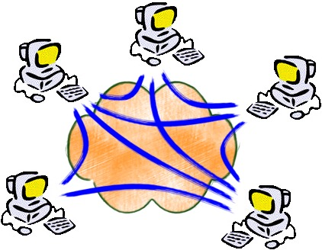
Network overlays
Overlay: a network implemented on top of a network
Why? What to do with this?

Slide 3
Overlay-based applications…
Content delivery, software publication
Streaming media applications
Collaborative platforms
Distributed computations (volunteer computing)
Distributed search engines
Social applications
Emerging applications ….
Today’s topic; overlay networking
  seen through file-sharing applications
Other applications in next lecture(s)

Slide 4
Overlays in file-sharing peer-to-peer (p2p) applications: what for?
Background: Common Primitives in file-sharing p2p apps:
Join: how do I begin participating?
Publish: how do I advertise my file?
Search: how to I find a file/service?
Fetch: how to I retrieve a file/use service?

Slide 5


Roadmap
First generation in p2p: file sharing/lookup
Centralized Database: single directory
  Napster
Query Flooding
  Gnutella
Hierarchical Query Flooding
  KaZaA
Structured Overlays
  DHT
Second generation in p2p ….

Slide 6


P2P: centralized directory
File transfer:
HTTP
original “Napster” design (1999, S. Fanning)
1) when peer connects, it informs central server:
  IP address, content
2) Alice queries directory server for “Boulevard of Broken Dreams”
3) Alice requests file from Bob
Bob
centralized
directory server
1
peers
1
1
3
2
1
Alice
Q: What is p2p in this?

Slide 7
Roadmap
First generation in p2p: file sharing/lookup
Centralized Database: single directory
  Napster
Query Flooding
  Gnutella
Hierarchical Query Flooding
  KaZaA
Structured Overlays
  DHT
Second generation in p2p ….

Slide 8
Gnutella: protocol
Query Flooding:
Join: on startup, client contacts a few other nodes (learn from bootstrap-node); these become its “neighbors” (overlay!! ☺)
Publish: no need
Search: ask “neighbors”, who ask their neighbors, and so on... when/if found, reply to sender.
Fetch: get the file directly from peer
File transfer:
HTTP
Query
QueryHit
Query
Query
QueryHit
Query
QueryHit
Query

Slide 9


Gnutella: Search
I have file A.
I have file A.
Reply
Request/Fetch
Query
Where is file A?
Q: Compare with Napster (publishing, searching, anything else)

Slide 10
Discussion +, -?
Napster
Pros:
  Simple
  Search scope is O(1)
Cons:
  Server maintains O(N) State
  Server performance bottleneck
  Single point of failure
Gnutella:
Pros:
  Simple
  Fully de-centralized
  Search cost distributed
Cons:
  Search scope is O(N)
  Search time is O(???)

Slide 11
Synch questions:
how are the ”neighbors” connected?
what is the overlay here useful for?
  Edge is not a physical link E.g. edge between peer X and Y if there’s a TCP connection
  Used for supporting the search operation (aka routing in p2p networks)

Slide 12
Roadmap
First generation in p2p: file sharing/lookup
Centralized Database: single directory
  Napster
Query Flooding
  Gnutella
Hierarchical Query Flooding : some directory structure
  KaZaA
Structured Overlays
  DHT
Second generation in p2p ….

Slide 13
KaZaA: join, publish
“Smart” Query Flooding:
Join: on startup, client contacts a “supernode” ... may at some point become one itself
Publish: send list of files to supernode
“Super Nodes”
insert(X,
123.2.21.23)
...
Publish
I have X!
123.2.21.23

Slide 14
KaZaA: Search
“Smart” Query Flooding:
Search: send query to supernode, supernodes flood query amongst themselves.
Fetch: get the file directly from peer(s); can fetch simultaneously from multiple peers
search(A)
-->
123.2.22.50
“Super Nodes”
search(A)
-->
123.2.0.18
123.2.22.50
Query
Replies
Where is file A?
123.2.0.18
Q: Compare with Napster, Gnutella (publishing, searching, anything else)

Slide 15
KaZaA: Discussion
Pros:
  Tries to balance between search overhead and space needs
  Tries to take into account node heterogeneity:
    Bandwidth
    Host Computational Resources
Cons:
  No real guarantees on search scope or search time
  Super-peers may “serve” a lot!
P2P architecture used by Skype, Joost (communication, video distribution p2p systems)

Slide 16
Roadmap
First generation in p2p: file sharing/lookup
Centralized Database: single directory
  Napster
Query Flooding
  Gnutella
Hierarchical Query Flooding
  KaZaA
Structured Overlays
  Combine database+distributed system know-how
Second generation in p2p ….

Slide 17
Problem from this perspective
How to find data in a distributed file sharing system?
(Routing to the data)
N₂
N₃
Publisher
N₁
Key=“LetItBe”
Value=MP3 data
Internet
N₅
?
N₄
Client
Lookup(“LetItBe”)
How to do Lookup?

Slide 18
Centralized Solution
Central server (Napster)
N₂
N₃
Publisher
N₁
Key=“LetItBe”
Value=MP3 data
Internet
DB
N₅
N₄
Client
Lookup(“LetItBe”)
O(M) state at server, O(1) at client
O(1) search communication overhead
Single point of failure

Slide 19
Distributed Solution
Flooding (Gnutella, etc.)
N₂
N₃
Publisher
N₁
Key=“LetItBe”
Value=MP3 data
Internet
N₅
N₄
Client
Lookup(“LetItBe”)
O(1) state per node
Worst case O(E) messages per lookup

Slide 20
Distributed Solution
(´with some more structure? In-between the two?)
Publisher
balance the update/lookup complexity..
Abstraction: a distributed lookup data structure (“hash-table” DHT) :
  put(id, item);item = get(id);
Key=“LetItBe”
Value=MP3 data
N₂
N₃
N₁
Internet
  Implementation:
  nodes form an overlay (a distributed data structure)
    eg. Ring, Tree, Hypercube, SkipList, Butterfly.
Hash function maps entries to nodes; using the overlay, find the node responsible for item; that one knows where the item is
N₅
N₄
Client
Lookup(“LetItBe”)
- >

Slide 21
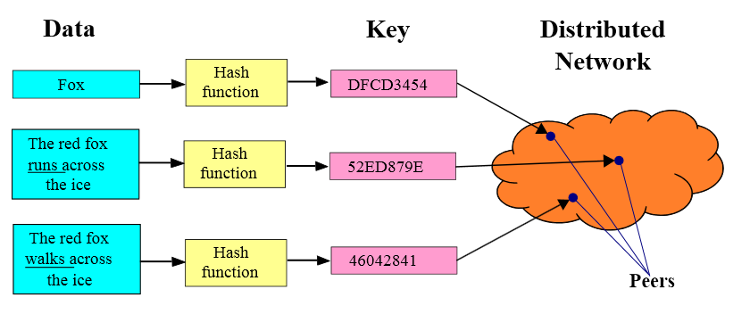
Hash function maps entries to nodes
Nodes-overlay has a structure
Using the node structure, can:
  Lookup: find the node responsible for item; that one knows where the item is
I do not know DFCD3454
but can ask a
neighbour in the DHT
Challenges:
  Keep the hop count (asking chain) small
  Keep the routing tables (#neighbours) “right size”
  Stay robust despite rapid changes in membership
figure source: wikipedia

Slide 22

Roadmap
First generation in p2p: file sharing/lookup
Centralized Database: single directory
  Napster
Query Flooding
  Gnutella
Hierarchical Query Flooding
  KaZaA
Structured Overlays
  DHT
Second generation in p2p ….
Swarming
  BitTorrent, Avalanche, …

Slide 23
BitTorrent: Next generation fetching
Key Motivation:
  Popularity exhibits temporal locality (Flash Crowds)
  Can bring file “provider” to “its knees”
Idea: Focused on Efficient Fetching, not Searching:
  Files are “chopped” in chunks, fetching is done from many sources
  Overlay: nodes “hold hands” with those who share (send chunks) at similar rates
Used by publishers to distribute software, other large files
http://vimeo.com/15228767

Slide 24
BitTorrent: Overview
Swarming:
Join: contact some server, aka “tracker” get a list of peers.
Publish: can run a tracker server.
Search: Out-of-band. E.g., use Google, some DHT, etc to find a tracker for the file you want. Get list of peers to contact for assembling the file in chunks
Fetch: Download chunks of the file from your peers. Upload chunks you have to them.
tracker: tracks peers
participating in torrent
torrent: group of
peers exchanging
chunks of a file
obtain list
of peers
trading
chunks
peer

Slide 25
File distribution: BitTorrent
Peer joining torrent:
  has no chunks, but will accumulate over time
  gets list of peers from tracker, connects to subset of peers (“neighbors”) who share at similar rates (tit-for-tat)
while downloading, peer uploads chunks to other peers.
once peer has entire file, it may (selfishly) leave or (altruistically) remain
tracker: tracks peers
participating in torrent
torrent: group of
peers exchanging
chunks of a file
obtain list
of peers
trading
chunks
peer

Slide 26
Roadmap
First generation in p2p: file sharing/lookup
Centralized Database: single directory
  Napster
Query Flooding
  Gnutella
Hierarchical Query Flooding
  KaZaA
Structured Overlays
  DHT
Second generation in p2p ….
Swarming
Next: guest lecture Monday
”SDN: Software-Defined Networks” Zhang Fu, Ericsson research

Slide 27
Reading instructions
KuroseRoss book: chapter 2.6
for Further Study, optional
Aberer’s coursenotes and references therein
  http://lsirwww.epfl.ch/courses/dis/2007ws/lecture/week%208%20P2P%20systems-general.pdf
  http://lsirwww.epfl.ch/courses/dis/2007ws/lecture/week%209%20Structured%20Overlay%20Networks.pdf
Incentives build Robustness in BitTorrent, Bram Cohen. Workshop on Economics of Peer-to-Peer Systems, 2003.
Do incentives build robustness in BitTorrent? Michael Piatek, Tomas Isdal, Thomas Anderson, Arvind Krishnamurthy and Arun Venkataramani, NSDI 2007
Christos Gkantsidis and Pablo Rodriguez, Network Coding for Large Scale Content Distribution, in IEEE INFOCOM, March 2005 (avalanche swarming: combining p2p + streaming)
Pointers to some work by the group
Georgiadis, G.; Papatriantafilou, M.: Overlays with preferences: Approximation algorithms for matching with preference lists. IEEE IPDPS 2010
Georgiadis, G.; Papatriantafilou, M.: REPO: A framework for studying unstructured overlays, EuroPar2009, LNCS Springer Verlag.

