Slide 1
Course Computer Communications
Study Period 3
EDA344, DIT 420

Slide 2

Course Aims
Study data communication and computer networks
  Learn well the basic principles, to follow constant change in the field
  Learn to deal with bigger problems by breaking into small ones
After completion of this course, the student should be able to
  distinguish network services, related protocols
  understand possibilities and constraints in the existing solutions
  build and configure a working network
Mobile network
Global ISP
Home network
Regional ISP
Institutional network

Slide 3
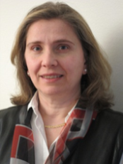


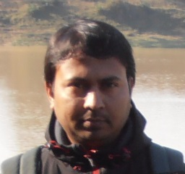
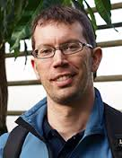
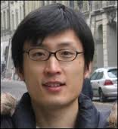
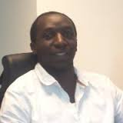
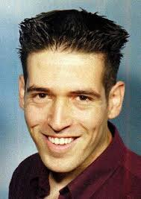
Course Homepage & Support Team
http://www.cse.chalmers.se/edu/course/EDA344 (please revisit/reload frequently)
Page in pingpong (for assignments submission and administration)
http://pingpong.chalmers.se/public/courseId/4814/lang-en/publicPage.do
Examiners:
Marina Papatriantafilou
Ali Salehson (”siblink” course EDA343)
Guest Lecturers:
Pierre Kleberger
Zhang Fu (Ericsson research )
Elad Schiller
TAs :
Aras Atalar
Bapi Chaterjee
Ivan Walulya

Slide 4

Main textbook
J. F. Kurose and K. W. Ross, Computer Networking: A Top Down Approach, 6th edition, Addison Wesley, 2013
online resources website:
(check/use it! Includes applets/ animations, blogg, …) http://wps.pearsoned.com/ecs_kurose_compnetw_6/216/55463/14198700.cw/

Slide 5
Course organization
14 Lectures, 2 tutorials, 4 Excercises sessions
  Cf ”Lectures and Excercises” @ web page
3 assignments
  Cf ”Assignmets and Exam” @ web page
Written exam (re-exams joint with EDA343)
Choose between
(a) wireshark lab-assignment or
. Network configuration lab-assignment
Take-home-questions assignment (overview study)
(b) http prg-assignment

Slide 6

Todos
  Get registered (student_office.cse@chalmers.se)
  Only then possible to get credit from completedwork
  Provides pingpong access
come to classes; take part in discussions;
Study, exercises & assignments in pace with classes; don't wait ☺
use the book’s companion site
Especially for assignments
Through pingpong: form groups of 2 (take time availability into account)
To choose for assignment 1:
  you will get invitation to the http-prg assignment
  You can accept within 3 working days; else by default you join the wireshark lab
For assignments 1&2: submit preparation test to get access to submission site
  Book times
  Demonstrate your solution in a demo session, validate testing
For all assignments: Submit your completed report/code by the due date
  You will get a reply within a week
  1 resubmission possible by due date that will be instructed in the reply

Slide 7
Notice:
  Lab important dates @ home page
  time slots for http programming assignment are for Q+A and Demo, i.e:
    TA support possible then ( this is their available support ”bandwidth”)
    actual progarmming work: your own planning and schedule

Slide 8
Student representatives for feedback
Randomly selected by the study administration to be student representatives:
TKITE davbe@student.chalmers.se DAVID BERGSTRÖM
TKITE genander@student.chalmers.se JACOB GENANDER
TKITE mlonn@student.chalmers.se MIKAEL LÖNN
TKELT tompett@student.chalmers.se TOMAS PETTERSSON
TKITE vicsand@student.chalmers.se VICTOR SANDELL
TASK: responsible for discussing about the course together with the examiner/course responsible and the program board of the program that gives the course, as follows:
  1. The student representatives and the course responsible have two informal meetings during the course: one in the second study week (get acquainted) and one after approximately half the course (give feedback to the teacher on the progress of the course).
  2. After the course, an evaluation questionnaire is sent out. The examiner will get an opportunity to add extra questions to the standard questionnaire.
  3. In the middle of the next study period, there will be an evaluation meeting: the student representatives and the examiner/course responsible meet the board of the program who gives the course, discussing the course’s advantages and potential for improvement.
The student representatives participating in the final meeting get a gift certificate valid at Cremona.

Slide 9


Questions?

