Slide 1
Course on Computer Communication and Networks
Lecture 3
Chapter 2: Application-layer
EDA344/DIT 420, CTH/GU

Slide 2
Chapter 2: Application Layer
Chapter goals:
conceptual + implementation aspects of network application protocols
  client server paradigm
specific protocols:
  http, (ftp), smtp, pop, dns, (p2p file sharing later in the course)

Slide 3
Applications and application-layer protocols
Application: communicating, distributed processes
  running in network hosts in “user space”
  e.g., email, file transfer, the Web
Application-layer protocols
  Are only one “piece” of an application -others are e.g. user agents.
    Web: browser
    E-mail: mail reader
    streaming audio/video: media player
application
transport
network
data link
physical
application
transport
network
data link
physical
application
transport
network
data link
physical
App-layer protocols:
define messages exchanged and actions taken
use services provided by lower layer protocols

Slide 4

















Client-server architecture
server:
always-on
permanent host address
clusters of servers for scaling
clients:
communicate with server
may be intermittently connected
may have dynamic host addresses
do not communicate directly with each other
client/server

Slide 5
Peer2Peer architecture
peer-peer
no always-on server
peers request service from other peers, provide service in return
peers are intermittently connected and may change addresses
  complex management

Slide 6


Roadmap
Addressing and Applications needs from transport layer
Http
  General description and functionality
  Authentication, cookies and related aspects
  Caching and proxies
FTP
SMTP (POP, IMAP)
DNS

Slide 7
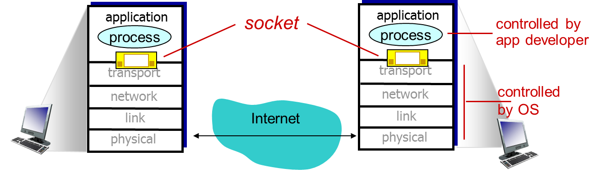
Addressing, sockets
socket: Internet application programming interface
  2 processes communicate by sending data into socket, reading data out of socket (like sending out, receiving in via doors)
Q: how does a process “identify” the other process with which it wants to communicate?
  IP address (unique) of host running other process
  “port number” - allows receiving host to determine to which local process the message should be delivered

Slide 8
Roadmap
Addressing and Applications needs from transport layer
Http
  General description and functionality
  Authentication, cookies and related aspects
  Caching and proxies
FTP
SMTP (POP, IMAP)
DNS

Slide 9
Transport service requirements of applications
& common apps examples
Application
file transfer
e-mail
Web documents
real-time audio/video
stored audio/video
interactive games
financial apps
Data loss
no loss
no loss
no-loss
loss-tolerant
loss-tolerant
loss-tolerant
no loss
Bandwidth
elastic
elastic
elastic
audio: 5Kb-1Mb
video:10Kb-5Mb
rather similar
few Kbps up
elastic
Time Sensitive
no
no
no
yes, 100’s msec
yes, few secs
yes, 100’s msec
yes and no

Slide 10


Services by Internet transport protocols
TCP service:
connection-oriented reliable transport between sending and receiving process
  correct, in-order delivery of data
  setup required between client, server
+ more, will focus in the TCP study
flow control: sender won’t overwhelm receiver
congestion control: sender won’t overwhelm the network links
does not provide: timing, bandwidth guarantees
UDP service:
connectionless
Unreliable, “best-effort” transport between sending and receiving process
does not provide: flow control, congestion control, timing, or bandwidth guarantee
Q: why bother? Why is there a UDP?

Slide 11
Internet apps: their protocols
Application
layer protocol
» smtp [RFC 821]
telnet [RFC 854]
» http [RFC 2068]
ftp [RFC 959]
proprietary
(e.g. RealNetworks)
NSF
SIP, RTP,
proprietary (e.g., Skype)
» DNS
[RFC 882, 883,1034,1035]
Underlying
transport protocol
TCP
TCP
TCP
TCP
TCP or UDP
TCP or UDP
typically UDP, TCP also possible
UDP
Application
e-mail
remote terminal access
Web
file transfer
streaming multimedia
remote file server
Internet telephony
nslookup and many others

Slide 12
Roadmap
Addressing and Applications needs from transport layer
Http
  General description and functionality
  Authentication, cookies and related aspects
  Caching and proxies
FTP
SMTP (POP, IMAP)
DNS

Slide 13
Web and HTTP
First, some jargon…
web page consists of objects
object can be HTML file, JPEG image, Java applet, audio file,…
web page consists of base HTML-file which includes several referenced objects
each object is addressable by a URL, e.g.,
www.someschool.edu/someDept/pic.gif
host name
path name

Slide 14


HTTP: hypertext transfer protocol overview
Web’s application layer protocol
http client: web browser; requests, receives, displays Web objects
http server: Web server sends objects
HTTP request
PC running
Firefox browser
HTTP response
uses TCP:
client initiates TCP connection to server, port 80
server accepts TCP connection
HTTP messages (application-layer protocol messages) exchanged
TCP connection closed
HTTP request
server
running
Apache Web
server
HTTP response
iphone running
Safari browser

Slide 15
http example
user enters URL
eg www.someSchool.edu/someDepartment/home.index
(contains text,
references to 10
jpeg images)
1a. http client initiates TCP connection to http server (process) at www.someSchool.edu. Port 80 is default for http server.
1b. http server at host www.someSchool.edu waiting for TCP connection at port 80. “accepts” connection, notifying client
2. client sends http request message (containing URL) into TCP connection socket
3. server receives request, forms response message with requested object (someDepartment/home.index), sends message into socket
4. client receives response msg with file, displays html. Parsing html file, finds 10 referenced jpeg objects
4a. server closes TCP connection.
time
6. Steps 1-5 repeated for each of 10 jpeg objects
6. Steps 1-5 repeated for each of 10 jpeg objects

Slide 16
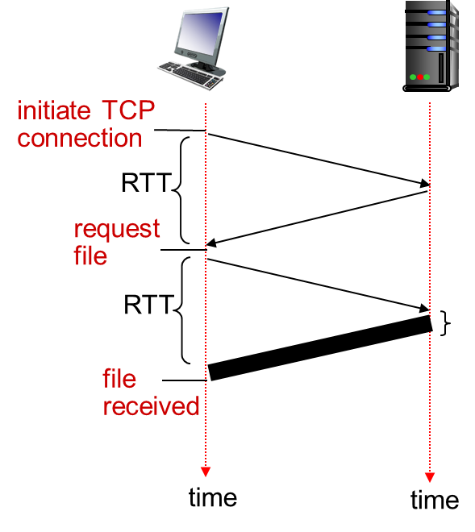
Non-persistent and persistent http
Non-persistent
server parses request, responds, closes TCP connection
non-persistent HTTP response time = 2RTT+ file transmission time
new TCP connection for each object => extra overhead per object
Persistent
on same TCP connection: server parses request, responds, parses new request,..
Client sends requests for all referenced objects as soon as it receives base HTML;
Less overhead per object
But objects are fetched sequentially
With both, browsers can open parallel sessions

Slide 17
HTTP request message
two types of HTTP messages: request, response
HTTP request message:
  ASCII (human-readable format)
carriage return character
request line
(GET, POST,
HEAD commands)
line-feed character
GET /index.html HTTP/1.1\r\n
Host: www-net.cs.umass.edu\r\n
User-Agent: Firefox/3.6.10\r\n
Accept: text/html,application/xhtml+xml\r\n
Accept-Language: en-us,en;q=0.5\r\n
Accept-Encoding: gzip,deflate\r\n
Accept-Charset: ISO-8859-1,utf-8;q=0.7\r\n
Keep-Alive: 115\r\n
Connection: keep-alive\r\n
\r\n
header
lines
carriage return,
line feed at start
of line indicates
end of header lines

Slide 18
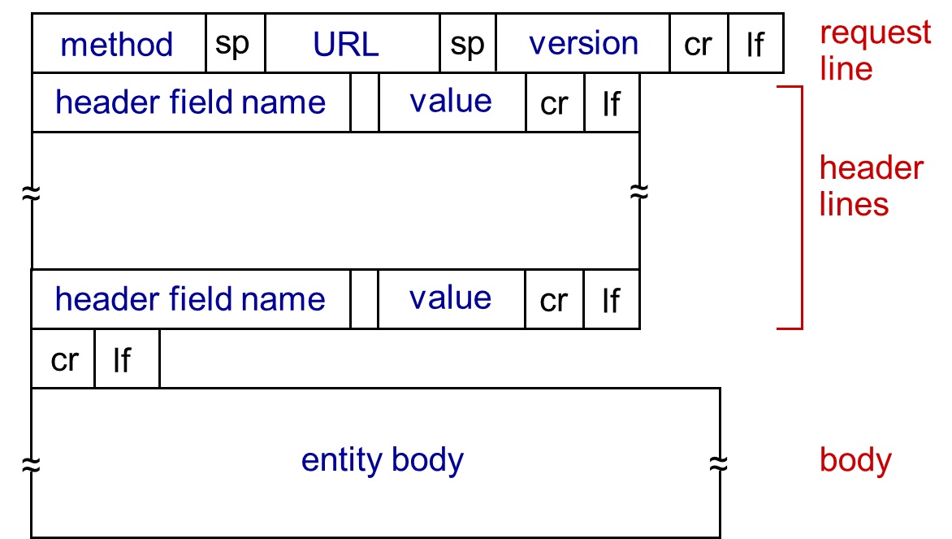
HTTP request message: general format
HTTP/1.0 (non-persistent)
GET
POST (eg data to some input form)
HEAD: asks server to send only header
HTTP/1.1 (persistent)
GET, POST, HEAD
PUT: uploads file in body to path specified in URL field
DELETE: deletes file specified in the URL field

Slide 19
HTTP response message
status line
(protocol
status code
status phrase)
HTTP/1.1 200 OK\r\n
Date: Sun, 26 Sep 2010 20:09:20 GMT\r\n
Server: Apache/2.0.52 (CentOS)\r\n
Last-Modified: Tue, 30 Oct 2007 17:00:02 GMT\r\n
ETag: "17dc6-a5c-bf716880"\r\n
Accept-Ranges: bytes\r\n
Content-Length: 2652\r\n
Keep-Alive: timeout=10, max=100\r\n
Connection: Keep-Alive\r\n
Content-Type: text/html; charset=ISO-8859-1\r\n
\r\n
data data data data data ...
header
lines
data, e.g.,
requested
HTML file
200 OK: request succeeded, requested object in this msg
301 Moved Permanently: requested object moved, new location specified later in this message (Location:)
400 Bad Request: request message not understood
404 Not Found: requested document not found on this server
505 HTTP Version Not Supported

Slide 20
Trying out HTTP (client side) for yourself
1. Telnet to a Web server:
telnet cis.poly.edu 80
opens TCP connection to port 80
(default HTTP server port) at cis.poly.edu.
anything typed in sent
to port 80 at cis.poly.edu
2. type in a GET HTTP request:
GET /~ross/ HTTP/1.1
Host: cis.poly.edu
by typing this in (hit carriage
return twice), you send
this minimal (but complete)
GET request to HTTP server
3. look at response message sent by HTTP server!

Slide 21
Topic of the programming assignment
http server
Study RFC
Work with the implemantation
You will learn godd things
It is optional

Slide 22
Roadmap
Addressing and Applications needs from transport layer
Http
  General description and functionality
  Authentication, cookies and related aspects
  Caching and proxies
FTP
SMTP (POP, IMAP)
DNS

Slide 23
HTTP is “stateless”
HTTP server maintains no information about past client requests
aside
protocols that maintain “state” are complex!
past history (state) must be maintained
if server/client crashes, their views of “state” may be inconsistent, must be reconciled
Q: how do web applications keep state though?

Slide 24
Cookies: keeping “state”
client
server
ebay 8734
usual http request msg
Amazon server
creates ID
1678 for user
cookie file
usual http response
set-cookie: 1678
backend
database
create
entry
ebay 8734
amazon 1678
usual http request msg
cookie: 1678
cookie-
specific
action
access
usual http response msg
one week later:
access
ebay 8734
amazon 1678
usual http request msg
cookie: 1678
cookie-
specific
action
usual http response msg

Slide 25
Cookies (continued)
aside
cookies can bring:
authorization
shopping carts
recommendations
user session state
Cookies and privacy:
cookies permit sites to learn a lot about you
you may supply name and e-mail to sites
search engines use cookies to learn yet more
advertising companies obtain info across sites

Slide 26
Roadmap
Addressing and Applications needs from transport layer
Http
  General description and functionality
  Authentication, cookies and related aspects
  Caching and proxies
FTP
SMTP (POP, IMAP)
DNS

Slide 27
Web Caches (proxy server)
Goal: satisfy client request without involving origin server
user configures browser: Web accesses via web cache
client sends all http requests to web cache; the cache(proxy) server
  if object at web cache, return object in http response
  else request object from origin server (or from next cache), then return http response to client
Hierarchical, cooperative caching, ICP: Internet Caching Protocol (RFC2187)
origin
server
Proxy
server
http request
http request
client
http response
http response
http request
http request
http response
http response
client
origin
server

Slide 28
Why Web Caching?
Assume: cache is close to client (e.g., in same network)
smaller response time
decrease traffic to distant servers
  link out of institutional/local ISP network can be bottleneck
Important for large data applications (e.g. video,…)
Performance effect:
origin
servers
public
Internet
1.5 Mbps
access link
institutional
network
10 Mbps LAN
institutional
cache
E(delay)=hitRatio*LocalAccDelay + (1-hitRatio)*RemoteAccDelay

Slide 29
Roadmap
Addressing and Applications needs from transport layer
Http
  General description and functionality
  Authentication, cookies and related aspects
  Caching and proxies
FTP
SMTP (POP, IMAP)
DNS

Slide 30

FTP: the file transfer protocol RFC 959
TCP control connection,
server port 21
FTP
user
interface
FTP
client
FTP
server
TCP data connection,
server port 20
user
at host
remote file
system
local file
system
transfer file to/from remote host
client/server model
  client: side that initiates transfer
  server: remote host
TCP connection to transfer each file
control connection: “out of band”
FTP server maintains “state”: current directory, earlier authentication

Slide 31
Roadmap
Addressing and Applications needs from transport layer
Http
  General description and functionality
  Authentication, cookies and related aspects
  Caching and proxies
FTP
SMTP (POP, IMAP)
DNS

Slide 32
Electronic Mail
outgoing
message queue
User Agent
a.k.a. “mail reader: composing, editing, reading mail messages -e.g., Outlook,
Mail Servers
Mailbox: incoming mail messages for user
message queue outgoing mail messages
SMTP protocol between mail servers to send email messages
  client: sending mail server
  “server”: receiving mail server
user mailbox
user
agent
mail
server
user
agent
SMTP
mail
server
user
agent
SMTP
SMTP
mail
server
user
agent
user
agent
user
agent

Slide 33

Scenario: Alice sends message to Bob
1) Alice, UA: message “to” bob@someschool.edu
2) Alice, UA: sends message to her mail server’s queue
3) Alice, mail server: TCP connection with Bob’s mail server (acting as a client of SMTP)
4) Alice’s mail server sends Alice’s message over the TCP connection
5) Bob’s mail server places the message in Bob’s mailbox
6) Bob invokes his UA to read message
user
agent
mail
server
user
agent
1
mail
server
2
3
6
4
Alice’s mail server
5
Bob’s mail server

Slide 34
Sample SMTP interaction
S: 220 hamburger.edu
C: HELO crepes.fr
S: 250 Hello crepes.fr, pleased to meet you
C: MAIL FROM: <alice@crepes.fr>
S: 250 alice@crepes.fr... Sender ok
C: RCPT TO: <bob@hamburger.edu>
S: 250 bob@hamburger.edu ... Recipient ok
C: DATA
S: 354 Enter mail, end with "." on a line by itself
C: Do you like ketchup?
C: How about pickles?
C: .
S: 250 Message accepted for delivery
C: QUIT
S: 221 hamburger.edu closing connection
SMTP (RFC 2821) uses TCP, port 25
three phases
  handshaking (greeting)
  transfer of messages
  closure
You can try it out through
telnet servername 25
see 220 reply from server
enter HELO, MAIL FROM, RCPT TO, DATA, QUIT commands

Slide 35
SMTP & Mail message format
header
blank
line
RFC 822: standard for text message format:
header lines, e.g.,
  To:, From:, Subject:
  different from SMTP MAIL FROM, RCPT TO: commands!
Body: the “message”
  ASCII 7-bit characters only
body

Slide 36
Mail access protocols
user
agent
mail access
protocol
user
agent
SMTP
SMTP
(e.g., POP,
IMAP)
sender’s mail
server
receiver’s mail
server
SMTP: delivery/storage to receiver’s server
mail access protocol: retrieval from server
  POP: Post Office Protocol [RFC 1939]: authorization, download
  IMAP: Internet Mail Access Protocol [RFC 1730]: more features, including manipulation of stored msgs on server

Slide 37
Roadmap
Addressing and Applications needs from transport layer
Http
  General description and functionality
  Authentication, cookies and related aspects
  Caching and proxies
FTP
SMTP (POP, IMAP)
DNS

Slide 38
DNS: Domain Name System
People: many identifiers:
  SSN, name, Passport #
Internet hosts, routers: IP address (32 bit) - used for addressing datagrams (129.16.237.85)
  “name”, e.g., (www.cs.chalmers.se)- used by humans
  name (alphanumeric addresses) hard to process @ router
Q: map between IP addresses and name ?

Slide 39
Hostname to IP address translation
Example: www.chalmers.se 129.16.71.10
File with mapping may be edited on the system
  Unix: /etc/hosts
  Windows: c:\windows\system32\drivers\etc\hosts
  Example of an entry manually entered in the file:
  “129.16.20.245 fibula.ce.chalmers.se fibula”
Does not scale, hard to change
All hosts need one copy of the file
Impossible on the Internet
Alternative: DNS, a large distributed database
DNS – Domain Name System
39

Slide 40
DNS: services, structure
DNS services
hostname to IP address translation
host aliasing
  canonical, alias names
mail server aliasing
load distribution
  replicated Web servers: many IP addresses correspond to one name
why not centralize DNS?
single point of failure
traffic volume
maintenance
A: doesn’t scale!

Slide 41
DNS: a distributed, hierarchical database
Root DNS Servers
aka Top- Level Domains
…
…
com DNS servers
org DNS servers
edu DNS servers
yahoo.com
DNS servers
pbs.org
DNS servers
poly.edu
DNS servers
umass.edu
DNS servers
amazon.com
DNS servers
client wants IP for www.amazon.com; 1st approx:
client queries root server to find com DNS server
client queries .com DNS server to get amazon.com DNS server
client queries amazon.com DNS server to get IP address for www.amazon.com

Slide 42
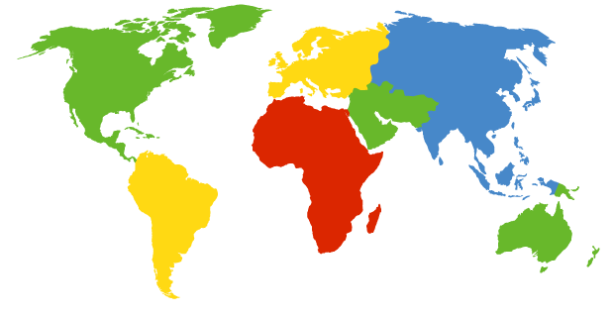
DNS: Root name servers (2009)
a Verisign, Dulles, VA
c Cogent, Herndon, VA (also LA)
d U Maryland College Park, MD
g US DoD Vienna, VA
h ARL Aberdeen, MD
j Verisign,
k RIPE London
i Netnod, Stockholm
e NASA Mt View, CA
f Internet Sys. consortium,
Palo Alto, CA
m WIDE Tokyo
b USC-ISI Marina del Rey, CA
l ICANN Los Angeles, CA
13 root name servers worldwide + replicas (http://www.root-servers.org)
42

Slide 43
TLD, authoritative servers
top-level domain (TLD) servers:
  responsible for com, org, net, edu, aero, jobs, museums, and all top-level country domains, e.g.: uk, fr, ca, jp
  Network Solutions maintains servers for .com TLD
  Educause for .edu TLD
authoritative DNS servers:
  organization’s own DNS server(s), providing authoritative hostname to IP mappings for organization’s named hosts
  can be maintained by organization or service provider

Slide 44
DNS name resolution example
root DNS server
host at cis.poly.edu wants IP address for gaia.cs.umass.edu
Query-response: uses UDP (why?)
Local name server
  acts as proxy for clients
  Sends queries to DNS hierarchy
  caches entries for TTL
  each ISP has one
2
3
TLD DNS server
4
5
local DNS server
dns.poly.edu
7
6
1
8
authoritative DNS server
dns.cs.umass.edu
requesting host
cis.poly.edu
gaia.cs.umass.edu

Slide 45
DNS Queries and Answers
root DNS server
iterated query:
contacted server replies with name of server to contact
“I don’t know this name, but ask this server”
root server always does this
2
3
iterative answer
4
TLD DNS
server
7
local DNS server
dns.poly.edu
recursive answer
6
5
recursive query:
puts burden of name resolution on contacted name server
heavy load at upper levels of hierarchy?
1
8
authoritative DNS server
dns.cs.umass.edu
requesting host
cis.poly.edu
gaia.cs.umass.edu
(normal way as above, iterative + recursive)

Slide 46
DNS: caching, updating records
once (any) name server learns mapping, it caches mapping
  cache entries timeout (disappear) after some time (TTL)
  TLD servers typically cached in local name servers
    thus root name servers not often visited
cached entries may be out-of-date (best effort name-to-address translation!)
  if name host changes IP address, may not be known Internet-wide until all TTLs expire
update/notify mechanisms proposed IETF standard
  RFC 2136

Slide 47
DNS records
DNS: distributed db storing resource records (RR)
RR format: (name, value, type, ttl)
type=A
  name is hostname
  value is IP address
type=CNAME
  name is alias name for some “canonical” (the real) name
  Eg www.ibm.com is really
  servereast.backup2.ibm.com
  value is canonical name
type=NS
  name is domain (e.g., foo.com)
  value is hostname of authoritative name server for this domain
type=MX
  value is name of mailserver associated with name

Slide 48
DNS protocol, messages
query and reply messages (use UDP), both with same message format
2 bytes
2 bytes
msg header
identification: 16 bit # for query, reply to query uses same #
flags:
  query or reply
  recursion desired
  recursion available
  reply is authoritative
identification
flags
# questions
# answer RRs
# authority RRs
# additional RRs
questions (variable # of questions)
answers (variable # of RRs)
authority (variable # of RRs)
additional info (variable # of RRs)

Slide 49
DNS protocol, messages
2 bytes
2 bytes
identification
flags
# questions
# answer RRs
# authority RRs
# additional RRs
name, type fields
for a query
questions (variable # of questions)
RRs in response
to query
answers (variable # of RRs)
records for
authoritative servers
authority (variable # of RRs)
additional “helpful”
info that may be used
additional info (variable # of RRs)

Slide 50
Inserting records into DNS
example: new startup “Network Utopia”
register name networkuptopia.com at DNS registrar (e.g., Network Solutions)
  provide names, IP addresses of authoritative name server (primary and secondary)
  registrar inserts two RRs into .com TLD server:
  (networkutopia.com, dns1.networkutopia.com, NS)
  (dns1.networkutopia.com, 212.212.212.1, A)
Adding a new host/service to domain:
  Add to authoritative name server
    type A record for www.networkuptopia.com
    type MX record for networkutopia.com (mail)

Slide 51
DNS and security risks
DDoS attacks
Bombard root servers
  Local DNS servers cache IPs of TLD servers, allowing root server bypass
Bombard TLD servers
  Potentially more dangerous
Redirect attacks
Man-in-middle
  Intercept queries
DNS poisoning
  Send bogus replies to DNS server, which caches
Exploit DNS for DDoS
Send queries with spoofed source address: target IP

Slide 52
Summary
Addressing and Applications needs from transport layer
application architectures
  client-server
  (p2p: will study later in the course, after the layers-centered study)
specific protocols:
  Http (connection to programming assignment)
  FTP
  SMTP (POP, IMAP)
  DNS

Slide 53
Resources
Reading list main textbook:
Study: 2.2, 2.4-2.5
Quick reading: 2.1, 2.3, 2.6
Review questions from the book, useful for summary study
Chapter 2: 4, 5, 6, 7, 8, 9, 10, 11, 12, 13, 16, 22, 23, 24

Slide 54
Example review question
Properties of transport service of interest to the app.
Data loss
some apps (e.g., audio) can tolerate some loss
other apps (e.g., file transfer, telnet) require 100% reliable data transfer
In-order vs arbitrary-order delivery
Bandwidth, Timing, Security
some apps (e.g., multimedia, interactive games) require minimum amount of bandwidth, and/or low delay and/or low jitter
other apps (elastic apps, e.g. file transfer) are ok with any bandwidth, timing they get
Some apps also require confidentiality, integrity (more in network security)

Slide 55
Extra slides/notes

Slide 56
HTTP: Conditional GET: client-side caching
client
server
Goal: don’t send object if client has up-to-date stored (cached) version
client: specify date of cached copy in http request
  If-modified-since: <date>
server: response contains no object if cached copy up-to-date:
  HTTP/1.0 304 Not Modified
http request msg
If-modified-since: <date>
object
not
modified
http response
HTTP/1.0
304 Not Modified
http request msg
If-modified-since: <date>
object
modified
http response
HTTP/1.1 200 OK
…
<data>

Slide 57

Caching example:
assumptions:
avg object size: 100K bits
avg request rate from browsers to origin servers:15/sec
  i.e. avg data rate to browsers: 1.50 Mbps
RTT from institutional router to any origin server: 2 sec
access link rate: 1.54 Mbps
consequences:
LAN utilization: 1.5%
access link utilization = 99%
total delay = Internet delay + access delay + LAN delay
= 2 sec + minutes + quite_small
origin
servers
public
Internet
1.54 Mbps
access link
problem!
institutional
network
100Mbps LAN

Slide 58
Caching example: faster access link
assumptions:
avg object size: 100K bits
avg request rate from browsers to origin servers:15/sec
  i.e. avg data rate to browsers: 1.50 Mbps
RTT from institutional router to any origin server: 2 sec
access link rate: 1.54 Mbps
consequences:
LAN utilization: 1.5%
access link utilization = 99%
total delay = Internet delay + access delay + LAN delay
= 2 sec + minutes + usecs
origin
servers
public
Internet
1.54 Mbps
access link
154 Mbps
154 Mbps
institutional
network
9.9%
100Mbps LAN
msecs
Cost: increased access link speed (not cheap!)

Slide 59
Caching example: install local cache
assumptions:
avg object size: 100K bits
avg request rate from browsers to origin servers:15/sec
  i.e. avg data rate to browsers: 1.50 Mbps
RTT from institutional router to any origin server: 2 sec
access link rate: 1.54 Mbps
consequences:
LAN utilization: 1.5%
access link utilization
total delay
origin
servers
public
Internet
1.54 Mbps
access link
institutional
network
?
100Mbps LAN
?
local web
cache
How to compute link
utilization, delay?
Cost: web cache (cheap!)

Slide 60
Caching example: install local cache
Calculating access link utilization, delay with cache:
suppose cache hit rate is 0.4
  40% requests satisfied at cache, 60% requests satisfied at origin
origin
servers
public
Internet
access link utilization:
  60% of requests use access link
data rate to browsers over access link = 0.6*1.50 Mbps = .9 Mbps
  utilization = 0.9/1.54 = .58
1.54 Mbps
access link
total delay
  = 0.6 * (delay from origin servers) +0.4 * (delay when satisfied at cache)
  = 0.6 (2.01) + 0.4 (~msecs)
  = ~ 1.2 secs
  less than with 154 Mbps link (and cheaper too!)
institutional
network
100Mbps LAN
local web
cache

Slide 61
FTP: separate control, data connections
FTP client contacts FTP server at port 21, using TCP
client authorized over control connection
client browses remote directory, sends commands over control connection
when server receives file transfer command, server opens 2nd TCP data connection (for file) to client
after transferring one file, server closes data connection
TCP control connection,
server port 21
FTP
client
TCP data connection,
server port 20
FTP
server
server opens another TCP data connection to transfer another file
control connection: “out of band”
FTP server maintains “state”: current directory, earlier authentication

Slide 62
FTP commands, responses
sample commands:
sent as ASCII text over control channel
USER username
PASS password
LIST return list of file in current directory
RETR filename retrieves (gets) file
STOR filename stores (puts) file onto remote host
sample return codes
status code and phrase (as in HTTP)
331 Username OK, password required
125 data connection already open; transfer starting
425 Can’t open data connection
452 Error writing file

Slide 63
POP3 protocol
S: +OK POP3 server ready
C: user bob
S: +OK
C: pass hungry
S: +OK user successfully logged on
authorization phase
client commands:
  user: declare username
  pass: password
server responses
  +OK
  -ERR
transaction phase, client:
list: list message numbers
retr: retrieve message by number
dele: delete
quit
C: list
S: 1 498
S: 2 912
S: .
C: retr 1
S: <message 1 contents>
S: .
C: dele 1
C: retr 2
S: <message 1 contents>
S: .
C: dele 2
C: quit
S: +OK POP3 server signing off

Slide 64
POP3 (more) and IMAP
more about POP3
previous example uses POP3 “download and delete” mode
  Bob cannot re-read e-mail if he changes client
POP3 “download-and-keep”: copies of messages on different clients
POP3 is stateless across sessions
IMAP
keeps all messages in one place: at server
allows user to organize messages in folders
keeps user state across sessions:
  names of folders and mappings between message IDs and folder name

