Slide 1
Course on Computer Communication and Networks
Lecture 2
Chapter 1: Introduction:
Part B: Network structure, performance, security prelude
CTH EDA344/GU DIT 420

Slide 2
















A closer look at network structure:
network edge: hosts:
run application programs e.g. Web, email, …
… based on network services available
mobile network
global ISP
home
network
access networks:
connect end-hosts to the Internet (edge routers)
through physical media: wired, wireless links
regional ISP
network core:
interconnected routers
network of networks
institutional
network

Slide 3



A closer look at network structure:
network edge: hosts:
run application programs e.g. Web, email, …
… based on network services available
application
transport
network
link
physical
access networks:
connect end-hosts to the Internet (edge routers)
through physical media: wired, wireless links
link
physical
Types of communication service available by the transport layer @ Internet:
connection-oriented: reliable, in-order data delivery (TCP)
connectionless: “best effort”, arbitrary order data-delivery (UDP)
Q: How & based on what “core” functionality?
  (…main Q for the course….)
switch
network
link
physical
application
transport
network
link
physical
UDP
TCP
router
network core:
interconnected routers
network of networks

Slide 4


Roadmap
Zooming into core
  Ways of data transfer
  Routing
  Performance: delays (& loss)
  …. throughput
Network/Internet structure complemented:
  access net, physical media
  backbones, NAPs, ISPs
Security prelude

Slide 5

The Network Core
mesh of interconnected routers
fundamental question: how is data transferred through net?
  packet-switching: data sent thru net in discrete “chunks”

Slide 6
Network Core: Packet Switching
10 Mbs
Ethernet
A
C
1.5 Mbs
B
queue of packets
waiting for output
link
45 Mbs
D
E
Application messages divided into packets
packets share network resources
resources used as needed
store and forward:
packets move one hop at a time
  transmit over link; wait turn at next link

Slide 7
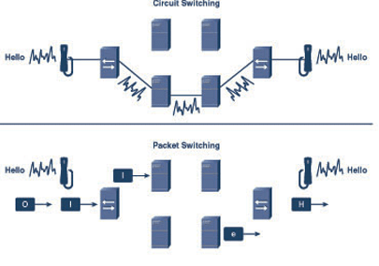
Alternative Core: Circuit Switching
(analogue telephony)
End-end resources dedicated for “call”
dedicated resources (link bandwidth, switch capacity): no sharing
circuit-like (guaranteed) performance
call setup required
Example video for Circuit vs packet switching
  http://www.youtube.com/watch?v=Dq1zpiDN9k4&feature=related

Slide 8
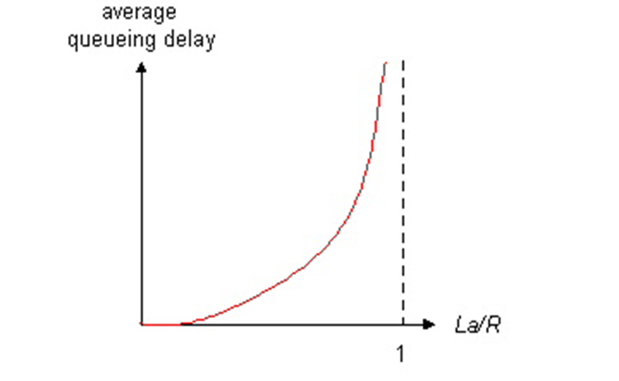

Packet switching versus circuit switching
Packet switching allows more users to use the network!
1 Mbit link
each user/connection:
  100Kbps when “active”
  active 10% of time (bursty behaviour)
circuit-switching how many users/connections?:
  10
packet switching
  with n= 35 users:
  P( k > 10 active) < 0.0004
  ⇒ almost all of the time, same queuing behaviour as in circuit switching)
Q: what happens with > 35 users?
Still circuit-like behavior?
utilization
n users
1 Mbps link
Hint: The probability of k out of n users active (p=0.1 in our example)

Slide 9
Roadmap
Zooming into core
  Ways of data transfer
  Routing
  Performance: delays, (& loss) …
  …. throughput
Network/Internet structure complemented:
  access net, physical media
  backbones, NAPs, ISPs
Security prelude

Slide 10
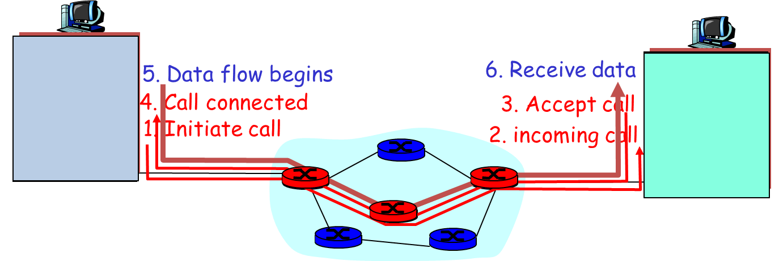
(Can we combine the benefits of CS & PS?)
Routing and network-core main design issue
What is routing’s role? find routes from source to destination
path selection algorithms
Important design issue/type of service offered at network layer:
  datagram network:
    destination address determines next hop
    routes may change during session
  virtual circuit network:
    path determined at call setup, remains fixed thru session
    “bridging” packet-switching with circuit switching
    routers can prioritize, must maintain per-session state
Simple to implement & maintain
(Internet approach)
Expensive, but better to build reliability

Slide 11
Roadmap
Zooming into core
  Ways of data transfer
  Routing
  Performance: delays, (& loss) …
  …. throughput
Network/Internet structure complemented:
  access net, physical media
  backbones, NAPs, ISPs
Security prelude

Slide 12
Delay in packet-switched networks
1. nodal processing:
  check bit errors
  determine output link
2. queuing
  time waiting at output link for transmission
  depends on congestion level of router
3. Transmission delay:
R=link bandwidth (bps)
L=packet length (bits)
time to send bits into link = L/R
4. Propagation delay:
d = length of physical link
s = propagation speed in medium (~2x10⁸ m/sec)
propagation delay = d/s
transmission
A
propagation
B
nodal
processing
queueing

Slide 13
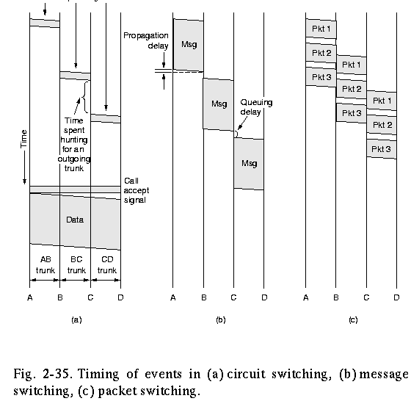
Visualize delays: Circuit, packet switching
store and forward behavior + other delays’ visualization (fig. from “Computer Networks” by A. Tanenbaum)

Slide 14
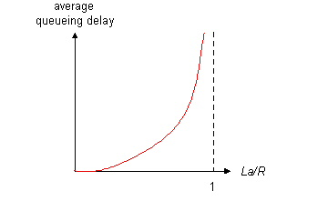
Queueing delay (revisited) …
R=link bandwidth (bps)
L=packet length (bits)
a=average packet arrival rate
traffic intensity = La/R
La/R ~ 0: average queueing delay small
La/R -> 1: delays become large
La/R > 1: more “work” arriving than can be serviced, average delay infinite! Queues may grow unlimited, packets can be lost

Slide 15
Delays and packet loss
Link queue (aka buffer) has finite capacity
packet arriving to full queue dropped (aka lost)
buffer
(waiting area)
packet being transmitted
A
B
packet arriving to
full buffer is lost

Slide 16

Connecting to “Packet switching vs Circuit switching”
PS: Good: Great for bursty data
  resource sharing
  no call setup
PS: Not so good? Excessive congestion: packet delay and loss
  protocols needed for reliable data transfer, congestion control
Q: How to provide circuit-like behavior?
  bandwidth guarantees are needed for some apps
  Some routing policy can help???
    Cf virtual circuit

Slide 17
Roadmap
Zooming into core
  Ways of data transfer
  Routing
  Performance: delays, (& loss)…
  …. throughput
Network/Internet structure complemented:
  access net, physical media
  backbones, NAPs, ISPs
Security prelude

Slide 18
Throughput
throughput: rate (bits/time unit) at which bits transferred between sender/receiver
  instantaneous: rate at given point in time
  average: rate over longer period of time
link capacity
R_{s} bits/sec
link capacity
R_{c} bits/sec
server, with
file of F bits
to send to client
pipe that can carry
fluid at rate
R_{s} bits/sec)
pipe that can carry
fluid at rate
R_{c} bits/sec)
server sends bits
(fluid) into pipe

Slide 19
Throughput (more)
R_{s} < R_{c} What is average end-end throughput?
R_{s} bits/sec
R_{c} bits/sec
R_{s} > R_{c} What is average end-end throughput?
R_{s} bits/sec
R_{c} bits/sec
bottleneck link
link on end-end path that constrains end-end throughput

Slide 20
… “Real” Internet delays and routes (1)…
What do “real” Internet delay & loss look like?
Traceroute program: provides delay measurement from source to router along end-end Internet path towards destination. For all i:
  sends three packets that will reach router i on path towards destination
  router i will return packets to sender
  sender times interval between transmission and reply.
3 probes
3 probes
3 probes

Slide 21
…“Real” Internet delays and routes (2)…
traceroute: gaia.cs.umass.edu to www.eurecom.fr
Three delay measurements from
gaia.cs.umass.edu to cs-gw.cs.umass.edu
1 cs-gw (128.119.240.254) 1 ms 1 ms 2 ms
2 border1-rt-fa5-1-0.gw.umass.edu (128.119.3.145) 1 ms 1 ms 2 ms
3 cht-vbns.gw.umass.edu (128.119.3.130) 6 ms 5 ms 5 ms
4 jn1-at1-0-0-19.wor.vbns.net (204.147.132.129) 16 ms 11 ms 13 ms
5 jn1-so7-0-0-0.wae.vbns.net (204.147.136.136) 21 ms 18 ms 18 ms
6 abilene-vbns.abilene.ucaid.edu (198.32.11.9) 22 ms 18 ms 22 ms
7 nycm-wash.abilene.ucaid.edu (198.32.8.46) 22 ms 22 ms 22 ms
8 62.40.103.253 (62.40.103.253) 104 ms 109 ms 106 ms
9 de2-1.de1.de.geant.net (62.40.96.129) 109 ms 102 ms 104 ms
10 de.fr1.fr.geant.net (62.40.96.50) 113 ms 121 ms 114 ms
11 renater-gw.fr1.fr.geant.net (62.40.103.54) 112 ms 114 ms 112 ms
12 nio-n2.cssi.renater.fr (193.51.206.13) 111 ms 114 ms 116 ms
13 nice.cssi.renater.fr (195.220.98.102) 123 ms 125 ms 124 ms
14 r3t2-nice.cssi.renater.fr (195.220.98.110) 126 ms 126 ms 124 ms
15 eurecom-valbonne.r3t2.ft.net (193.48.50.54) 135 ms 128 ms 133 ms
16 194.214.211.25 (194.214.211.25) 126 ms 128 ms 126 ms
17 * * *
18 * * *
19 fantasia.eurecom.fr (193.55.113.142) 132 ms 128 ms 136 ms
trans-oceanic
link
* means no reponse (probe lost, router not replying)

Slide 22
Roadmap
Zooming into core
  Ways of data transfer
  Routing
  Performance: delays, (& loss) …
  …. throughput
Network/Internet structure complemented:
  access net, physical media
  backbones, NAPs, ISPs
Security prelude

Slide 23

Access networks and physical media
Q: How to connect end systems to edge router?
residential access nets
institutional access networks (school, company)
mobile access networks
keep in mind:
bandwidth (bits per second) of access network?
shared or dedicated?

Slide 24
Access net: digital subscriber line (DSL)
central office
telephone
network
DSL
modem
splitter
DSLAM
ISP
voice, data transmitted
at different frequencies over
dedicated line to central office
DSL access
multiplexer
  use existing telephone line to central office DSLAM
    data over DSL phone line goes to Internet
    voice over DSL phone line goes to telephone net
  < 2.5 Mbps upstream transmission rate (typically < 1 Mbps)
  < 24 Mbps downstream transmission rate (typically < 10 Mbps)

Slide 25



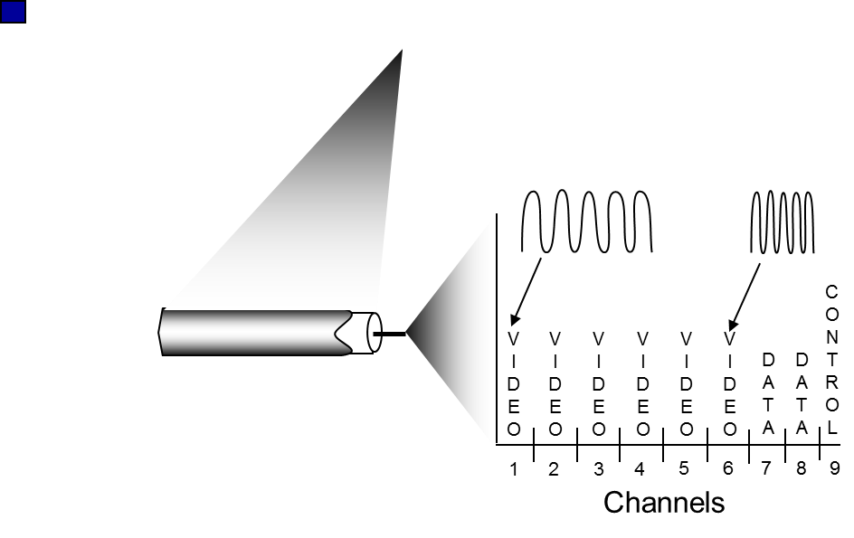
Access net: cable network
cable headend
…
cable
modem
splitter
CMTS
cable modem
termination system
data, TV transmitted at different
frequencies over shared cable
distribution network
ISP
HFC: hybrid fiber coax
  asymmetric: up to 30Mbps downstream transmission rate, 2 Mbps upstream transmission rate
network of cables, attaches homes to ISP router
  homes share access network to cable headend
  unlike DSL, which has dedicated access to central office

Slide 26





Access net: home network
wireless
devices
to/from headend or central office
often combined
in single box
cable or DSL modem
wireless access
point (54 Mbps)
router, firewall, NAT
wired Ethernet (100 Mbps)

Slide 27









Enterprise access networks (Ethernet)
institutional link to
ISP (Internet)
institutional router
Ethernet
switch
institutional mail,
web servers
typically used in companies, universities, etc
  10 Mbps, 100Mbps, 1Gbps, 10Gbps transmission rates

Slide 28
Wireless access networks
shared wireless access network connects end system to router
  “adhoc” or via base station aka “access point”
wireless LANs (10’s m)
  802.11b/g (WiFi): 11 or 54 Mbps
wider-area wireless access (10’s km)
  provided by telco operator
  ~1-10 Mbps over cellular system
  3G, 4G: LTE
router
base
station
mobile
hosts

Slide 29

Physical Media
physical link: transmitted data bit propagates across link
  guided media:
    signals propagate in solid media: copper, fiber
  unguided media:
    signals propagate freely e.g., radio
packets, e.g.
L bits each
2
1
R: link transmission rate
host
  aka link capacity,
  aka link bandwidth

Slide 30


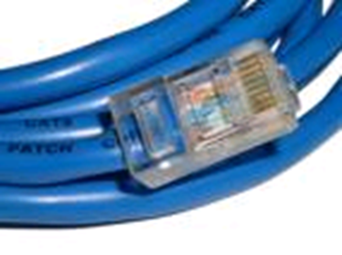
Guided physical Media: coax, fiber, twisted pair
Coaxial cable:
wire (signal carrier) within a wire (shield)
broadband: multiple channels multiplexed on cable (HFC, cable TV)
Fiber optic cable:
low attenuation: fewer repeaters
low error rate: light pulses immune to electromagnetic noise
high-speed operation: e.g., 10-100 Gps
Twisted Pair (TP)
two insulated copper wires
  Category 3: traditional phone wires, 10 Mbps Ethernet
  Category 5/6: more twists, higher insulation: 100-1000 Mbps/10 Gbps

Slide 31
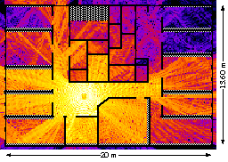
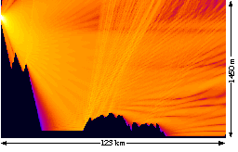
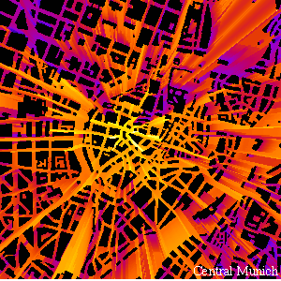
Unguided Physical media: Radio
Properties: Attenuation, Multipath propagation
radio links (Mbps): terrestrial microwave, LAN/WiFi, wide-area/cellular, satellite
Signal can fade with distance, can get obstructed, can take many different paths between sender and receiver due to reflection, scattering, diffraction
signal at sender
signal at receiver

Slide 32
Roadmap
Zooming into core
  Ways of data transfer
  Routing
  Performance: delays, (& loss)…
  …. throughput
Network/Internet structure complemented:
  access net, physical media
  backbones, NAPs, ISPs
Security prelude

Slide 33
Internet structure: network of networks
roughly hierarchical
national/international backbone providers (NBPs)- tier 1 providers
  e.g. BBN/GTE, Sprint, AT&T, IBM, UUNet/Verizon, TeliaSonera
  interconnect (peer) with each other privately, or at public Network Access Point (NAPs: routers or NWs of routers)
regional ISPs, tier 2 providers
  connect into NBPs; e.g. Tele2
local ISP, company
  connect into regional ISPs
local
ISP
regional ISP
NBP B
NAP
NAP
NBP A
regional ISP
local
ISP

Slide 34
Internet structure: network of networks
“Tier-2” ISPs: smaller (often regional) ISPs
  Connect to one or more tier-1 ISPs, possibly other tier-2 ISPs
Tier-2 ISPs also peer privately with each other.
Tier-2 ISP pays tier-1 ISP for connectivity to rest of Internet
tier-2 ISP is customer of
tier-1 provider
Tier-2 ISP
Tier-2 ISP
Tier 1 ISP
Tier 1 ISP
Tier 1 ISP
Tier-2 ISP
Tier-2 ISP
Tier-2 ISP

Slide 35
Internet structure: network of networks
“Tier-3” ISPs and local ISPs
  last hop (“access”) network (closest to end systems)
local
ISP
Tier 3
ISP
local
ISP
local
ISP
local
ISP
Local and tier- 3 ISPs are customers of
higher tier ISPs
connecting them to rest of Internet
Tier-2 ISP
Tier-2 ISP
Tier 1 ISP
Tier 1 ISP
Tier 1 ISP
Tier-2 ISP
Tier-2 ISP
Tier-2 ISP
local
ISP
local
ISP
local
ISP
local
ISP

Slide 36
Internet structure: network of networks
a packet passes through many networks
local
ISP
Tier 3
ISP
local
ISP
local
ISP
local
ISP
Tier-2 ISP
Tier-2 ISP
Tier 1 ISP
Tier 1 ISP
Tier 1 ISP
Tier-2 ISP
Tier-2 ISP
Tier-2 ISP
local
ISP
local
ISP
local
ISP
local
ISP

Slide 37
Roadmap
Zooming into core
  Ways of data transfer
  Routing
  Performance: delays, …
  …. throughput, loss
Network/Internet structure complemented:
  access net, physical media
  backbones, NAPs, ISPs
Security prelude

Slide 38
Network Security Prelude
The field of network security is about:
  how adversaries can attack computer networks
  how we can defend networks against attacks
  how to design architectures that are immune to attacks
Internet not originally designed with (much) security in mind
  original vision: “a group of mutually trusting users attached to a transparent network” ☺
  Internet protocol designers playing “catch-up”
  Security considerations in all layers!

Slide 39
Bad guys can put malware into hosts via Internet
Malware can get in host from a virus, worm, or trojan horse.
Spyware malware can record keystrokes, web sites visited, upload info to collection site.
Infected host can be enrolled in a botnet, used for spam and DDoS attacks.
Malware is often self-replicating: from an infected host, seeks entry into other hosts

Slide 40
Bad guys can attack servers and network infrastructure
Denial of service (DoS): attackers make resources (server, bandwidth) unavailable to legitimate traffic by overwhelming resource with bogus traffic
select target
break into hosts around the network (see botnet)
send packets toward target from compromised hosts
target

Slide 41
The bad guys can sniff packets
Packet sniffing:
  Shared/broadcast medium (shared Ethernet, wireless)
  promiscuous network interface reads/records all packets passing by
A
C
src:B dest:A payload
B
Wireshark software used for end-of-chapter labs is a (free) packet-sniffer
NOTE: be aware that it is inappropriate to use outside the lab

Slide 42
The bad guys can use false source addresses
IP spoofing: send packet with false source address
A
C
src:B dest:A payload
B

Slide 43
The bad guys can record and playback
record-and-playback: sniff sensitive info (e.g., password), and use later
  password holder is that user from system point of view
C
A
src:B dest:A user: B; password: foo
B

Slide 44

Chapter 1: Summary
Covered a “ton” of material!
what’s the Internet
what’s a protocol?
protocol layers, service models
network edge (types of service)
network core (ways of transfer, routing)
performance, delays, loss
access net, physical media
backbones, NAPs, ISPs
Security concerns
(history: read more corresponding section, interesting & fun ☺)
In order to have:
context, overview, “feel” of networking
A point of reference for context in the focused discussions to come

Slide 45
Reading instructions
1. Kurose Ross book
Careful | Quick
4/e,5/e,6/e: 1.3, 1.4, 1.5 | 4/e,5/e,6/e: the rest
Extra Reading (optional)
Computer and Network Organization: An Introduction,
by Maarten van Steen and Henk Sips, Prentice Hall
(very good introductory book for non-CSE students

Slide 46
Review questions
Review questions from Kurose-Ross book, chapter 1 (for basic study)
R11, R12, R13, R16, 17, R18, R19, R20, R21, R22, R23, R24, R25, R28.
Extra questions, for further study: delay analysis in packet switched networks:
http://www.comm.utoronto.ca/~jorg/teaching/ece466/material/466-SimpleAnalysis.pdf

Slide 47
Review: Network Taxonomy
Communication
networks
Circuit-switched
networks
Packet-switched
networks
Networks
with VCs
Datagram
Networks
Datagram network (eg Internet) cannot be characterized either connection-oriented or connectionless.
  Internet provides both connection-oriented (TCP) and
connectionless services (UDP), at the network edge, to apps.

Slide 48
Review questions:
Throughput: Internet scenario
10 connections (fairly) share backbone bottleneck link of R bits/sec
R_{s}
R_{s}
R_{s}
per-connection end-end throughput: min(R_{c},R_{s},R/10 (if fair))
in practice: R_{c} or R_{s} is often bottleneck
R
R_{c}
R_{c}
R_{c}

Slide 49
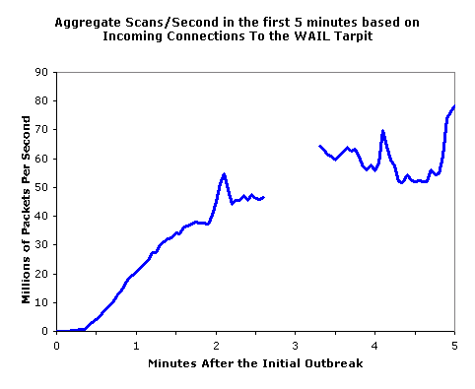
Example types of malware
Trojan horse
  Hidden part of some otherwise useful software
  Today often on a Web page (Active-X, plugin)
Virus
  infection by receiving object (e.g., e-mail attachment), actively executing
  self-replicating: propagate itself to other hosts, users
Worm:
  infection by passively receiving object that gets itself executed
  self- replicating: propagates to other hosts, users
Sapphire Worm: aggregate scans/sec
in first 5 minutes of outbreak (CAIDA, UWisc data)

