Slide 1
Course on Computer Communication and Networks
Lecture 14 partB
Chapter 2.6; peer-to-peer applications
(and network overlays)
EDA344/DIT 420, CTH/GU

Slide 2
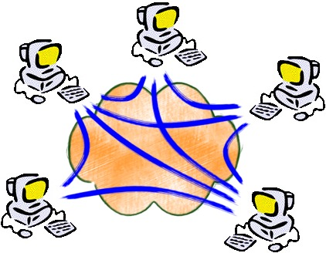
Network overlays
Overlay: a network implemented on top of a network
Why? What to do with this?
Recall: applications can deal with needs of multimedia traffic
They actually do more for sharing resources @ edge of the network with peer-to-peer (P2P) overlays

Slide 3

















Pure P2P architecture
no always-on server
arbitrary end systems directly communicate
peers are intermittently connected and change IP addresses
examples:
  file distribution/sharing (BitTorrent, …)
  Streaming (KanKan)
  VoIP (Skype)

Slide 4
file-sharing peer-to-peer (p2p) applications: preliminaries
Background: Common Primitives in file-sharing p2p apps:
Join: how do I begin participating?
Publish: how do I advertise my file?
Search: how to I find a file/service?
Fetch: how to I retrieve a file/use service?

Slide 5


Roadmap
First generation in p2p: file sharing/lookup
Centralized Database: single directory
  Napster
Query Flooding
  Gnutella
Hierarchical Query Flooding
  KaZaA
Structured Overlays
  DHT
Second generation in p2p ….

Slide 6


P2P: centralized directory
File transfer:
HTTP
original “Napster” design (1999, S. Fanning)
1) when peer connects, it informs central server:
  IP address, content
2) Alice queries directory server for “Boulevard of Broken Dreams”
3) Alice requests file from Bob
Bob
centralized
directory server
1
peers
1
1
3
2
1
Alice
Q: What is p2p in this?

Slide 7
Roadmap
First generation in p2p: file sharing/lookup
Centralized Database: single directory
  Napster
Query Flooding
  Gnutella
Hierarchical Query Flooding
  KaZaA
Structured Overlays
  DHT
Second generation in p2p ….

Slide 8
Gnutella: protocol
Query Flooding:
Join: on startup, client connects to a few other nodes (learn from bootstrap-node); these become its “neighbors” (overlay!! ☺)
Publish: no need
Search: ask “neighbors”, who ask their neighbors, and so on... when/if found, reply to sender.
Fetch: get the file directly from peer
File transfer:
HTTP
Query
QueryHit
Query
Query
QueryHit
Query
QueryHit
Query

Slide 9


Gnutella: Search
I have file A.
I have file A.
Reply
Request/Fetch
Query
Where is file A?
Q: Compare with Napster

Slide 10
Discussion +, -?
Napster
Pros:
  Simple
  Search scope is O(1)
Cons:
  Server maintains O(peers,items) State
  Server performance bottleneck
  Single point of failure
Gnutella:
Pros:
  Simple
  Fully de-centralized
  Search cost distributed
Cons:
  Search scope is O(peers, items)
  Search time is O(???)

Slide 11
Synch questions:
how are the ”neighbors” connected?
what is the overlay here useful for?
  Edge is not a physical link E.g. edge between peer X and Y if they know each-other’s IP addresses or there’s a TCP connection
  Used for supporting the search operation (aka routing in p2p networks)

Slide 12
Roadmap
First generation in p2p: file sharing/lookup
Centralized Database: single directory
  Napster
Query Flooding
  Gnutella
Hierarchical Query Flooding : some directory structure
  KaZaA
Structured Overlays
  DHT
Second generation in p2p ….

Slide 13
KaZaA: join, publish
“Smart” Query Flooding:
Join: on startup, client contacts a “supernode” ... may at some point become one itself
Publish: send list of files to supernode
“Super Nodes”
insert(X,
123.2.21.23)
...
Publish
I have X!
123.2.21.23

Slide 14
KaZaA: Search
“Smart” Query Flooding:
Search: send query to supernode, supernodes flood query amongst themselves.
Fetch: get the file directly from peer(s); can fetch simultaneously from multiple peers
search(A)
-->
123.2.22.50
“Super Nodes”
search(A)
-->
123.2.0.18
123.2.22.50
Query
Replies
Where is file A?
123.2.0.18
Q: Compare with Napster, Gnutella (publishing, searching, anything else)

Slide 15
KaZaA: Discussion
Pros:
  Tries to balance between search overhead and space needs (trading-off Napster’s & Gnutella’s extremes)
  Tries to take into account node heterogeneity:
    Peer’s Resources (eg bandwidth)
Cons:
  No real guarantees on search scope or search time
  Super-peers may “serve” a lot!
P2P architecture used by Skype, Joost (communication, video distribution p2p systems)

Slide 16
Roadmap
First generation in p2p: file sharing/lookup
Centralized Database: single directory
  Napster
Query Flooding
  Gnutella
Hierarchical Query Flooding
  KaZaA
Structured Overlays
  Combine database+distributed system know-how
Second generation in p2p ….

Slide 17
Problem from this perspective
How to find data in a distributed file sharing system?
(aka “routing” to the data, i.e. content-oriented routing)
N₂
N₃
Publisher
N₁
Key=“LetItBe”
Value=MP3 data
Internet
N₅
?
N₄
Client
Lookup(“LetItBe”)
How to do Lookup?

Slide 18
Centralized Solution
Central server (Napster)
N₂
N₃
Publisher
N₁
Key=“LetItBe”
Value=MP3 data
Internet
DB
N₅
N₄
Client
Lookup(“LetItBe”)
O(peers,items) state at server, O(1) at client
O(1) search communication overhead
Single point of failure

Slide 19
Distributed Solution
Flooding (Gnutella, etc.)
N₂
N₃
Publisher
N₁
Key=“LetItBe”
Value=MP3 data
Internet
N₅
N₄
Client
Lookup(“LetItBe”)
O(1) state per node
Worst case O(peers, items) complexity per lookup

Slide 20
Distributed Solution
(with some more structure? In-between the two?)
Publisher
balance the update/lookup complexity..
Abstraction: a lookup data structure (distributed “hash-table” DHT) :
  insert(key, item);
  item = get(key);
Key=“LetItBe”
Value=MP3 data
N₂
N₃
N₁
Internet
N₅
N₄
Client
Lookup(“LetItBe”)

Slide 21
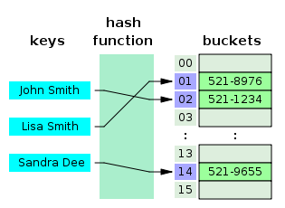
(Recalling hash tables)
figure source: wikipedia; "Hash table 3 1 1 0 1 0 0 SP" by Jorge Stolfi - Own work. Licensed under CC BY-SA 3.0 via Commons - https://commons.wikimedia.org/wiki/File:Hash_table_3_1_1_0_1_0_0_SP.svg#/media/File:Hash_table_3_1_1_0_1_0_0_SP.svg

Slide 22
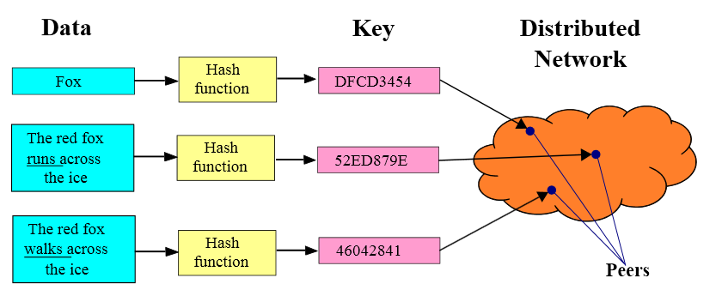
Distributed Hash Tables (DHT)
  Implementation:
  nodes form an overlay (a distributed data structure)
    eg. Ring, Tree, cube
  Hash function maps entries to nodes (insert)
Nodes-overlay has structure (Distributed Hash Table); using it, do:
  Lookup/search: find the node responsible for item; that one knows where the item is
Upon being queried:
”I do not know DFCD3454
but can ask some
Neighbour/s in the DHT”
figure source: wikipedia

Slide 23
Distributed-Hash-Table-Based p2p sharing
Join:
  get connected in the overlay through info from bootstrap-node & using the specific DHT algorithm (eg Chord)
  Start maintaining of files that you are responsible for (following the hash function)
  NOTE: upon leaving DHT needs restructuring!
Publish: tell which files you have, to the peers that will be responsible for them (according to the hash function)
Search: ask the appropriate neighbour, who either is responsible for the searched file or will ask the next appropriate neighbor, and so on; guaranteed search time; commonly in O(logNodes)
Fetch: get the file directly from peer
Publisher
Key=“LetItBe”
Value=MP3 data
N₂
N₃
N₁
Internet
N₅
N₄
Client
Lookup(“LetItBe”)
Challenges [cf related literature@end of notes]:
  Keep the hop count (asking chain) small
  Keep the routing tables (#neighbours) “right size”
  Stay robust despite rapid changes in membership (churn)

Slide 24
e.g. Circular DHT (1)
O(N) messages
on avgerage to resolve
query, when there
are N peers
0001
Who’s responsible
for key 1110 ?
I am
0011
1111
1110
1110
0100
1110
1100
1110
0101
1110
1110
1010
1000
24

Slide 25
Circular DHT with shortcuts
1
Who’s responsible
for key 1110?
3
15
4
12
5
10
8
Here: reduced from 6 to 2 messages.
possible to design shortcuts so O(log N) neighbors, O(log N) messages in query
Application 2-25

Slide 26
Roadmap
First generation in p2p: file sharing/lookup
Centralized Database: single directory
  Napster
Query Flooding
  Gnutella
Hierarchical Query Flooding
  KaZaA
Structured Overlays
  DHT
Second generation in p2p ….
Swarming
  BitTorrent, Avalanche, …

Slide 27

BitTorrent: Next generation fetching
Key Motivation:
  Popularity exhibits temporal locality (Flash Crowds)
  Can bring file “provider” to “its knees”
Idea: Focused on Efficient Fetching, not Searching:
  Files are “chopped” in chunks, fetching is done from many sources
  Overlay: nodes “hold hands” with those who share (send chunks) at similar rates
Method used by publishers to distribute software, other large files
http://vimeo.com/15228767

Slide 28
BitTorrent: Overview
Swarming:
Join: contact some server, aka “tracker” get a list of peers.
Publish: can run a tracker server.
Search: Out-of-band. E.g., use search-engine, some DHT, etc to find a tracker for the file you want. Get list of peers to contact for assembling the file in chunks
Fetch: Download chunks of the file from several of your peers. Upload chunks you have to them.
tracker: tracks peers
participating in torrent
torrent: group of
peers exchanging
chunks of a file
obtain list
of peers
trading
chunks
peer

Slide 29
File distribution: BitTorrent
Peer joining torrent:
  has no chunks, but will accumulate over time
  gets list of peers from tracker, connects to subset of peers (“neighbors”) who share at similar rates (tit-for-tat)
while downloading, peer uploads chunks to other peers.
once peer has entire file, it may (selfishly) leave or (altruistically) remain
tracker: tracks peers
participating in torrent
torrent: group of
peers exchanging
chunks of a file
obtain list
of peers
trading
chunks
peer

Slide 30
Roadmap
First generation in p2p: file sharing/lookup
Centralized Database: single directory
  Napster
Query Flooding
  Gnutella
Hierarchical Query Flooding
  KaZaA
Structured Overlays
  DHT
Second generation in p2p ….
Swarming

Slide 31
Reading instructions
KuroseRoss book: chapter 2.6
for Further Study, optional
Aberer’s coursenotes and references therein
  http://lsirwww.epfl.ch/courses/dis/2007ws/lecture/week%208%20P2P%20systems-general.pdf
  http://lsirwww.epfl.ch/courses/dis/2007ws/lecture/week%209%20Structured%20Overlay%20Networks.pdf
Regarding fair sharing in p2p systems
  Incentives build Robustness in BitTorrent, Bram Cohen. Workshop on Economics of Peer-to-Peer Systems, 2003.
  Do incentives build robustness in BitTorrent? Michael Piatek, Tomas Isdal, Thomas Anderson, Arvind Krishnamurthy and Arun Venkataramani, NSDI 2007
Regarding other applications in p2p sharing, eg Dissemination and media streaming
  J. Mundinger, R. R. Weber and G. Weiss. Optimal Scheduling of Peer-to-Peer File Dissemination. Journal of Scheduling, Volume 11, Issue 2, 2008. [arXiv] [JoS]
  Christos Gkantsidis and Pablo Rodriguez, Network Coding for Large Scale Content Distribution, in IEEE INFOCOM, March 2005 (Avalanche swarming: combining p2p + media streaming)
Pointers to some work by the group
Georgiadis, G.; Papatriantafilou, M.: Overlays with preferences: Approximation algorithms for matching with preference lists. IEEE IPDPS 2010
Zhang Fu, Marina Papatriantafilou: Off the Wall: Lightweight Distributed Filtering to Mitigate Distributed Denial of Service Attacks. SRDS 2012: 207-21 (builds on router-overlays)

