Slide 1
Course on Computer Communication and Networks
Lecture 14 Part A
Chapter 7.5: Network support for multimedia
EDA344/DIT 420, CTH/GU

Slide 2

Recall: multimedia networking
Application Classes, challenges
Today’s representative technology
  recovery from jitter and loss
  Streaming protocols
  (Overlays) CDN: content distribution networks
Traffic Engineering:
  historic flash-back (telco’s vision of world-wide networks (VC-based)
  MPLS
  Related: Tunneling

Slide 3


Let’s hit the road again☺: Roadmap
Improving timing guarantees in Networks (also related with congestion-control)
  Packet scheduling and policing
Two generally different approaches
  The VC (ATM) approach (incl. material from Ch 3, 5)
  Internet approaches in discussion/evolution: Int-serv + RSVP, Diff-serv

Slide 4
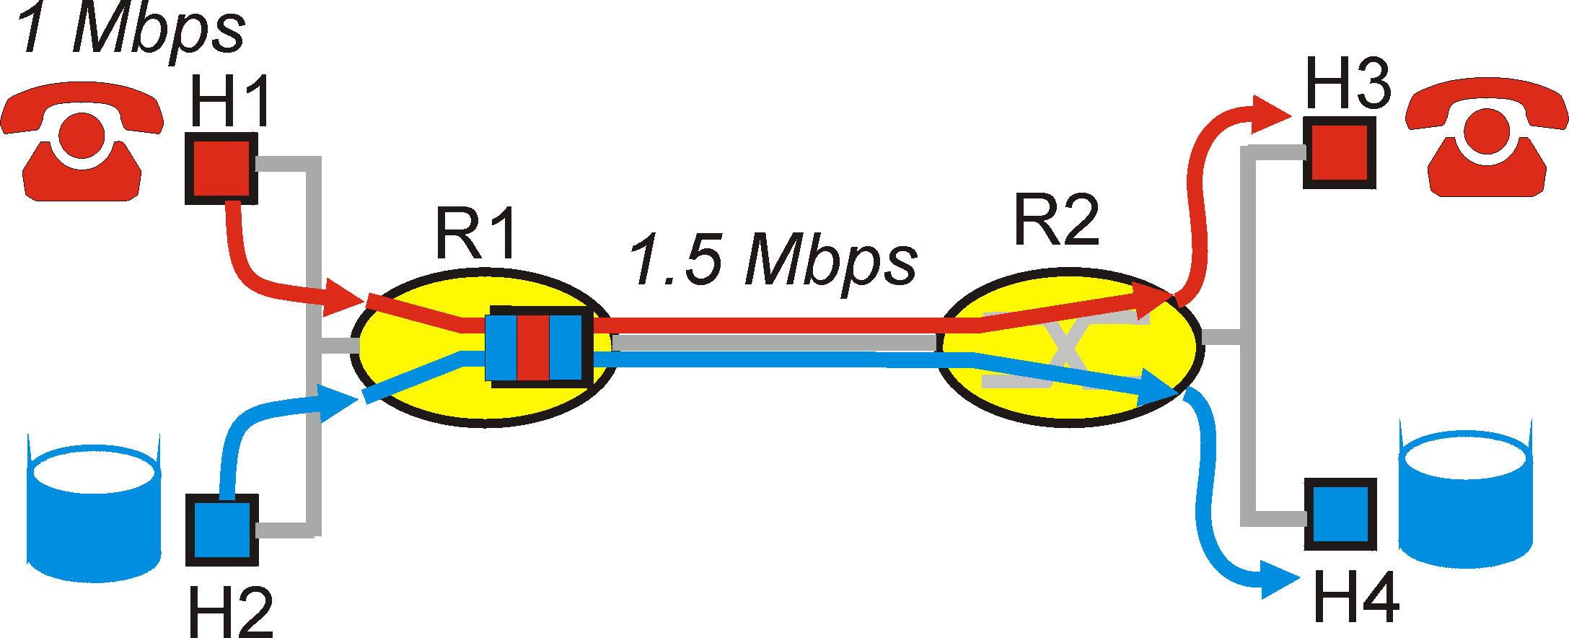
Improving timing/bandwidth guarantees in Networks
aka Quality of Service (QoS): agreement on
  Traffic characteristics (packet rate, sizes, …)
  Network service guarantees (delay, jitter, loss rate, …)
model for resource sharing and congestion studies: questions/principles for QoS
  Distinguish traffic?
  Control offered load? (isolate different ”streams”?)
  Resources? (utilization)
  Control acceptance of new sessions?
Packet classification & scheduling (bandwidth allocation)n control
Traffic shaping/policing (enforce contract terms)
Admission control will not study methods here)

Slide 5
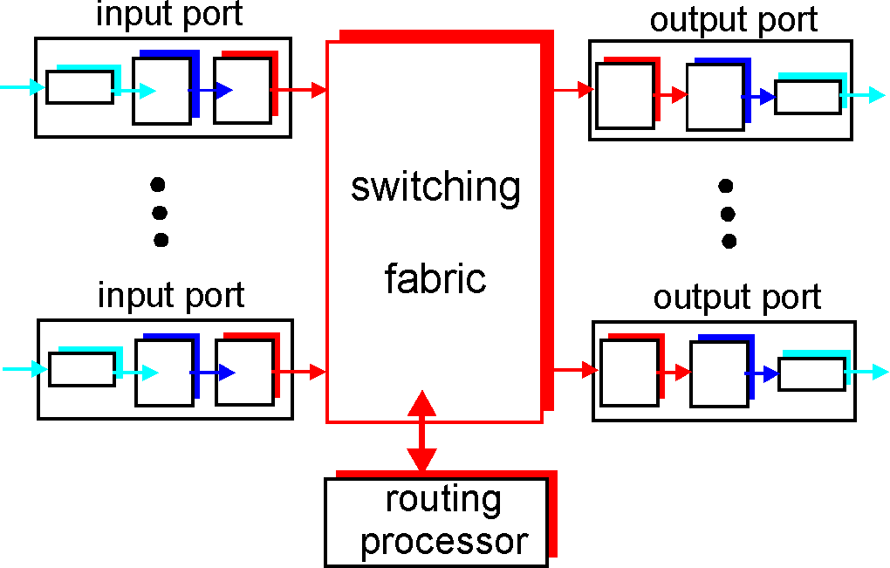
Where does this go in?
Scheduling = choosing the next packet for transmission on a link (= allocate bandwidth)

Slide 6
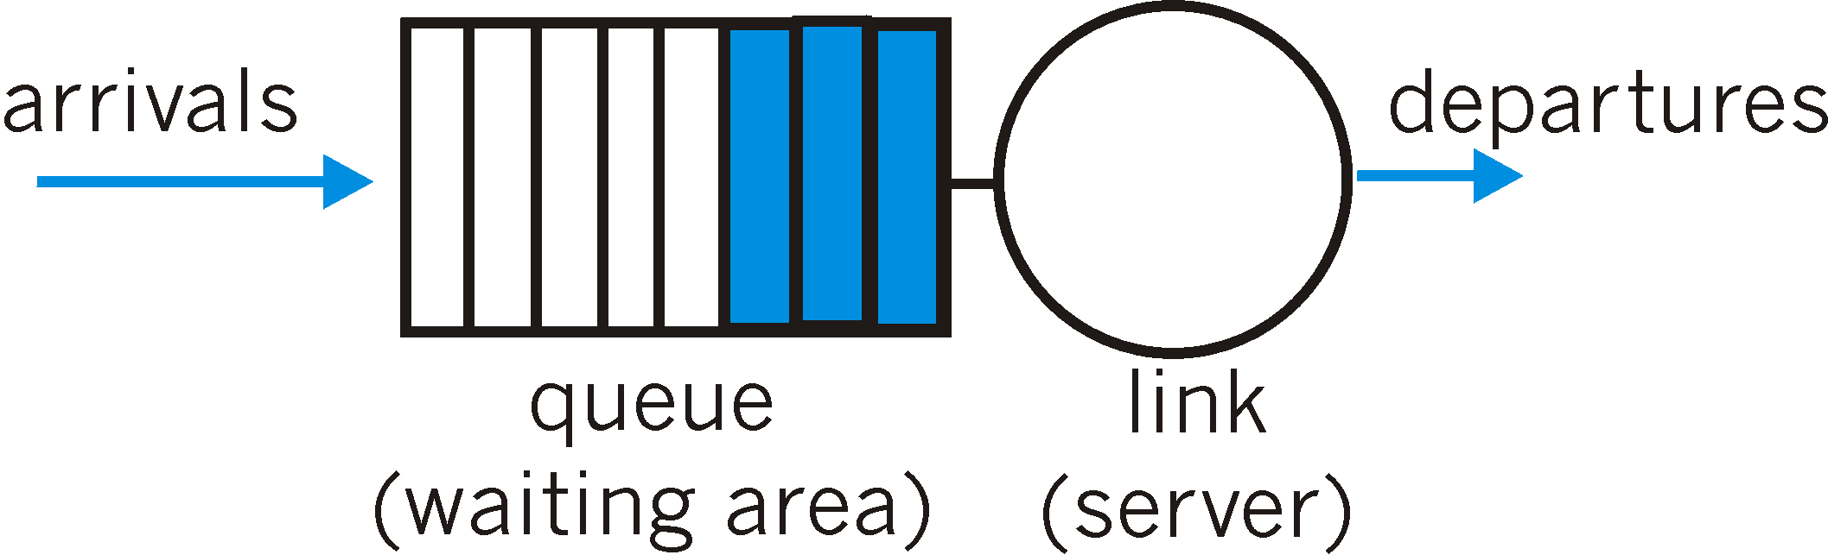
Packet Scheduling: FIFO
FIFO: in order of arrival to the queue
  if buffer full: a discard policy determines which packet to discard among the arrival and those already queued

Slide 7
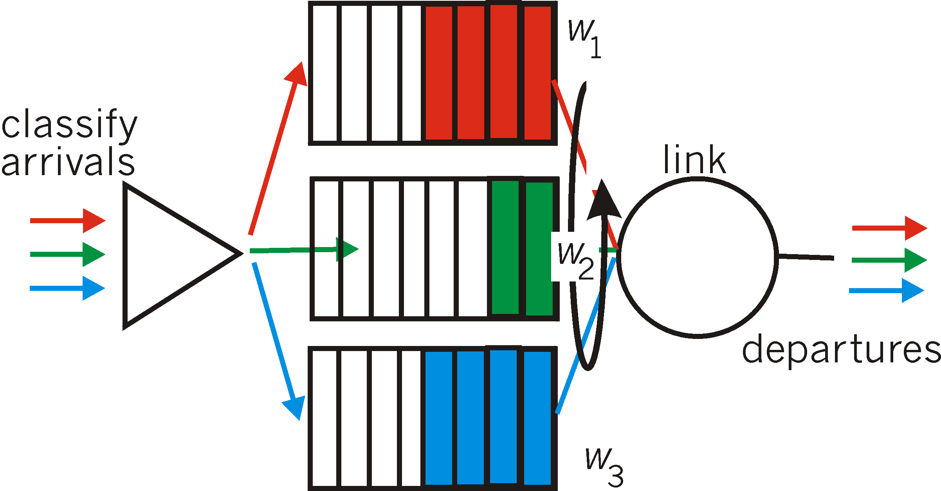
Packet Scheduling: Weighted Fair Queueing
Weighted Fair Queuing: generalized Round Robin, including priorities (weights)
  provide each class with a differentiated amount of service
  class i receives a fraction of service w_{i}/∑(w_{j})
More on packet scheduling: work-conserving policies, delays, …

Slide 8
Policing Mechanisms
Idea: shape the packet traffic (the network provider does traffic policing, ie monitors/enforces the ”shape” agreed).
Traffic shaping, to limit transmission rates:
  (Long term) Average Rate (e.g.100 pkts/sec or 6000 packets per min), crucial aspect is the interval length
  Peak Rate: e.g.1500 pkts/sec peak
  (Max.) Burst Size: Max. number of packets sent consecutively, ie over a very short period of time

Slide 9
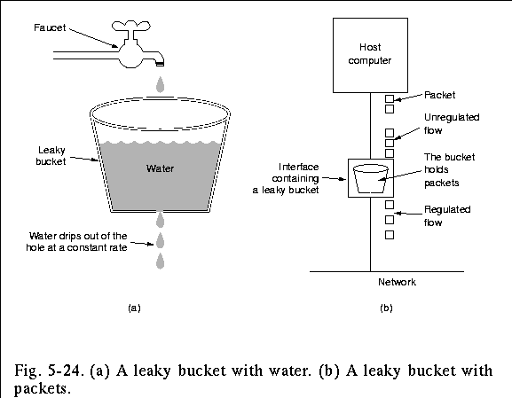
Policing Mechanisms: Pure Leaky Bucket
Idea: eliminates bursts completely; may cause unnecessary packet losses

Slide 10
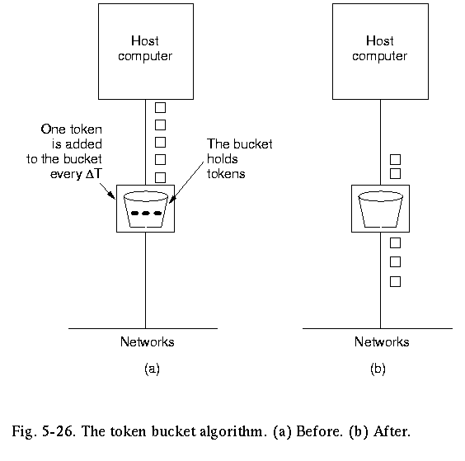
Policing Mechanisms:LeakyToken Bucket
Idea: packets sent by consuming tokens produced at constant rate r
  limit input to specified Burst Size (b= bucket capacity) and Average Rate (max admitted #packets over time period t is b+rt).
  to avoid still much burstiness, put a leaky bucket -with higher rate; after the token bucket)

Slide 11
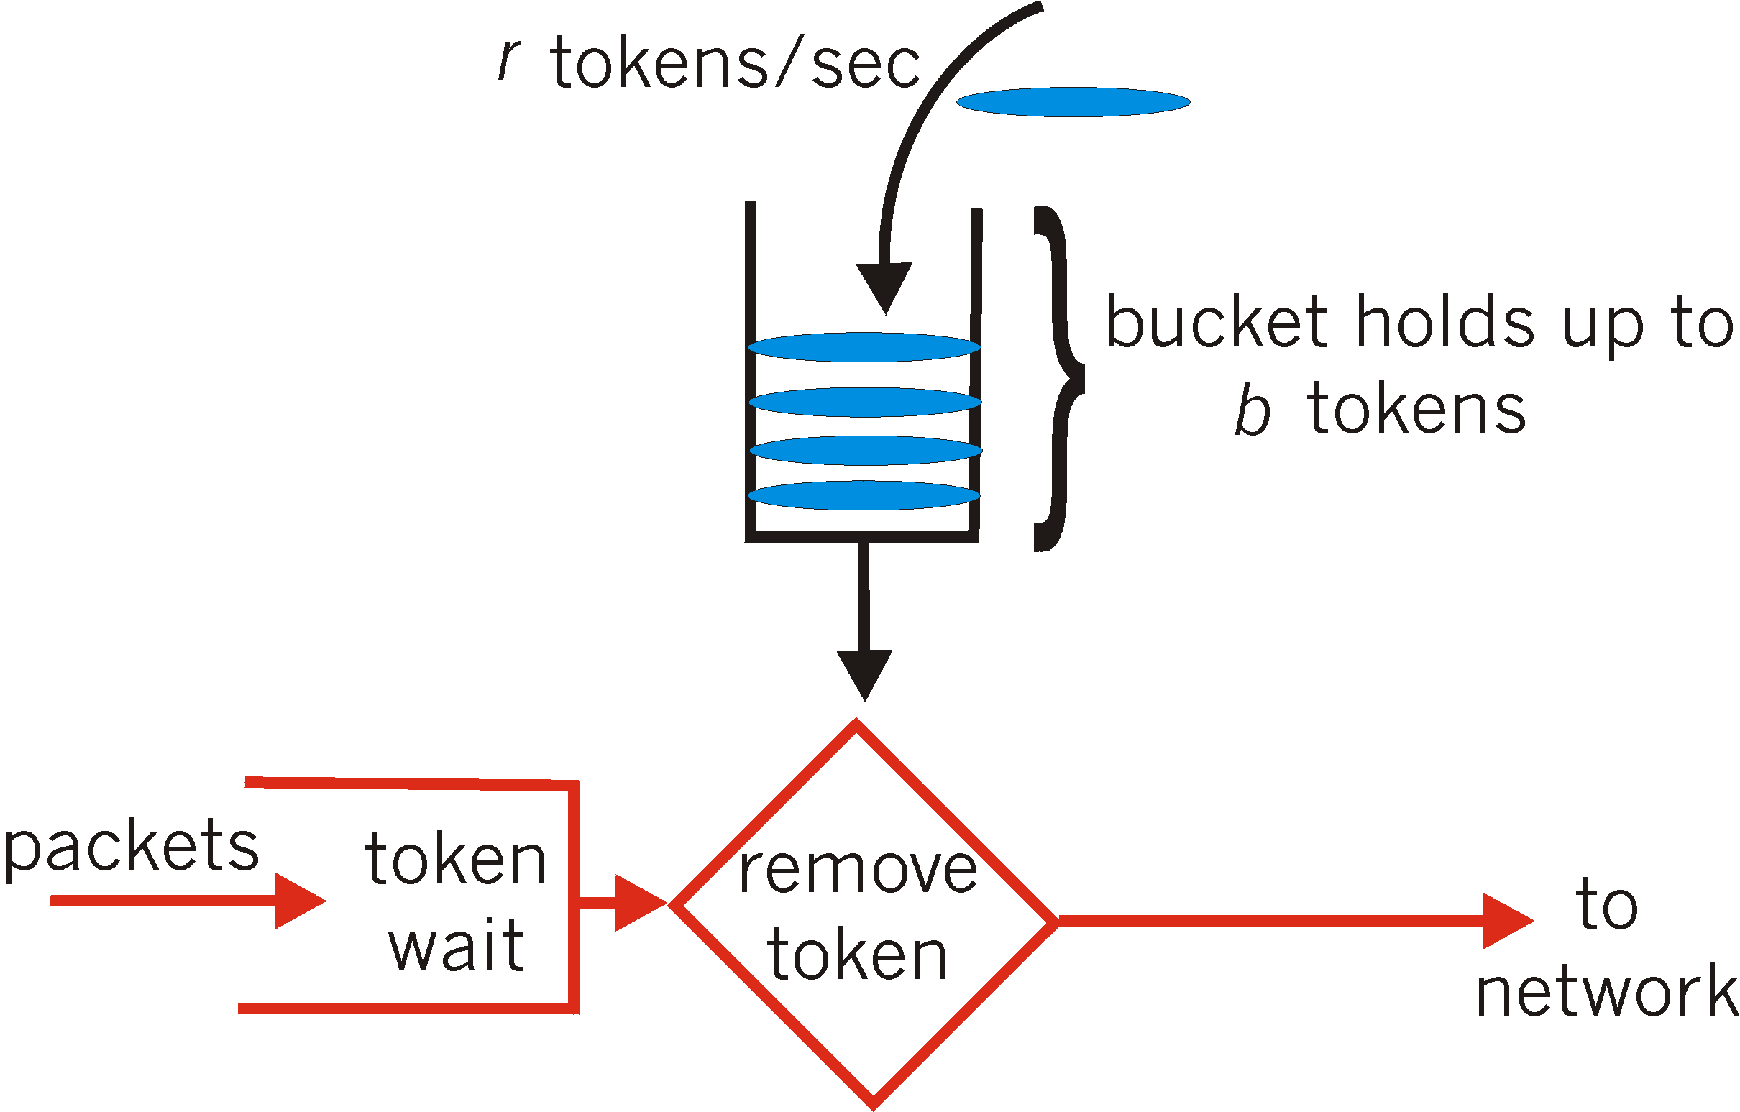
Policing Mechanisms: token bucket
Another way to illustrate token buckets:

Slide 12
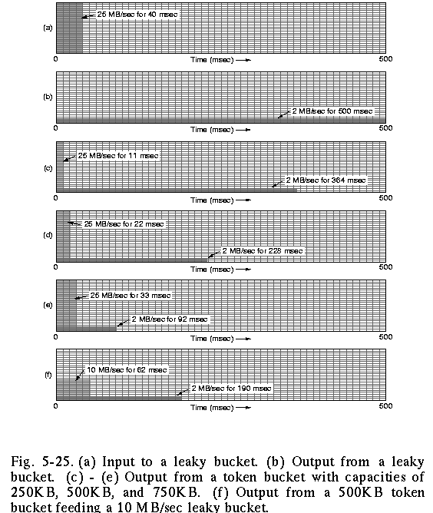
Policing: the effect of buckets
input
output pure leaky bucket, 2MBps
output token bucket 250KB, 2MBps
output token bucket 500KB, 2MBps
output token bucket 750KB, 2MBps
output token bucket 500KB, 2MBps, feeding 10MBps leaky bucket

Slide 13
Roadmap
Improving timing guarantees in Networks (also related with congestion-control)
  Packet scheduling and policing
Two generally different approaches
  The VC (ATM) approach (incl. material from Ch 3, 5)
  Internet approaches in discussion: Int-serv + RSVP, Diff-serv

Slide 14
Virtual Circuit example:
ATM: Asynchronous Transfer Mode nets
Internet ‘s IP:
today’s de facto standard for global data networking
1970/80’s:
telco’s develop ATM: competing network standard for carrying high-speed voice/data
ATM principles:
virtual-circuit networks: switches maintain state for each “call”
small (48 byte payload, 5 byte header) fixed length cells (like packets)
  fast switching
  small size good for voice
well-defined interface between “network” and “user” (think of classic telecom)

Slide 15
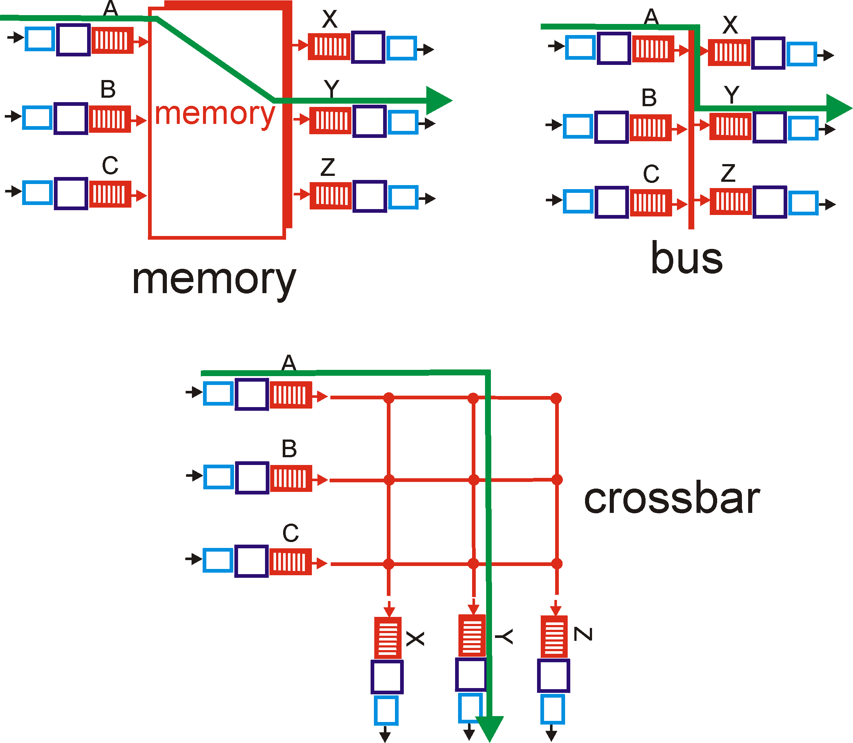
Recall: switching fabrics
ATM switches: VC technology
  Virtual channels, virtual circuits
    Based on Banyan crossbar switches
ATM routing: as train travelling for routers (hence no state for each ”stream/passenger”, but for each ”train” = virtual path)

Slide 16

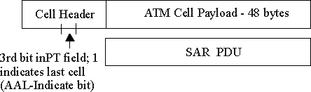
ATM cell (small packet)
48-byte payload
  Why?: small payload -> short cell-creation delay for digitized voice
  halfway between 32 and 64 (compromise!)
Header: 5bytes
  VCI: virtual channel ID
  PT: Payload type (e.g. Resource Management cell versus data cell)
  CLP: Cell Loss Priority bit
    CLP = 1 implies low priority cell, can be discarded if congestion
  HEC: Header Error Checksum
Cell header
Cell format

Slide 17
Example VC technology
ATM Network service models:
Service
Model
Constant Bit Rate
VariableBR
(RT/nRT)
Available BR
UndefinedBR
Guarantees ?
Example
voice
Video/
“streaming”
www-browsing
Background file transfer
Congestion
feedback
no
congestion
no
congestion
yes
no
Bandwidth
constant
rate
guaranteed
rate
guaranteed
minimum
none
Loss
yes
yes
no
no
Order
yes
yes
yes
yes
Timing
yes
yes
no
no
With ABR you can get min guaranteed capacity and better, if possible; with UBR you can get better, but you may be thrown out in the middle ☹

Slide 18
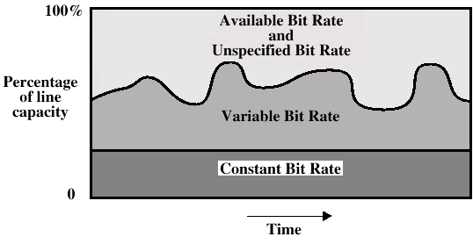
ATM Bit Rate Services

Slide 19
ATM (VC) Congestion Control
Several different strategies:
Admission control and resource reservation (CBR and VBR traffic:
  reserve resources when opening a VC; traffic shaping and policing (use bucket-like methods)
Rate-based congestion control: (ABR traffic)
  idea = give feedback to the sender and intermediate stations on the available (= max. acceptable) rate on the VC.
  similar to ”choke packets” (option/field provided in IP (ICMP) also, but not really used in implementations)

Slide 20
Roadmap
Improving timing guarantees in Networks (also related with congestion-control)
  Packet scheduling and policing
Two generally different approaches
  The VC (ATM) approach (incl. material from Ch 3, 4, 5)
  Internet approaches in discussion: Int-serv + RSVP, Diff-serv

Slide 21



Intserv: QoS guarantee scenario
Resource reservation per individual application session
  call setup, signaling (RSVP)
    Maintains state a la VC (but soft state, ie times out)
      responsibility at the client to renew reservations
    traffic, QoS declaration
    per-element admission control
request/
reply
  QoS-sensitive scheduling (e.g., WFQ)

Slide 22
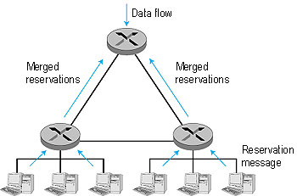
RSVP: resource reservation protocol
RSVP: a leading candidate for signaling protocol
  allows reservations for bandwidth in multicast trees
  is receiver-oriented (the receiver of a
    data flow initiates and maintains the
    resource reservation for the flow).
  Maintains soft-state
    receivers renew interest regularly
  does not specify how the network
    provides the reserved bandwidth, only
    allows the applications to reserve it.
  is not a routing protocol; it depends on
    an underlying routing protocol to
    determine the routes for the flows; when a route changes,
    RSVP re-reserves resources.
  does not define the admission test, but it assumes that the routers perform such a test and that RSVP can interact with the test.

Slide 23
Back to Internet bandwidth guarantee support: alternatively?
Concerns with Intserv:
Scalability: signaling, maintaining per-flow router state difficult with large number of flows
Diffserv approach:
provide functional components to build service classes
  Network core: stateless, simple
  Combine flows into aggregated flows
  Classification, shaping, admission at the network edge

Slide 24

Diffserv Architecture
Edge router:
per-flow traffic management
marks packets as in-profile and out-profile
marking
r
scheduling
.
b
.
.
Core router:
per class traffic management
buffering and scheduling based on marking at edge
preference given to in-profile packets

Slide 25
Edge-router Packet Marking
profile: pre-negotiated rate A, bucket size B
packet marking at edge based on per-flow profile
Rate A
B
User packets
Possible usage of marking:
class-based marking: packets of different classes marked differently
Packet is marked in the Type of Service (TOS) in IPv4, and Traffic Class in IPv6

Slide 26
DiffServ Core Functions
Forwarding: according to “Per-Hop-Behavior” (PHB) specified for the particular packet class; PHB is strictly based on classification marking
  PHB does not specify what mechanisms to use to ensure required PHB performance behavior
  Examples:
    Class A gets x% of outgoing link bandwidth over time intervals of a specified length
    Class A packets leave before packets from class B
Advantage:
No state info to be maintained by routers

Slide 27
Roadmap - Summary
Improving timing guarantees in Networks (also related with congestion-control)
  Packet scheduling and policing
Two generally different approaches
  The VC (ATM) approach (incl. material from Ch 3, 4, 5)
  Internet approaches in discussion: Int-serv + RSVP, Diff-serv
Internet core and transport protocols do not provide guarantees for multimedia streaming traffic
Applications take matters into own hands
  interesting evolving methods
Another type of service at the core (VC-like) would imply a different situation
  But then the Internet core would be different
Traffic engineering, Intserv & Diffserv approaches to provide some alternatives
Internet-of-Things in evolution
  even more types of traffic…

Slide 28
Reading list, review questions, further study
Upkar Varshney, Andy Snow, Matt McGivern, and Christi Howard. 2002. Voice over IP. Commun. ACM 45, 1 (January 2002), 89-96. DOI=10.1145/502269.502271
Jussi Kangasharju, James Roberts, Keith W. Ross, Object replication strategies in content distribution networks, Computer Communications, Volume 25, Issue 4, 1 March 2002, Pages 376-383, ISSN 0140-3664, http://dx.doi.org/10.1016/S0140-3664(01)00409-1.
K.L Johnson, J.F Carr, M.S Day, M.F Kaashoek, The measured performance of content distribution networks, Computer Communications, Volume 24, Issue 2, 1 February 2001, Pages 202-206, ISSN 0140-3664, http://dx.doi.org/10.1016/S0140-3664(00)00315-7.
Eddie Kohler, Mark Handley, and Sally Floyd. 2006. Designing DCCP: congestion control without reliability. SIGCOMM Comput. Commun. Rev. 36, 4 (August 2006), 27-38. DOI=10.1145/1151659.1159918 http://doi.acm.org/10.1145/1151659.1159918
Chapter 7.5
3.6.2
5.5.1
R7: 5, 6, 7, 8, 12, 14, 17

Slide 29
Extra slides/notes for further study

Slide 30
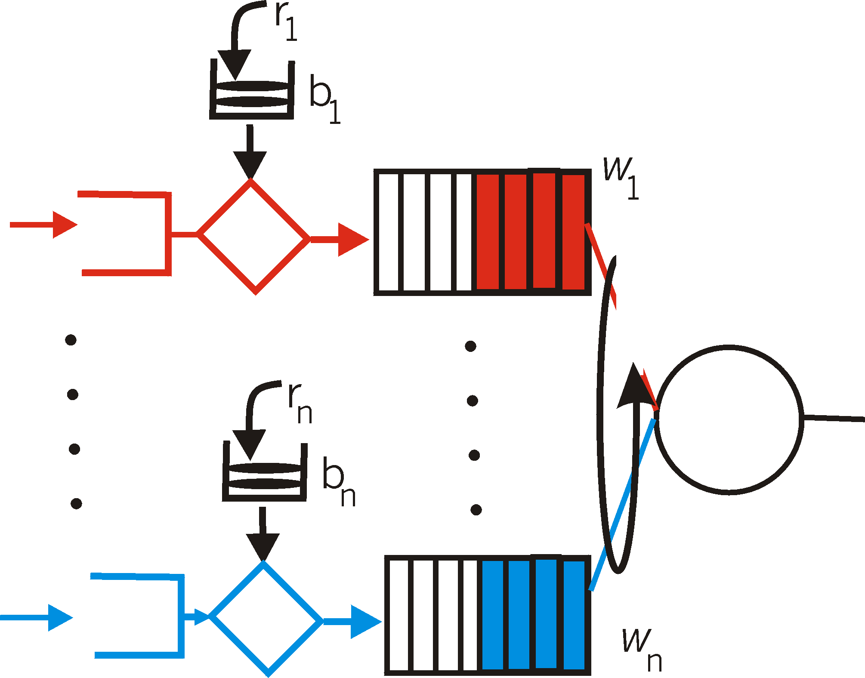
Token bucket + WFQ…
…can be combined to provide upper bound on packet delay in queue:
b_{i} packets in queue, packets are serviced at a rate of at least R · w_{i}/∑ (wj) packets per second, then the time until the last packet is transmitted is at most
b_{i} /(R · w_{i}/∑ (wj))

Slide 31
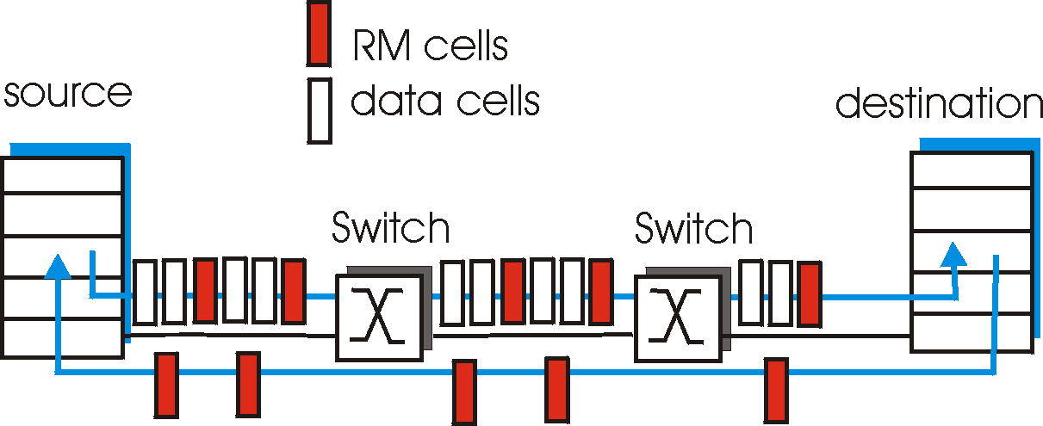
ATM ABR congestion control
ABR: available bit rate:
“elastic service”
if path “underloaded”:
  sender should use available bandwidth
if path congested:
  sender throttled to minimum guaranteed rate
RM (resource management) cells:
interspersed with data cells
bits in RM cell set by switches (“network-assisted”)
  NI bit: no increase in rate (mild congestion)
  CI bit: congestion indication two-byte ER (explicit rate) field in RM cell
  congested switch may lower ER value in cell
  sender’ send rate thus minimum supportable rate on path

Slide 32
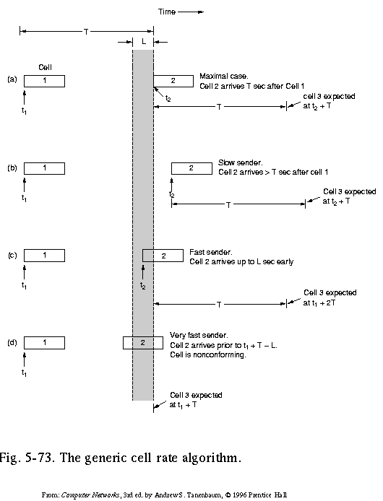
Traffic Shaping and Policing in ATM
Enforce the QoS parameters: check if Peak Cell Rate (PCR) and Cell Delay Variation (CDVT) are within the negotiated limits:
Generic Cell Rate Algo: introduce:
expected next time for a successive cell, based on T = 1/PCR
border time L ( = CDVT) < T in which next transmission may start (but never before T-L)
A nonconforming cell may be discarded, or its Cell Loss Priority bit be set, so it may be discarded in case of congestion

Slide 33
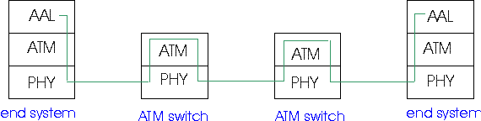
ATM Adaptation (Transport) Layer: AAL
Basic idea: cell-based VCs need to be ”complemented ”to be supportive for applications.
Several ATM Adaptation Layer (AALx) protocols defined, suitable for different classes of applications
  AAL1: for CBR (Constant Bit Rate) services, e.g. circuit emulation
  AAL2: for VBR (Variable Bit Rate) services, e.g., MPEG video
  .....
”suitability” has not been very successful
computer science community introduced AAL5, (simple, elementary protocol), to make the whole ATM stack usable as switching technology for data communication under IP!

Slide 34
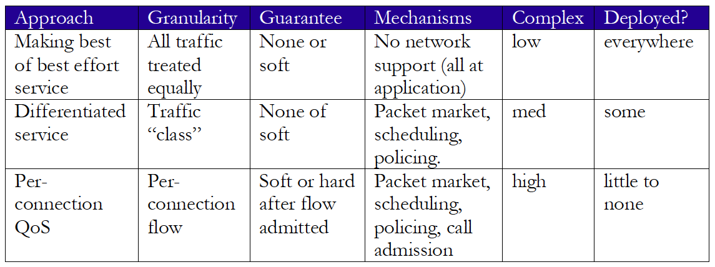
Network support for multimedia

