Slide 1
Parallel Functional Programming at Scale, at Facebook
Simon Marlow
May 2015

Slide 3
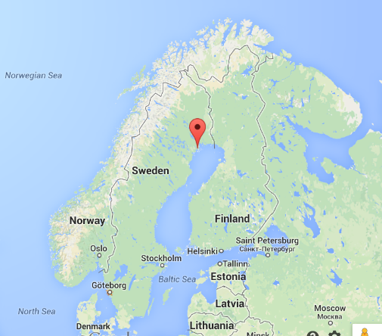

Slide 4
Headlines
Right now there are thousands of multicore machines running Haskell 24/7 at Facebook
Haskell is a key part of the anti-abuse infrastructure
Using a novel kind of implicit parallelism (the Haxl monad)
This talk
The problem
Abuse detection & remediation
Why (and how) Haskell?
Applicative do-notation
Experience: tales from the trenches

Slide 5
Abuse detection & remediation

Slide 6
The problem
There is spam and other types of abuse
Malware attacks, credential stealing
Sites that trick users into liking/sharing things or divulging passwords
Fake accounts that spam people and pages
Spammers can use automation and viral attacks
Want to catch as much as possible in a completely automated way
Squash attacks quickly and safely

Slide 7
The write pipeline

Slide 8
Yes!
Evil?

Slide 9
∑
We call this system Sigma

Slide 10
Sigma :: Content -> Bool
Sigma classifies tens of billions of actions per day
Facebook + Instagram
Sigma is a rule engine
For each action type, evaluate a set of rules
Rules can block or take other action
Manual + machine learned rules
Rules can be updated live
Highly effective at eliminating spam, malware, malicious URLs, etc. etc.

Slide 11
How do we define rules?

Slide 12
Example
Fanatics are spamming their friends with posts about Functional Programming!
Let’s fix it!

Slide 13
Example
Need info about the content
We want a rule that says
If the person is posting about Functional Programming
And they have >100 friends
And more than half of their friends like C++
Then block, else allow
Need to fetch the friend list
Need info about each friend

Slide 14
Our rule, in Haskell
fpSpammer :: Haxl Bool
fpSpammer =
Haxl is a monad
“Haxl Bool” is the type of a computation that may:
do data-fetching
consult input data
maybe throw exceptions
finally, return a Bool

Slide 15
Our rule, in Haskell
fpSpammer :: Haxl Bool
fpSpammer =
talkingAboutFP
where
talkingAboutFP =
strContains “Functional Programming” <$> postContent
postContent is part of the input (say)
postContent :: Haxl Text

Slide 16
Our rule, in Haskell
fpSpammer :: Haxl Bool
fpSpammer =
talkingAboutFP .&&
numFriends .> 100
where
talkingAboutFP =
strContains “Functional Programming” <$> postContent
(.&&) :: Haxl Bool -> Haxl Bool -> Haxl Bool
(.>) :: Ord a => Haxl a -> Haxl a -> Haxl Bool
numFriends :: Haxl Int

Slide 17
Our rule, in Haskell
fpSpammer :: Haxl Bool
fpSpammer =
talkingAboutFP .&&
numFriends .> 100 .&&
friendsLikeCPlusPlus
where
talkingAboutFP =
strContains “Functional Programming” <$> postContent
friendsLikeCPlusPlus = do
friends <- getFriends
cppFriends <- filterM likesCPlusPlus friends
return (length cppFriends >= length friends `div` 2)

Slide 18
Observations
Our language is Haskell + libraries
Embedded Domain-Specific Language (EDSL)
Users can pick up a Haskell book and learn about it
Tradeoff: not exactly the syntax we might have chosen, but we get to take advantage of existing tooling, documentation etc.
Focus on expressing functionality concisely, avoid operational details
“pure” semantics
no side effects – easy to reason about
scope for automatic optimisation

Slide 19
Efficiency
Rules are data + computation
Fetching remote data can be slow
Latency is important!
We’re on the clock: the user is waiting
So what about efficiency?

Slide 20
Fetching data efficiently is all that matters.

Slide 21
Fetch only the data you need to make a decision
Fetch data concurrently whenever possible
Let’s deal with (1) first.

Slide 22
Example
Fast
We want a rule that says
If the person is posting about Functional Programming
And they have >100 friends
And more than half of their friends like C++
Then block, else allow
Avoid slow checks if fast checks already determine the answer
Slow
Very slow

Slide 23
.&& is short-cutting
fpSpammer :: Haxl Bool
fpSpammer =
talkingAboutFP .&&
numFriends .> 100 .&&
friendsLikeCPlusPlus
where
talkingAboutFP =
strContains “Functional Programming” <$> postContent
friendsLikeCPlusPlus = do
friends <- getFriends
cppFriends <- filterM likesCPlusPlus friends
return (length cppFriends >= length friends `div` 2)
(.&& )= liftA2 (&&)
Programmer is responsible for getting the order right
(tooling helps with this)

Slide 24
Concurrency
Multiple independent data-fetch requests must be executed concurrently and/or batched
Traditional languages and frameworks make the programmer deal with this
threads, futures/promises, async, callbacks, etc.
Hard to get right
Our users don’t care
Clutters the code
Hard to refactor later

Slide 25
Haxl’s advantage
Because our language has no side effects, the framework can handle concurrency automatically
We can exploit concurrency as far as data dependencies allow
The programmer doesn’t need to think about it
getFriends
friendsLikeCPlusPlus = do
friends <- getFriends
cppFriends <- filterM likesCPlusPlus friends
...
likesCPlusPlus
likesCPlusPlus
likesCPlusPlus
likesCPlusPlus
likesCPlusPlus

Slide 26
numCommonFriends a b = do
fa <- friendsOf a
fb <- friendsOf b
return (length (intersect fa fb))
friendsOf a
friendsOf b
length (intersect ...)

Slide 27
How does Haxl work?

Slide 28
Step 1
Haxl is a Monad
The implementation of (>>=) will allow the computation to block, waiting for data.
This is the result of a computation
Done indicates that we have finished
Blocked indicates that the computation requires this data.
data Result a
= Done a
| Blocked (Seq BlockedRequest) (Haxl a)
newtype Haxl a = Haxl { unHaxl :: IO (Result a) }
Haxl may need to do IO

Slide 29
Monad instance
instance Monad Haxl where
return a = Haxl $ return (Done a)
Haxl m >>= k = Haxl $ do
r <- m
case r of
Done a -> unHaxl (k a)
Blocked br c -> return (Blocked br (c >>= k))
If m blocks with continuation c, the continuation for m >>= k is c >>= k

Slide 30
So far we can only block on one data-fetch
Our example will block on the first friendsOf request:
How do we allow the Monad to collect multiple data-fetches, so we can execute them concurrently?
numCommonFriends a b = do
fa <- friendsOf a
fb <- friendsOf b
return (length (intersect fa fb))
blocks here

Slide 31
First, rewrite to use Applicative operators
Applicative is a weaker version of Monad
When we use Applicative, Haxl can collect multiple data fetches and execute them concurrently.
numCommonFriends a b =
length <$> (intersect <$> friendsOf a <*> friendsOf b)
class Applicative f where
pure :: a -> f a
(<*>) :: f (a -> b) -> f a -> f b
class Monad m where
return :: a -> m a
(>>=) :: m a -> (a -> m b) -> m b

Slide 32
Applicative instance
<*> allows both arguments to block waiting for data
<*> can be nested, letting us collect an arbitrary number of data fetches to execute concurrently
instance Applicative Haxl where
pure = return
Haxl f <*> Haxl x = Haxl $ do
f' <- f
x' <- x
case (f',x') of
(Done g, Done y ) -> return (Done (g y))
(Done g, Blocked br c ) -> return (Blocked br (g <$> c))
(Blocked br c, Done y ) -> return (Blocked br (c <*> return y))
(Blocked br1 c, Blocked br2 d) -> return (Blocked (br1 <> br2) (c <*> d))
Notes:
Unlike in monadic bind, the applicative operator can evaluate both of its arguments.
The result of the whole expression depends on whether the left or right arguments were blocked
If both are Done, then the result is Done.
If the right or the left are Blocked, then the whole computation is Blocked, and we construct the continuation appropriately.
If *both* the left and right are Blocked then the computation is Blocked, and we combine the sets of blocked requests from both sides.
This final case is how a computation can be blocked on multiple things: when both branches of <*> are Blocked, then the computation is blocked on multiple data-fetches.
This is the key idea in our approach, so I want to emphasize it: Applicative gives us the ability to explore multiple branches of a computation. So by using Applicative rather than Monad to structure our code, we can explore more of the computation to find blocked requests and hence perform them concurrently.

Slide 33
Putting it together
Here is where the actual concurrency and/or batching happens
Given
We can run a Haxl computation
fetch :: [BlockedRequest] -> IO ()
runHaxl :: Haxl a -> IO a
runHaxl (Haxl h) = do
r <- h
case r of
Done a -> return a
Blocked br cont -> do
fetch (toList br)
runHaxl cont

Slide 34
Example
(intersect <$> friendsOf x) <*> friendsOf y
=
(friendsOf x >>= return . intersect) <*> friendsOf y
=
(Blocked [FriendsOf x] (get (FriendsOf x)) >>= return . intersect)
<*> friendsOf y
=
(Blocked [FriendsOf x] (get (FriendsOf x) >>= return . intersect))
<*> friendsOf y
=
(Blocked [FriendsOf x] (get (FriendsOf x) >>= return . intersect))
<*> Blocked [FriendsOf y] (get (FriendsOf y))
=
Blocked [FriendsOf x, FriendsOf y]
((get (FriendsOf x) >>= return . intersect) <*> get (FriendsOf y))
(<$>) = fmap
fmap f m = m >>= return . f
friendsOf :: UserId -> Haxl [UserId]
friendsOf x =
Haxl (return (Blocked [FriendsOf x] (get (FriendsOf x))

Slide 35
<*>
<*>
Round 1
>>=
>>=
<*>
Round 2

Slide 36
(Some) Concurrency for free
Applicative is a standard class in Haskell
Lots of library functions are already defined using it
These work concurrently when used with Haxl
e.g.
sequence :: Monad m => [m a] -> m [a]
mapM :: Monad m => (a -> b) -> m [a] -> m [b]
filterM :: Monad m => (a -> m Bool) -> [a] -> m [a]
friendsLikeCPlusPlus = do
friends <- getFriends
cppFriends <- filterM likesCPlusPlus friends
...

Slide 37
Haxl is a general solution
... to the problem of scheduling I/O
it’s useful anywhere that needs to do I/O and doesn’t want to express concurrency explicitly.
Other examples:
a blog engine
a build system

Slide 38
Is this implicit parallelism?

Slide 39
Granularity
Tradeoff between granularity and parallelism
Lots of fine-grained parallelism, but difficult to exploit
hard to distinguish between fine and coarse automatically
So we’re usually happy with either
simple annotations
automatic parallelism over restricted domains (vectorisation)
explicit dataflow (par Monad)

Slide 40
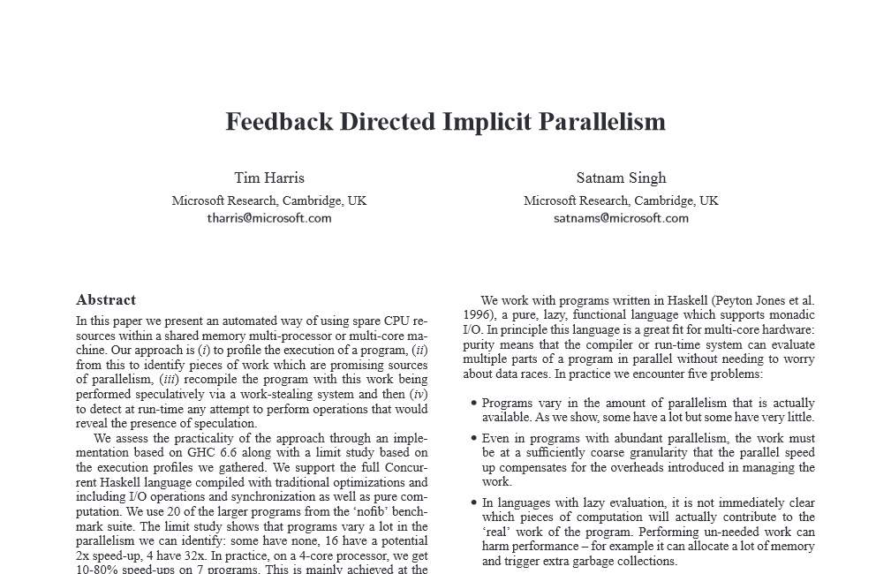

Slide 41
Remote data-fetching changes the equation
Parallelism between data-fetches is all exploitable, because it’s coarse-grained
So we can make it as implicit as we like
(we have to wave hands slightly about data-fetching not being strictly pure)

Slide 42
How implicit is Haxl?
We had to use <*> to get parallelism:
When we use >>= (or the “do” syntactic sugar) we get sequential execution
blog :: Haxl Html
blog = renderPage <$> leftPane <*> mainPane
getAllPostsInfo :: Haxl [PostInfo]
getAllPostsInfo = do
ids <- getPostIds
mapM getPostInfo ids

Slide 43
Haxl is semi-implicit
You can control parallelism using Applicative vs. Monad constructs
However, these are part of the computational fabric
we normally use Applicative and Monad interchangeably when both are available
For Haxl we want Applicative to be used “when possible”
e.g. mapM (= traverse), filterM, etc.
Defaulting things to Applicative when possible is a kind of implicit parallelism.
There’s a ubiquitous way we can do this...

Slide 44
Back to our earlier example
These behave the same:
Data dependencies tell us we can translate one into the other
numCommonFriends a b = do
fa <- friendsOf a
fb <- friendsOf b
return (length (intersect fa fb))
This is the version we want to write
numCommonFriends a b =
length <$> (intersect <$> friendsOf a <*> friendsOf b)
This is the version we want to run

Slide 45
Translating do-syntax to Applicative
numCommonFriends = do
fx <- friendsOf x
fy <- friendsOf y
return (length (intersect fx fy))
automatically
numCommonFriends =
length <$> (intersect <$> friendsOf x <*> friendsOf y)

Slide 46
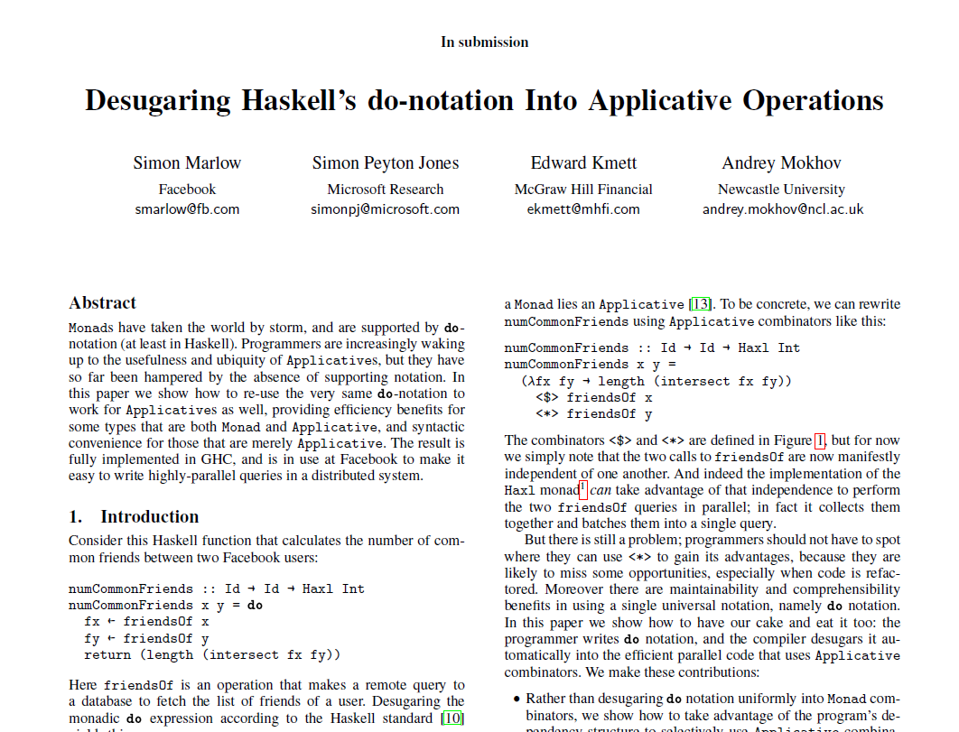

Slide 47
Why is this useful?
We don’t have to represent parallelism explicitly with <*>
Just write a sequence of statements
Compiler analyses the dependencies and extracts the maximum parallelism by transforming the sequence using <*> where possible
We don’t have to think about dependencies
We cannot miss any opportunities accidentally

Slide 48
Start with a simple example
do x1 <- A
x2 <- B
return (x1,x2)
Standard Haskell desugaring
ApplicativeDo
A >>= \x1 ->
B >>= \x2 ->
return (x1,x2)
equivalent
(,) <$> A <*> B
f <$> ma = ma >>= \a ->
return (f a)
mf <*> ma = mf >>= \f ->
ma >>= \a ->
return (f a)

Slide 49
Dependencies prevent <*>
do x1 <- A
x2 <- B[x1]
return (x1,x2)
Now we cannot use <*>, because B depends on x1
This is the essence of the difference between Applicative and Monad:
So we want to use Applicative when possible but Monad when necessary.
(<*>) :: Applicative f => f (a -> b) -> f a -> f b
(>>=) :: Monad f => f a -> (a -> f b) -> f b

Slide 50
Mixing it up
What about
do x1 <- A
x2 <- B
x3 <- C[x1]
x4 <- D[x2]
return (x3,x4)
A
B
C
D

Slide 51
do x1 <- A
x2 <- B
x3 <- C[x1]
x4 <- D[x2]
return (x3,x4)
ApplicativeDo
((,) <$> A <*> B) >>= \(x1,x2) ->
(,) <$> C[x1] <*> D[x2]

Slide 52
But is that the best translation?
But we only have dependencies A->C and B->D, so why not
A
C
(,)
result
(A | B) ; (C | D)
B
D
A
C
result
(A ; C) | (B ; D)
B
D

Slide 53
Evaluating cost
Take a simple parallel cost model
“|” = “max”
“;” = “+”
e.g. take A = 2, B = 1, C = 1, D = 2
(A | B) ; (C | D) cost: 4
(A ; C) | (B ; D) cost: 3

Slide 54
Alternative translations
(A | B) ; (C | D)
((,) <$> A <*> B) >>= \(x1,x2) ->
(,) <$> C[x1] <*> D[x2]
(A ; C) | (B ; D)
(,) <$> (A >>= \x1 -> C[x1])
<*> (B >>= \x2 -> D[x2])

Slide 55
But...
do x1 <- A
x2 <- B
x3 <- C[x1]
x4 <- D[x2]
return (x3,x4)
NO!
(,) <$> (A >>= \x1 -> C[x1])
<*> (B >>= \x2 -> D[x2])
This is not semantically equivalent to the original
Effects would take place in the order A,C,B,D

Slide 56
But do we really care about ordering?
Haxl doesn’t – or at least, there are no effects to observe
But we do want exceptions to be deterministic:
If B and C throw exceptions, I always want B’s exception.
Reordering to A,C,B,D would break this.
do x1 <- A
x2 <- B
x3 <- C[x1]
x4 <- D[x2]
return (x3,x4)

Slide 57
Preserving equivalence is good
It means ApplicativeDo works with any Monad/Applicative that satisfies the laws.
If we reordered things, it would only work on commutative Monads.

Slide 58
What does optimal mean?
Choices:
do x <- A
y <- B
z <- C[x]
return (y + z)
A
B
C
 | A=0, B=2, C=1 | A=1, B=2, C=0
(A | B) ; C A ; (B | C) | 3 2 | 2 3

Slide 59
We don’t know the costs at compile time.
Therefore, be conservative.
Our goal:
(there may be multiple valid solutions)
Choose a translation that is optimal when all statements have equal cost.

Slide 60
Refinement: use “join”
do x1 <- A
x2 <- B
x3 <- C[x1]
x4 <- D[x2]
return (x3,x4)
Better:
ApplicativeDo
((,) <$> A <*> B) >>= \(x1,x2) ->
(,) <$> C[x1] <*> D[x2]
join :: Monad m => m (m a) -> m a
join m = m >>= id
join ((\x1 x2 -> (,) C[x1] <*> D[x2]) <$> A <*> B)

Slide 61
Algorithm sketch
Two stages:
do x1 <- A
x2 <- B[x1]
x3 <- C
return (x2,x3)
rearrangement
{ x1 <- A; x2 <- B[x1] } | { x3 <- C }
desugaring
(\x2 x3 -> (x2,x3))
<$> (A >>= \x1 -> B[x1])
<*> C

Slide 62
Rearrangement
Start with a list of statements
Introduce “parallel blocks”
Meaning: just flatten the list
A parallel block will turn into an applicative expression
l = { s₁ ; ... ; s_{n} }
s = ( l₁ | ... | l_{n} )
do x1 <- A
x2 <- B[x1]
x3 <- C
return (x2,x3)
rearrangement
{ x1 <- A; x2 <- B[x1] } | { x3 <- C }

Slide 63
Where do we introduce parallel blocks?
Take the sequence without the final return
(desugaring will put it back later)
Split the sequence into segments
Place a segment boundary between two statements when there are no dependencies that cross the boundary
Make a parallel block from the segments; apply recursively
do x1 <- A
x2 <- B[x1]
x3 <- C
return (x2,x3)
do x1 <- A
x2 <- B[x1]
x3 <- C
return (x2,x3)
rearrange { x1 <- A; x2 <- B[x1] }
| rearrange { x3 <- C }

Slide 64
What if there are no segments?
If it’s a single statement: we’re done
Otherwise we need a “;” somewhere
In this case we have no choice:
(we’ll do a more complex example shortly)
Result of rearrangement:
rearrange { x3 <- C }
= { x3 <- C }
rearrange { x1 <- A; x2 <- B[x1] }
= { x1 <- A; x2 <- B[x1] }
{ x1 <- A; x2 <- B[x1] } | { x3 <- C }

Slide 65
Next, desugar to get an expression
desugaring a parallel block yields an Applicative expression:
desugar ({ x1 <- A; x2 <- B[x1] } | { x3 <- C }) (x2,x3)
The expression from “return”
(\x2 x3 -> (x2,x3))
<$> desugar { x1 <- A; x2 <- B[x1] } x2
<*> desugar { x3 <- C } x3

Slide 66
(\x2 x3 -> (x2,x3))
<$> desugar { x1 <- A; x2 <- B[x1] } x2
<*> desugar { x3 <- C } x3
First, deal with this:
Next:
desugar { x3 <- C } x3
=
C
desugar { x1 <- A; x2 <- B[x1] } x2
=
A >>= \x1 -> desugar { x2 <- B[x1] } x2
=
A >>= \x1 -> B[x1]

Slide 67
Result
do x1 <- A
x2 <- B[x1]
x3 <- C
return (x2,x3)
(\x2 x3 -> (x2,x3))
<$> (A >>= \x1 -> B[x1])
<*> C

Slide 68
A more complex example
Rearrange:
There are no segments
We have to insert “;” somewhere
And end up with the optimal result
x1 <- A
x2 <- B[x1]
x3 <- C
x4 <- D[x3]
x5 <- E[x1,x4]
return (x2,x4,x5)

Slide 69
Finding the optimal result
Just evaluate all possibilities:
Starting with
For each i in 2..n, compute
Evaluate with parallel cost model, with “|” = “max” and “;” = “+”
Every statement costs 1
Pick the cheapest!
{ s₁ ; ... ; s_{n} }
rearrange { s₁ ; ... ; s_{i-1} } ; rearrange { s_{i} ; ... ; s_{n} }

Slide 70
x1 <- A
x2 <- B[x1]
x3 <- C
x4 <- D[x3]
x5 <- E[x1,x4]
return (x2,x4,x5)
A ; (B|{C;D;E}) (cost 4)

Slide 71
x1 <- A
x2 <- B[x1]
x3 <- C
x4 <- D[x3]
x5 <- E[x1,x4]
return (x2,x4,x5)
A;B ; C;D;E (cost 5)

Slide 72
x1 <- A
x2 <- B[x1]
x3 <- C
x4 <- D[x3]
x5 <- E[x1,x4]
return (x2,x4,x5)
({A;B}|C) ; D;E (cost 4)

Slide 73
x1 <- A
x2 <- B[x1]
x3 <- C
x4 <- D[x3]
x5 <- E[x1,x4]
return (x2,x4,x5)
({A;B}|{C;D}) ; E (cost 3)
We have a winner!

Slide 74
After desugaring:
join (\(x1,x2) x4 ->
E[x1,x4] >>= \x5 -> pure (x2,x4,x5))
<$> (A >>= \x1 -> B[x1] >>= \x2 -> return (x1,x2))
<*> (C >>= \x3 -> D[x3])

Slide 75
Exhaustive search is O(n³)
The “segments” part of the algorithm cuts down the search space
(in the paper we have a proof that it doesn’t affect optimality)
There are other tricks to cut down the search space
... but in practice we use a heuristic instead of the full O(n³) search
heuristic is worse in 1.4% of cases
Full details in the paper, “Translating Haskell’s do-notation into Applicative operations” (under submission)

Slide 76
Results
This transform is being used across our codebase at Facebook
Users typically don’t worry about concurrency
There are a few pitfalls:
explicit use of >>=
“shortcut” functions that take Haxl computations as arguments can break things
we want all the Haxl computations visible in the same do-block

Slide 77
Haxl project: experience

Slide 78
The Haxl project
We had an existing system and home-grown DSL, called FXL, and lots of code written in it
Started April 2013
By July 2015 we had deleted all the FXL code and replaced it with Haskell, and trained our engineers to use Haskell.

Slide 79
1. Existing source code
hundreds of thousands of lines of existing FXL code
Impractical and error-prone to translate code by hand
Wrote a tool to do the migration
Source code still FXL (during the migration), run the tool each time the code changes.
FXL Code
Haskell Code
Automatic translation

Slide 80
2. Migrating running code to Haskell

Slide 81
2. Migrating running code to Haskell
hundreds of different requests (one for each write action)
had to ensure that each one:
performed well enough
gave exactly the same answers
(otherwise we introduce false positives/negatives)
As each request type is ready, we want to switch it over to running on Haskell in production

Slide 82
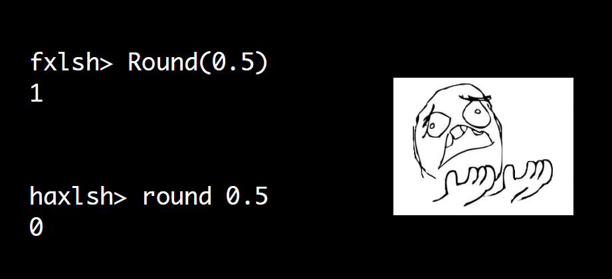

Slide 83
At scale, the edge cases happen all the time
Invalid Unicode
Invalid arguments to primitives & library functions
Exception behaviour, values of exceptions
Is “NaN” a valid number in JSON? What about “infinity”?
Floating-point:
round 0.5
printing floating-point values
divide-by-zero throws in FXL
semantics of \s in regex with Unicode
etc. etc.

Slide 84
3. Migrating the users
Dozens of FXL users in multiple geographical locations
Wrote a lot of teaching material
Ran multi-day hands-on workshops
Created internal Facebook group for questions (“Haxl Therapy”)
Haxl team helped with code reviews

Slide 85
How did users cope with the switch?
Still committing happily
Some struggles with do-notation vs. fmap, <$>, =<<
“How do I convert a Haxl t to t?”
Users started embracing the new features
Started building abstractions, adding types, creating tests
Unblocks some large-scale rewrites and redesigns of subsystems

Slide 86
Does it work?

Slide 87
Is it stable enough?
Is performance good enough?
Did we have to hack the compiler?
What about build systems, packages, cabal hell, etc. etc.
How do we do live updates?

Slide 88
Thrift
Thrift
Sigma (C++)
Sigma (C++)
Execution layer (Haskell)
FXL Engine (C++)
Client Code (Haskell)
Client Code (FXL)
Haxl framework, libraries (Haskell)
Haxl Data Sources (Haskell/C++)
Data Sources (C++)
Data Sources (C++)

Slide 89
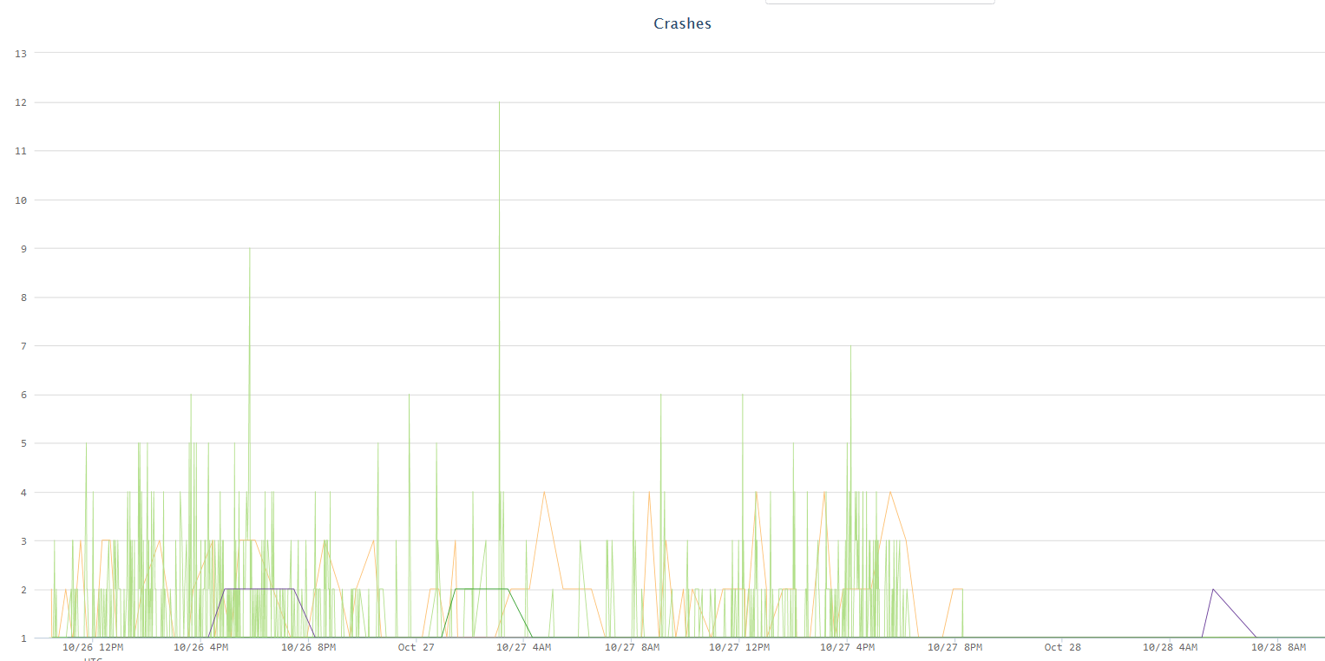
Found one bug in the GHC garbage collector
There was a multi-year-old bug in the GC that caused our machines to crash every few hours under constant load.
This is the only runtime bug we’ve found
(we found one more that only affected shutdown)
Rolled out new release with GC fix

Slide 90
Stability
The Haskell code just doesn’t crash. (*)
which is good, because diagnosing a crash in Haskell is Very Hard
(*) except for FFI code
One FFI-related memory bug was particularly hard to find

Slide 91
Performance

Slide 92
Performance
Overall: 30% better throughput for typical workload

Slide 93
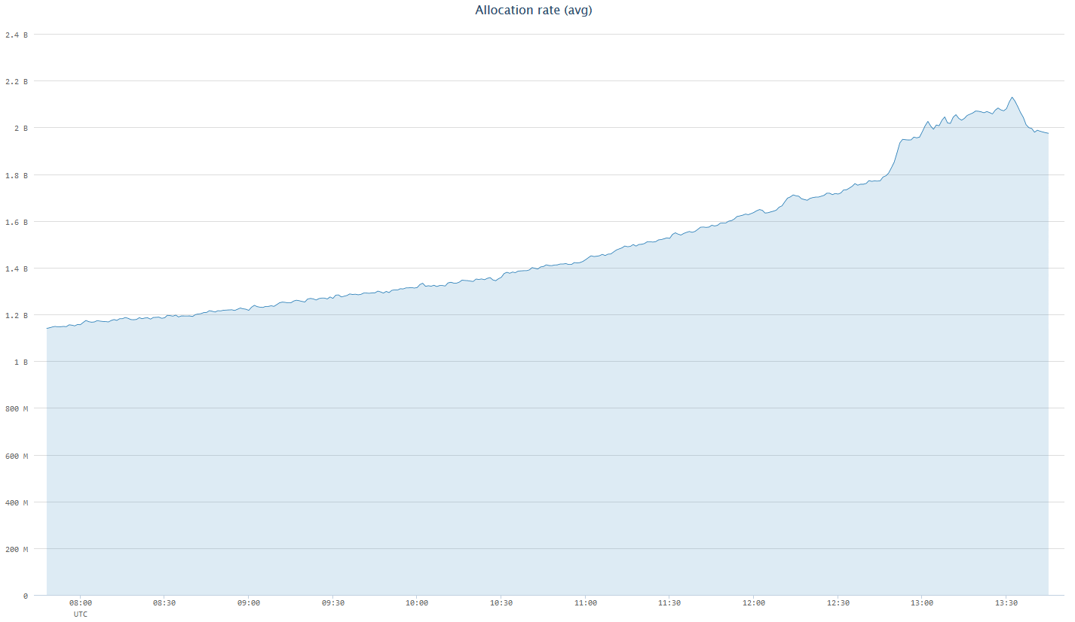
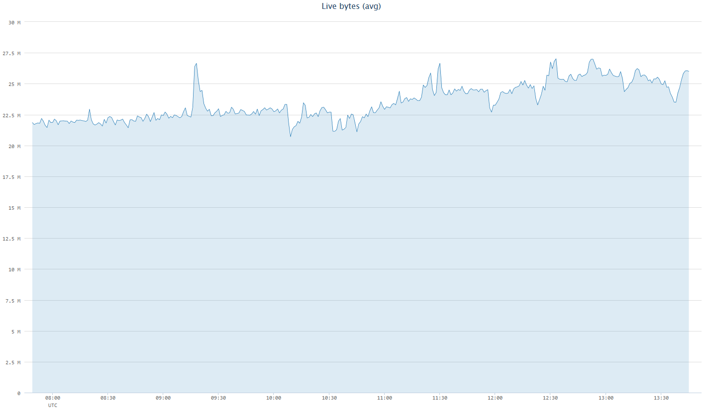
Good monitoring is essential
Noisy environment:
multiple sources of changes
dependencies on other services
traffic isn’t constant
spam/malware attacks are bursty
Hooked up GHC’s garbage collector stats API to Facebook’s monitoring infrastructure

Slide 94
Resource limits
Server resources are finite, and we have latency bounds
Our job is to keep the system responsive, so we cannot allow individual requests to hog resources
Fact of life: individual requests will sometimes hog resources if allowed to
Usually: doing some innocuous operation on untypically large data
e.g. regex engines sometimes go out to lunch

Slide 95
Allocation limits
So we implemented allocation limits in GHC
Counter is per-thread, ticks down with memory allocation
Triggers an exception when the counter reaches zero
Easy in Haskell, very difficult in C++
setAllocationCounter :: Int64 -> IO ()
getAllocationCounter :: IO Int64
enableAllocationLimit :: IO ()
disableAllocationLimit :: IO ()

Slide 96
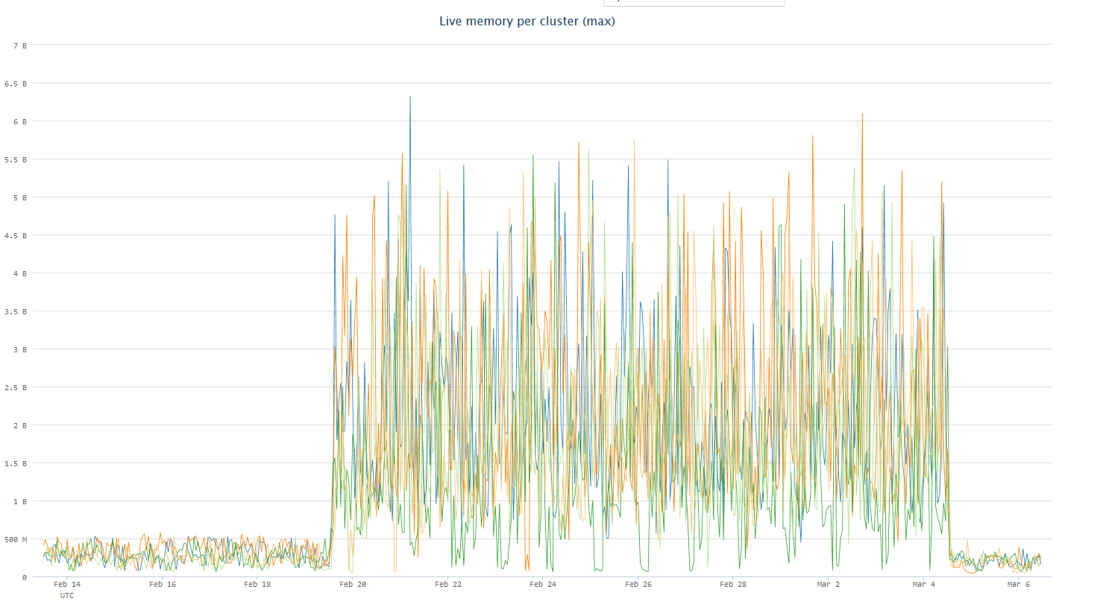
How important are allocation limits?
one heavyweight request was enabled
allocation limits enabled

Slide 97
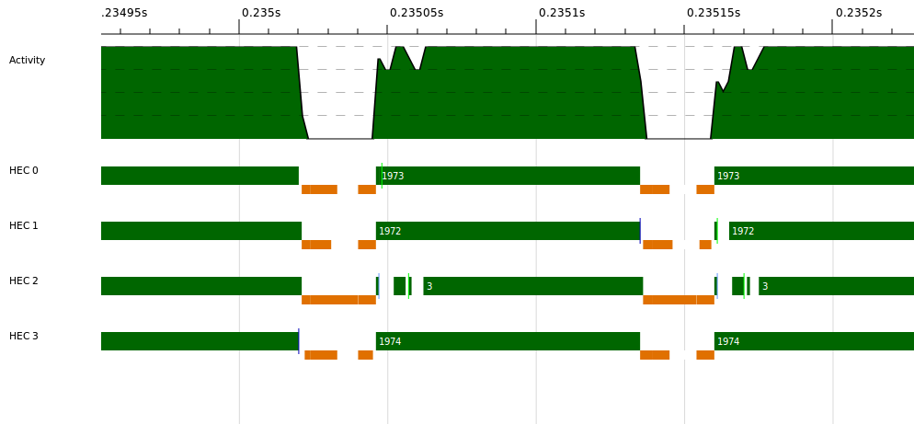
GC vs. latency
GHC has a stop-the-world parallel collector
obviously to meet our latency goals we cannot GC for too long

Slide 98
GC vs. latency
So how do we manage this?
Fixed number of worker threads + allocation limits
effectively puts a bound on the amount of work we are doing at any given time
Very little persistent state (a few MB).
A handful of GC improvements, all upstreamed

Slide 99
Hot-swapping code

Slide 100
Fast deployment
The faster we can get new rules into production, the more spam we catch before people see it, the faster we stop viral malware, etc.
(Not all changes need immediate deployment: code review is the norm)
“Code in the repo is what is running in production”
Deployment typically on the order of a few minutes

Slide 101
How can we deploy new code?
Haskell has an optimising compiler, runs native code
Haskell code needs to be compiled and distributed to servers
Servers need to start running the new code somehow

Slide 102
Restarting the process doesn’t work
Takes a while to start up
Caches would be cold
A rolling restart would take too long

Slide 103
Live updates
Sigma (C++)
Execution layer (Haskell)
Client Code (Haskell)
New Client Code (Haskell)
Haxl framework, libraries (Haskell)
Haxl Data Sources (Haskell/C++)
Data Sources (C++)

Slide 104
Live Updates
Main idea
load the new code directly into the running process
needs a dynamic linker
Start taking requests using the new code
When all requests running on the old code have finished, remove it from the process
GHC’s runtime has a built-in linker
We added support for unloading objects with GC integration

Slide 105
Questions?
The Haxl Team, past and present
Jonathan Coens Bartosz Nitka Aaron Roth Kubo Kováč Katie Ots Jon Purdy | Zejun Wu Jake Lengyel Andrew Farmer Louis Brandy Noam Zilberstein Simon Marlow

