Slide 1
Skeletons for
Parallel Scientific Computing
David Duke
Computational Science and Engineering Group
School of Computing
University of Leeds, UK

Slide 2
The purpose of computing
is insight, not numbers.
R. Hamming, Numerical Methods for Scientists and Engineers, 1962.

Slide 3
Outline
Background
  Computational science & visualization
  Topological analysis
  Running case study: the Joint Contour Net (JCN) and its implementation
Sequential implementation
Skeletons
Shared-memory parallelism in the Par Monad
Distributed parallelism
  Eden
  Distributed skeletons
  Performance
  Distributed data representation
Insight and conclusions
  Strengths and weaknesses of skeletons
  Challenges and opportunities in functional HPC

Slide 4

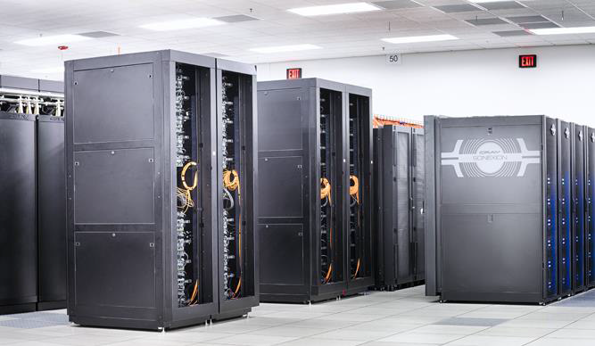
Computational science
Simulation/Sensors ➾ {dataset} ➾ Visualization/Analysis
Characteristics
  volumetric (3D) time-varying data, or hyper-volumes
  multifields: f :: M ⊂ R⁴⁺ → R^{n}
Example problems:
  nuclear scission [LBL/FHPC14]: 66×40×40, 2 fields [× 40]
  star formation [ICFP’08]: 250×250×600, 13 fields [× 200]
  hurricane Isabel simulation: 500×500×100, 13 fields [× 48]
  combustion: Landge et.al., SC14: - 2025×1600×400 [× ?]
  high-dimensional spaces: Gerber et.al. 700K samples in 10D
  HIV capsid: Zhao et.al. (UIUC) - 64M atoms
  ...
Challenge - scale
Zhao et.al., Nature, 497, 2013
NCSA Blue Waters
Cray XE/XK
10 Petaflops, 300K cores, $200M

Slide 5
Scientific datasets
What is a scientific dataset?
  (discrete) set of samples ...
    scalar data - pressure, temperature
    vector data - velocity, curl
    tensor data - diffusion
  .. at points in some continuous space
    3D
    3D + time
    higher dimensions - e.g. in optimization
Sample points may be
  organised on a regular grid
  irregularly spaced
But we also need to interpolate
  so we divide the dataset into topological cells
  simplicial (triangles/tets) -> barycentric interpolant
  square/rectangular -> bi/trilinear interpolant
  other subdivisions and interpolants used
a
c
interpolated
point
Fp= f(Fa,Fb,Fc)
b
triangular
(simplicial)
cell
rectangular
cell
sample point
position
field values

Slide 6
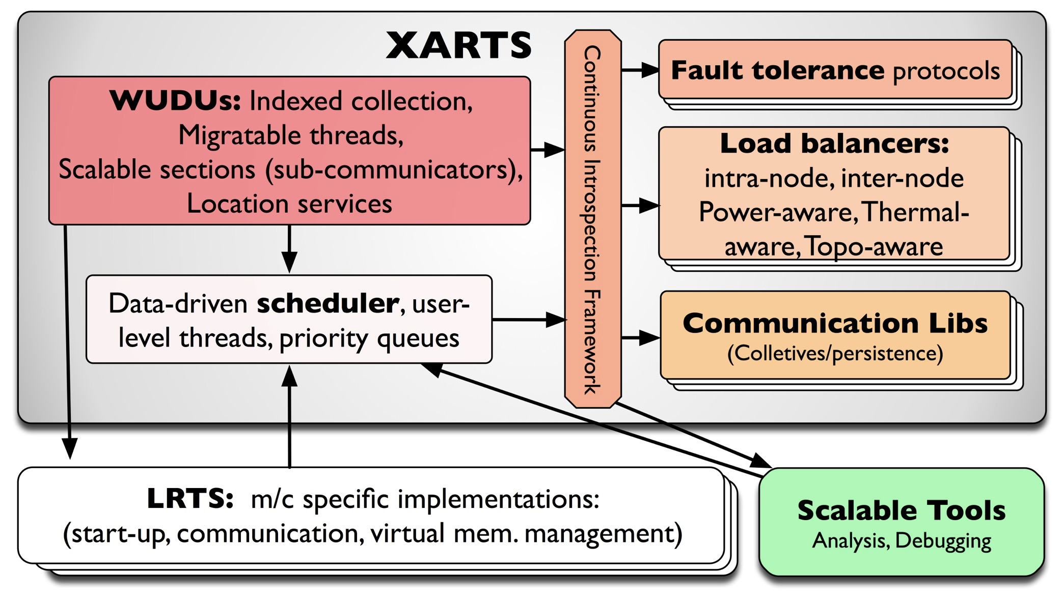
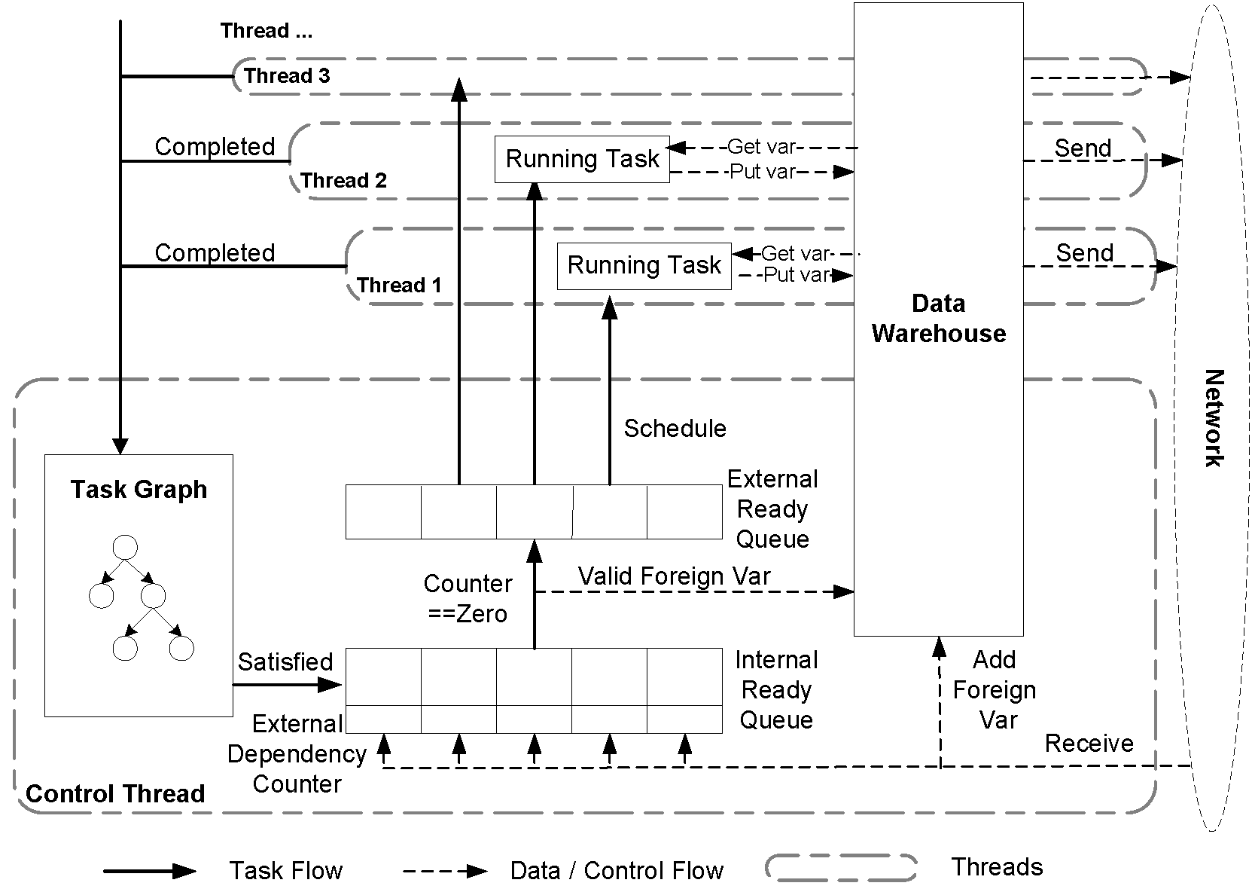
Implementation
Parallel Run-Time Systems
  processor virtualisation
  migratable work and data
  asynchrony, reflection
  fault tolerance
Domain-Specific Languages
Example of platforms
  Uintah (SCI - Utah)
  Charm++ (UIUC)
  VTK (Kitware - visualization)
Imperative technologies
Imperative thinking
Getting Ready for Adaptive RTSs, Laxmikant Kale, Salesian conference on High-speed Computing, LANL, 2014.
The Uintah Framework: A Unified Heterogeneous
Task Scheduling and Runtime System: Meng, Humphry, Berzins, Proc. Supercomputing, 2012

Slide 7
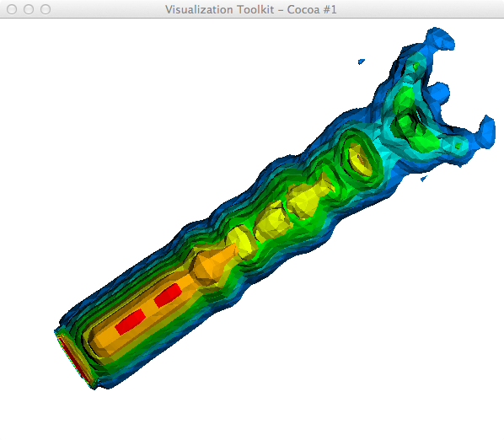
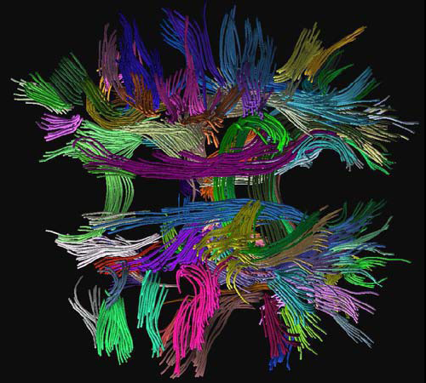
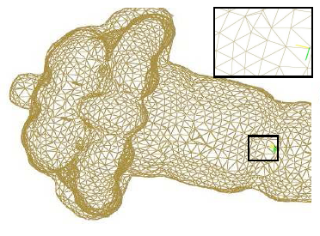
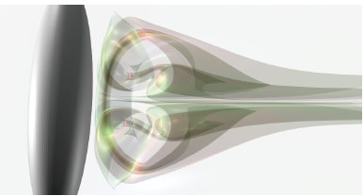
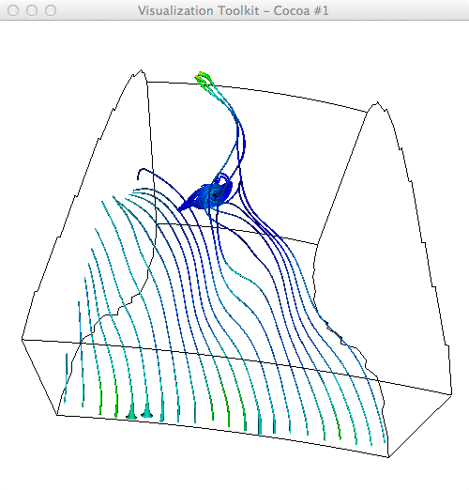
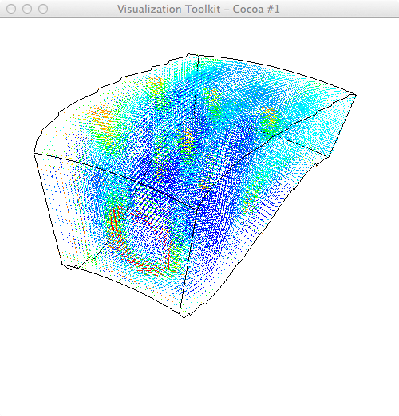
Visualization Examples
DTI Fiber Clustering in the Whole Brain, S. Zhang & D. Laidlaw, Proc. IEEE Visualization 2004.
Topologically Accurate Dual Isosurfacing Using Ray Intersection: Jaya Sreevalsan-Nair, Lars Linsen, and Bernd Hamann
Generation of Accurate Integral Surfaces in Time-Dependent Vector Fields, C. Garth, H. Krishnan, X. Tricoche, T. Bobach, and K.I. Joy

Slide 8

Challenges
Data scale:
  10¹² bytes (tera-scale), 10¹⁵ (peta-scale), 10¹⁸ (exa-scale)
  “discovery science”
  push for ever-greater spatial and temporal resolution
Visualization limits:
  10⁷ retinal cells,
  1 byte/cell (RGB), 300MB/s raw b/with
  perception: effective bandwidth 10-100KB/s
  display: 4×10⁶ pixels on a good single-screen display
Geometric & topological analysis
  identify features
  guide/accelerate visualization
  quantitative summary
  multifields
How long to eyeball
1 GB?
1 TB?
1 EB?
2.7 hrs
112 days
317000 years

Slide 9
One answer: abstraction
What if we have too many raw numbers?
  (0,0) (0,9) (1,8) (1,1) (2,2) (2,7) (3,0)
  (3,3) (3,6) (3,9) (4,1) (4,4) (4,5) (4,8)
  (5,2) (5,7) (6,3) (6,6) (7,4) (7,5) (8,4)
  (9,3) (9,6) (10,2) (10,6) (11,1) (11,3)
  (11,6) (12,0) (12,3) (12,6) (13,3) (13,6)
Need visual summaries!
Simple example: histograms
  quantise value range into set of discrete buckets
  visualize the buckets
As always, choice of visualization is critical

Slide 10
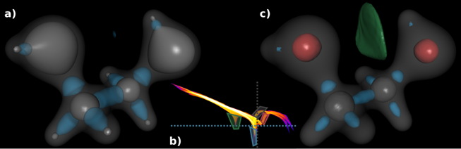
Continuous scatterplots
Scientific data are discrete samples of a continuous field
Discrete scatterplots miss important detail: the "bits between the samples"!
Useful! But the result is an image, not an abstraction.
Carr, Geng, Tierny, Chattopadhyay & Knoll, Fiber Surfaces: Generalizing Isosurfaces to Bivariate Data, Eurovis, 2015.
Bachthaler & Weiskopf, Continuous Scatterplots, IEEE TVCG 14(6), 2008

Slide 11
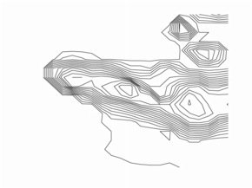
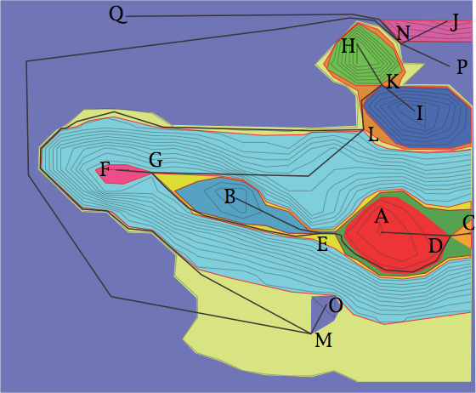
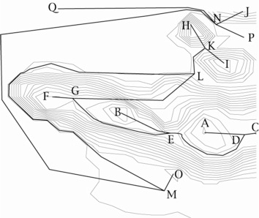
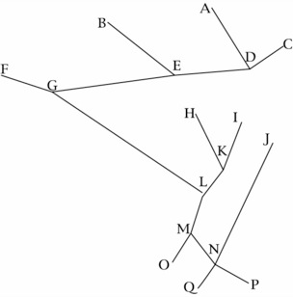
Introducing scalar topology
Rubber-sheet geometry
Captures properties unchanged under
  continuous deformation
  affine transformation
contour
nesting
contours
with paths
contour
tree
Example courtesy of Hamish Carr

Slide 12
More formally ...
Assumptions
  scalar field f : M ⊂ R^{m} ➝ R
  samples at discrete points in bounded domain
  subdivided into discrete [simplicial] cells
Vocabulary for “interesting things” in space
  local / global minima & maxima
  saddles
Segment domain into regions of equivalence
Reeb graph (contour tree):
  regions inside and outside a contour
  contour connectivity
  captures nesting of contours
Morse-Smale complex:
  watershed and inverse watershed
  regions of equivalent gradient / flow
  captures “diamond” boundary of regions
9
8
7
1
8
4
5
2
5
3
3
6
9
1
8
7
1
8
1
4
5
2
5
3
9
3
6
9
minima
maxima
saddle

Slide 13
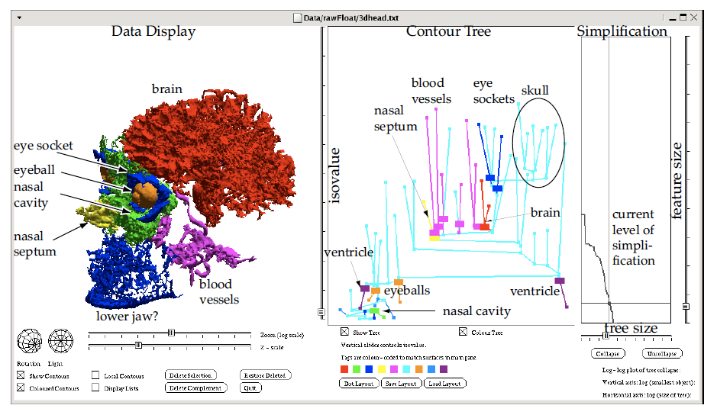
Practical examples
Raleigh-Taylor instability, 1152 x 1152 x 1000
Carr, Snoeyink, & van de Panne, Flexible isosurfaces: Simplifying and displaying scalar topology using the contour tree, Computational Geometry, 2010.
Gyulassy, Bremer, Hamann, Pascucci, A Practical Approach to Morse-Smale Complex Computation: Scalability and Generality, IEEE TVCG 14(6), 2008
Schneider, Wiebel, Carr, Hlawitschka, and Scheuermann, Interactive Comparison of Scalar Fields Based on Largest Contours with Applications to Flow Visualization, IEEE TVCG, 14(6), 2008.
L2 isosurface from CFD simulation of a Francis turbine.

Slide 14
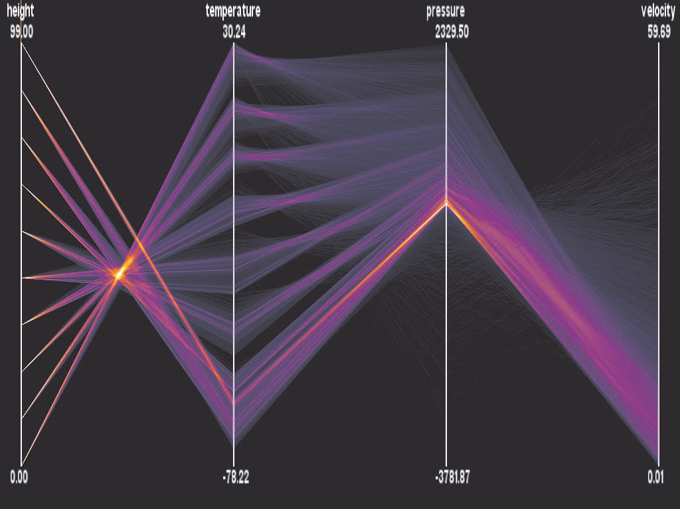
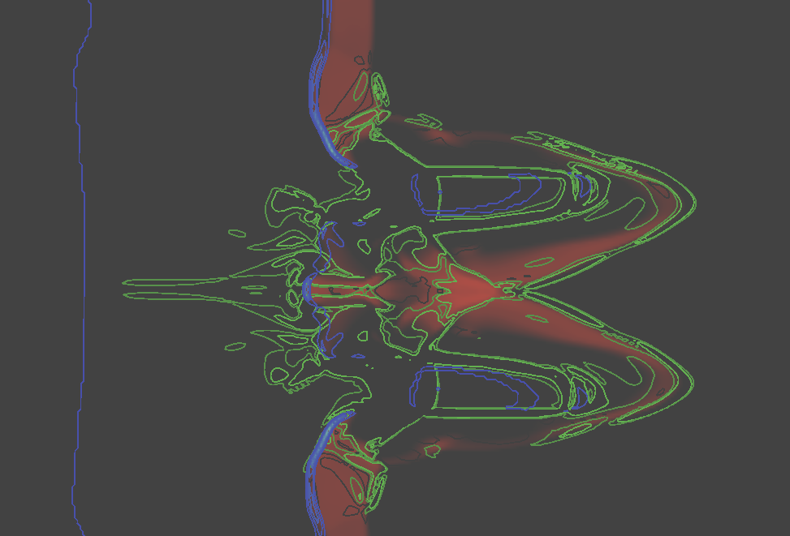
Challenge: multifield visualisation
Understand interaction between properties
  Routine in information visualization
  Tufte: “Graphical excellence is nearly always multivariate”
For scientific datasets:
  Harder! Data pinned to points in physical space/time
  Ad-hoc methods: overlay; probing; scatterplot matrices

Slide 15
Multifield topology: Joint Contour Net
Generalisation of the Contour Tree / Reeb Graph
  family of scalar fields f : M ⊂ R^{m} ➝ R^{n}
Segment domain into regions
… based on combinations of field value.
JCN
  nodes = equivalence classes in range (intervals)
  edges = adjacency
  reduces to Reeb graph
  (Contour tree) for n=1.
No simple concept of
minimum / maximum /
saddle.
Any dimension domain.
8/7
7/8
1/9
[6-9) / [6-9)
[1-6) / [6-9)
[6-9) / [4-6)
4/4
5/5
2/6
[1-6) / [4-6)
[6-9) / [4-6)
[1-6) / [1-4)
3/1
6/2
9/3
[6-9) / [1-4)

Slide 16
JCN construction
1. frags := cells
2. For each field d
3. for each f in frags
4 remove f from frags
5. subdivide f against d
6. insert results into frags
7. uf := UnionFind over frags
8. for each a,b in frags, a /= b
9. if a,b are adjacent AND
10. AND a,b have equivalent field values
11. then merge a,b in uf
12. JCNnodes := uf classes
13. JCNedges := { (a,b) in JCNnodes
14. | a /= b AND a,b adjacent }
4/4
4.5/4.5
5/5
3.5
4.5
3.5/2.5
3.5
1.5
2.5
3/1
6/2
3.5
4.5
5.5
5/5
4/4
4.5/4.5
5/5
4.5
3.5
3.5
3.5/2.5
2.5
1.5
3/1
6/2
3/1
3.5
4.5
5.5

Slide 17
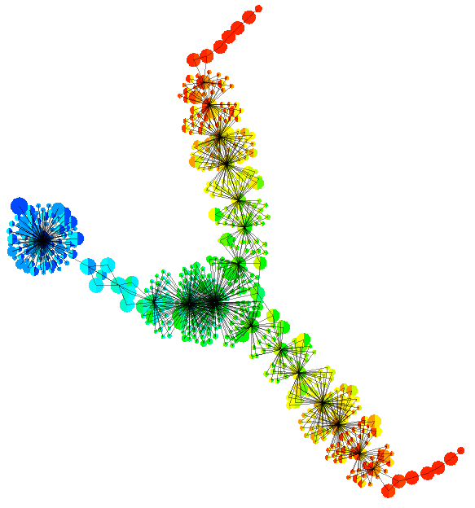
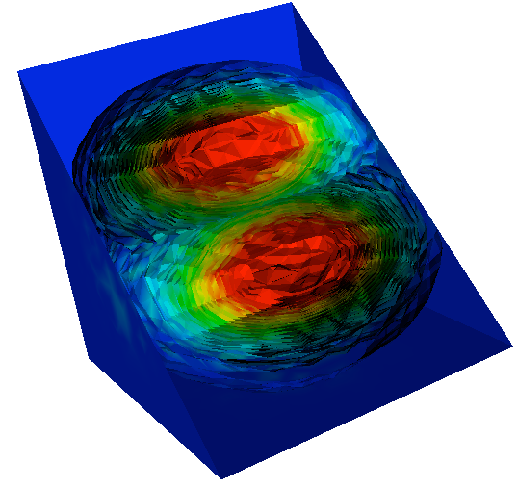
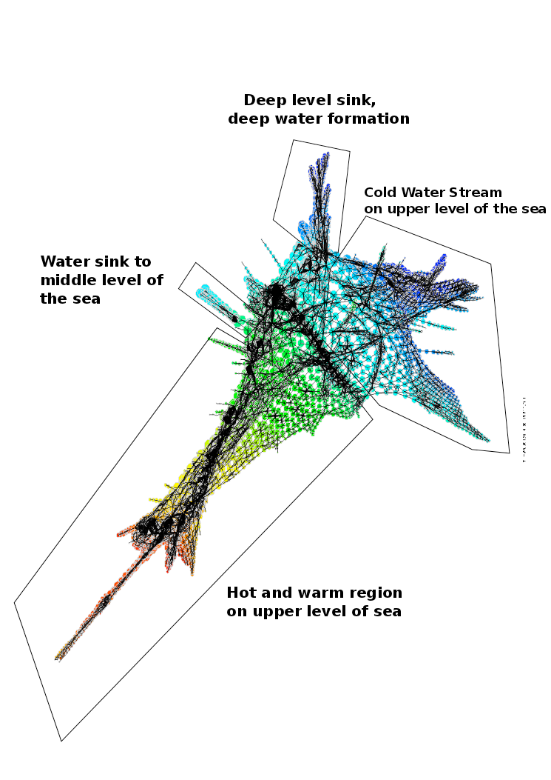
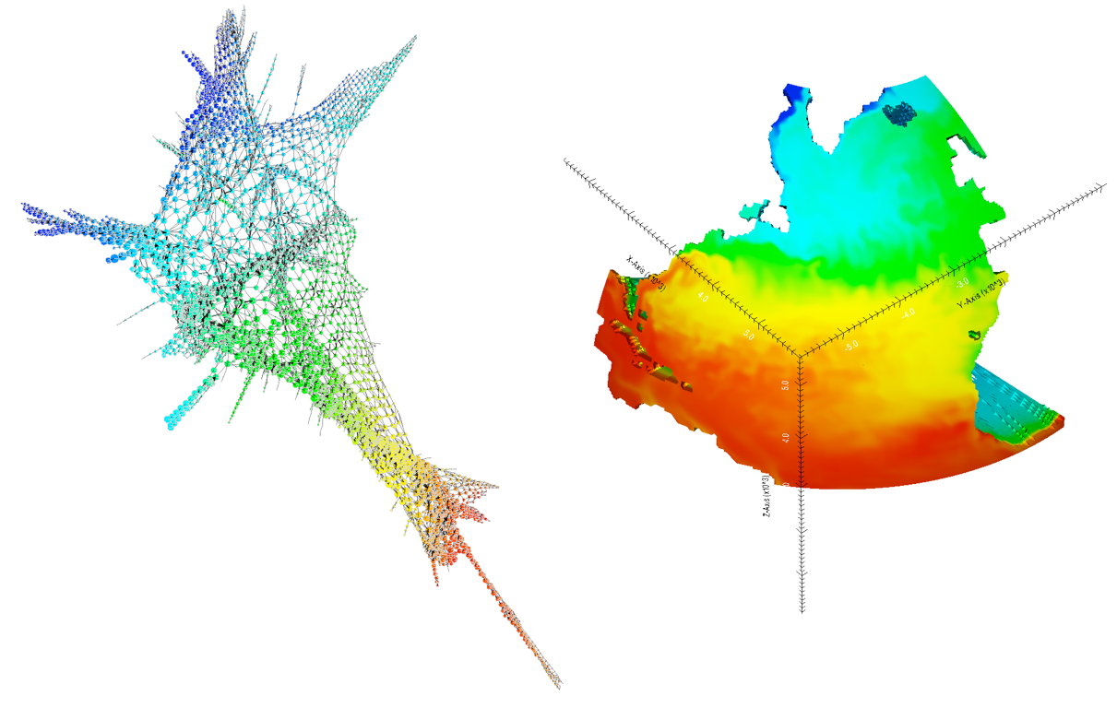
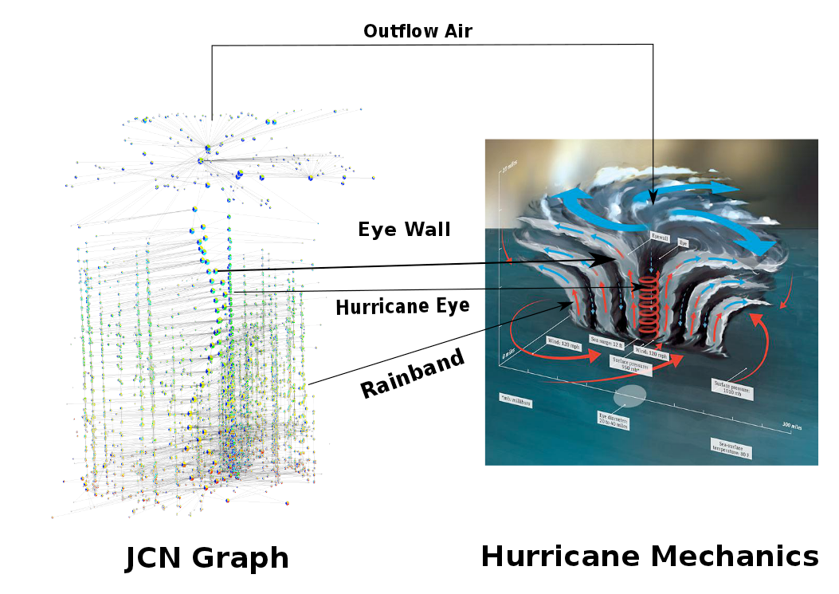
JCN examples
nucleus 1
Nuclear fission
IEEE Visualization 2012
Physical Review C 90(5) 2014
Physical Review C 91(3) 2015
Oceanography
Topological Methods in Visualisation 2015
Hurricane formation
Computer Graphics & Visual Computing 2014
Mathematics of singular fibers
IEEE Visualisation 2015
outer
shells
nucleus 2

Slide 18
Functional Programming
Why?
  unexplored territory!
  much easier / faster / cheaper to explore implementation space
  build a trusted reference implementation
  (cf. testing)
  longer-term aims: application-quality implementation
    in-situ visualization (laziness / streaming)
    heterogeneous platforms (SE costs)
  previous successes with
    streaming (lazy marching cubes, Vis 2006)
    DSLs for data visualization (Vis 2008, ICFP 2008)
Why not?
  Haskell not widely known or used in Vis / HPC
  vis infrastructure comparatively poor (HOpenGL + ?)
  collaborator wants insight, not beautiful code

Slide 19
Sequential code - types
data Ptope d r = Ptope TopeMark !Int [Ptope d r]
| Point TopeMark !d !r
| Nil
data TopeMark = None -- no mark yet computed
| CPOS -- polytope is strictly above wrt cut
| CMIN -- polytope is strictly below cut
| CEQ -- polytope lies in cutting plane
data Outcome = NonePlus -- No facet is strictly above the cut plane.
| NoneMinus -- No facet is strictly below the plane.
| Mixed -- >=1 facet lies on either side of the plane.
| AllEqual -- All facets lie in the plane.
type Break d r = ([Ptope d r], [Ptope d r], [Ptope d r])
-- For testing
edge da db ra rb = Ptope None 1 [ Point None da ra
, Point None db rb]
tri da db dc ra rb rc
= Ptope None 2 [ edge da db ra rb
, edge db dc rb rc
, edge da dc ra rc]
(da, ra)
(db, rb)
(dc, rc)

Slide 20
Sequential code - polytope cutting
cut :: (Coord d, Coord r) => Int -> Double -> Break d r -> Ptope d r -> Break d r
cut !i !v (mas, eas, pas) !pt
= case pt of
Point _ d r -> let !c = classify v (r .! i)
!p = Point c d r
in case c of
CEQ -> ( mas, p:eas, pas)
CPOS -> ( mas, eas, p:pas)
CMIN -> (p:mas, eas, pas)
Ptope _ d ps -> case split fm fe fp of
AllEqual -> (mas, (Ptope CEQ d fe) : eas, pas)
Mixed -> let pl = (base d fp)
ml = (base d fm)
in ((Ptope CMIN d ml) : mas, eas, (Ptope CPOS d pl) : pas)
NonePlus -> ((Ptope CMIN d (fm++fe)) : mas, eas, pas)
NoneMinus -> (mas, eas, (Ptope CPOS d (fe++fp)) : pas)
where
(fm, fe, fp) = foldl' (cut i v) ([],[],[]) ps
base 1 ps = mid : ps
base n ps = Ptope CEQ (n-1) [p | p <- concatMap facets ps, mark p == CEQ] : ps
mid = Point CEQ dp rp
where
[Point _ da ra, Point _ db rb] = (fm++fe++fp)
!ai = ra .! i
!bi = rb .! i
!p = (v - ai) / (bi - ai)
!dp = czipWith (\u v -> (1-p)*u + p*v) da db
!rp = czipWith (\u v -> (1-p)*u + p*v) ra rb
(da, ra)
CPOS
mid
CPOS
base 2
CMIN
CPOS
(db, rb)
mid
(dc, rc)

Slide 21
Sequential code - fragment merger
data Fragment d r = Fragment { fragCoord :: r
, fragFacets :: [d]
}
linkFaces :: (Coord d, Coord r)
=> FragValue s r -- map from fragment nr to range value
-> Int -- number (id) of fragment containing these faces
-> UnionFind s -- the union-find structure
-> KD.KDtree d Int -- spatial search structure for fragment centers
-> [(Int, Int)] -- current proto-graph (edges between adjacent fragments)
-> [d] -- list of face center points still to process
-> ST s (KD.KDtree d Int, [(Int, Int)])
linkFaces sb n uf faces gr [] = return (faces, gr)
linkFaces sb n uf faces gr (f:fs)
= do case KD.find f faces of
Nothing -> let kd = KD.insert f n faces
in linkFaces sb n uf kd gr fs
Just m -> do { nval <- sb `getA` n
; mval <- sb `getA` m
; if nval == mval
then do { union n m uf
; let kd = KD.delete f faces
; linkFaces sb n uf kd gr fs
}
else do { let kd = KD.delete f faces
; linkFaces sb n uf kd ((n,m):gr) fs
}
}
(1,1)
(1,2)
(1,1)

Slide 22
Opportunities for parallelisation
... can be non-trivial to spot!
makeJCN :: (Coord d, Coord r) => (d, d) -> r -> r -> [Cell d r] -> JCN d r
makeJCN extent fmin swid
= mergeFrags extent
. concatMap (cellFrags fmin swid)
cellFrags :: (Coord d, Coord r) => r -> r -> Cell d r -> [Fragment d r]
cellFrags fmin swid
= map (mkfrag fmin swid) . polytopes fmin swid
mkfrag :: (Coord d, Coord r) => r -> r -> Ptope d r -> Fragment d r
mkfrag fmin swid ptps
= let mins = czipWith3 slab fmin swid crds
crds = minCorner $ rngCoords ptps
centers = map center . ptfacets $ ptps
in Fragment mins centers
dice :: (Coord d, Coord r) => [Ptope d r] -> (Int, [Double]) -> [Ptope d r]
dice ptopes (i, []) = ptopes
dice ptopes (i, (v:vs))
= below ++ dice above (i, vs)
where
(below, above) = diceEach ptopes ([], [])
diceEach [] res = res
diceEach (p:ps) (bs, as)
= let (!m1s,!e1s,!p1s) = cut i v ([], [], []) p
in diceEach ps (m1s ++ bs, e1s ++ p1s ++ as)

Slide 23
Parallel Topology
Historically challenging to parallelize topology
  topology = global property
  stubbornly serial!
  analysis overhead already large (est. 1.2KB per point)
  divide-and-conquer (Cole-McLaughlin & Pascucci)
  cost of maintaining information to "zip" partial solutions
Large-scale datasets => emphasis on distributed memory
  communication costs dominate
  solutions to date:
    distribute the data structure, then query (Weber & Morozov)
    stratify, terminate at desired resolution (Gyulassy, Landge, Pascucci et.al.)

Slide 24
The parallel Haskell jigsaw
Architecture
  shared memory multi-core
  distributed memory cluster
  GPU
  FPGA
  ...
Run-time System
  GHC
  GdH
  Eden
  Grid-GUM
  ...
Library support
  Eval monad
  Par monad
  Lvish
  ...
Coding strategy
  hand-tailor to application
  skeletons

Slide 25
Skeletons
Algorithmic Skeletons:
Structured Management of Parallel Computation, Cole, 1989.
From Loogen et.al.
  commonly-used patterns of parallel evaluation
  simplify development .. can simply be used in a given application context
  may be different implementations
  efficiency given by a cost model
For a functional programmer, skeleton = HOF

Slide 26
Par Monad
Deterministic and explicit parallel computation
  Computations that fork and communicate
  IVars for data communication
  Thread evolution as continuation monad over a meta-scheduler state
  Implemented using reflection of GHC RTS
Interface
class NFData where ...
runPar :: Par a -> a
fork :: Par () -> Par ()
new :: Par (IVar a)
put :: NFData a => IVar a -> a -> Par ()
get :: IVar a -> Par a

Slide 27
Skeletons in the Par monad
Parallel map:
parMap :: NFData b => (a -> b) -> [a] -> Par [b]
parMap f [] = []
parMap f (a:as) = do b <- spawn $ return (f a)
bs <- parMap f as
return $ b:bs
Chunked map:
parMapChunk :: Int -> (a -> b) -> [a] -> Par [b]
Divide-and-conquer:
parDaC :: NFData s
=> (p -> Bool) -- can the problem be simplified?
-> (p -> (p,p)) -- subdivide problem
  -> (s -> s -> s) -- merge two solutions
  -> (p -> s) -- solve a "trivial" problem
  -> p -- initial problem
  -> s -- solution

Slide 28
Intermission

Slide 29
Parallelizing JCN
Embarrassingly parallel
  partition the domain
  compute local JCNs
  merge JCNs to generate the global structure
Input/Output
  Each process access the input files directly
  The main process write the final JCN to the output file
Merger
  need to capture fragment adjacencies
  solution:
    facet mid-points are unique
    store in spatial search structure (KD-tree)
partition
compute
merge

Slide 30





Divide-and-conquer skeleton
parDaC :: NFData s
=> (p -> Bool) -- is trivial?
-> (p -> (p,p)) -- subdivide
-> (s -> s -> s) -- merge
-> (p -> s) -- compute
-> p
-> s
parDaC refine split merge solve problem
= runPar $ go problem
where go p
| refine p
= do let (p1, p2) = split p
s1 <- spawn $ go p1
s2 <- spawn $ go p2
liftM2 merge (get s1) (get s2)
| otherwise = return (solve p)

Slide 31
Map skeleton
Exploit parMap
mapSkel :: NFData s
=> (p -> [sp]) -- split into sub-problems
-> (sp -> ss) -- solve a sub-problem
-> ([ss] -> s) -- merge sub-problem solutions
-> p -- initial problem
-> s -- solution
mapSkel split solve merge p
= runPar . liftM merge . parMap solve . split $ problem
parMapChunk variant

Slide 32
Eager skeleton
Input divided into stream of subproblem pairs
One thread spawned for each subproblem & merge step
IVars communicate solutions towards the root
eager split solve merge p
= runPar $ do
let mt l r = spawn $ liftM2 merge (get l ) (get r)
let tree = sched (return ◦ solve) mt
(mrgJobs, ) <- foldM tree ([],[]) $ split p
finishMerger mTask mrgJobs >>= get
Merge JCNs
Compute JCNs
stream of
subproblems

Slide 33
Pipeline skeleton
Eager Skeleton was too eager
  fragmentation faster than merger
  leaves complete, building up large volume of data
Rate-limiting mechanism
  delay fragmentation until pending mergers complete
Create
Subproblem Stream
Compute JCN
Merge

Slide 34
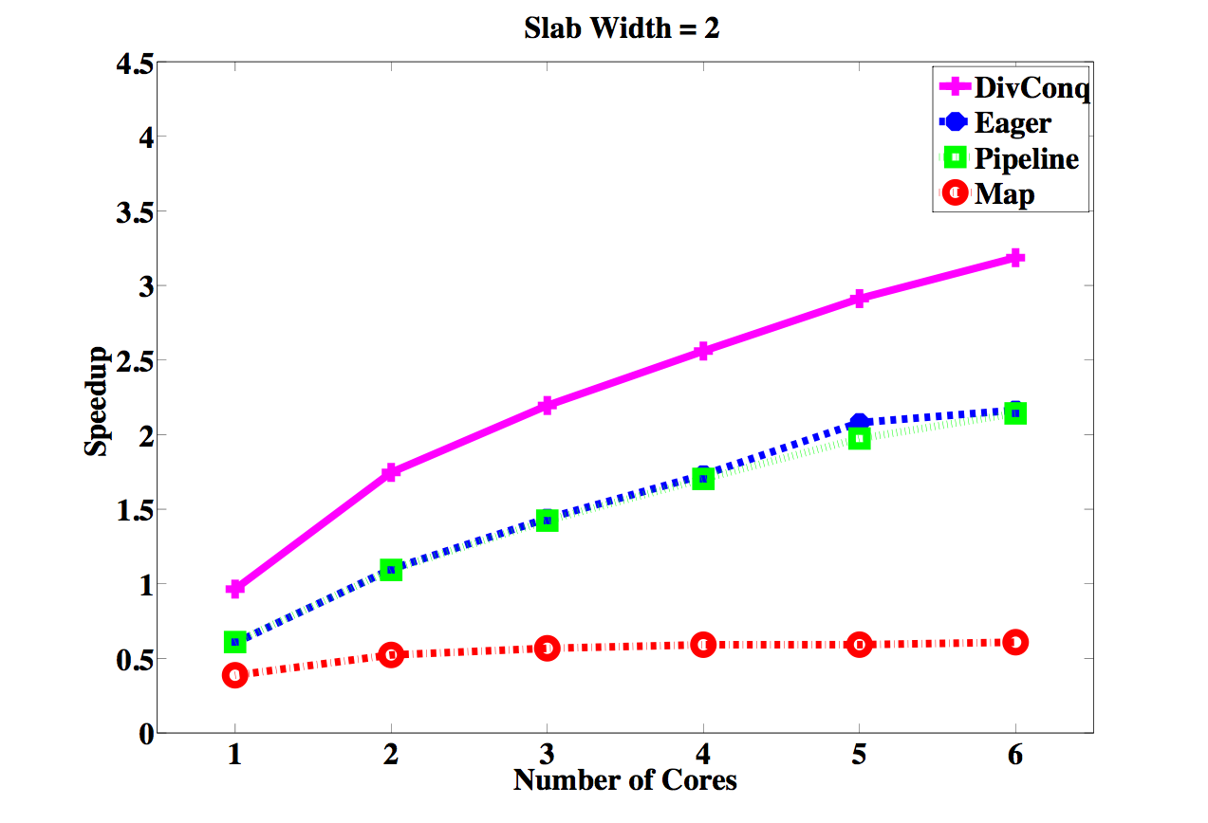
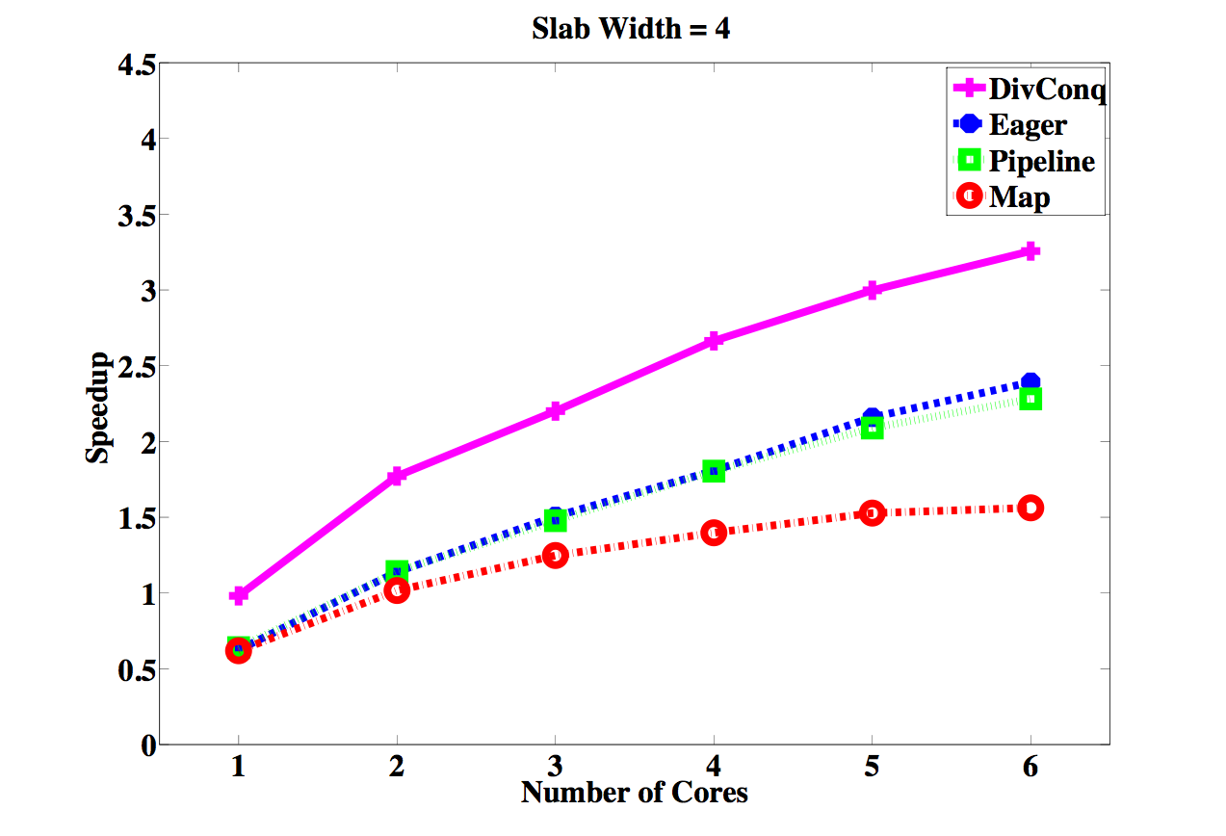
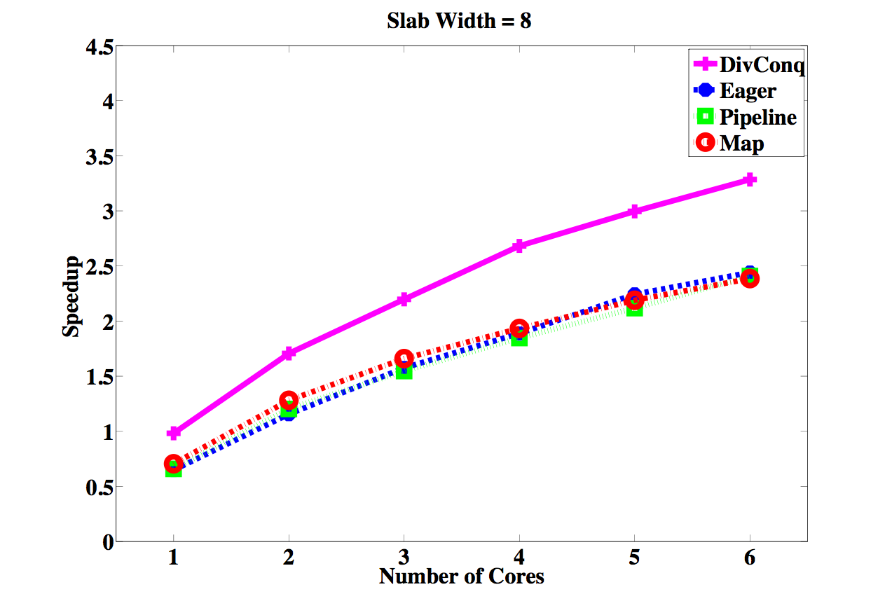
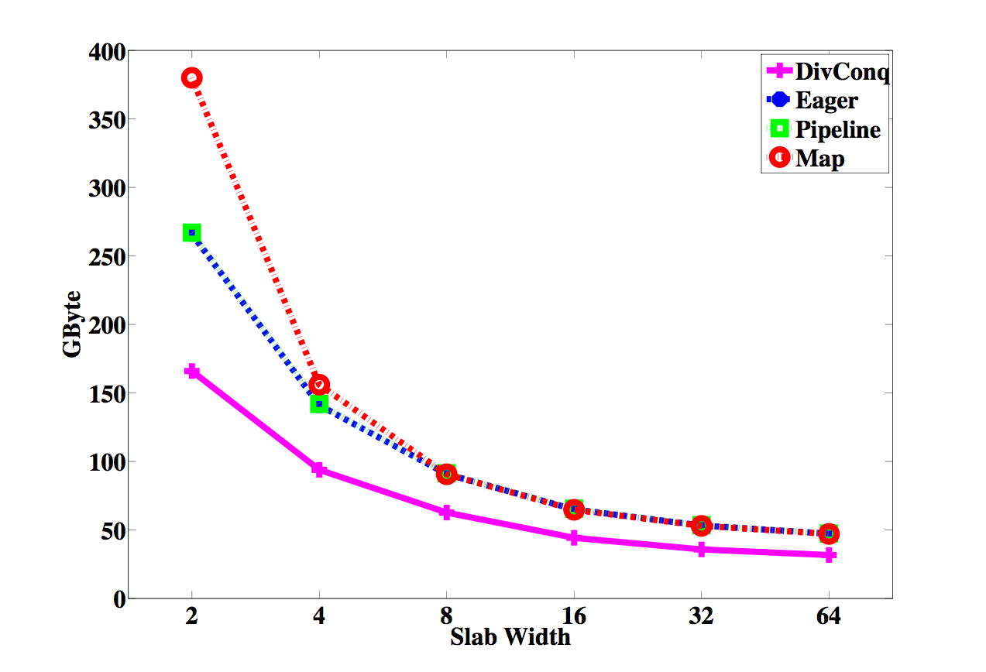
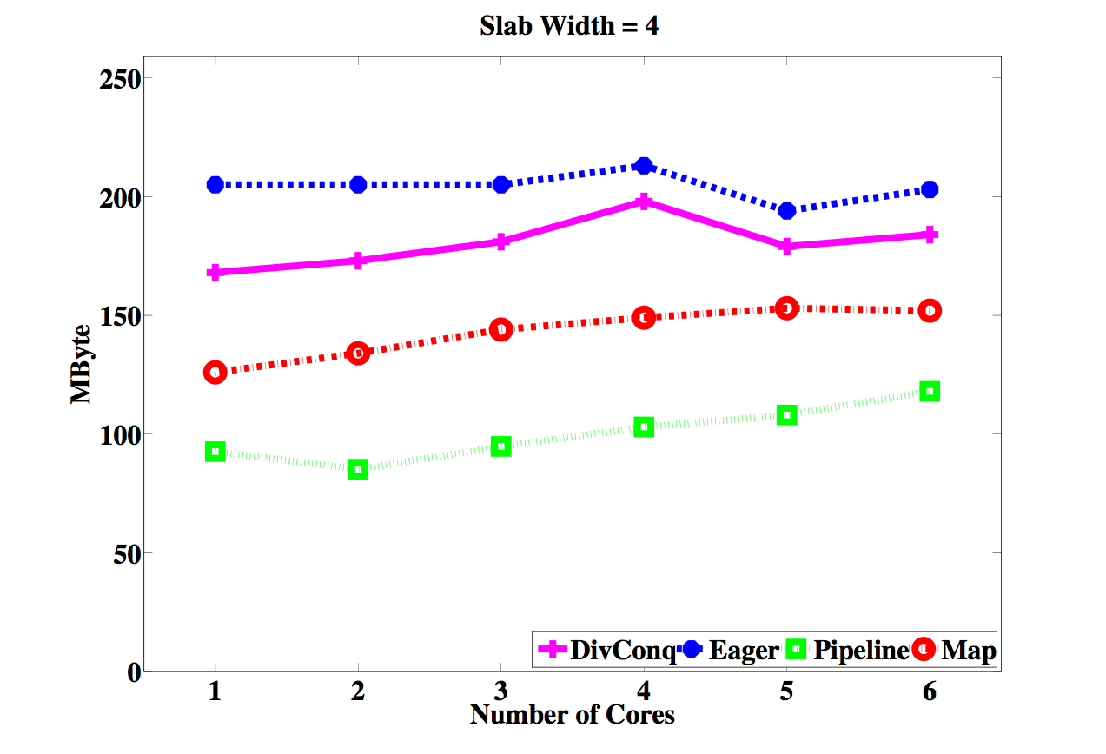
Parallel Performance
Total Memory Allocation
Maximum Memory Residency

Slide 35
Distributed-memory parallelism
Why?
  massive simulations
  e.g. PB-scale combustion studies at SCI (Utah) and LBL
Distributed topology
  Distributed merge/contour tree implementations [on Cray]
  (Morozov & Weber, 2013)
  Partial trees are distributed across nodes
Platform
  ARC1: cluster built on 32-core nodes
  Using Eden, a distributed-memory fork of GHC
  Eden Trace-Viewer: similar to threadscope, currently less information
Starting point: three Eden skeletons
  parallel map-reduce (disMapReduce)
  distributed divide-and-conquer (disDC)
  workpool

Slide 36
Eden language
Eden primitive constructs:
    class Trans a where ...
    process :: (Trans a, Trans b) => (a -> b) -> Process a b
    (#) :: (Trans a, Trans b) => Process a b -> a -> b
Eden’s RTS extends the GHC runtime system:
  process creation (strict)
  task placement
  synchronisation
  data communication
    implicit parent-child channels
    explicit creation and use of dynamic channels

Slide 37
Eden skeletons
Map-reduce:
map :: (a -> b) -> [a] -> [b]
foldr :: (b -> c -> c) -> c -> [b] -> c
mapRedr :: (b -> c -> c) -> c -> (a -> b) -> [a] -> c
mapRedr rf e mf = (foldr rf e) . (map mf)
Distributed map-reduce:
disMap :: (Trans a, Trans b) -> (a -> b) -> [a] -> [b]
disMapRedr :: (Trans a, Trans b) => (b -> b -> b) -> b -> (a -> b)->[a] -> b
disMapRedr rf e mf xs
| noPe == 1 = mapRedr g e f xs
| otherwise = (foldr rf e)
. (disMap (disMapRedr rf e mf))
. (splitIntoN noPe) $ xs

Slide 38
The Experimental Platform
ARC2 : One of the HPC clusters at University of Leeds
Compute | 3040 cores Each Node has A dual socket with 2.6GHz 8-core Intel E5-2670 processors 32GB of DDR3 memory 500 Gb of local Hard drive
Storage | Lustre file system Delivering 4GB/s via the InfiniBand network 170TB storage
Network | All user traffic data is transferred over InfiniBand network Gigabit for management

Slide 39





Distributed Divide and Conquer Skeleton
The best performance on shared memory implementation
disDC :: (Trans a, Trans b)
=> Int — branching degree
-> Places — ticket list
-> (a -> Bool) — trivial?
-> (a -> b) — solve
-> (a -> [a] — split
-> (a -> [b] -> b) — merge
-> a — input
-> b
A
B
C
D
A
B
C
D
A
B
C
D
dividing the domain
computing local JCNs and
reducing them into a global structure

Slide 40




Unbalanced Computation Load
JCN Computation on scission dataset
JCN Computation on a synthetic dataset
JCN is a data dependent computation
Divide and Conquer skeleton leads to an unbalance computation load

Slide 41
Over-decomposition
Common strategy in computational science
  decompose problem into N >> no. PEs
  maintain work pool of tasks
  scheduler "smooths over" differences from data dependencies
  dynamic load balancing
Eden has a workpool skeleton
workpool :: (Trans t, Trans r)
=> Int -- number of workers
-> Int -- prefetch
-> (t -> r) -- map function
-> [t] -- list of tasks
-> [r]
Could be used for both fragmentation and merger ..

Slide 42
Eden Workpool
Eden library provides several extensions that integrate map and reduce functions
BUT all allow merger of intermediate results in arbitrary order
This is a problem (why?)
fragment
merge
decompose
local JCN graphs
first merge task
Fortunately, strategies are just Eden functions ...
... so we can write our own.

Slide 43

Designing a new skeleton
Seek dynamic load balancing in both map and reduce stages
Multi-level reduction of spatially-adjacent sub-problems
  uses a merger function that matches intermediate results in a multi-level scheme
A
B
C
D
A
B
C
D
E
F
G
H
E
F
G
H
A
B
C
D
E
F
G
H

Slide 44

newWorkpool
A new workpool skeleton for JCN-like computations
Master
red. Order
mergerTasks
split
++
Eden workpool
last
Worker 1
Worker 2
Worker n

Slide 45
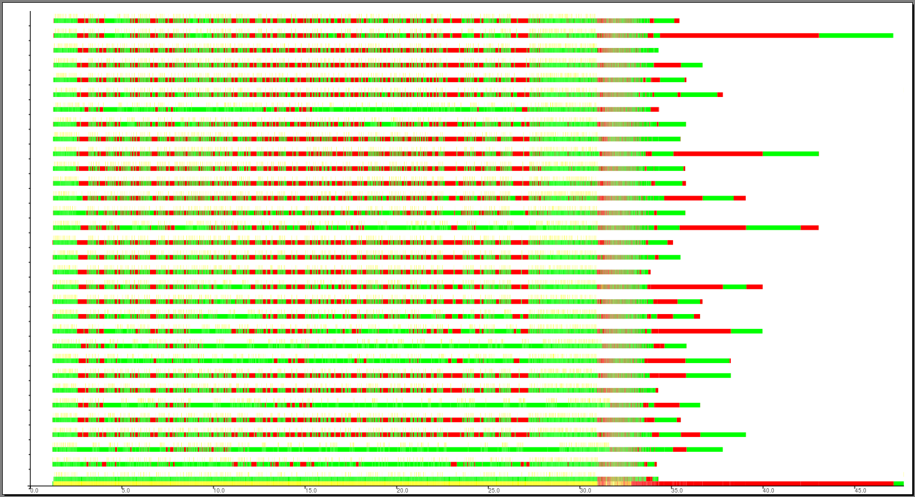
newWorkpool: run-time profile
JCN of Isabel dataset on 32 PEs

Slide 46
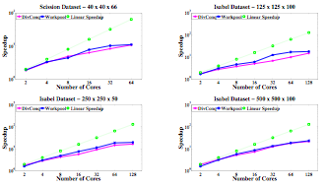
Performance of Distributed JCN

Slide 47
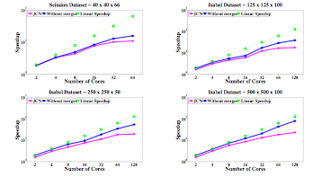
JCN without Merger

Slide 48
  A distributed JCN representation
Observation: merging JCNs involves only nodes on sub-problem boundary
Alternative strategy:
  distributed representation
  incremental updates
5/1
8/3
3/4
5/1
7/5
6/2
4/3
7/5
Challenge: over-decomposition gives [initial] subproblems with small interior graph

Slide 49
Shared & Distributed Mem Implementation

Slide 50
What we achieved / found ...
Unexpected lessons on skeletons
  skeletons can themselves be non-trivial functions
  conveniently abstract for straightforward cases
  inconveniently abstract for understanding performance
  can we have our cake and eat it too?
  … are there sensible building blocks for skeletons?
Tooling still an issue
  Peter Wortmann's enhanced profiling support invaluable - but further work needed
  (see Haskell Symposium 2013 paper)
  hard to measure communication costs
  profiling over 100's of cores
  integrating IO into skeletons and distributed Haskell
Contributions
  scaled parallel JCN implementation from small to modest datasets
  understood issues affecting further scaling
  achieved some impact ...

Slide 51
Impact
Haskell not yet on the cover of Nature ...
... but two Physical Review C papers are a start ...

Slide 52
Broader issues
So why isn't Haskell used in ..
  .. computational science (Fortran, C/C++, Chapel, OpenCL, ...)
  .. computer graphics & games (C++, C++, C++, C++, ...)
  .. <insert your favourite application area>?
Technology
  technology only just mature
  absence of a standard (who programs in Haskell'98 these days?!)
  tools, esp. cost modelling and profiling
  legacy code and inertia
  different engineering challenges and trade-offs from success areas
People issues
  Your top C++ programmer leaves ... replace in days
  Your top (HPC) Haskell programmer leaves ... replace when?
  Project risk against likely benefits

Slide 53
What we achieved ...
Contributions
  scaled parallel JCN implementation from small to modest datasets
  understood issues affecting further scaling
Unexpected lessons on skeletons
  skeletons can themselves be non-trivial functions
  conveniently abstract for straightforward cases
  inconveniently abstract for understanding performance
  can we have our cake and eat it too?
  … are there sensible building blocks for skeletons?
Tooling still an issue
  e.g. measuring communication costs, profiling over 100s of cores, IO
Ongoing and future work
  moving work towards GPU clusters
  heterogeneous resources, complex memory hierarchy
  in-situ processing
  run on Tianhe-2 ?!

Slide 54
Future
Challenges
  Haskell / FP have made inroads in some sectors
  Why? What do they excel at?
  EDSLs - Obsidian, Repa, Accelerate ...
  Heterogeneous resources, complex memory hierarchy
  In-situ processing
  Try running on Tianhe-2 ?!
Current plans
  Memory-sensitive representation
  Games - one of the most performance-critical CS applications

Slide 55
Acknowledgements
UK Engineering and Physical Sciences Research Council
Multifield Extension of Topological Analysis,
Grant EP/J013072/1
Collaborators and contributors
  Fouzhan Hosseini
  Nicholas Schunck
  Hamish Carr
  Geng Zhao
  Amit Chattopadhyay
  Aaron Knoll
  Jost Berthold
  Thomas Horstmeyer
  Hans-Wolfgang Loidl
  Ben Lippmeier

