Slide 1
Seminar Course
Distributed Computing and Systems, Cluster 2
Philippas Tsigas and Olaf Landsiedel
Notes:
I am Olaf, one of the Assistant Prof. in Compute Science
Year master course

Slide 2

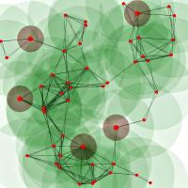
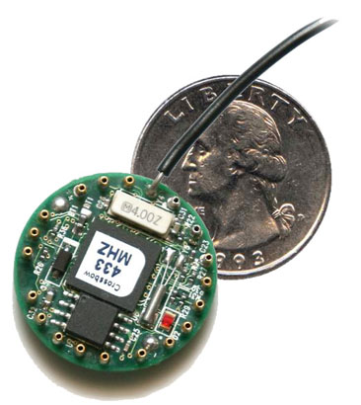
Wireless Sensor Networks
What is a Wireless Sensor Network?
  Wireless network of
    Small, embedded computing devices
  Embedded into the environment
    Sense and interact with the surroundings
WSNs are key building blocks
  For our networked society
    Smart meters, smart buildings, …
    Cyber Physical System (CPS)
    Internet of Things (IoT)
    Machine-To-Machine (M2M)

Slide 3
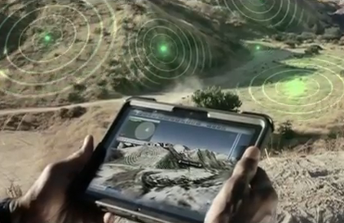
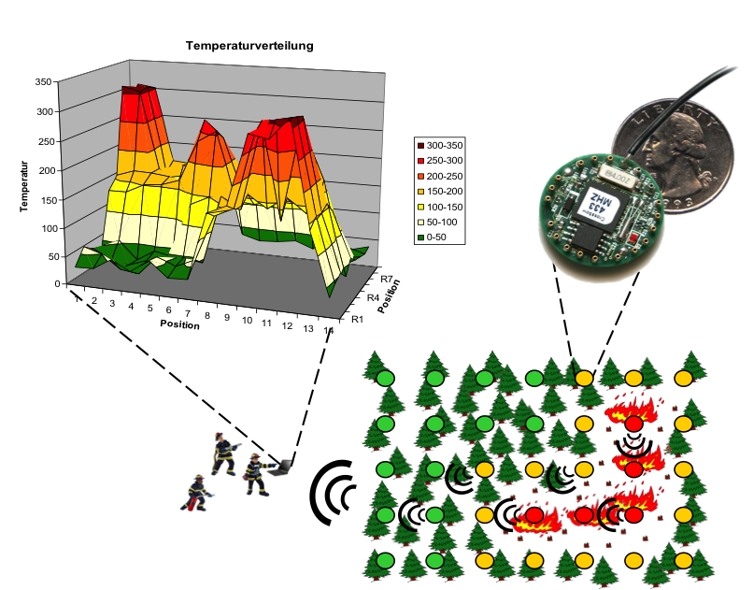
Topic 1:
Applications, Use Cases and Vision
What are wireless sensor networks?
What can we do with them?
Challenges for application development?
Relation to the Internet of Things etc.

Slide 4
Papers Topic 1
Main article:
  “Sensing data centres for energy efﬁciency”
  Jie Liu and Andreas Terzis
  Philos. Trans. A. (Math Phys Eng Sci), 2012
  (http://rsta.royalsocietypublishing.org/content/370/1958/136.full.pdf+html)
Extension article I:
  “Deploying a Wireless Sensor Network on an Active Volcano”
  Geoff Werner-Allen; Konrad Lorincz; Mario Ruiz; Omar Marcillo; Jeffrey B. Johnson; Jonathan Lees; Matt Welsh
  IEEE Internet Computing, 2006
  (http://www.eecs.harvard.edu/~mdw/papers/volcano-ieeeic06.pdf)
Extension article II:
  "Sensor network-based countersniper system.
  Simon, Gyula, et al.
  Proceedings of the 2nd international conference on Embedded networked sensor systems. ACM, 2004.
  (http://www.isis.vanderbilt.edu/sites/default/files/Simon_G_11_3_2004_Sensor_Net.pdf)
Background Article (Base paper on WSNs to introduce you to the area):
  “Sensor network algorithms and applications”
  Niki Trigoni and Bhaskar Krishnamachar
  Philos. Trans. A. (Math Phys Eng Sci), 2012
  (http://rsta.royalsocietypublishing.org/content/370/1958/5.full.pdf+html)

Slide 5
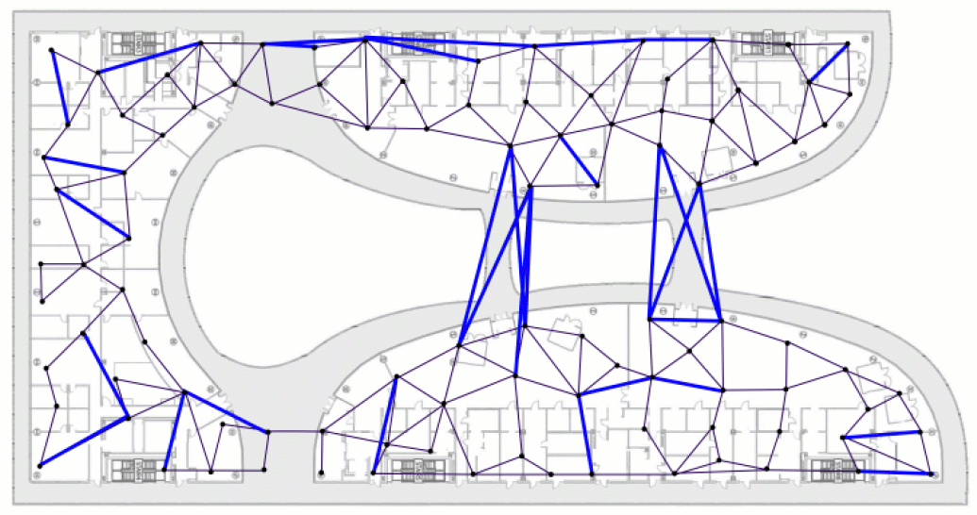
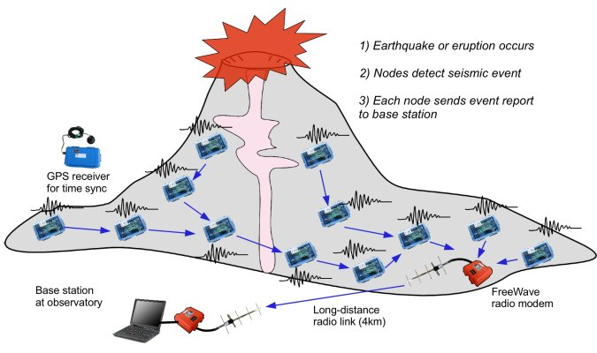
Topic 2:
Energy Efficient Routing in WSNs
Routing Metrics
  Which nodes provide routing progress?
Link estimation
  Which neighbors are reliably reachable?
Routing protocols
  Combing metrics and link estimation to a protocol
  Energy efficiency?

Slide 6
Papers Topic 2
Main Article (Routing Protocol):
  "Collection tree protocol"
  Gnawali, Omprakash, et al.
  Proceedings of the 7th ACM Conference on Embedded Networked Sensor Systems. 2009
  (http://sing.stanford.edu/pubs/sensys09-ctp.pdf)
Supporting Article I (Routing Metric):
  "A high-throughput path metric for multi-hop wireless routing."
  De Couto, Douglas SJ, et al.
  Wireless Networks 11.4 (2005)
  (http://dl.acm.org/citation.cfm?id=1150541; access from within Chalmers)
Supporting Article II (Link Estimation + Routing Protocol):
  Woo, Alec, Terence Tong, and David Culler. "Taming the underlying challenges of reliable multihop routing in sensor networks." Proceedings of the 1st international conference on Embedded networked sensor systems. ACM, 2003.
  (http://dl.acm.org/citation.cfm?id=958494; access from within Chalmers)
Background Article (Base paper on WSNs to introduce you to the area):
  “Sensor network algorithms and applications”
  Niki Trigoni and Bhaskar Krishnamachar
  Philos. Trans. A. (Math Phys Eng Sci), 2012
  (http://rsta.royalsocietypublishing.org/content/370/1958/5.full.pdf+html)

Slide 7
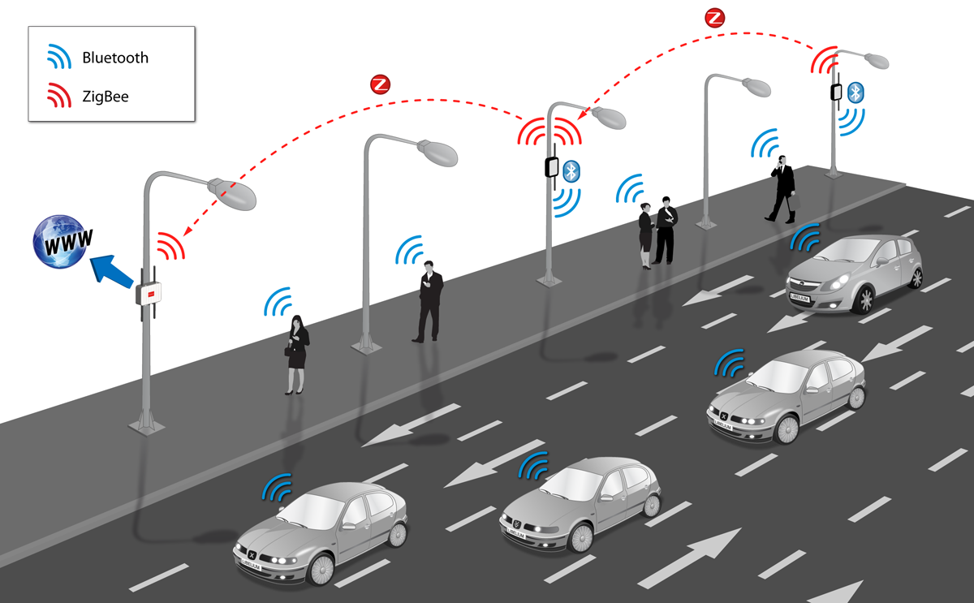
Topic 3
Energy Efficient Medium Access
Sensor nodes are commonly battery driven
  ->Nodes turn radios on sporadically
  How can nodes communicate in this setup?
  How do we make this reliable?
  How do we make this energy efficient?

Slide 8
General Distributed System

Slide 9
Topic 4
Social Sensing and Crowdsourcing
People, their smart phones, and social media are a big “sensor”
  What are people doing
  Where?
  What are people thinking?
Problem
  Who is telling the truth?
  Privacy?
Approach
  Identify “trusted” sources
  Aggregate many sources

Slide 10
Papers Topic 4
Main Article:
  "On Truth Discovery in Social Sensing: A Maximum Likelihood Estimation Approach”
  Dong Wang, Hieu Le, Lance Kaplan, Tarek Abdelzaher,
  In Proc. 11th ACM/IEEE Conference on Information Processing in Sensor Networks (IPSN), April 2012.
  (https://www.ideals.illinois.edu/bitstream/handle/2142/25815/Factfinders.pdf?sequence=2)
Supporting Article I:
  “Mobiscopes for human spaces”
  T. Abdelzaher et al..
  IEEE Pervasive Computing, 6(2):20–29, 2007
  (http://research.microsoft.com/pubs/77862/kansal_pervasive2007.pdf)
Supporting Article II:
  “CarTel: a distributed mobile sensor computing system”
  B. Hull et al..
  In SenSys’06, 2006.
  (http://db.csail.mit.edu/pubs/fp02-hull.pdf)
Supporting Article III:
  “Crowdsourcing urban air temperatures from smartphone battery temperatures”
  Overeem, A., J. C. R. Robinson, H. Leijnse, G. J. Steeneveld, B. K. P. Horn, and R. Uijlenhoet
  Geophys. Res. Lett., 40, 2013
  (http://onlinelibrary.wiley.com/doi/10.1002/grl.50786/pdf)

Slide 11
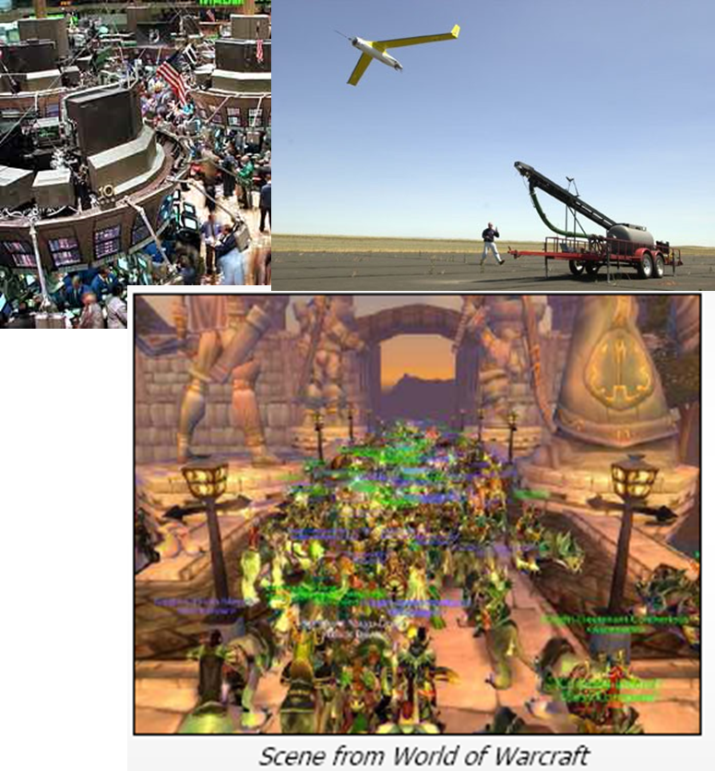
Topic 5
Parallel Programming Methodologies in Distributed Systems
Distributed Applications Demand High Level Data Sharing
  synchronization (shared state concurrency) is hopelessly intractable here.
  Solutions?
  Scalable
  Usable

Slide 12
Papers Topic 5
Main Article:
  Cederman, Daniel, et al. "A Study of the Behavior of Synchronization Methods in Commonly Used Languages and Systems”. In the Proceedings of the 27th International Parallel and Distributed Symposium (IPDPS 2013), pages , IEEE Press 2013. (http://ieeexplore.ieee.org/stamp/stamp.jsp?arnumber=06569906; access from within Chalmers)
Supporting Articles:
  M. Michael and M. Scott, “Simple, fast, and practical nonblocking and blocking concurrent queue algorithms,” in Proceedings of the ﬁfteenth annual ACM symposium on Principles of distributed computing. ACM, 1996, pp. 267–275. (http://ieeexplore.ieee.org/xpls/abs_all.jsp?arnumber=1019408; access from within Chalmers)
  Tsigas, Ph, et al. “A simple, fast and scalable non-blocking concurrent FIFO queue for shared memory multiprocessor systems” in Proceedings of the thirteenth annual ACM symposium on Parallel algorithms and architectures, Pages 134-143, 2001. (http://dl.acm.org/citation.cfm?doid=378580.378611; access from within Chalmers)
Background Article:
  K. Fraser and T. L. Harris, “Concurrent programming without locks,” ACM Transactions on Computer Systems (TOCS), vol. 25, no. 2, 2007. (http://dl.acm.org/citation.cfm?id=1233309, access from within Chalmers)

Slide 13
Topic 6
Energy Efficient Data Sharing
In order to achieve Europe’s ambitious goals on energy efficiency by 2020, Europe needs to improve the energy efficiency of ICT systems and use ICT as an enabler to improve energy efficiency across the economy.
For ICT systems such as high performance computing (HPC) centres, there is potential for up to 70% energy savings through combining computer technologies.
Reducing the energy consumption of embedded systems would increase their deployment as intelligent components in other sectors of the economy such as energy-smart buildings (whose energy-saving potential is around 30%) and the manufacturing industry and transport (whose energy-saving potential is around 25%).

Slide 14
Papers Topic 6
Main Article:
  Hunt, N, et al. “Characterizing the Performance and Energy Efficiency of Lock-Free Data Structures”. In the Proceedings of the 27th International Parallel and Distributed Symposium (IPDPS 2013), pages , IEEE Press 2013. (http://ieeexplore.ieee.org/xpl/articleDetails.jsp?arnumber=5936698; access from within Chalmers)
Supporting Article:
  J. Li, J. F. Mart´ınez, and M. C. Huang. “The thrifty barrier: Energy-aware synchronization in shared-memory multiprocessors.” In HPCA, 2004. (http://ieeexplore.ieee.org/xpls/abs_all.jsp?arnumber=1410061&tag=1; access from within Chalmers)
Background Article:
  Susanne Albers, “Energy efficient Algorithms”. In Communications of the ACM, Volume 53 Issue 5, May 2010 (http://dl.acm.org/citation.cfm?id=1735245; access from within Chalmers)

Slide 15
Topic 7
Ways of leveraging social networks in distributed systems design: The case of Spam filtering.

Slide 16
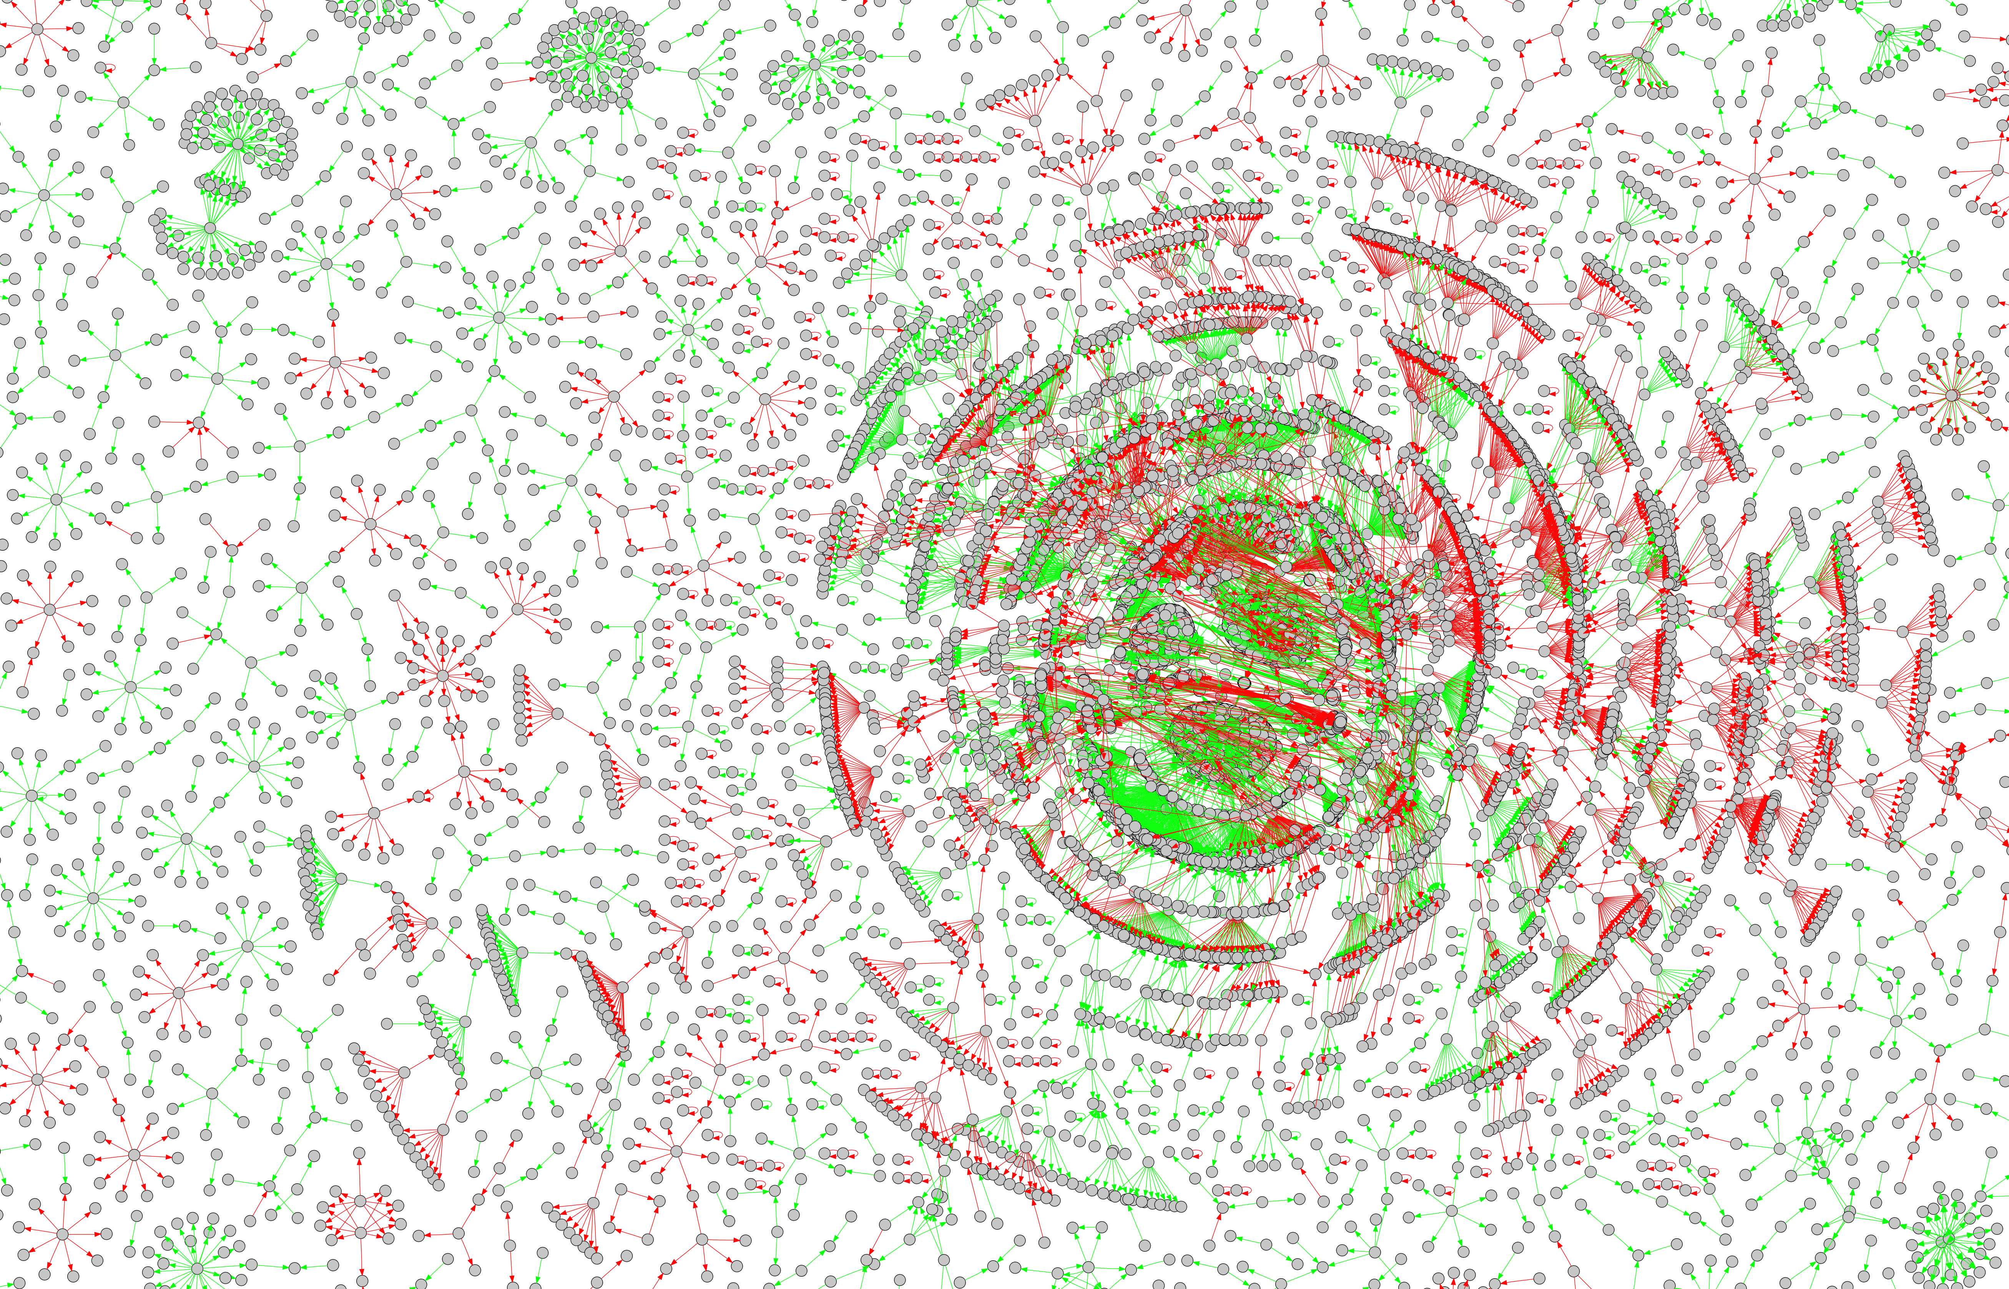
Separating legitimate (ham) and unsolicited (spam) email in a large-scale email network generated from real email traffic.

Slide 17
Papers Topic 7
Main Article:
  Moradi, F., Olovsson, T., and Tsigas, Ph. “Towards Modeling Legitimate and Unsolicited Email Traffic Using Social Network Properties,” in Proceedings of the 5th Workshop on Social Network Systems (SNS’12), pp. 9:1 - 9:6, ACM, 2012. (http://dl.acm.org/citation.cfm?id=2181185; access from within Chalmers)
Supporting Articles:
  Mislove, Alen, et al. “Measurement and Analysis of Online Social Networks,” In Proceedings of the 7th ACM SIGCOMM conference on Internet measurement, pp. 29-42, ACM, 2007. (http://dl.acm.org/citation.cfm?id=1298311; access from within Chalmers)
  Nanavati, A. A., et al. “Analyzing the Structure and Evolution of Massive Telecom Graphs,” IEEE Transactions on Knowledge & Data Engineering, vol. 20 no. 5, pp. 703-718, 2008. (http://ebiquity.umbc.edu/_file_directory_/papers/407.pdf)
Background Article:
  Newman, M. E. J. “The Structure and Function of Complex Networks,” SIAM Review, vol. 45, no. 2, pp. 167-256, 2003. (Sections I-III) (http://epubs.siam.org/doi/abs/10.1137/S003614450342480, access from within Chalmers)

