Slide 1


Welcome this Monday to …
an afternoon with a lecture and workshop on
scientific reading, writing and reviewing
Before the first language lecture on Sept, 8th, please
read the three survey examples that can be found on the
course homepage!
You do not have to read them in detail. Rather, get acquainted with them, browse them and pay attention
to how they are structured. They will be discussed and
further analysed in class.

Slide 2
Three diverse texts
All examples of survey papers
  Model-Based Evaluation: From Dependability to Security by Nicol et al
  Prudent Practices for Designing Malware Experiments: Status Quo and Outlook by Rossow et al
  Little words can make a big difference for text classification by Riloff
Introducing scientific writing, function, structure and organization of survey papers
How to work with reviewing strategies

Slide 3
Analyses of
  Text structure, logic, text building, general to specific, topic sentences
  Definitions and explanations
  Problem, process, and solution, argumentation
  Data commentary
  Style and language
  In-text referencing
  Summary writing strategies, paraphrasing
Notes:
In the workshop, analyses of text parts
The information flow and logic in the text
Based on Feak and Swales - analyses through a set of examples from Nicol et al, to get an in-depth understanding of the text

Slide 4
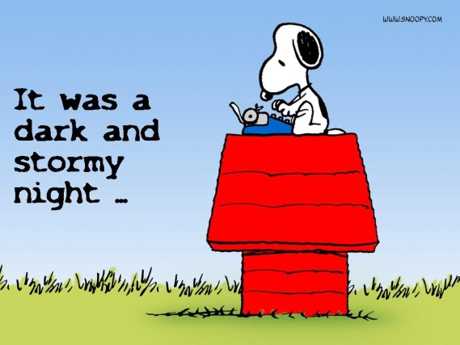
Finally….
In this course a large number of teachers
and TAs are involved. We are all here to help you
improve your writing, reading and reviewing skills,
something that is of value in a much wider context than computer science.
Do take advantage of this opportunity!
Looking forward seeing you
Monday 8 Sept in EB!

