Slide 1
A Consistency Framework for Iteration Operations in
Concurrent Data Structures
Distributed Computing and Systems
Chalmers University of Technology
Gothenburg, Sweden
Yiannis Nikolakopoulos
A. Gidenstam
M. Papatriantafilou
P. Tsigas

Slide 2
Outline
Background
Examples and Research Questions
Conclusions
Concurrent Data Structures
Iteration Operations
Contribution
Consistency Definitions
Algorithmic Design
Future Work
Related Work

Slide 3
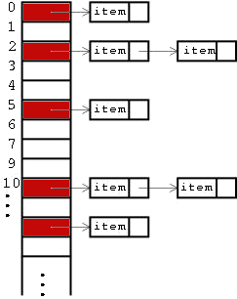
Concurrent Data Structures
In a multicore system:
Share data among
different threads/processes
Implementations:
Fine grained locking
Non-blocking
Transactional memory based

Slide 4
Iteration Operations
Traditionally:
Traverse all the contents of a data structure, regardless of the Abstract Data Type
In a concurrency context…
What is a consistent iteration?
while (Iterator.hasNext())
Iterator.next();

Slide 5

Concurrent Iteration on a
Concurrent Queue
Enqueue
Dequeue

Slide 6
Concurrent Iteration on a
Concurrent Queue
Enqueue
Dequeue
What about the new node?
Will I ever finish?
What is a consistent state to return?
?

Slide 7
Concurrent Iteration on a
Concurrent Queue
Enqueue
Dequeue
?
Is it ok to
return the first nodes?

Slide 8
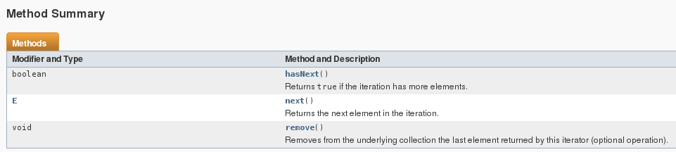
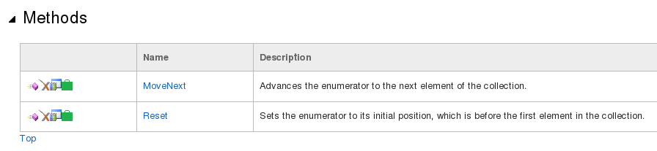
Concurrent Iterations in
Programming Frameworks
Increasing support in data structures included in concurrency libraries:
  Intel’s Thread Building Blocks
  Java
  .NET
Java | .NET
snapshot style | moment-in-time snapshot
weakly consistent | not a moment-in-time snapshot

Slide 9
Consistency Questions
Iteration concurrently with modifications?
  Traversing a moving path!
Is atomic-like behavior too expensive?
Any acceptable weaker notions of iteration?

Slide 10
Outline
Background
Examples and Research Questions
Conclusions
Concurrent Data Structures
Iteration Operations
Contribution
Consistency Definitions
Algorithmic Design
Future Work
Related Work

Slide 11
Iteration Consistency Specifications
Contribution
Different levels of consistency, building on [Lamport86], [Herlihy90]
safeness, weak regularity, regularity, linearizability
How hard is it to provide the different consistency levels?
Algorithmic designs and implementations, extending a lock-free queue [MS96]

Slide 12
Interlude – Reminder:
Consistency and Correctness
Linearizability [Herlihy90]
  Every operation appears to take effect instantaneously within its duration
  Every concurrent execution, is mapped to a sequential one
DEQ(): 10
DEQ(): 25
ENQ(10)
ENQ(25)
time

Slide 13
Iteration: A First Approach
On a lock-free concurrent queue [MS96]
A simple Scan&Return:
Can return a state that never existed
a
b
b
c
Iterate(): {a,b,c}
Contribution
weak regularity
Dequeue():a
Dequeue():b
Enqueue(c)

Slide 14
Linearizable Iteration
Contribution
Double – Collect based
  Scan once
  Validate
  Retry if needed
Helping from modify ops
  Mark nodes with
  appropriate information
Progress: Can get interrupted
Efficient in garbage collected environments!
Expensive communication
Good progress properties

Slide 15
Linearizable Iteration:
One tricky case
Linearizability enforces overlapping iterations to synchronize with each other (total order)
ITRT(): {10}
ITRT(): {10,25}
ENQ(10)
ENQ(25)
time

Slide 16
Regular Iteration
Contribution
Iterations are only enforced to “behave well” with respect to the update ops
  May miss/capture different concurrent updates
  Always consistent with the update semantics
ITRT(): {10}
ITRT(): {10,25}
ENQ(10)
ENQ(25)
time

Slide 17
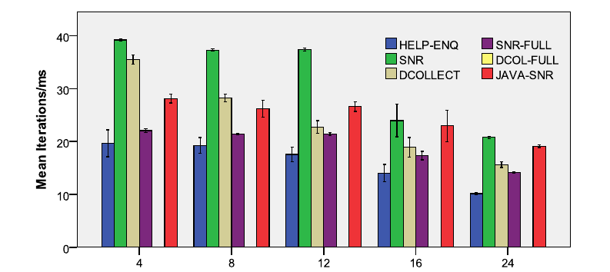
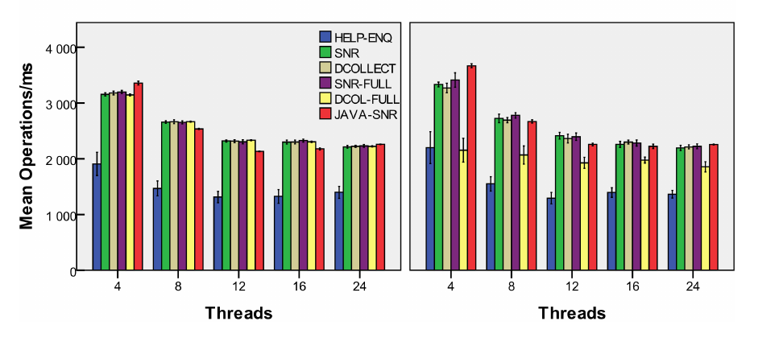
Definitions and Trade-offs
Safeness
Weak regularity
Regularity
Linearizability

Slide 18
Iteration Semantics
An iteration operation should return a state that:
  Is not future
  Is not overwritten by a more recently linearized update operation

Slide 19
Related Work and Iterator Relevance
[PBBO2012] Persistent Concurrent Trie
  Iteration exploiting immutability (Scala)
[PT2013] Linearizable Iteration in Sets
  Commutativity is a key
Java 8: Stream API
  Parallel and Concurrent Map operations on streams, built up using iterations

Slide 20
Future Work
Iteration operations in more complex data structures:
  Hash Tables, Binary Trees
Consistency definitions framework
  Extend in other bulk operations:
  e.g (regular?) range queries in large in-memory data structures
  Need for “partial” iterations:
  in-memory analytics, data streaming

Slide 21
Conclusion
Concurrent Iteration: consistency challenge
Introduce a framework of consistency definitions
Algorithmic implementation trade-offs
  Consistency vs Performance and Efficiency
  Helping methods for Strong Consistency
Extend the framework to bulk read operations on dynamic data sets
(e.g. IoT and BigData applications)

Slide 22
References
[HW90] Maurice P. Herlihy and Jeannette M. Wing, “Linearizability: a correctness condition for concurrent objects,” ACM Trans. Program. Lang. Syst., vol. 12, no. 3, pp. 463–492, July 1990.
[L86] L. Lamport, “On interprocess communication,” Distrib Comput, vol. 1, no. 2, pp. 86–101, Jun. 1986.
[MS96] Maged M. Michael and Michael L. Scott, “Simple, fast, and practical non-blocking and blocking concurrent queue algorithms,” in Proceedings of the fifteenth annual ACM symposium on Principles of distributed computing, New York, NY, USA, 1996, PODC ’96, pp. 267–275, ACM.
[PT2013] E. Petrank and S. Timnat. Lock-free data-structure iterators. In Distributed Computing, number 8205 in LNCS, pages 224–238. Springer, 2013.
[PBBO2012] A. Prokopec, N. G. Bronson, P. Bagwell, and M. Odersky. Concurrent tries with efficient non-blocking snapshots. PPoPP ’12, pages 151–160. ACM, 2012.

Slide 23
Backup slides

Slide 24
Registers – [Lamport86]
Safeness
Regularity
Atomicity
Read(): 10
Read(): 25
Read(): 10
Write(10)
Write(25)
time
Write(10)
Write(10)
Write(10)

