Slide 1

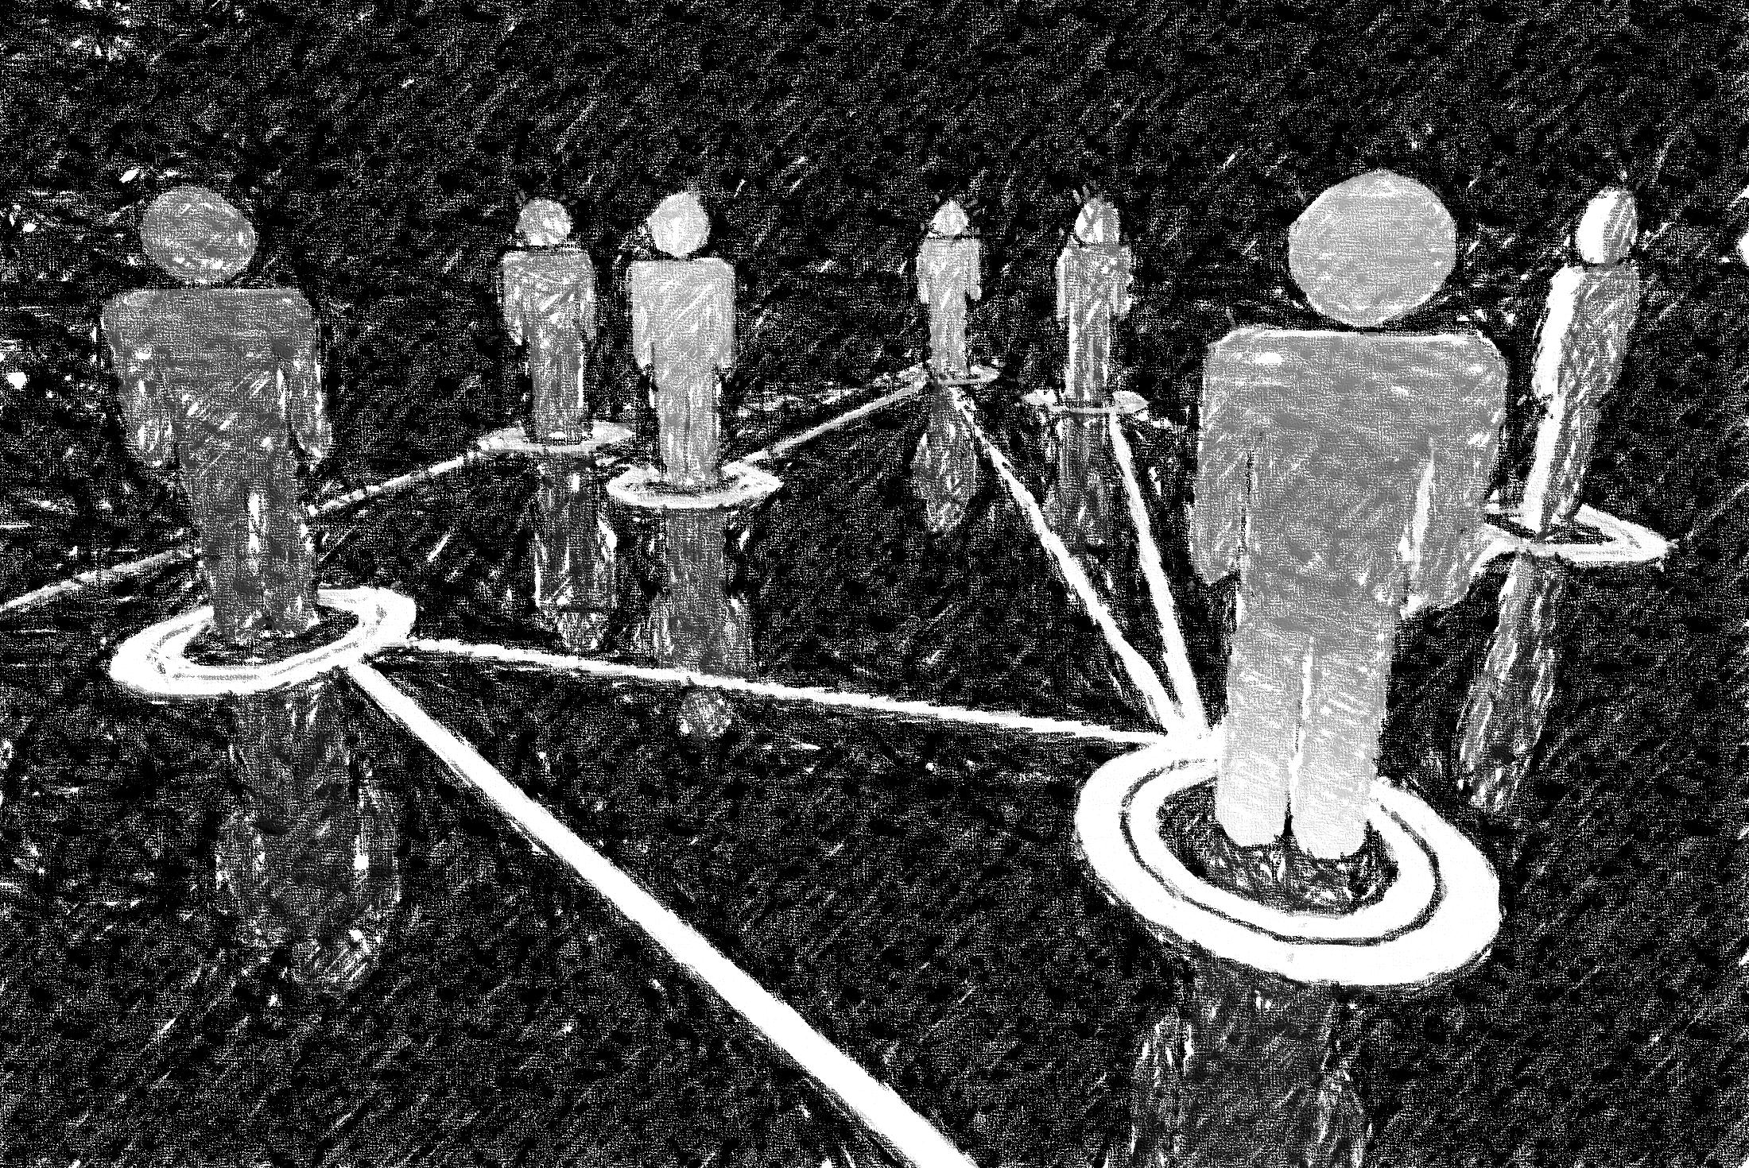

Towards Modeling Legitimate and Unsolicited
Email Traffic Using Social Network Properties
Farnaz Moradi,
Tomas Olovsson, Philippas Tsigas

Slide 2
Legitimate and Unsolicited
Email Traffic
The battle between spammers and anti-spam strategies is not over yet.

Slide 3

Legitimate and Unsolicited
Email Communications
Human-generated communications create implicit social networks
Spam is sent automatically
  It is expected that it does not exhibit the social network properties of human-generated communications
Spam can be identified based on how it is sent
  It is expected that this behavior is more difficult for the spammers to change than the content of the email

Slide 4

Outline
Email Dataset
Email Networks
Social Network Properties
Implication
Conclusions

Slide 5

Email Dataset
SMTP packets were collected (port 25)
Packets were aggregated into TCP flows
Emails were re-constructed from flows
Emails were classified into Accepted and Rejected by receiving mail servers
Accepted emails classified into Ham and Spam using a well-trained SpamAssassin
Automatic anonymization of email addresses extracted from SMTP headers and removal of packet content
OptoSUNET Core Network
SUNET Customers
Access Routers
2 Core Routers
Packets
797 M
40 Gb/s
10 Gb/s (x2)
Flows
46.8 M
NORDUnet
Emails
20 M
Main Internet
Rejected
Accepted
3.4 M
16.6 M
Ham
Spam
1.5 M
1.9 M

Slide 6
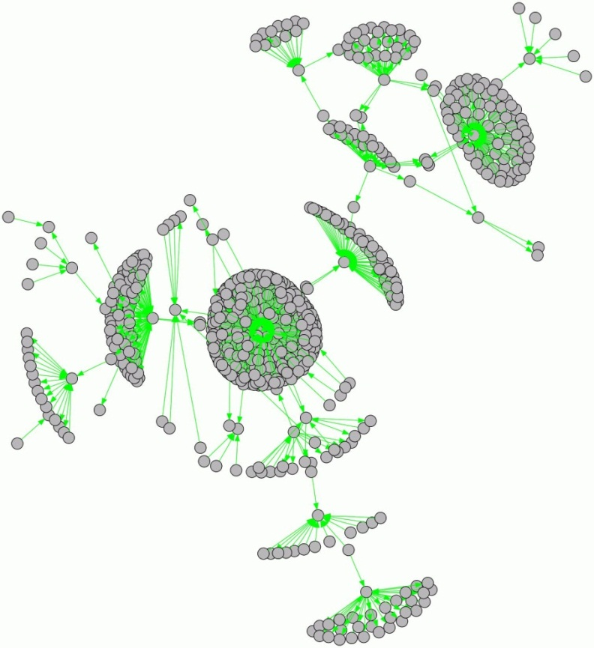
Email Networks
Implicit social networks:
  Nodes (V): Email addresses
  Edges (E): Transmitted Emails
Dataset A:
  |V| = 10,544,647
  |E| = 21,562,306
Dataset B:
  |V| = 4,525,687
  |E| = 8,709,216

Slide 7




Structural and Temporal Properties of Email Networks
Do email networks exhibit similar structural and temporal properties to other Social Networks?
  Scale free (power law degree distribution)
  Small world (short path length & high clustering)
  Connected components (giant core)

Slide 8
Scale-Free Networks
Power law degree distribution
Complete
Ham
Dataset A
Rejected
Spam

Slide 9
Scale-Free Networks
Power law degree distribution
Complete
Ham
Dataset B
Rejected
Spam

Slide 10

Small-World Networks
Small average shortest path length
High average clustering coefficient
Dataset A
Dataset B

Slide 11
Connected Components
Giant connected component
Power law component size distribution
Dataset A
Dataset B

Slide 12
Implications
Spam does not exhibit the social network properties of human-generated communications
The unsolicited email traffic causes anomalies in the structural properties of email networks
These anomalies can be identified by using an outlier detection mechanism
Complete

Slide 13
Identifying Spamming Nodes
Dataset A
1 day
7 days
Dataset | Network | Total spam | Spam sent by outliers (1<k<100)
 | 1 day | 68% | 95.5%
A | 7 days | 70% | 96.8%
 | 14 days | 70% | 96.9%
 | 1 day | 40% | 82.7%
B | 7 days | 35% | 81.3%
 | 14 days | 39% | 87.3%

Slide 14
Conclusions
A network of legitimate email traffic can be modeled similar to other social networks
  Small-world, scale-free network
A network of unsolicited traffic differs from social networks
  Spammers do not emulate a social network
This unsocial behavior of spam is not hidden in the mixture of email traffic
  Spammers can be identified without inspecting the content of the emails
Thank You!

Slide 15
Discussion
SMTP traffic collected on a backbone link can reveal the unsocial behavior of spam
Dataset features:
  Asymmetric Routing
    A comparative analysis of the distinguishing behavior of spam and ham traffic
  Missing Past
    Minor effects on the structural properties
  Measurement Duration
    Evidence on how structural properties might change with longer periods of measurements
OptoSUNET Core Network
SUNET Customers
Access Routers
2 Core Routers
40 Gb/s
10 Gb/s (x2)
NORDUnet
Main Internet

Slide 16


Unsolicited Email Traffic
Consumes network and mail server resources
Goal: stop spam as close to its source as possible
Access
Routers
Core
Routers
MTAs

