Slide 1



Evaluation of Message Passing Synchronization Algorithms in Embedded Systems
Lazaros Papadopoulos, Ivan Walulya, Philippas Tsigas,
Dimitrios Soudris and Brendan Barry
National Technical University of Athens
School of Electrical and Computer Engineering
Division of Computer Science

Slide 2
“Watt’s Next?”
Power consumption
  Design decisions
  Performance/watt metric
Improvements in compute performance
  More power budget
  Cooling problems
http://bit.ly/t6zo2j

Slide 3
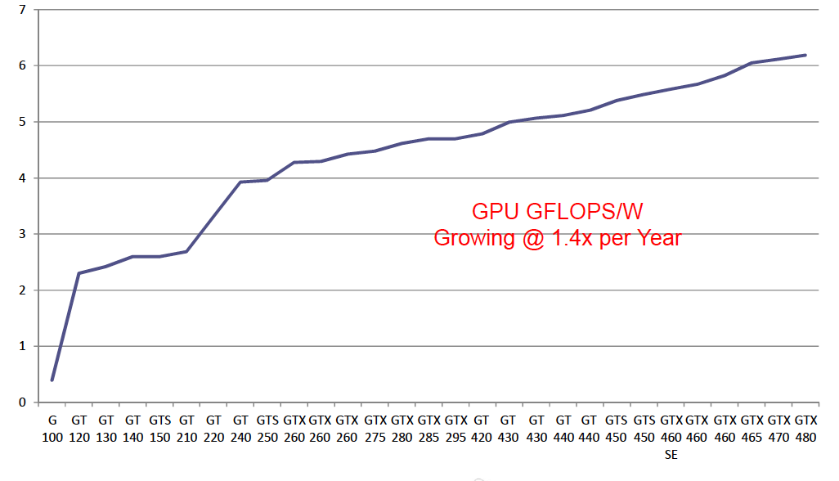
GPU FLOPS/W Trend

Slide 4
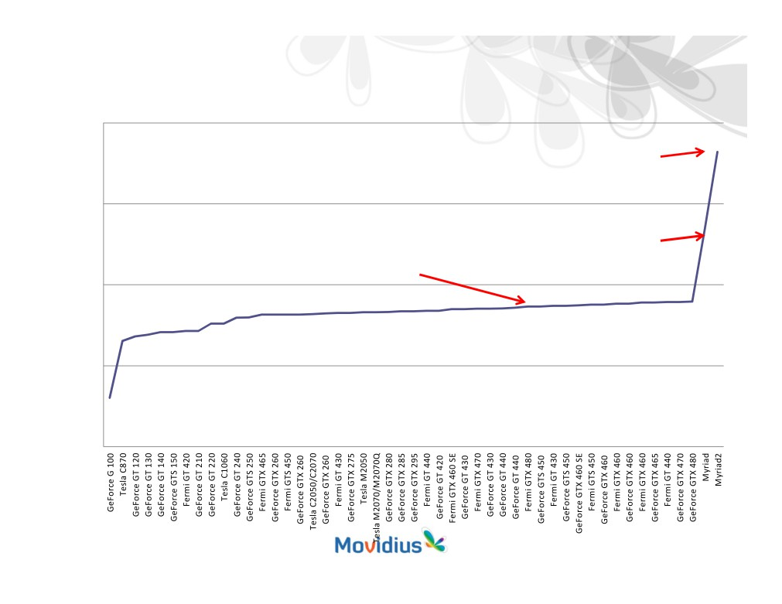

GPU FLOPS/W Trend
Emerging Embedded Systems Trend
1000.00
Myriad 2
28nm 2014
438.86
100.00
GPU rate of increase
Myriad
49.37
1.4x per Year
65nm 2011
7 Years to hit 50GFLOPS/W!
10.00
6.05
6.19
4.99
3.95
2.02
1.00
0.40
0.10
Evaluation of Message Passing Synchronization Algorithms in Embedded Systems 4

Slide 5
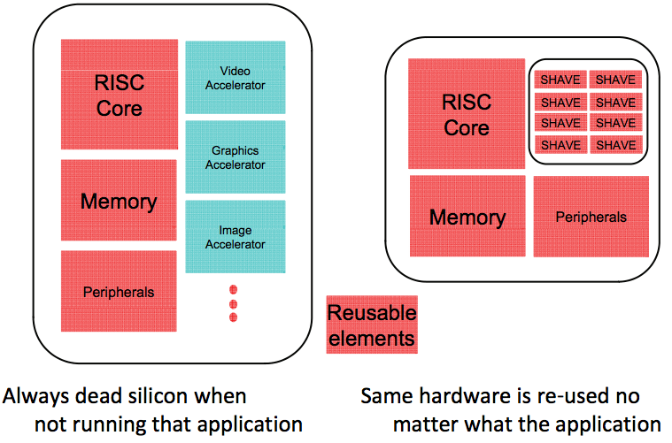
But how?
Old Approach
New Approach

Slide 6
Now that I’ve got an
Ultra low power Compute Platform
What can I do with it?
Potential of such low power processors for use in high end computations.
Can they offer a solution to power problems
Can high-performance computing techniques be deployed on these processors?

Slide 7
Outline
Introduction
  Synchronization on multi-core platforms
  Movidius SoC
Algorithmic Designs
Experimental results
Conclusions

Slide 8
Synchronization
Hardware support
Mutexes
  Scalability
  Busy Waiting
Lock alternatives or lock-free designs??
Message-passing techniques from HPC domain

Slide 9
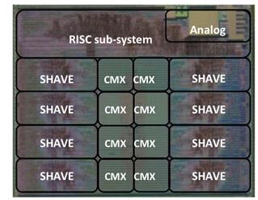
Myriad architecture
Processors:
  32-bit general purpose RISC SPARC processor (LEON).
  8 SHAVE (Streaming Hybrid Architecture Vector Engine) processors for computational processing.
Memory:
  CMX (Connection Matrix): 1 MB on-chip RAM (with 128KB per SH AVE core)
  SDRAM: 64MB.
Synchronization support on Myriad1: Mutexes, FIFO registers

Slide 10
Algorithmic Designs
Single Lock
Double Lock
Client-Server
Remote Core Locking - RCL

Slide 11

Single Lock
No concurrency
Busy waiting
No Scalability
Done
yet?
Done
yet?

Slide 12
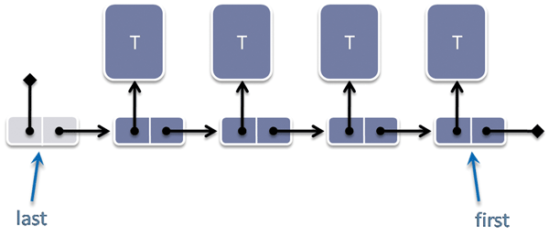
Multiple Locks
Better concurrency
Improved scalability
Busy waiting

Slide 13

Client-Server arbitration (C-S)
Request for access
Spin on local variable
Access granted by server
Limited Concurrency
Thread
Thread
Thread
Thread
Pend
Post
Server
Queue

Slide 14
Remote Core Locking (RCL)
Migrate Critical Section
No shared data transfers
Reduced Bus traffic
Thread
Thread
Post
Server
Queue

Slide 15
Remote Core Locking - RCL
Memory
Th-1
Th-2
Server
enq()
&e6
head
e1
e4
e0
head
Th-1
deq()
tail
head
e5
deq(&e1)
&e1
e5
e1
tail
e4
Th-2
tail
e6
tail
head

Slide 16
RCL - Drawbacks
Clients server communication costs
Serialization of a concurrent data structure
Losing one core

Slide 17
Experimental evaluation
  FIFO Queues
  Cores execute Enqueue and Dequeue operations
    High contention
Test Configurations
  Random, initial size 0
  N/2 Producers / N/2 Consumers, initial size 0
  20,000 Operations
Measured execution time in cycles

Slide 18
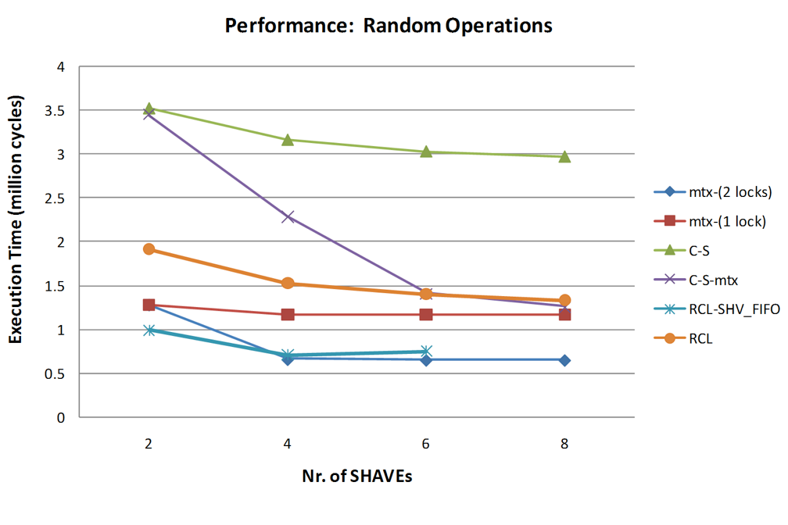
Experimental Results

Slide 19
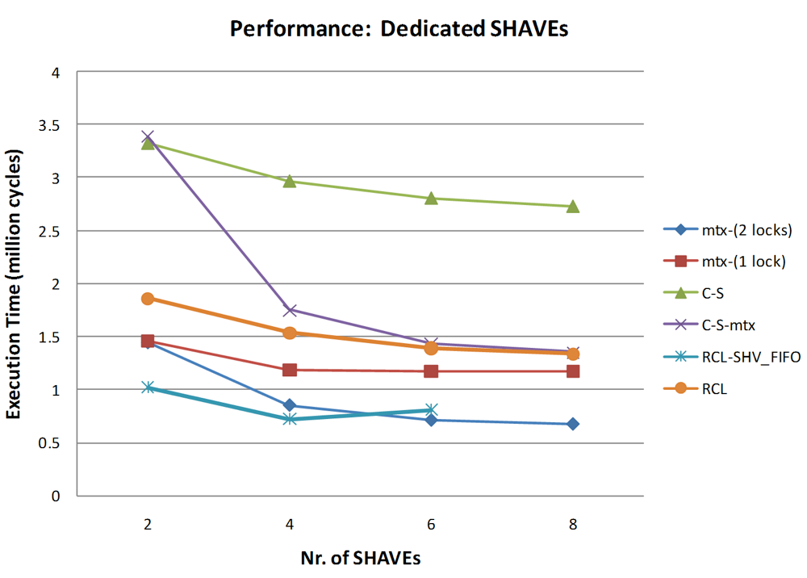
Experimental Results

Slide 20
Conclusions
Complex data structures can be deployed on ultra low power processors
With relatively low absolute performance can they be viable for high-end computing
With 3D stacking it may become possible to stack many processors for very fast and energy-efficient communication

Slide 21

Questions?
Thank You!

