Slide 1
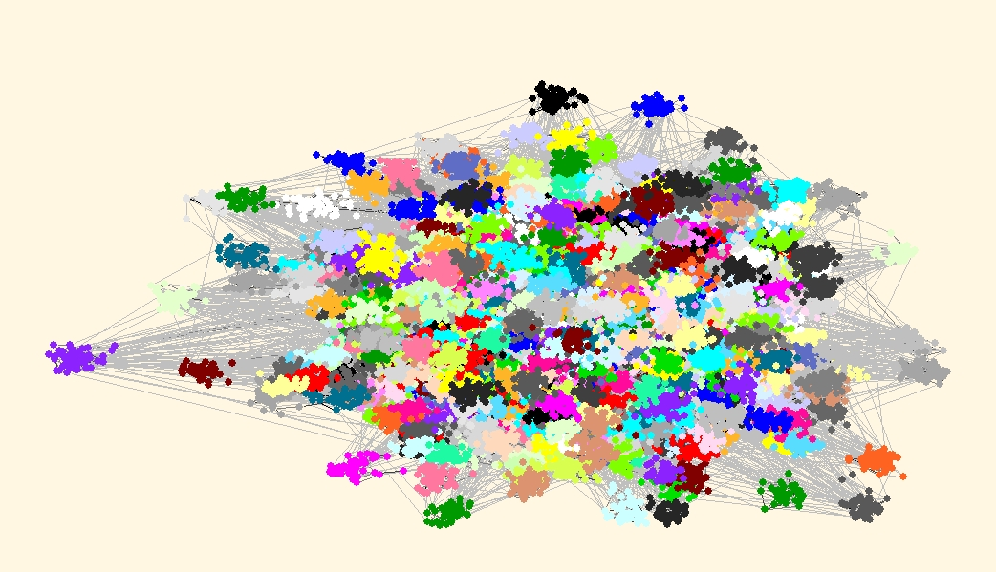


Overlapping Communities for Identifying Misbehavior in Network Communications
Farnaz Moradi, Tomas Olovsson, Philippas Tsigas

Slide 2
Network Misbehavior
Identifying anomalies/intrusions in a graph generated from Internet traffic
Intrusion can be defined as entering communities to which one does not belong [Ding et al. 2012]
  A modularity-based community detection algorithm is not useful
Our alternative definition is being member of multiple communities
  Algorithms which find overlapping communities can be used for intrusion detection
  Non-overlapping communities can be enhanced with auxiliary communities for intrusion detection

Slide 3
Outline
Community detection algorithms
  Overlapping
  Non-overlapping
Framework for network misbehavior detection
Experimental results
  Scanning
  Spamming
Conclusions

Slide 4
Community Detection
Community: a group of densly connected nodes with sparse connections with the rest of the network
Overlapping
Non-overlapping
Notes:
Overlap: a person is in a community of friends, colleagues, family, sport club, ...
... Different algs use very different approaches to identify these different type of communities ....

Slide 5
Auxiliary Communities
Enhancing non-overlapping communities
NA: Neighboring Auxiliary communities
EA: Egonet Auxiliary communities of sink nodes
...
...
...
...
...
...
NA communities
EA communities

Slide 6
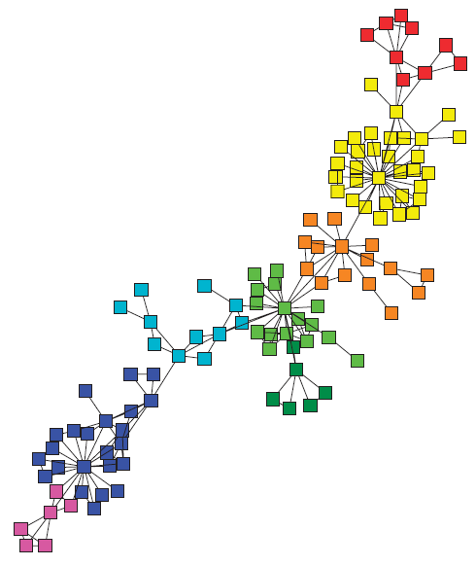
Community Detection Algorithms
Non-overlapping algorithms
  Blondel (Louvain method), [Blondel et al. 2008]
    Fast Modularity Optimization
    Blondel L1: the first level of clustering hierarchy
  Infomap, [Rosvall & Bergstrom 2008]
Overlapping algorithms
  LC, [Ahn et al. 2010]
  LG, [Evans & Lambiotte 2009]
  SLPA, [Xie & Szymanski 2012]
  OSLOM, [Lancichinetti et al. 2011]
  DEMON, [Coscia et al. 2012]
Notes:
Infomap: a group of nodes among which information flows quickly can be aggregated and described as a single well-connected module.

Slide 7
Framework
The network misbehavior detection framework uses:
  A community detection algorithm
    overlapping algorithm
    non-overlapping algorithm enhanced with auxiliary communities
  Filters
    Community-based properties
    Application specific properties
An anomaly score is assigned
to each node
Overlapping communities
Neighbor properties
Community properties
Anomaly Score

Slide 8

Experimental Results
Scan
Incoming traffic flows to SUNET
Malicious sources
  DShield/SRI reports
Blondel L1 enhanced with EA communities
Community properties
$$φ_{1}(v)=\left|communities(v)\right|$$

Slide 9
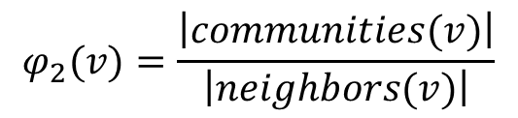

Experimental Results
Spam
Incoming and outgoing SMTP traffic on SUNET
Spam senders
  Content-based filter
Community properties
$$φ_{1}(v)=\left|communities(v)\right|$$
$$φ_{2}(v)=\frac{\left|communities(v)\right|}{\left|neighbors(v)\right|}$$

Slide 10
Experimental Results
Spam
Overlapping
Non-overlapping

Slide 11
Conclusions
Community detection algorithms can be deployed as the basis for network misbehavior detection
  auxiliary communities
  overlapping algorithms
Algorithms which identify coarse-grained communities are not suitable for anomaly detection
EA auxiliary communities are more useful than NA communities
Thank You!

