Slide 1




A Graph-Based Analysis of Medical Queries of a Swedish Health Care Portal
Farnaz Moradi, Ann-Marie Eklund, Dimitrios Kokkinakis,
Tomas Olovsson, Philippas Tsigas

Slide 2
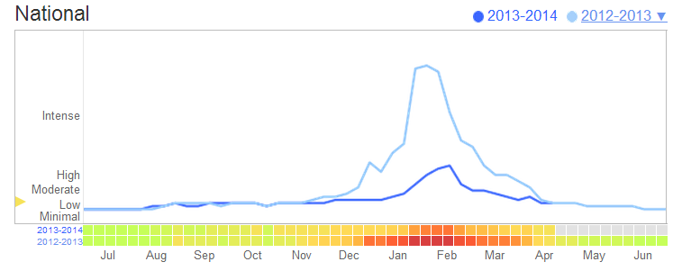
Query Log Analysis
Analysis of query logs is used for
  Improving search experience
  Making suggestions
  User behavior modeling
  Advertisements
  Spell checking
Analysis of health care query logs can be used for
  Track health behavior online (e.g. Google Flu Trends)
  Identifying links between symptoms, diseases, and medicine
Sweden
Notes:
Aggregate search data is used for estimating flu activities. Certain search terms are good indicators of flu activities

Slide 3
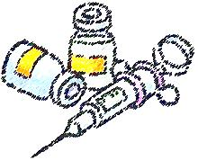
Outline
Dataset
  Swedish health care portal
Our approach
  Semantic analysis
  Graph analysis
Results
  Similarity
  Time window
Conclusions

Slide 4
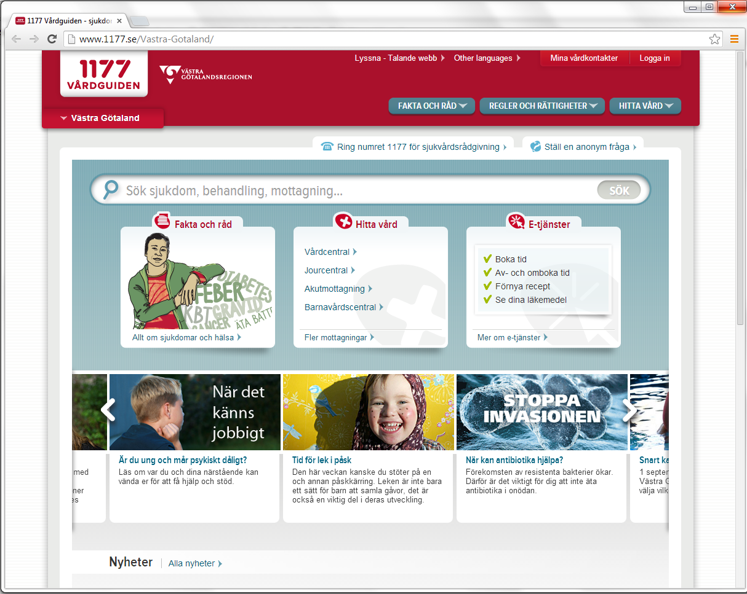
Oct 2010 - Sep 2013
Euroling AB
67 million queries
  27 million unique
  2.2 million unique after case folding
Notes:
Vårdguiden.se: official health information website of the county of Stockholm
1177.se: a common website for Swedish regions and counties and official national phone number for health information and advice
Merged together in November 2013
Euroling AB: provides indexing and search functionality to vårdguiden

Slide 5
Query Log
session ID
timestamp
search query
Q 929C0C14C209C3399CAE7AEC6DB92251 1377986505 symptom brist folsyra hidden:meta:region:00 = 13 1 -N - sv =
Q 2E6CD9E0071057E4BEDC0E52B0B0BDAC 1377986578 folsyra hidden:meta:region:00 = 36 1 -N - sv =
Q 527049C35E3810C45B22461C4CCB2C23 1377986649 kroppens anatomi hidden:meta:region:01 = 25 1 -N - sv =
Q F86B6B133154FD247C1525BAF169B387 1377986685 stroke hidden:meta:region:00 = 320 1 -N - sv =
Q 17CCB738766C545BFE3899C71A22DE3B 1377986807 diabetes typ 2 vad beror på hidden:meta:region:12 = 61 1 -N - sv =
meta data
Links
Batch ID
Spelling suggestions
Swedish

Slide 6
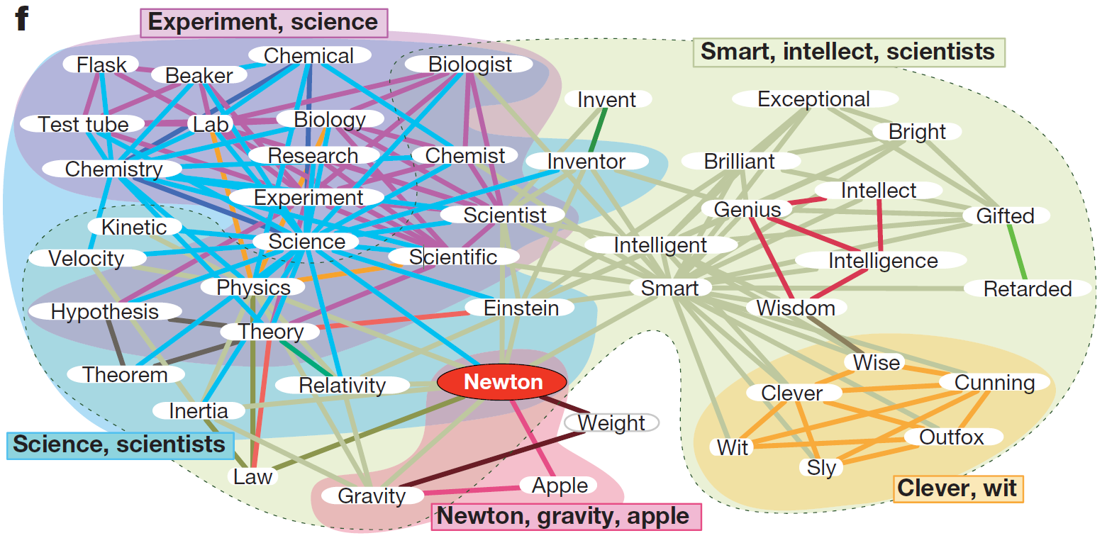
Our approach
  Relations among the words in health-related context
    Word communities
Semantic analysis
  Automatic annotation of logs
Graph analysis
  Network of words
Full word association network around the word ‘Newton’
Yong-Yeol Ahn, James P. Bagrow, Sune Lehmann, “Link communities reveal multiscale complexity in networks”, Nature, 2010.

Slide 7
Semantic Enhancement
Automatic annotation of logs
Two medically-oriented semantic resources
  Systematized Nomenclature of Medicine - Clinical Terms (SNOMED CT)
  National Repository for Medical Products (NPL)
One named entity recognizer
Q 59BC6A34E64C201145CF 1288180864 karolinska sjukhuset hud hidden:meta:category:PageType;Article = 51 1 -N - sv =
ORGZ-ENT body structure¤181469002#39937001¤hud N/A
Named entity
SNOMED CT
NPL
Notes:
SNOMED CT: systematically organized collection of medical terms. Provides code and concept definitions for most clinical areas. 18 top-level hierarchies. 280000 terms
NPL: official Swedish product registry for drugs. 11250 enteries
Named entity recognizer. Ontological categories location, organization, person, time, measure entities

Slide 8
Semantic Communities
Words that co-occurred with the same semantic label
{tandsjukdom, emalj, olika, vanligaste, tandsjukdomar, licken, plack, ovanliga}
tandsjukdom N/A disorder¤234947003¤tandsjukdom N/A
tandsjukdomar N/A disorder¤234947003¤tandsjukdom N/A
vanligaste tandsjukdomar N/A disorder¤234947003¤tandsjukdom N/A
tandsjukdom licken N/A disorder¤234947003¤tandsjukdom N/A
ovanliga tandsjukdomar N/A disorder¤234947003¤tandsjukdom N/A
tandsjukdom emalj N/A disorder¤234947003¤tandsjukdom == body structure¤362113009#76993005¤emalj N/A
olika tandsjukdomar N/A disorder¤234947003¤tandsjukdom N/A
plack tandsjukdom N/A morphologic abnormality¤1522000¤plack == disorder¤234947003¤tandsjukdom N/A

Slide 9
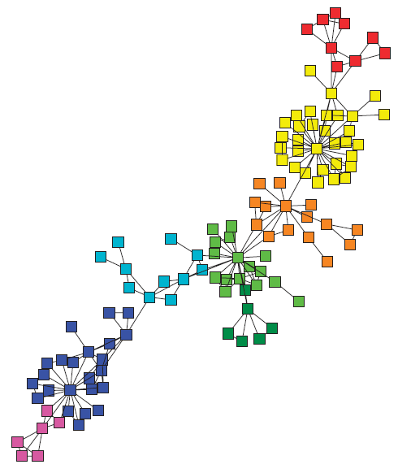
Graph Analysis
Real-world networks are not random graphs
  Social, information, and biological networks
Structural properties
  Scale free
  Small world
  Community structure
Word co-occurrence network
Co-occurrence network of words in sentences in human language is a scale-free, small-world network [Ferrer et al. 2001]

Slide 10
Graph Analysis
Word co-occurrence network
  Nodes= 265,785
  Edges= 1,555,149
  Small world
    Clustering coefficient = 0.34
    Effective diameter = 4.88
  Scale free
    Power-law degree distribution
Algorithms introduced for analysis of social and information networks can be directly deployed for analysis of word co-occurrence graphs

Slide 11
Graph Communities
Personalized PageRank-based community detection algorithm
Random walk-based
Seed expansion
  Local
  Overlapping
  High quality
  Low complexity
…
tandsjukdom
munhåleproblem
licken
hipoplasy
lixhen
rubev
bortnött
barn
…
hypoplazy
emalj
…
…
hypoplazi
hypopla
tändernaamelin
permanentatänder

Slide 12
Results
Semantic communities
  16,427 unique communities
  11% coverage
Graph communities
  107,765 unique communities
  93% coverage
tandsjukdom N/A disorder¤234947003¤tandsjukdom N/A
tandsjukdomar N/A disorder¤234947003¤tandsjukdom N/A
vanligaste tandsjukdomar N/A disorder¤234947003¤tandsjukdom N/A
tandsjukdom licken N/A disorder¤234947003¤tandsjukdom N/A
ovanliga tandsjukdomar N/A disorder¤234947003¤tandsjukdom N/A
tandsjukdom emalj N/A disorder¤234947003¤tandsjukdom == body structure¤362113009#76993005¤emalj N/A
olika tandsjukdomar N/A disorder¤234947003¤tandsjukdom N/A
plack tandsjukdom N/A morphologic abnormality¤1522000¤plack == disorder¤234947003¤tandsjukdom N/A
…
tandsjukdom
munhåleproblem
licken
hipoplasy
rubev
lixhen
bortnött
barn
hypoplazy
emalj
…
…
…
hypoplazi
tändernaamelin
hypopla
permanentatänder

Slide 13

Results
Jaccard similarity
$J\left(S,C\right)=\frac{\left|S ∩C\right|}{\left|S ∪C\right|}$
  {tandsjukdom, emalj, olika, vanligaste, tandsjukdomar, licken, plack, ovanliga}
  {tandsjukdom, licken, munhåleproblem, rubev, emalj, tändernaamelin, hypopla, permanentatänder, lixhen, hypoplazy, hipoplasy, hypoplazi, bortnött, hipoplazy}
  Jaccard similarity = 0.16
Semantic and graph communities capture different word relations

Slide 14
Results
Time window length
  Graphs generated from one month of query logs are structuraly similar to the complete graph
One month
One year

Slide 15
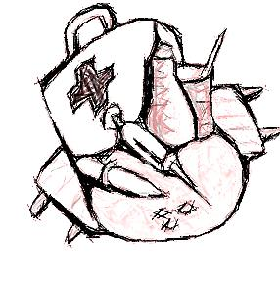
Future Directions
Improvement
  Better handling of word/term variation
  Filtering out non-medical words
  Using co-occurrence frequencies
Applications
  Terminology
  Recommendations
  Reducing ambiguity
  Spelling suggestions

Slide 16
Conclusions
A graph generated from co-occurrence of words in Swedish health-related queries is a small-world, scale-free network and exhibits a community structure.
Graph communities achieve a much higher coverage of the words compared to semantic communities.
Graph communities partially overlap with semantic communities and can complement semantic analysis.
Short time window lengths are adequate for graph analysis of medical queries.
Thank You!

