Slide 1
A Lock-Free Algorithm for Concurrent Bags
Håkan Sundell Anders Gidenstam
Marina Papatriantafilou
Philippas Tsigas
School of business and informatics
University of Borås
Distributed Computing and Systems group,
Department of Computer Science and Engineering,
Chalmers University of Technology

Slide 2
Outline
Introduction
Lock-free synchronization
The Problem & Related work
The new lock-free bag algorithm
Experiments
Conclusions

Slide 3
Synchronization on a shared object
Lock-free synchronization
Allows concurrent operations without enforcing mutual exclusion
Avoids:
Blocking (or busy waiting), convoy effects, priority inversion and risk of deadlock
Progress Guarantee
At least one operation always makes progress
P1
P2
Op B
Op B
Op B
Op A
P4
P3

Slide 4
Correctness of a concurrent object
Desired semantics of a shared data object
Linearizability [Herlihy & Wing, 1990]
For each operation invocation there must be one single time instant during its duration where the operation appears to take effect.
The observed effects should be consistent with a sequential execution of the operations in that order.
O₁
O₂
O₃

Slide 5
Correctness of a concurrent object
Desired semantics of a shared data object
Linearizability [Herlihy & Wing, 1990]
For each operation invocation there must be one single time instant during its duration where the operation appears to take effect.
The observed effects should be consistent with a sequential execution of the operations in that order.
O₁
O₂
O₃
O₁
O₃
O₂

Slide 6
Correctness of a concurrent object
Desired semantics of a shared data object
Linearizability [Herlihy & Wing, 1990]
For each operation invocation there must be one single time instant during its duration where the operation appears to take effect.
The observed effects should be consistent with a sequential execution of the operations in that order.
O₁
O₂
O₃
O₁
O₃
O₂

Slide 7
System Model
Processes can read/write single memory words
Model: Sequential consistency
Synchronization primitives
Built into CPU and memory system
Atomic read-modify-write (i.e. a critical section of one instruction)
Examples: Compare-and-Swap, Load-Linked / Store-Conditional
CPU
CPU
Shared Memory

Slide 8
Outline
Introduction
Lock-free synchronization
The Problem & Related work
The new lock-free bag algorithm
Experiments
Conclusions

Slide 9
The Problem: Concurrent bag shared data object
Basic operations: Add() and TryRemoveAny()
Elements in the bag are unordered
Desired Properties
Linearizable and lock-free
Linearizable means: Add(A) -> TryRemoveAny() returns A; if TryRemoveAny() returns EMPTY then the bag really was empty
Dynamic size (maximum only limited by available memory)
Bounded memory usage (in terms of live contents)
Fast on current systems
A
D
F
B
E
G
C

Slide 10
The Problem: Concurrent bag shared data object
Motivation
Useful for communication/work distribution, e.g.
Implementation of Parallel foreach / forall
Between (unordered) pipeline stages
Abstract data type available in some languages
Bag / Producer-Consumer Collection
.NET C#
…
A concurrent bag can be implemented with other data structures, e.g. queue, stack, …
But “better” service comes at a price

Slide 11
Related Work: Lock-free Multi-P/C Queues
[Michael & Scott, 1996]
Linked-list, one element/node
Global shared head and tail pointers
[Tsigas & Zhang, 2001]
Static circular array of elements
Two different NULL values for distinguishing initially empty from dequeued elements
Global shared head and tail indices, lazily updated
[Michael & Scott, 1996] + Elimination [Moir, Nussbaum, Shalev & Shavit, 2005]
Same as the above + elimination of concurrent pairs of enqueue and dequeue when the queue is near empty
[Hoffman, Shalev & Shavit, 2007] Baskets queue
Linked-list, one element/node
Reduces contention between concurrent enqueues after conflict
Uses stronger memory management than M&S (SLFRC or Beware&Cleanup)
N-1
0

Slide 12
Related Work: Lock-free Multi-P/C Stacks and Pools
L-F stacks
[Michael, 2004]
Linked-list, one element/node
Global shared head pointer
[Michael, 2004] + Elimination [Hendler, Shavit & Yerushalami, 2004]
Same as the above + elimination of concurrent pairs of push and pop.
L-F pool
[Afek, Korland, Natanzon & Shavit, 2010]
Tree of balancers with elimination + queues.

Slide 13
Outline
Introduction
Lock-free synchronization
The Problem & Related work
The new lock-free bag algorithm
Experiments
Conclusions

Slide 14
The Algorithm Basic Idea
Linked-lists of array blocks
One list per thread
Always used by Add()
TryRemoveAny() looks there first
Add()s by different threads do not contend
A TryRemoveAny() has a large number of blocks to choose from
Low risk for contention
Static thread-local storage (TLS)
Used to avoid reading/writing shared state

Slide 15
The Algorithm Basic Idea
Add()
Item is inserted in an empty slot in the first array block in the thread’s list
A new first block is added when all slots have been used
The current slot index is stored in TLS

Slide 16
The Algorithm Basic Idea
TryRemoveAny()
The thread first scans the first block in its list (from the current index in TLS)
When an item is found it is removed via CAS
If the block is empty it is removed from the list

Slide 17
The Algorithm
Issues
Finding items when own list is empty
Detecting that the bag is empty
Managing the linked lists

Slide 18
The Algorithm
Finding items when the own list is empty
Steal items from blocks belonging to other threads
Hence, CAS needed to remove items
Never leave a block until it is empty
Help removing empty blocks

Slide 19
The Algorithm
Detecting that the bag is empty
No single place to look
Scan all blocks of all threads
Items may be added concurrently
Items may be removed concurrently

Slide 20
The Algorithm
Notification mechanism
Per-block bit field
One bit for each thread
All bits cleared by Add()
Thieves set their bit before scanning the block
If the bit is still set for all blocks when the thief rescans the bag is empty?

Slide 21
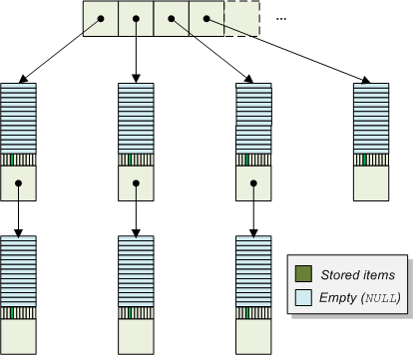
The Algorithm
Notification mechanism
No, there can still be one pending Add per other thread
Cleared the notify bits before the thief started scanning
Items can show up and disappear (removed) during the scan

Slide 22
The Algorithm
Notification mechanism
No, there can still be one pending Add per other thread
Cleared the notify bits before the thief started scanning
Items can show up and disappear (removed) during the scan
Rescan everything #threads+1 times
if found empty in all scans it truly was empty
Pending Add
removed before
rescan reaches here
Pending Add
after rescan was
here

Slide 23
The Algorithm Managing the linked lists
Removing blocks
When the block is scanned and found empty it is marked logically deleted, with mark1
By owner
No problem
By thief
Must not be the first block in the linked-list since owner may add items there
Mark the preceding block with mark2 first
The block cannot be the first
Prevents the block from becoming the first block
Seeing mark1 or mark2 invokes helping
Memory management
(Modified) Hazard pointers scheme [Michael, 2002]

Slide 24
The Algorithm Managing the linked lists
Properties
Only the owner can remove the first block
The last block of each linked-list cannot be removed
Thieves can remove any other block found empty
So
After an linked list has been scanned by TryRemoveAny() there can be at most 2 empty blocks in it
Hence, a thread finding the bag empty will have no more than 2*#threads blocks to traverse once it has helped any pending removals (at most 1 per thread)

Slide 25
Outline
Introduction
Lock-free synchronization
The Problem & Related work
The new lock-free bag algorithm
Experiments
Conclusions

Slide 26
Experimental evaluation
Micro benchmark
Threads execute Add and TryRemoveAny operations on a shared bag
High contention
Test Configurations
Random 50% / 50%, initial size 0
1 Producer / N-1 Consumers, initial size 0
N-1 Producers / 1 Consumer, initial size 0
N/2 Producers / N/2 Consumers, initial size 0
Measured throughput in items/sec
#TryRemoveAny not returning EMPTY
Application
Parallel computation of Mandelbrot set
Producer/Consumer pattern

Slide 27
Experimental evaluation
Algorithms
L-F queue [Michael & Scott, 1996]
L-F queue [Michael & Scott, 1996] + Elimination [Moir, Nussbaum, Shalev & Shavit, 2005]
L-F queue [Tsigas & Zhang, 2001]
L-F queue [Hoffman, Shalev & Shavit, 2007]
L-F stack [Michael, 2004]
L-F stack [Michael, 2004] + Elimination [Hendler, Shavit & Yerushalami, 2010]
L-F pool [Afek, Korland, Natanzon & Shavit, 2010]
The new L-F bag [Gidenstam, Sundell, Papatriantafilou & Tsigas, 2011]
PC Platform
CPU: 2x Intel Xeon X5660 @ 2.8 GHz
6 cores per CPU with 2 hardware threads each => 12 cores, 24 hw threads
RAM: 12 GB DDR3 @ 1333 MHz
Windows 7 64-bit

Slide 28
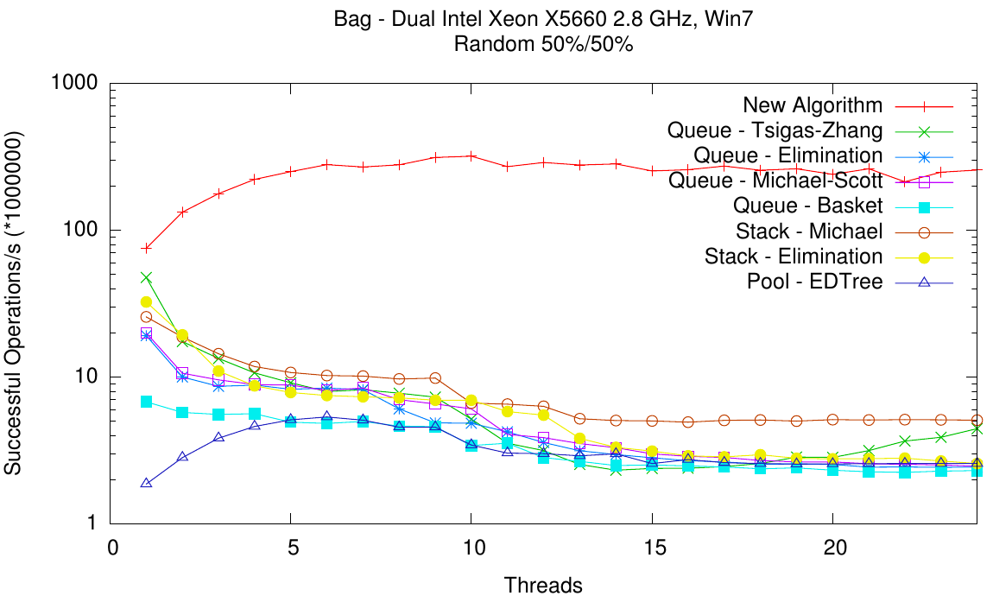
Experimental evaluation (i)

Slide 29
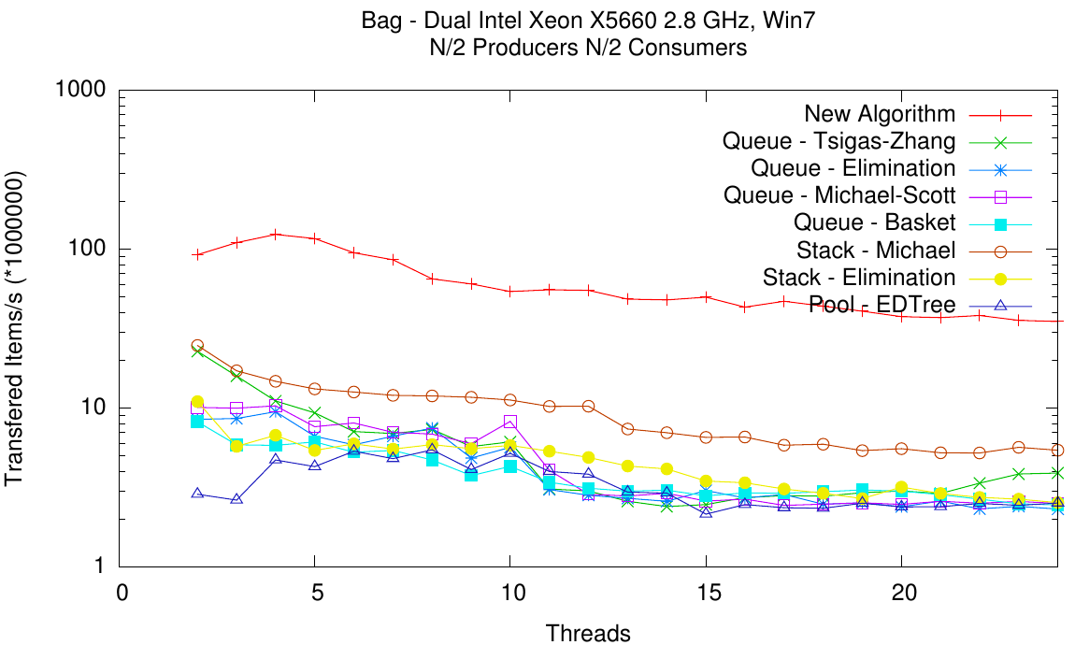
Experimental evaluation (ii)

Slide 30
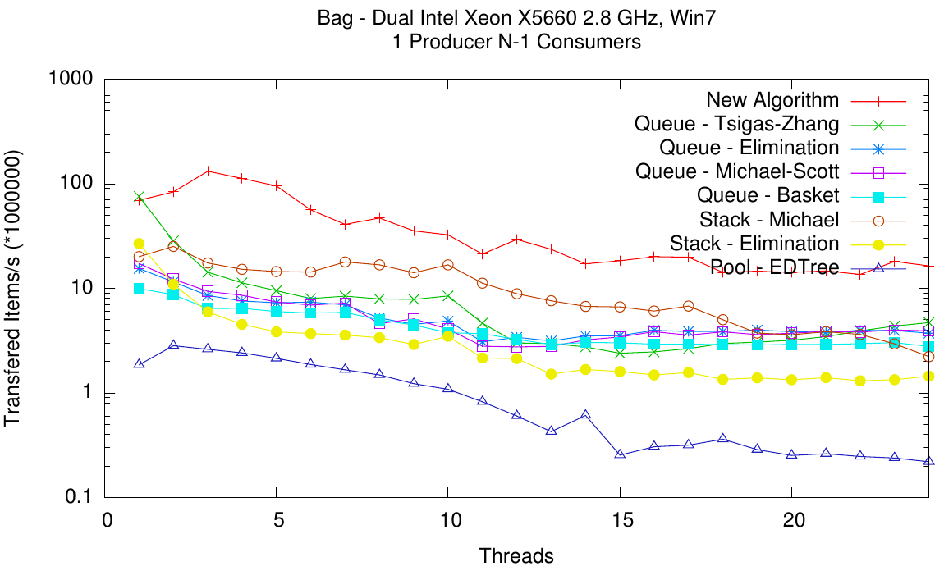
Experimental evaluation (iii)

Slide 31
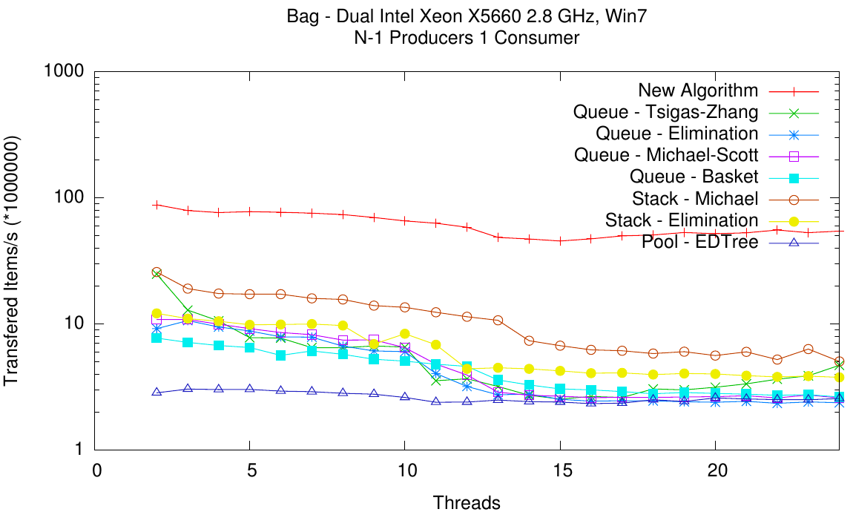
Experimental evaluation (iv)

Slide 32
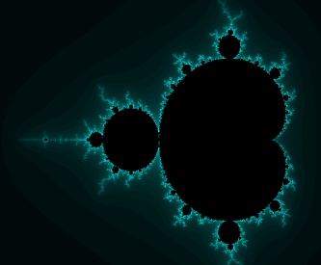
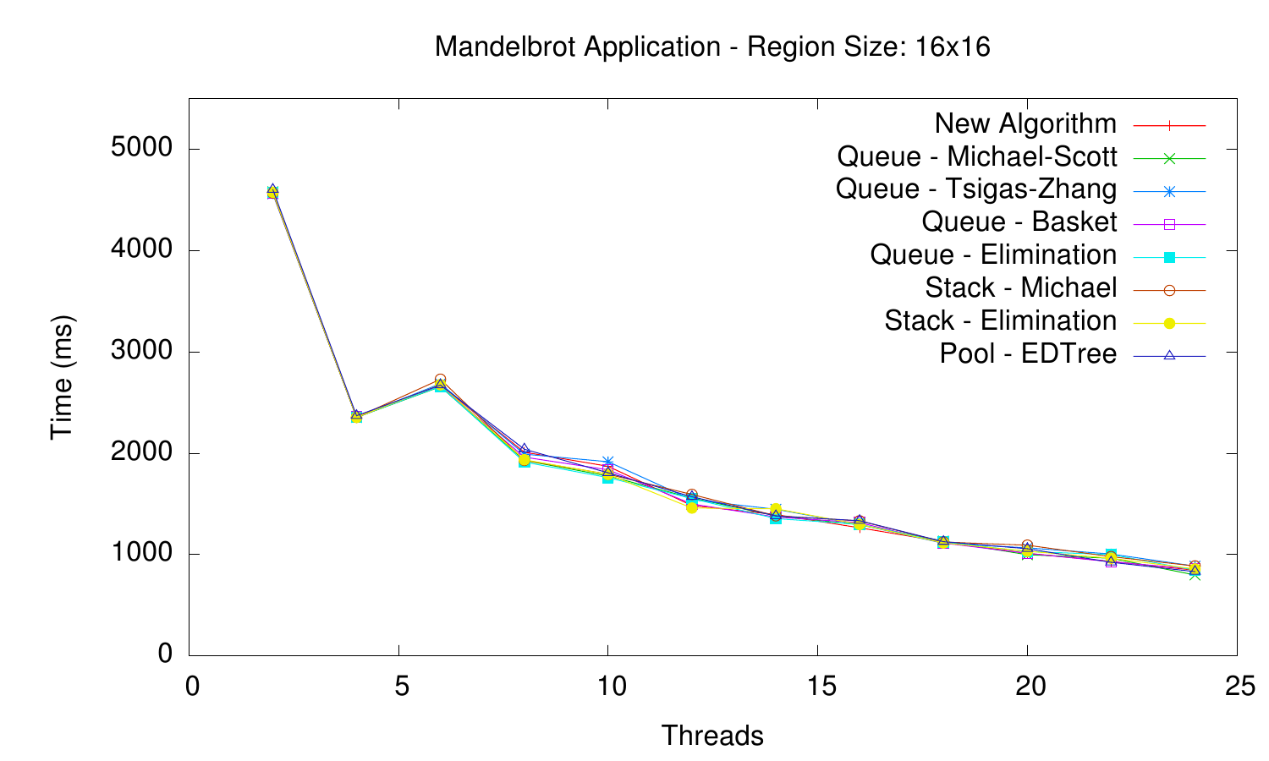
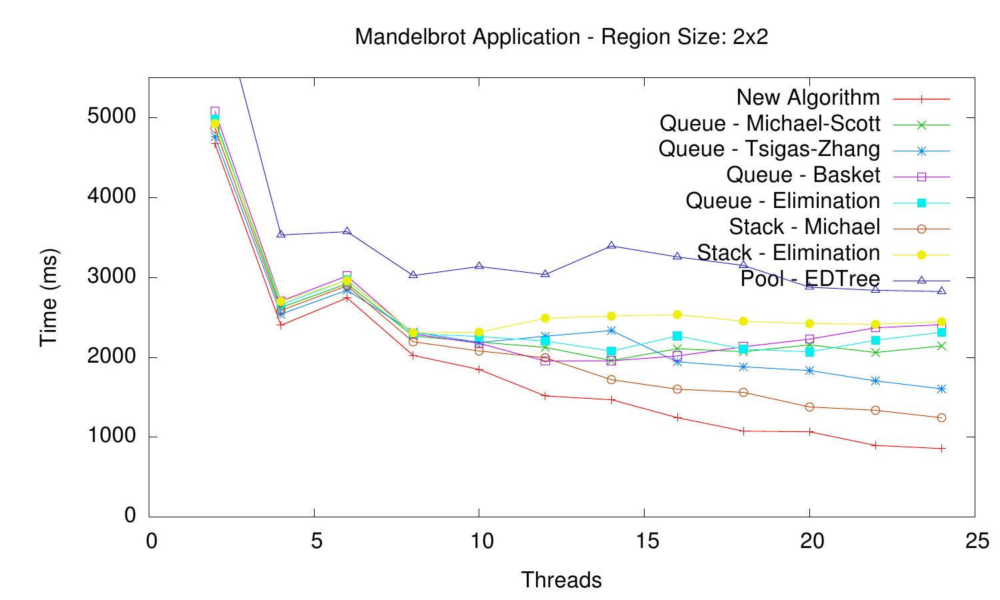
Experimental evaluation (v) Parallel application for the Mandelbrot set
16x16 chunks: Large work units => Low contention on the shared data structure (bag)
2x2 chunks: Small work units => High contention. The bag implementation matters

Slide 33
Conclusions
Lock free and linearizable algorithm for a concurrent bag producer/consumer collection data structure
Distributed design, promoting access-parallelism.
Exploiting thread-local static storage.
Dynamic in size via lock-free memory management.
Only requires atomic primitives available in contemporary systems.

Slide 34
Thank you for listening!
Questions?

