Slide 1
Behavior of Synchronization Methods in Commonly Used Languages and Systems
Distributed Computing and Systems
Chalmers University of Technology
Gothenburg, Sweden
Yiannis Nikolakopoulos
ioaniko@chalmers.se
Joint work with:
D. Cederman, B. Chatterjee, N. Nguyen,
M. Papatriantafilou, P. Tsigas

Slide 2
Developing a multithreaded application…
The boss wants .NET
Java is nice
Multicores everywhere
The client wants speed… (C++?)
Notes:
Multicores everywhrere… thus Joe needs to develop a multithread app.
Project not standarized – needs to choose where to work in

Slide 3
Developing a multithreaded application…
Concurrent Data Structures Then we need Synchronization.
The worker threads need to access data
Notes:
And now the multiple worker threads will need data
A useful model is using concurrent data structures for accessing data
As in every multithreaded application synchronization is necessary and essential: correctness

Slide 4
Implementing Concurrent Data Structures
Implementation
Coarse Grain Locking
Fine Grain Locking
Test And Set
Array Locks
And more!
Performance Bottleneck
Notes:
Let’s see now what choices does Joe have for implementation
... And many more depending on the programming environment

Slide 5
Implementing Concurrent Data Structures
Lock Free
Implementation
Coarse Grain Locking
Fine Grain Locking
Test And Set
Array Locks
And more!
Runtime System
Hardware platform
Which is the fastest/most scalable?

Slide 6

Implementing concurrent data structures
Notes:
There are plenty of options and choices when we design such a data structure

Slide 7
Problem Statement
How the interplay of the above parameters and the different synchronization methods, affect the performance and the behavior of concurrent data structures.
Notes:
Saw the need to study how these parameters along with synchronization, affect the performance and behavior of concurrent ds.

Slide 8
Outline
Introduction
Experiment Setup
Highlights of Study and Results
Conclusion

Slide 9
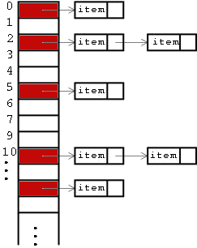
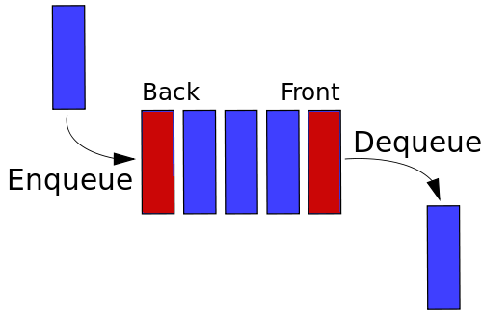
Which data structures to study?
Represent different levels of contention:
Queue - 1 or 2 contention points
Hash table - multiple contention points
Notes:
Out of countless data structures used what is the best needed to test?
Stacks, queues, trees, tries, hash tables, maps, dictionaries…
Since the main issue is concurrency…

Slide 10
How do we choose implementation?
Possible criteria:
Framework dependencies
Programmability
“Good” performance
Notes:
Going back to Joe for a while..
What are the criteria for choosing an implementation

Slide 11
Interpreting “good”
Throughput:
The more operations completed per time unit the better.
Is this enough?
Notes:
Throughput is definitely a way to interpret this
Enough? Maybe yes, maybe no..

Slide 12
Non-fairness
Notes:
Let us recall this case of unfairness

Slide 13
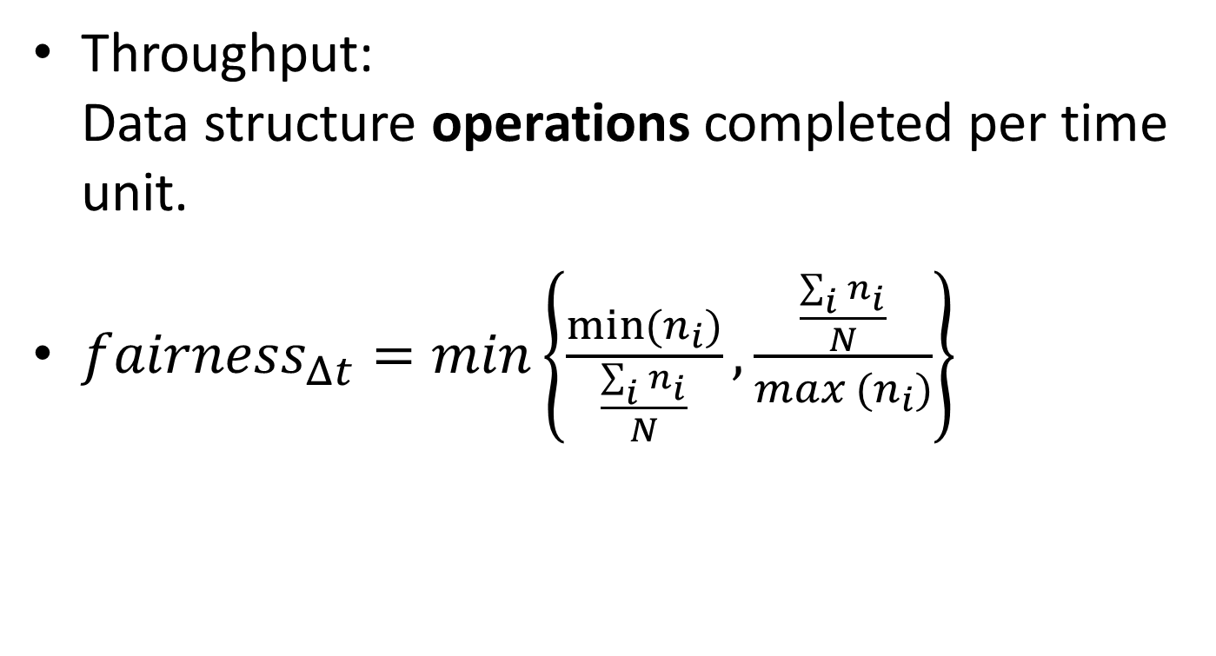
What to measure?
Throughput:
Data structure operations completed per time unit.
${fairness}_{Δt}=min\left\{\frac{min⁡(n_{i})}{\frac{\sum_{i}{n_{i}}}{N}},\frac{\frac{\sum_{i}{n_{i}}}{N}}{max (n_{i})}\right\}$
Average operations per thread
Operations by thread i
Notes:
What should we measure then?
…
Based on some previous work we defined our second measure…

Slide 14
Implementation Parameters
Programming
Environments
C++
Java
C# (.NET,
Mono)
TAS, TTAS, Lock
-
free, Array lock
Synchronization
PMutex,
Methods
Reentrant,
lock
construct,
Lock
-
free memory
synchronized
M
utex
management
NUMA
Intel Nehalem, 2 x 6 core
AMD Bulldozer, 4 x 12 core
Architectures
(24 HW threads)
(48 HW threads)
Do they influence fairness?

Slide 15
Experiment Parameters
Different levels of contention
Number of threads
Measured time intervals

Slide 16
Outline
Introduction
Experiment Setup
Highlights of Study and Results
Conclusion
Queue
  Fairness
  Intel vs AMD
  Throughput vs Fairness
Hash Table
  Intel vs AMD
  Scalability
Notes:
“Selection of highlights” – do not apologize

Slide 17
Fairness can change along different time intervals
Observations: Queue
24 Threads, High contention

Slide 18
Significantly different fairness behavior in different architectures
Observations: Queue
Fairness
24 Threads, High contention
Notes:
Split in 2 parts

Slide 19
Significantly different fairness behavior in different architectures
Observations: Queue
Fairness
24 Threads, High contention
Lock-free is less affected in this case
Notes:
Split in 2 parts

Slide 20
Queue: Throughput vs Fairness
Fairness 0.6 s, Intel
Throughput
C++
C++
1
16
14
0,8
12
0,6
10
8
Operations per ms (thousands)
Fairness
0,4
6
4
0,2
2
0
0
2
4
6
8
12
24
48
2
4
6
8
12
24
48
Threads
Threads
TTAS
Lock-free
PMutex
Notes:
Tradeoff between throughput and fairness
LF and Pmutex balance it
Don’t repeat the legend
Mention again the change of x-axis

Slide 21
Observations: Hash table
Operations are distributed in different buckets
Things get interesting when
#threads > #buckets
Tradeoff between throughput and fairness
  Different winners and losers
  Contention is lowered in the linked list components
Notes:
Diagram here

Slide 22
Fairness differences in Hash table across architectures
Observations: Hash table
24 Threads, High contention

Slide 23
Fairness differences in Hash table across architectures
Observations: Hash table
24 Threads, High contention
Lock-free is again not affected

Slide 24
Observations: Hash table
In C++, custom memory management and lock-free implementations excel in scalability and performance.

Slide 25
Conclusion
Which is the fastest/most scalable?
Complex synchronization mechanisms (Pmutex, Reentrant lock) pay off in heavily contended hot spots
Scalability via more complex, inherently
parallel designs and implementations
Tradeoff between throughput and fairness
  LF Hash table
  Reentrant lock vs Array Lock vs LF Queue
Fairness can be heavily influenced by HW
  Interesting exceptions
Is fairness influenced by NUMA?
Notes:
(remove implicit and easy to use…)
Removed:
Implicit and easy to use language constructs provide decent but moderate results.

