Slide 1


Lock-free Cuckoo Hashing
Distributed Computing and Systems
Chalmers University of Technology
Gothenburg, Sweden
Nhan Nguyen & Philippas Tsigas
ICDCS 2014

Slide 2
Our contributions: a concurrent hash table
For shared memory multicores.
  It is based on cuckoo hashing.
Support multi-readers/multi-writers:
  Query/ Insert/ Delete operations can be performed concurrently.
Guarantee lock-free progress:
  At least one operation completed in a finite time.
  No locking, fault-tolerance.
Achieve great performance and scalability in multicores:
  Outperform state-of-the-art chained and hopscotch hashing implementations.

Slide 3
Concurrent hash tables for multicores
Hash table: a data structure mapping a key to a position in an array, using a hash function
  Efficient random accesses: O(1) search time.
  When multiple keys are hashed to one position:
    Conflict resolutions schemes: separate chaining, linear probing, cuckoo hashing, etc.
Computational model:
  Shared memory multicores.
  Asynchrony:
    Processes running at different speeds, can be halted, delayed…
  Multithreaded programs: simultaneous processes concurrently access shared data.

Slide 4
Concurrent hash tables - Design challenges
Concurrency challenges:
  Concurrency between read and write operations
    Consistency and validity of data: atomicity?
    Scalability: Locking does not scale, especially under high contention.
  Resizing the table, concurrently with other operations.
  Desired properties for concurrent data structures
  Non-blocking progress guarantees.
  Fault tolerance

Slide 5
Concurrent hash tables - State-of-the-art
Lock-free chained hashing [Michael-SPAA02]
  Each bucket points to a linked lists to hold conflicted keys.
  Lock-free ordered linked list is used.
Resizable hash table based on split-ordered lists [Shalev-JACM06]
  Keys is stored in a special (i.e. split-ordered) linked list.
  Natural (and inexpensive) resize.
Concurrent hopscotch [Herlihy-DISC08]
  Linear probing + cuckoo hashing.
  Limit the probing length within a constant k by using a displacement technique during insertion.
And several others!

Slide 6
Outline
Background
  Concurrent hash tables.
  Cuckoo hashing and its concurrent implementations.
Our lock-free cuckoo hashing
  Design challenges and solutions.
Performance evaluation
Conclusions

Slide 7
Cuckoo hashing
H₁: X MOD 10
H_{2:} X DIV 3
19
What is cuckoo hashing? [Pagh2004]
  Two hash functions ⬄ two hash tables.
  A key is stored in either of the tables
  Conflict resolution: relocate existing keys to leave empty slot for the new key.
Why cuckoo hashing?
  An simple yet efficient hashing scheme.
    Query needs two reads.
  Cache advantage.
9
11
2
1

Slide 8
Concurrent cuckoo hashing – State-of-the-art
Lock-based cuckoo hashing [Herlihy-TheArt]
  Lazy relocation: relocation only when the number of elements in a bucket is more than a predefined threshold (e.g. 4).
  An array of locks: need to acquire lock in any operation.
MemC3: Concurrent cuckoo hashing for MemCache [BinFan-NDSI13]
  Single-writer/multi-readers
  Insert and relocation:
    Find cuckoo path.
    Move the hole backward: locking the slots.

Slide 9
Our cuckoo hashing design
Support multi-readers/multi-writers.
Highly concurrent
  Queries are not blocked by modification operations.
  Efficient relocations.
Lock-freedom progress guarantee.
➔First known lock-free cuckoo hashing!
Note: we are not addressing bucketized cuckoo hashing nor the resizing issue.

Slide 10
Outline
Background
  Concurrent hash tables.
  Cuckoo hashing and its concurrent implementations.
Our lock-free cuckoo hashing
  Design challenges and solutions.
Performance evaluation
Conclusions

Slide 11
Concurrent cuckoo hashing – Additional challenges
Elements can be stored in two tables of a single data structure.
Elements can be moved between tables.
➔Challenges in concurrency control while guaranteeing:
  Consistency?
    Keys being modified are under movement.
  Correctness?
    Keys under movement might be invisible to query.
  Progress & efficiency: Locking or non-blocking?

Slide 12

Concurrency Issue 1: Query vs Relocation
H₁: X MOD 10
H_{2:} X DIV 3
Thread 1
Thread 2
Thread 3
19
INS 1
MOV 11
Q 11?
In H₁?
In H₂?
INS 9
MOV 11
11
11
2
11?

Slide 13
Concurrency Issue 1: Query vs Relocation
H₁: X MOD 10
H_{2:} X DIV 3
Thread 1
Thread 2
Thread 3
19
INS 1
MOV 11
Q 11?
In H₁?
In H₂?
INS 9
MOV 11
Key exists!
But QUERY returns FALSE?
11
2
11?

Slide 14

Solution 1: Two-round query
H₁: X MOD 10
H_{2:} X DIV 3
Thread 1
Thread 2
Thread 3
19
INS 1
MOV 11
Q 11?
In H₁?
In H₂?
In H₁?
In H₂?
INS 9
MOV 11
11
2
11?

Slide 15
Concurrency Issue 1: more problems?
H₁: X MOD 10
H_{2:} X DIV 3
Thread 1
Thread 2
Thread 3
19
INS 1
MOV 11
Q 11?
In H₁?
In H₂?
In H₁?
In H₂?
INS 9
MOV 11
INS 21
MOV 11
INS 10
MOV 11
11
11
2
11?

Slide 16
Solution 1: Two-round query + logical timestamp
H₁: X MOD 10
H_{2:} X DIV 3
Thread 1
Thread 2
Thread 3
19
INS 1
MOV 11 [+1]
Q 11?
In H₁? t₁
In H₂? t₂
In H₁? t’₁
In H₂? t’₂
t’₁≥t₁+2 & t’₂≥t₁+2
INS 9
MOV 11 [+1]
Restart the QUERY if:
t’₁ ≥ t₁ + 2 AND t’₂ ≥ t₁ + 2
INS 21
MOV 11 [+1]
INS 10
MOV 11 [+1]
t₂
t₁
11
2
11?

Slide 17

Concurrency Issue 2: Relocation of keys
H₁: X MOD 10
H_{2:} X DIV 3
H₁: X MOD 10
H_{2:} X DIV 3
t₃
19
19
9
9
19
- “Nestless” keys
- Chain of locks
- Query is also being blocked
t₄
19
19
9
t₂
11
9
9
11
11
1
1
t₁
11
11
2
2
1
1
17

Slide 18
Solution 2: Fine-grained relocation process
H₁: X MOD 10
H_{2:} X DIV 3
H₁: X MOD 10
H_{2:} X DIV 3
19
t₃
9
9
19
19
No “nestless” key
No chain of locks
Query operations are not blocked
Relocation by a simple “MOVE”
  Use single-word Compare-And-Swap primitives
  Helping is needed for progress
- “Nestless” keys
- Chain of locks
- Query is also being blocked
t₄
19
19
9
t₂
11
9
9
11
11
1
t₁
11
11
1
2
2
1
1
18

Slide 19
Concurrency Issue 3: Concurrent Insertions
H₁: X MOD 10
H_{2:} X DIV 3
Is duplication OK?
With respect to the correctness!
Depends:
Query:
  No problem, decide on one!
Insert:
  Does it need care? YES!
Remove:
  more care, remove one or both?
19
W
11
Y
11
X
2
Z
Insert <11,X> Insert <11,Y>

Slide 20
Solution 3: Help deleting duplication
H₁: X MOD 10
H_{2:} X DIV 3
Is duplication OK?
Our proposal:
Allow duplication
  Element in the first table is the valid one.
QUERY to query: Return the first found <key, value>
QUERY to modify: be aware of, and help delete one duplication, so that:
  Insert: have space for new or relocated keys.
  Delete: make sure a deleted key no longer exists.
19
W
11
Y
11
X
2
Z
Insert <11,X> Insert <11,Y>

Slide 21
Correctness and progress guarantee
Correctness
  Linearizability: each operation takes affect at an instant point in time
  Proved by pointing out linearization points
  Progress guarantee: Lock-freedom
  There is always an operation completes after a finite number of steps
See paper for the proof.

Slide 22
Outline
Background
  Concurrent hash tables.
  Cuckoo hashing and its concurrent implementations.
Our lock-free cuckoo hashing
  Design challenges and solutions.
Performance evaluation
Conclusions

Slide 23
Experimental setup
Implementation
  C++ with GNU GCC 4.7
Experimental methods
  Micro benchmark: synthesized threads performing operations on a shared hash table.
Platform:
  2x8-core Intel Xeon with HyperThreading: 32 hardware threads.
  Linux kernel 3.0
Compared with:
  Hopscotch hashing [Herlihy-DISC08] – Maybe the fastest!
  Lock-based chained hashing [Knuth-TheArt].

Slide 24
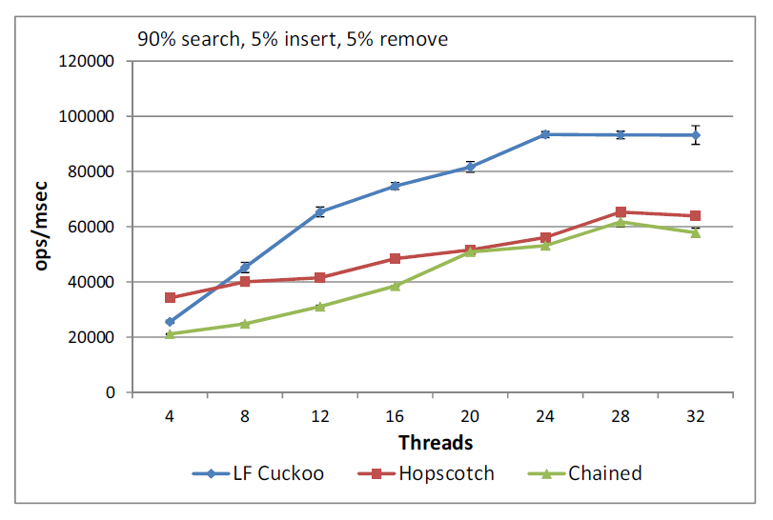
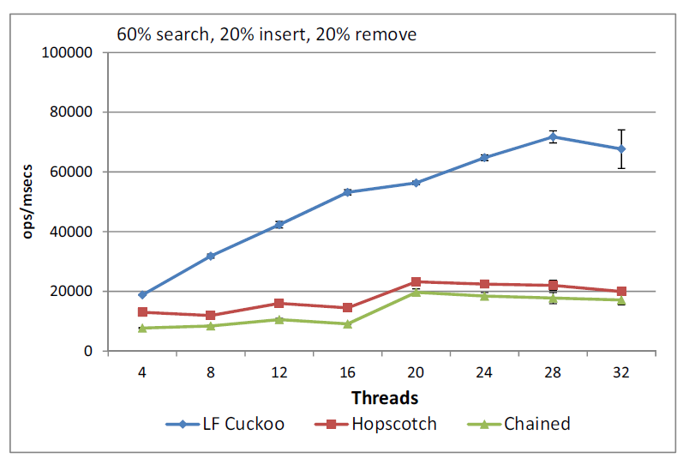
Throughput
Lock-free Cuckoo
Lock-free Cuckoo

Slide 25
Cache behaviour

Slide 26
Outline
Background
  Concurrent hash tables.
  Cuckoo hashing and its concurrent implementations.
Lock-free cuckoo hashing
  Design challenges and solutions.
Performance evaluation
Conclusions

Slide 27
Conclusions
We proposed an efficient concurrent hash table:
  Use cuckoo hashing technique.
  Support concurrency among all operations.
  Guarantee lock-freedom.
  Achieve great performance and scalability.
Future improvements
  Resize
  Improve table density:
    Current: <50% density (~ cuckoo hashing).
    Using bucket: multiple elements in a table slot.

Slide 28
Questions?
Thank you!
Nhan Nguyen:
nhann@chalmers.se / ndnhan@gmail.com
Distributed Computing and Systems, DCS @Chalmers
http://www.cse.chalmers.se/research/group/dcs/

Slide 29
Comparisons
Hopscotch hashing - combine cuckoo and linear hashing [Herlihy2008]
  Linear probing but guarantee no more than n probes (n<32)
  (Maybe) current fastest hashing.
Lock-based chained hashing [KnuthTheArt].
  Linked list to store conflicted keys hashing to the same bucket.
  Number of locks = concurrency level

Slide 30
Challenges in designing hash table
Conflict resolution
  Closed addressing: separate chaining
  Open addressing: linear probing, cuckoo hashing, hopscotch hashing
Efficiency:
  Worst case scenario: O(1) search complexity
Resize

Slide 31
Hash table
Mapping a key to a position in a array, using a hash function
  Constant search time O(1)
  Efficient random accesses
Is a fundamental search/associative data structure
Applications:
  Database systems
  Cache
  Symbol tables, e.g. compiler.
  Data dictionaries, associative arrays

