Slide 1
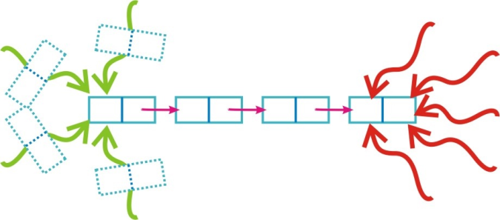
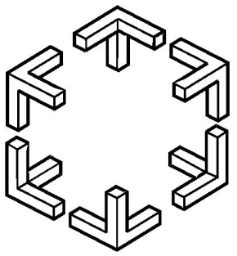
Understanding Performance of Concurrent Data Structures on Graphics Processors
Daniel Cederman, Bapi Chatterjee, Philippas Tsigas
Euro-PAR
2012
Distributed Computing and Systems
D&IT, Chalmers University, Sweden
(Supported by PEPPHER, SCHEME, VR)

Slide 2
Main processor
Uniprocessors – No more
Multi-core, Many-core
Co-processor
Graphics Processors
SIMD, N x speedup
Parallelization on GPU (GPGPU)
CUDA, OpenCl
Independent of CPU
Ubiquitous

Slide 3
Data structures + Multi-core/Many-core = Concurrent data structure
Rich literature and growing
Applications
CDS on GPU
Synchronization aware applications on GPU
Challenging but required
Concurrent Programming
Parallel Slowdown

Slide 4
Concurrent Data Structures on GPU
Implementation Issues
Performance Portability

Slide 5
Outline of the talk
GPU (Nvidia)
Architecture Evolution
Support to Synchronization
Concurrent Data Structure
Concurrent FIFO Queues
CDS on GPU
Implementation & Optimization
Performance Portability Analysis

Slide 6
Outline of the talk
GPU (Nvidia)
Architecture Evolution
Support to Synchronization
Concurrent Data Structure
Concurrent FIFO Queues
CDS on GPU
Implementation & Optimization
Performance Portability Analysis

Slide 7
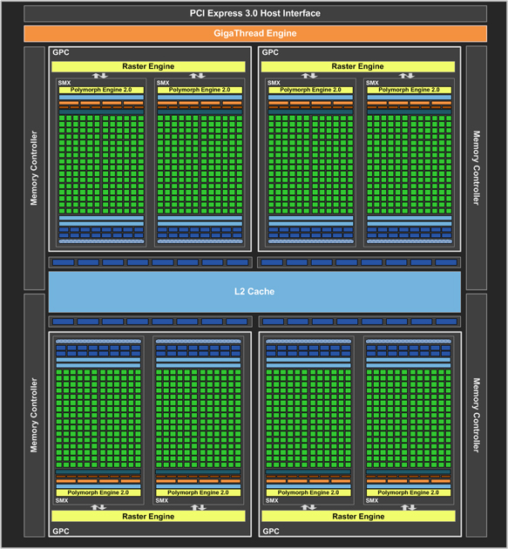
GPU Architecture Evolution
Processor | Atomics | Cache
Tesla(CC 1.0) | No Atomics | No Cache
Tesla (CC = 1.x, x>0) | Atomics available | No Cache
Fermi (CC=2.x) | Atomics on L2 | Unified L2 and Configurable L1
Kepler (CC=3.x) | Faster than earlier | L2 73% faster than Fermi

Slide 8
Compare and Swap (CAS) on GPU
CAS behavior on GPUs

Slide 9
CDS on GPU – Motivation & Challenges
Transition from a pure co-processor to a more independent compute unit.
CUDA and OpenCL.
Synchronization primitives getting cheaper with availability of multilevel cache.
Synchronization aware programs vs. inherent SIMD.

Slide 10
Outline of the talk
GPU (Nvidia)
Architecture Evolution
Support to Synchronization
Concurrent Data Structure
Concurrent FIFO Queues
CDS on GPU
Implementation & Optimization
Performance Portability Analysis

Slide 11
Concurrent Data Structure
Synchronization Progress guarantee.
Blocking.
Non-blocking.
Lock – free
Wait - free

Slide 12
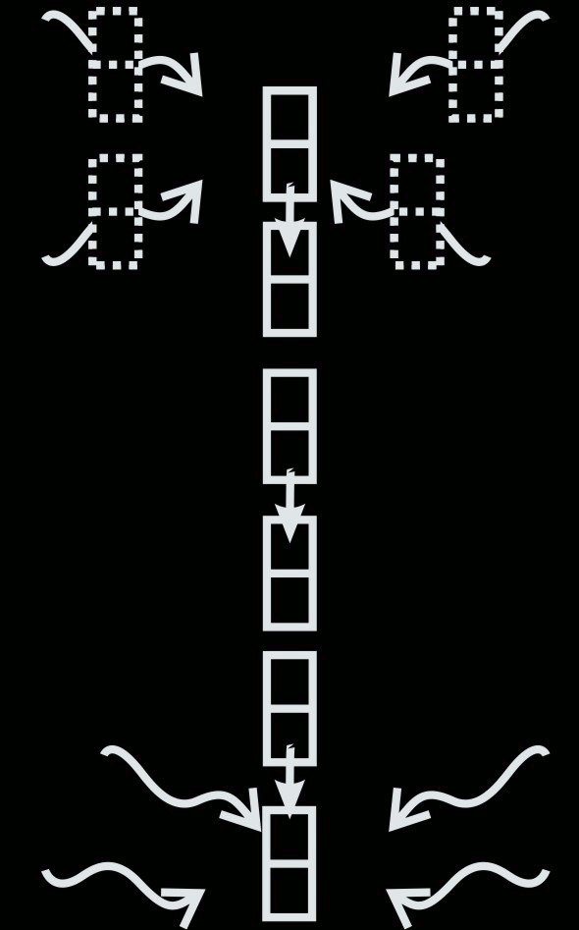
Concurrent FIFO Queues

Slide 13
Concurrent FIFO Queues
Single Producer Single Consumer (SPSC) | Multi Producer Multi Consumer (MPMC)
Lamport 1983 : Lamport Queue | Michael & Scott 1997 : MS-Queue (Blocking and non-blocking)
Giacomoni et al. 2008 : FastForward Queue | Tsigas & Zhang 2001: TZ-Queue
Lee et al. 2009 : MCRingBuffer Preud'homme et al. 2010 : BatchQueue

Slide 14
SPSC FIFO Queues
Lamport [1]
enqueue (data) {
if (NEXT(head) == tail)
return FALSE;
buffer[head] = data;
head = NEXT(head);
return TRUE;
}
dequeue (data) {
if (head == tail) {
return FALSE;
data = buffer[tail];
tail = NEXT(tail);
return TRUE;
}
Lock-free, Array-based.
Synchronization through atomic read and write on shared head and tail Causes cache thrashing.

Slide 15
SPSC FIFO Queues
FastForward [2]
head and tail private to producer and consumer lowering cache thrashing.
BatchQueue [3]
The queue is divided into two batches – producer writes to one of them while the consumer reads from the other one.

Slide 16
SPSC FIFO Queues
MCRingBuffer [4]
Similar to BatchQueue but handles many batches.
Many batches may cause less latency if producer is not fast enough.

Slide 17
MPMC FIFO Queues
MS-queue (Blocking) [5]
Linked-List based.
Mutual exclusion locks to synchronize.
CAS-based spin lock and Bakery Lock – fine Grained and Coarse grained.

Slide 18
MPMC FIFO Queues
MS-queue (Non-blocking) [5]
Lock-free.
Uses CAS to add nodes at tail and remove nodes from head.
Helping mechanism between threads leads to true lock-freedom.

Slide 19
MPMC FIFO Queues
TZ-Queue (Non-Blocking) [6]
Lock-free, Array-based.
Uses CAS to insert elements and move head and tail.
head and tail pointers are moved after every x:th operation.

Slide 20
Outline of the talk
GPU (Nvidia)
Architecture Evolution
Support to Synchronization
Concurrent Data Structure
Concurrent FIFO Queues
CDS on GPU
Implementation & Optimization
Performance Portability Analysis

Slide 21
Implementation Platform
Processor | Clock Speed | Memory Clock | Cores | LL Cache | Architecture
8800GT | 1.6GHz | 1.0GHz | 14 | 0 | Tesla(CC 1.1)
GTX280 | 1.3GHz | 1.1GHz | 30 | 0 | Tesla(CC 1.3)
Tesla C2050 | 1.2GHz | 1.5GHz | 14 | 786kB | Fermi(CC 2.0)
GTX680 | 1.1 GHz | 3.0GHz | 8 | 512kB | Kepler(CC 3.0)
Intel E5645(2x) | 2.4GHz | 0.7GHz | 24 | 12MB | Intel HT

Slide 22
GPU implementation
A thread-block works either as a producer or as a consumer.
Varying number of thread blocks for MPMC queues.
Shared Memory is used for private variables of producer and consumer.

Slide 23
GPU optimization
BatchQueue and MCRingBuffer - advantage of shared memory to make them Buffered.
Coalescing in memory transfer in buffered queues.
Empirical optimization in TZ-Queue – move the pointers after every second operation.

Slide 24
Experimental Setup
Throughput = # {successful enque or deque} / ms.
MPMC experiments : 25% enque and 75% deque.
Contention – high and low.
In CPU, producers and consumers were put on different sockets.

Slide 25
SPSC on CPU
Throughput
Cache Profile
Reducing Cache Thrashing Increasing Throughput

Slide 26
SPSC on GPU
Throughput
GPU without cache – no cache thrashing.
GPU Shared memory advantage – Buffering.
High memory clock + faster cache advantage – unbuffered.

Slide 27
MPMC on CPU
Best Lock based vs Lock-free
(High Contention)
Best Lock based vs Lock-free
(Low Contention)
SpinLock (CAS based) beats the bakery lock (read/write).
Lock free better than Blocking.

Slide 28
MPMC on GPU
(High Contention)
GTX280(CC 1.3)
C2050(CC 2.0)
Newer Architecture
Scalability
GTX680(CC 3.0)

Slide 29
Compare and Swap (CAS) on GPU
CAS behavior on GPUs

Slide 30
MPMC on GPU
(Low Contention)
GTX280(CC 1.3)
C2050(CC 2.0)
Lower Contention
Scalability
GTX680(CC 3.0)

Slide 31
Summary
Concurrent queues are in general performance portable from CPU to GPU.
The configurable cache are still NOT enough to remove the benefit of redesigning algorithms from GPU shared memory viewpoint.
Significantly improved atomics in Fermi and further in Kepler is a big motivation for algorithmic designs of CDS for GPU.

Slide 32
References
Lamport L.: Specifying Concurrent program modules. ACM Transactions on Programming Languages and Systems 5, (1983), 190 -222
Giacomoni, J., Moseley, T., Vachharajani, M.: FastForward for efficient pipeline parallelism: a cache-optimized concurrent lock-free queue. In: Proceedings of the 13th ACM SIGPLAN Symposium on Principles and practice of parallel programming, ACM (2008) 43-52
Preud'homme, T., Sopena, J., Thomas, G., Folliot, B.: BatchQueue: Fast and Memory-Thrifty Core to Core Communication. In: 22nd International Symposium on Computer Architecture and High Performance Computing (SBAC-PAD). (2010) 215-222
Lee, P.P.C., Bu, T., Chandranmenon, G.: A lock-free, cache-efficient shared ring Buffer for multi-core architectures. In: Proceedings of the 5th ACM/IEEE Symposium on architectures for Networking and Communications Systems. ANCS '09, New York, NY, USA, ACM (2009) 78-79
Michael, M., Scott, M.: Simple, fast, and practical non-blocking and blocking concurrent queue algorithms. In: Proceedings of the 15th annual ACM symposium on Principles of distributed computing, ACM (1996) 267-275
Tsigas, P., Zhang, Y.: A simple, fast and scalable non-blocking concurrent fifo queue for shared memory multiprocessor systems. In: Proceedings of the 13th annual ACM symposium on Parallel algorithms and architectures, ACM (2001) 134-143

