Slide 1
Performance and power consumption evaluation of concurrent queue implementations in embedded systems
Lazaros Papadopoulos, Ivan Walulya, Paul Renaud-Goud, Philippas Tsigas,
Dimitrios Soudris and Brendan Barry
National Technical University of Athens
School of Electrical and Computer Engineering
Division of Computer Science

Slide 2
“Watt’s Next?”
Power consumption
Design decisions
Performance/watt metric
Improvements in compute performance
More power budget
Cooling problems
http://bit.ly/t6zo2j

Slide 3
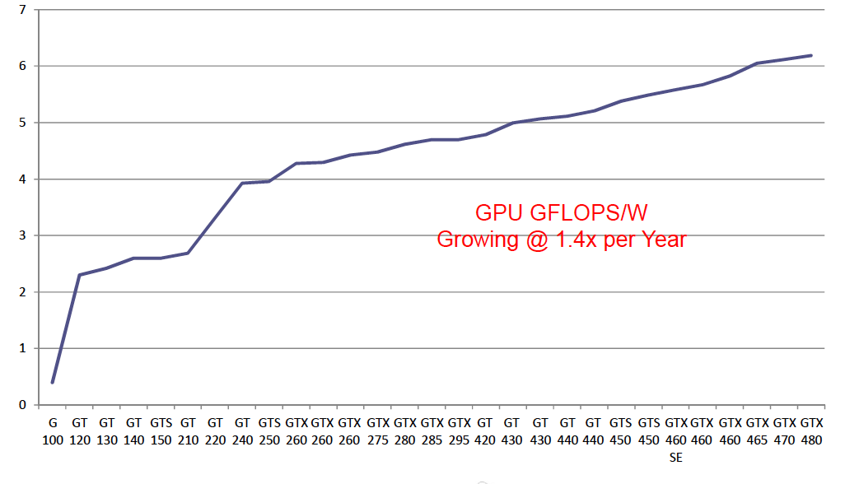
GPU FLOPS/W Trend

Slide 4
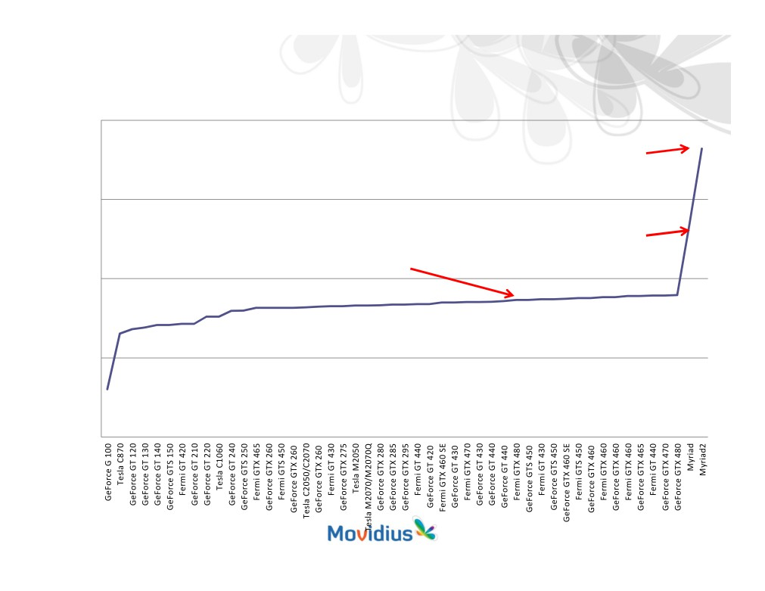
GPU FLOPS/W Trend
Emerging Embedded Systems Trend
1000.00
Myriad 2
28nm 2014
438.86
100.00
GPU rate of increase
Myriad
49.37
1.4x per Year
65nm 2011
7 Years to hit 50GFLOPS/W!
10.00
6.05
6.19
4.99
3.95
2.02
1.00
0.40
0.10
Evaluation of Message Passing Synchronization Algorithms in Embedded Systems 4

Slide 5
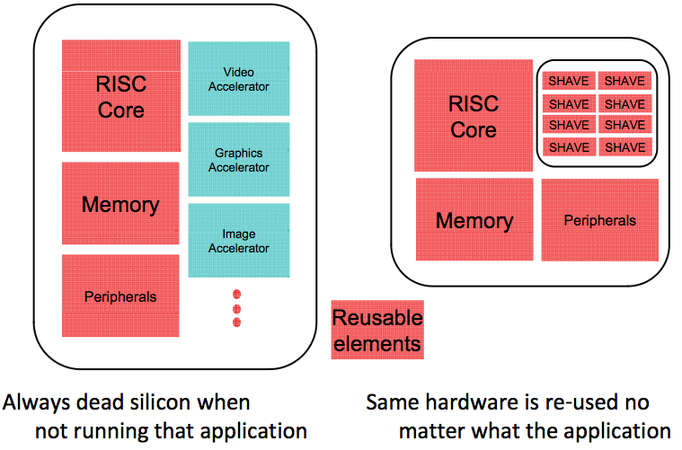
Trends
Old Approach
New Approach

Slide 6
Now that I’ve got an
Ultra low power Compute Platform
What can I do with it?
Potential of such low power processors for use in high end computations.
Can they offer a solution to power problems
Can high-performance computing techniques be deployed on these processors?

Slide 7
Outline
Introduction
Synchronization on multi-core platforms
Movidius SoC
Algorithmic Designs
Experimental results
Conclusions

Slide 8
Concurrent Data Structures
Hardware support
Mutexes
Scalability
Busy Waiting
Non-blocking
Atomic hardware primitives (e.g. LL/SC, CAS)
Good progress guarantees (lock/wait-freedom)
Scalable
Message-passing techniques from HPC domain

Slide 9
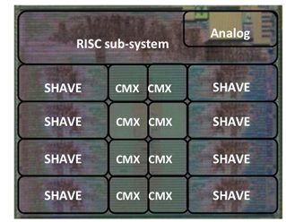
Myriad architecture
Processors:
32-bit general purpose RISC SPARC processor (LEON).
8 SHAVE (Streaming Hybrid Architecture Vector Engine) processors for computational processing.
Memory:
CMX (Connection Matrix): 1 MB on-chip RAM (with 128KB per SH AVE core)
SDRAM: 64MB.
Synchronization support on Myriad: Mutexes, FIFO registers

Slide 10
Algorithmic Designs
Single Lock
Double Lock
Client-Server
Remote Core Locking - RCL

Slide 11
Single Lock
No concurrency
Busy waiting
No Scalability
Done
yet?
Done
yet?

Slide 12
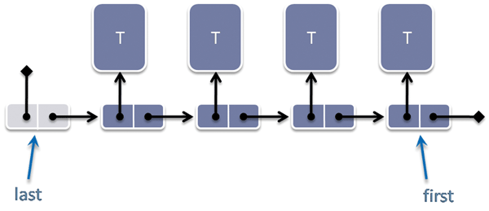
Multiple Locks
Better concurrency
Improved scalability
Busy waiting

Slide 13
Client-Server arbitration (C-S)
Request for access
Spin on local variable
Shared variables
Hardware FIFO queues
Thread
Thread
Thread
Thread
Pend
Post
Server
Queue

Slide 14
Remote Core Locking (RCL)
Migrate Critical Section
No shared data transfers
Reduced Bus traffic
Thread
Thread
Post
Server
Queue

Slide 15
Client-Server
Memory
Th-1
Th-2
Server
enq()
&e6
head
e1
e4
e0
head
Th-1
deq()
tail
head
e5
deq(&e1)
&e1
e5
e1
tail
e4
Th-2
tail
e6
tail
head

Slide 16
Client-Server Drawbacks
Clients-Server communication costs
Serialization of a concurrent data structure
Losing one core

Slide 17
Experimental evaluation
FIFO Queues
Cores execute Enqueue and Dequeue operations
High contention
Test Configurations
Random
Dedicated (N/2 Producers / N/2 Consumers)
Measured execution time in cycles
Power consumption

Slide 18
Experimental evaluation
Single lock mtx (1-lock)
implementation with 2 locks mtx (2-locks)
Client-Server with Leon as server C-S (Leon Server)
Shave as Server C-S (Shave Server)
Shave as server using FIFO registers C-S (Shave FIFO)
Remote Core Locking RCL
Remote Core Locking using FIFO registers RCL (Shave FIFO)

Slide 19
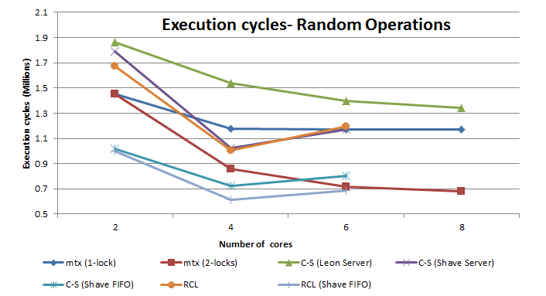
Experimental Results

Slide 20
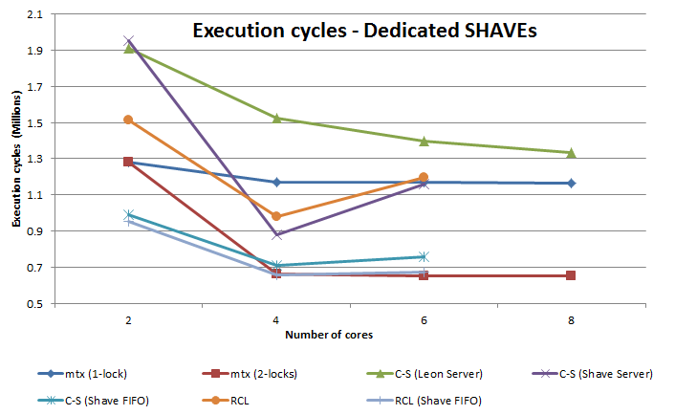
Experimental Results

Slide 21
Power Consumption Evaluation
power consumption measured using a shunt resistor connected to the power supply of the platform

Slide 22
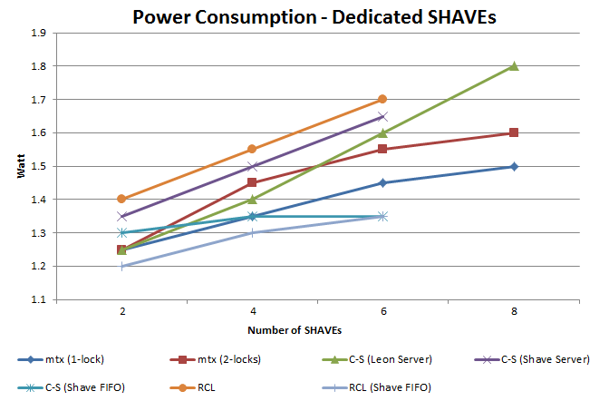
Experimental Results

Slide 23
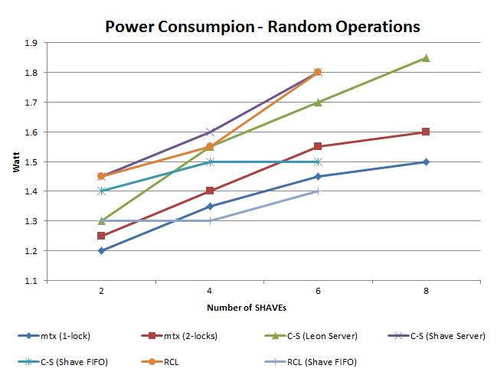
Experimental Results

Slide 24
Conclusions
Complex data structures can be deployed on ultra low power processors
Exploit hardware primitives for better power values.
With relatively low absolute performance can they be viable for high-end computing
With 3D stacking it may become possible to stack many processors for very fast and energy-efficient communication

Slide 25
Questions?
Thank You!
The research leading to these results has received funding from the
European Union Seventh Framework Programme (FP7) under grant agreement n°611183 (EXCESS Project, www.excess-project.eu)

Slide 26
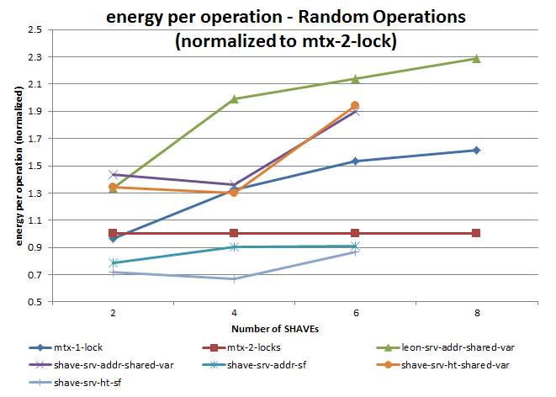
Back UP

Slide 27
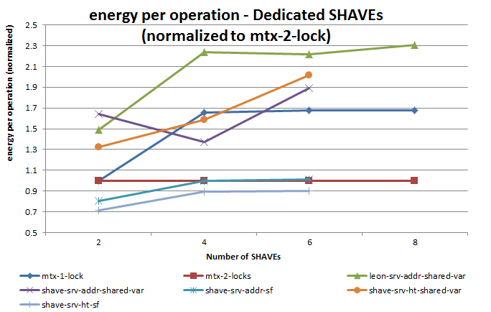
Back UP

Slide 28
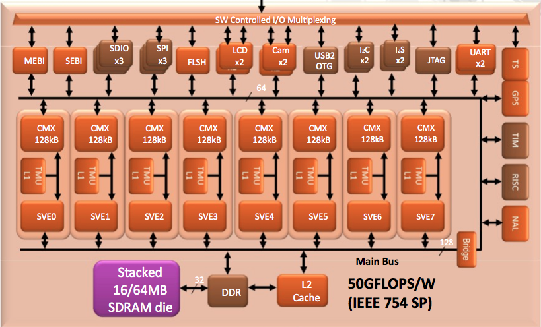
Back UP

Slide 29
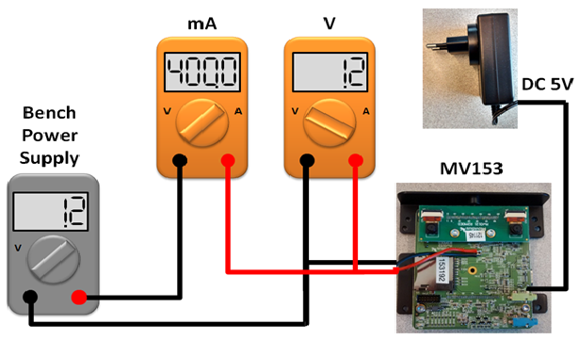
Back UP

