Slide 1
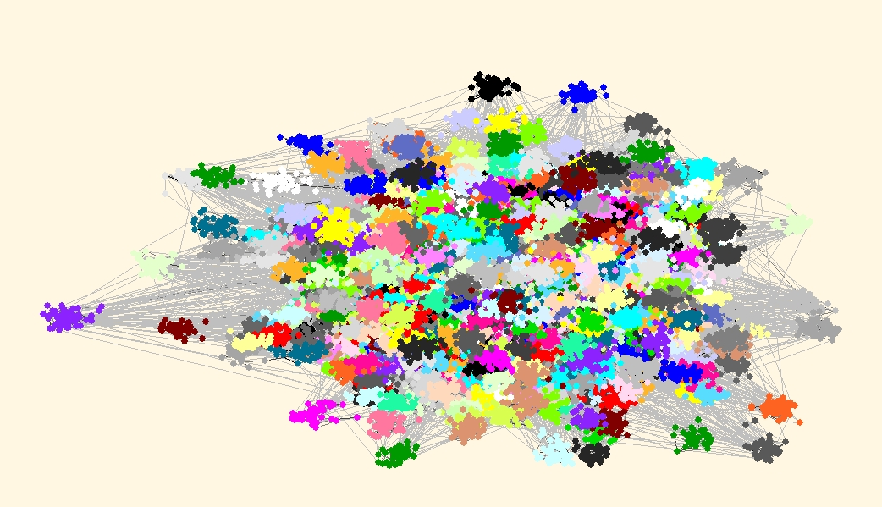


A Local Seed Selection Algorithm for Overlapping Community Detection
Farnaz Moradi, Tomas Olovsson, Philippas Tsigas

Slide 2
Motivation
Community detection in large-scale real networks
Global and local algorithms
Local algorithms for global community detection
  Seed expansion
  Seed selection

Slide 3
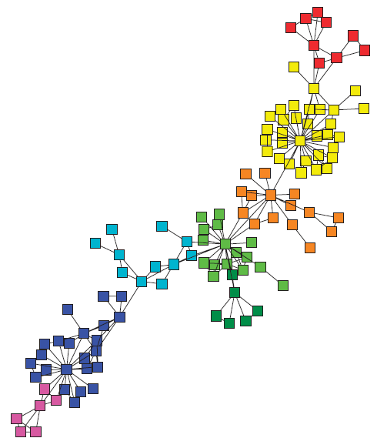
Outline
Community detection algorithms
  Global and local algorithms
Seed selection
  Challenges
Proposed seed selection algorithm
  Link prediction
  Graph coloring
Experimental Results
Conclusions

Slide 4
Community Detection Algorithms
Global algorithms require the global structure of the network to be known
  High quality communities
  Not scalable
Local algorithms only need the knowledge of local neighborhood of the seed nodes
  Easily paralelizable
  Low coverage if seeds are not selected carefully

Slide 5
Seed Selection
Naive approach
  All nodes being expanded
  Expensive
Challenges in local seed selection
  Unaccessible global information
  Unknown number of seeds
  Well distributed over the network
  No neighboring seeds

Slide 6
Seed Selection Algorithms
Spread hub (SH) [CIKM 2013]
  Highest degree nodes (k or higher)
Low conductance cuts (EC) [KDD 2012]
  Egonets with low conductance
Local maximal degree (MD) [SNA 2012]
  Local maximal degree nodes
Global
Local
Local

Slide 7
Proposed Local Seed Selection Algorithm
Properties
  Local
  Parameter free
  Distributed/parallelizable
Approach
  Link prediction
  Graph coloring

Slide 8
Link Prediction
Predicting the relations that should exist or are very likely to be formed in a network
Local similarity indices
  CN: Common Neighbors, PA: Preferrential Attachment, HP: Hub Promoted, LHN: Leich-Holme-Newman, RA: Resource Allocation
We define a similarity score for seed selection as sum of the similarities of a node with its neighbors

Slide 9
Link Prediction-Based Seeding
Intution: a node which has high similarity with its neighbors is expected to be in the same community with its neighbors
20
2
20
1
2
1
20
3
0
20
0
3
20
4
5
SS(5)= CN(5,0)+CN(5,1)+CN(5,2)
+CN(5,3)+CN(5,4)+CN(5,6)
= 4+4+4+4+4+0 = 20
4
5
8
12
6
12
6
12
13
7
10
13
6
7
2
15
8
10
15
8
14
11
8
10
10
8
8
9
14
11
9
6
Similarity score calculation
using common neighbors (CN)
Local seed selection based
on similarity scores

Slide 10
Biased Coloring-Based Seeding
Enhancing our seed selection algorithm
  Well distributed seeds
  No neighboring seeds
Steps of the algorithm:
  Calculate the similarity scores
  Nodes with the highest local similarity score pick a specific color (in contrast to basic random coloring)
  Other nodes pick a color at random
  Color conflicts are resolved locally
  Nodes with the specific color are selected as seeds

Slide 11
Biased Coloring-Based Seeding
2
1
C1
Specific color
3
0
C2
4
C3
5
C4
20
C5
2
20
12
1
13
6
7
20
20
C6
2
1
3
0
15
8
14
11
10
3
0
20
4
5
20
9
2,3. Local color assignment
based on similarity scores
4
5
8
6
12
12
6
10
13
7
12
6
2
15
8
13
7
8
10
10
8
14
11
9
15
8
8
6
14
11
10
9
1. Similarity score calculation
using common neighbors
4,5. Local color conflict resolution
and seed selection

Slide 12
Local Community Detection
The selected seed nodes are expanded into overlapping communities
  Local community detection
Personalized PageRank-based community detection algorithm
  Yang and Leskovec [ICDM 2012]

Slide 13





Experimental Evaluation
Large-scale real networks
Compare local seed selection algorithms
  Number of seeds
  Quality of the communities (F1-score and conductance)
  Coverage of the communities
  Execution time

Slide 14
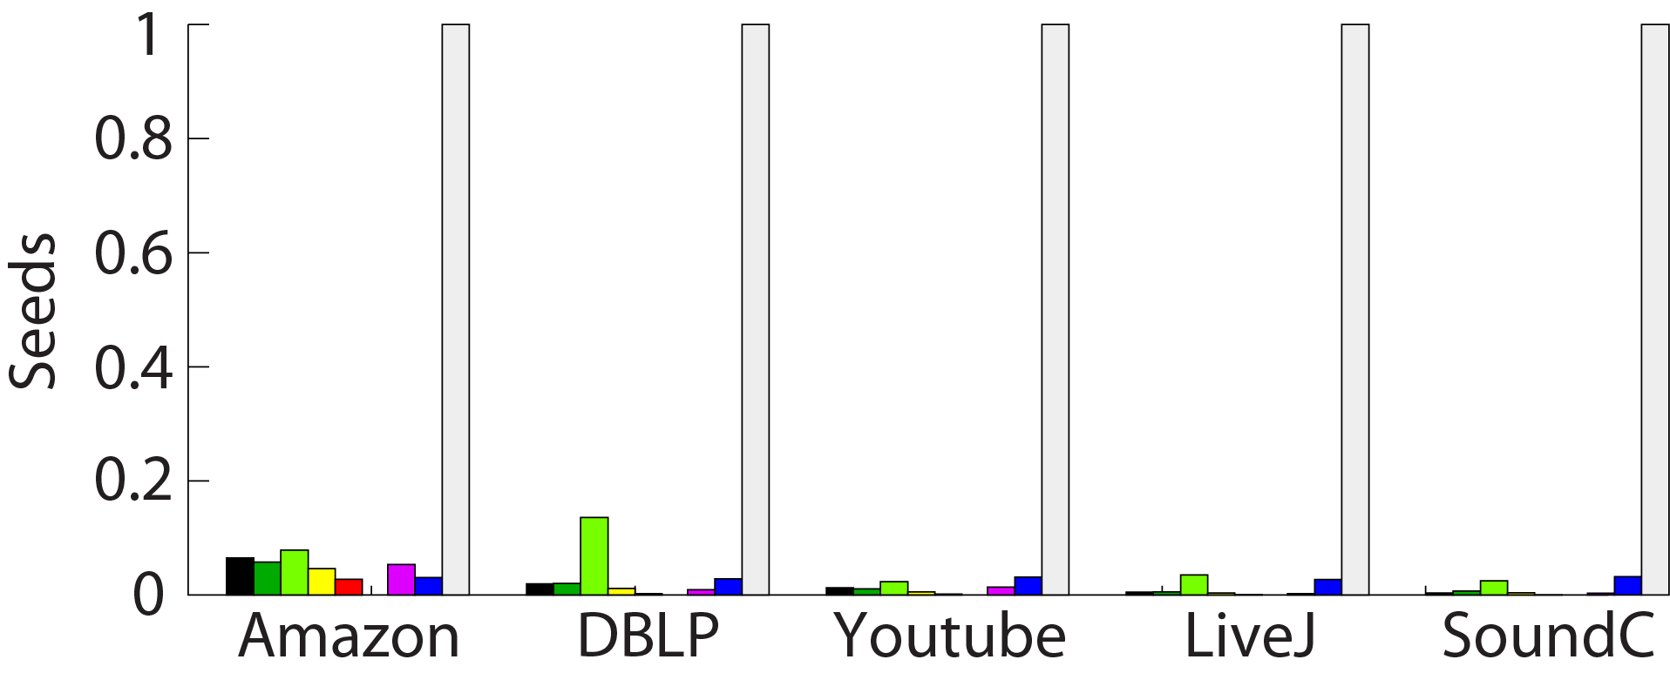
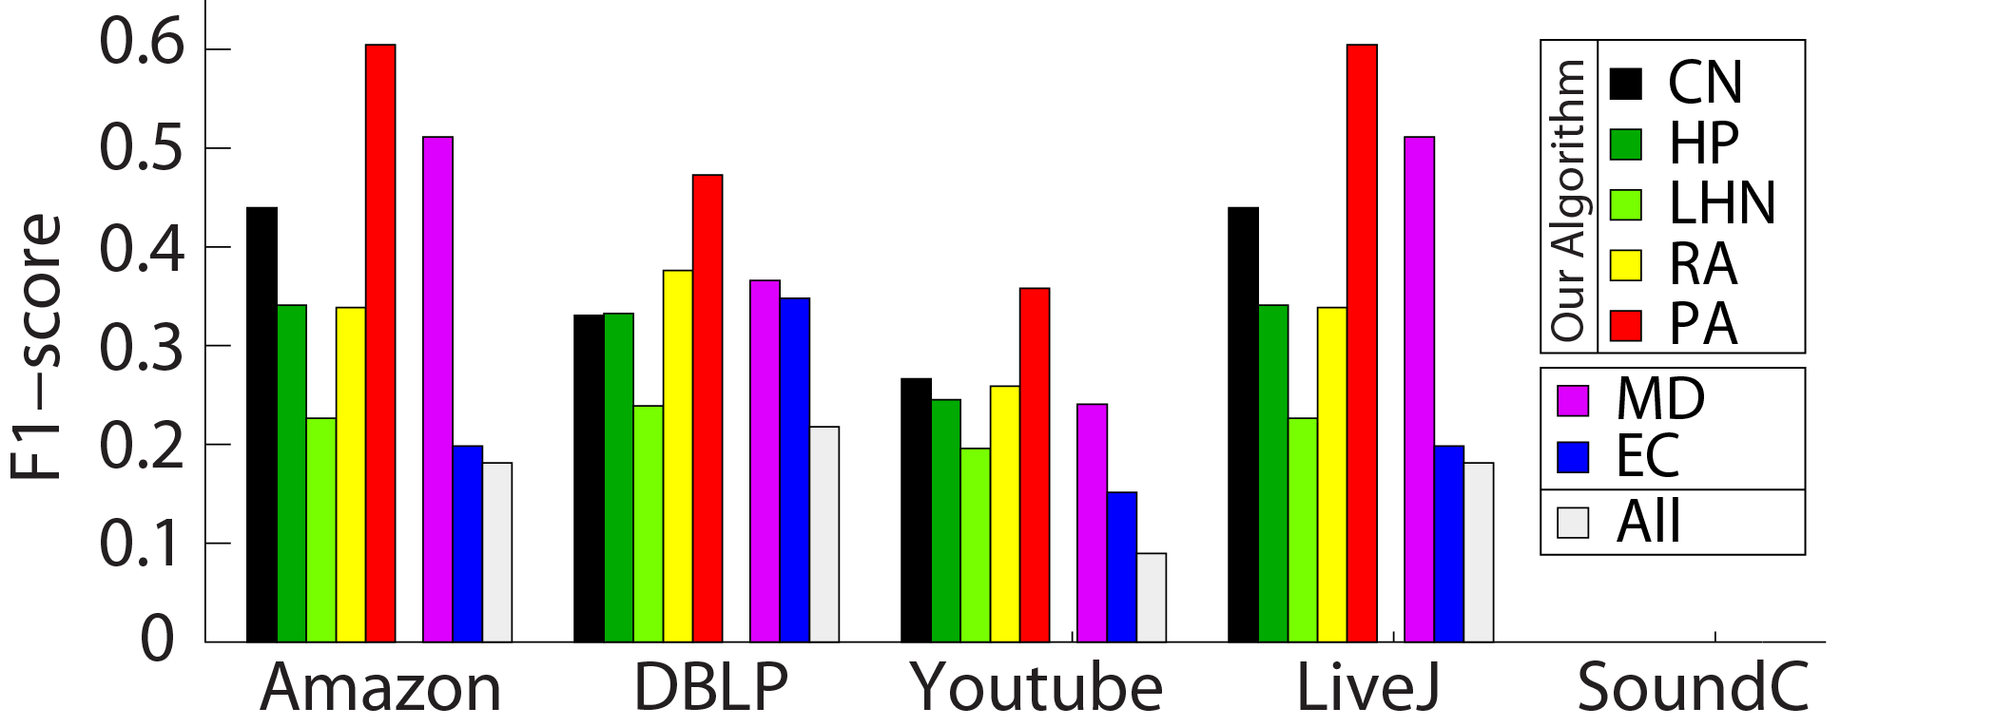
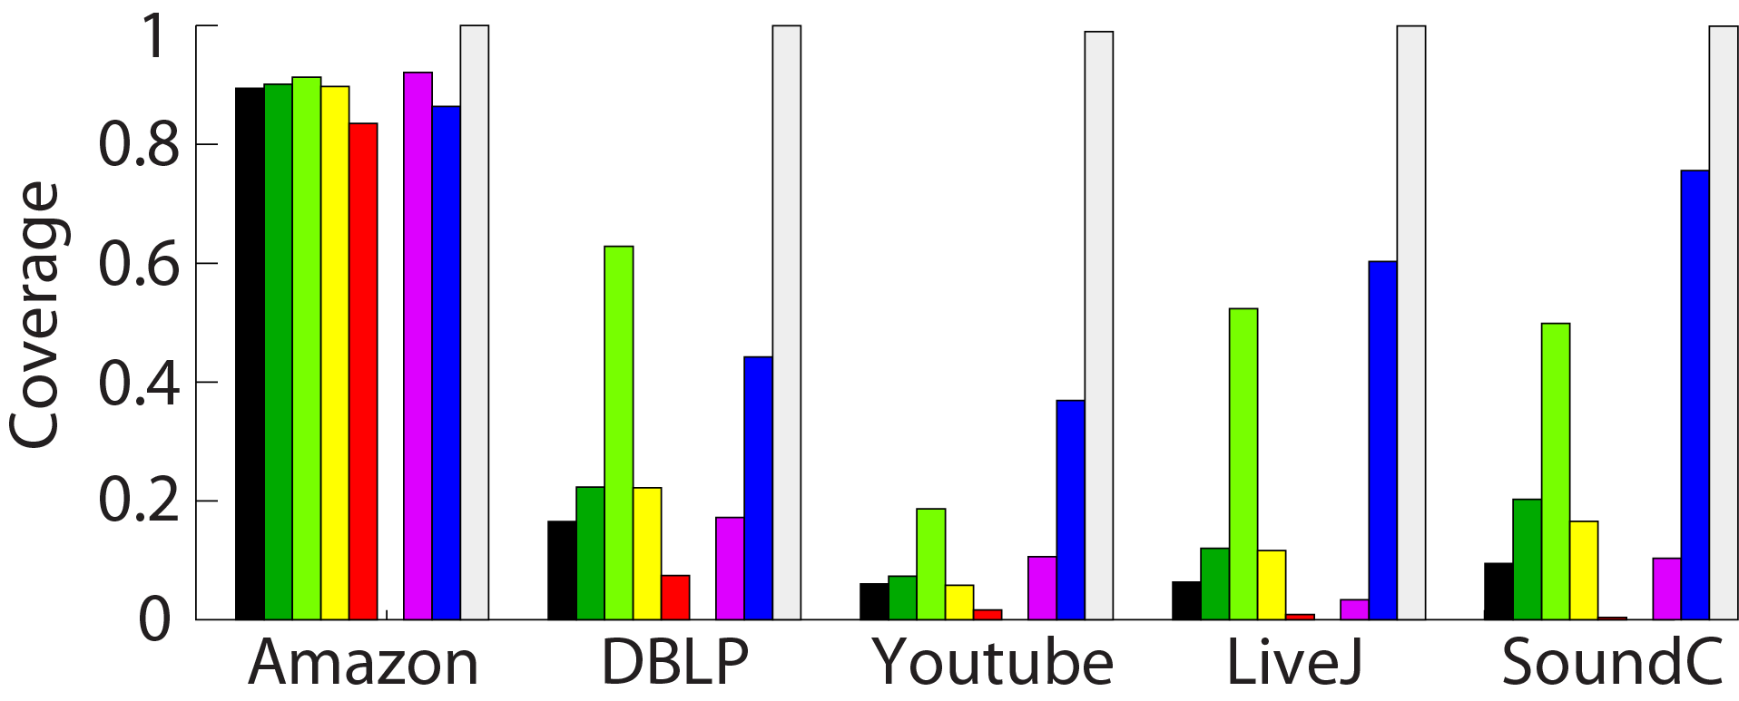
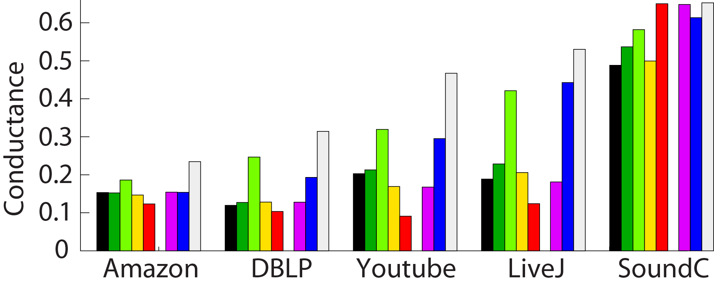
Experimental Results
Link Prediction-Based Seeding

Slide 15
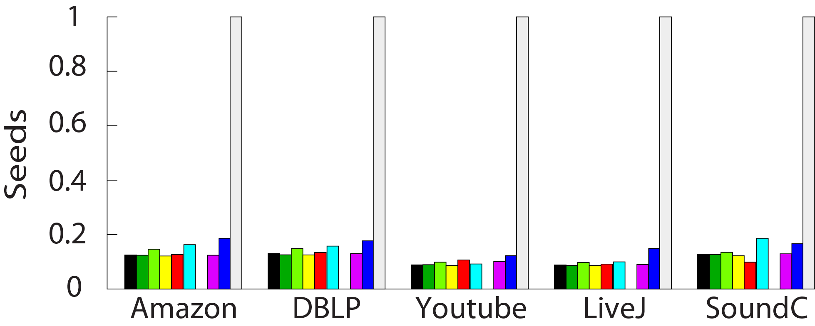
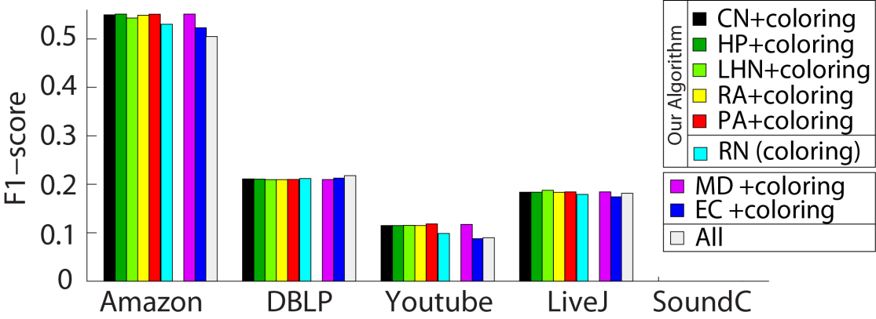
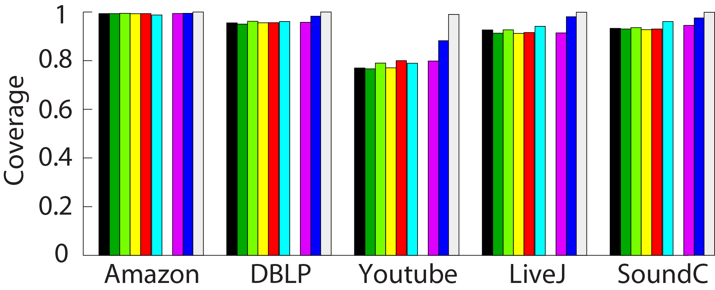
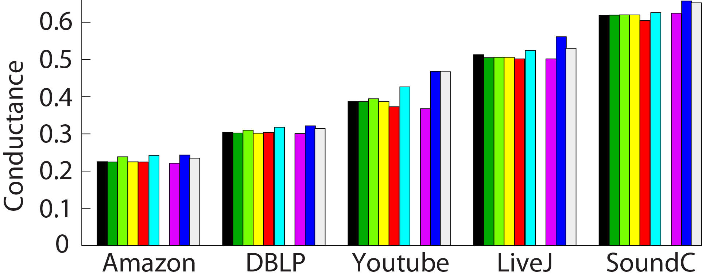
Experimental Results
Biased Coloring-Based Seeding

Slide 16
Experimental Results
Execution Time
 |  | Seeding | Community Detection | F1-Score | Conductance | Coverage
 | PA+Coloring | 52 s | 2 h 38 m | 0.55 | 0.22 | 0.99
Amazon | All | - | 17 h 15 m | 0.51 | 0.23 | 1.00
 | DEMON | - | 37 h 40 m | 0.51 | 0.50 | 0.79
 | PA+Coloring | 2 m 16 s | 1 h 12 m | 0.19 | 0.30 | 0.96
DBLP | All | - | 8 h 42 m | 0.21 | 0.31 | 1.00
 | DEMON | - | 32 h 54 m | 0.25 | 0.63 | 0.85

Slide 17
Conclusions
A novel seed selection algorithm
  Link prediction-based and biased coloring-based
Our biased coloring algorithm can be used to improve existing seed selection algorithms
Experiments on large-scale real networks
  Well distributed seeds over the network
  Communities with high coverage and quality
  Reduced execution time
Thank You!

Slide 18
C1
Specific color
22
2
3
21
C2
20
23
4
C3
18
1
19
0
C4
6
9
13
5
C5
16
8
10
17
7
11
C6
15
14
12
2,3. Local color assignment
based on similarity scores
0
0
0
22
0
2
3
0
0
22
21
2
3
0
20
0
23
0
4
21
18
1
0
20
23
4
0
19
0
0
0
18
1
0
0
6
0
9
0
19
0
13
5
10
0
6
9
16
8
5
17
0
0
7
0
16
13
10
0
0
11
7
8
0
15
14
12
17
11
1. Similarity score calculation
using common neighbors (CN)
15
14
12
4,5. Local color conflict resolution
and seed selection

