Slide 1
Crossroad between banking, regulations and technology
Sinan Gabel
Presentation at ”Domain Specific Languages for Economical and Environmental Modelling (DSL4EE) - the Global Systems Dynamics and Policy (GSDP) project in collaboration with the Hiperfit project” workshop,
Göteborg, 17 June 2011
Notes:
Crossroad: Both in the sense of an intersection, and a turning/decisive point in time!

Slide 2
Disclaimer
The opinions expressed are those of the author and do not necessarily reflect the views of Nordea

Slide 3
Abstract
Technology is playing an increasingly important role in banking, for example, within the area of trading and capital markets. A challenge for a bank is to utilise technology to gain a competitive advantage while retaining cost-efficiency & transparency for bank-internal and bank-external purposes including regulatory purposes, for example for pricing and risk management of financial instruments. It will be explained in broad terms, with examples, why we today are standing at an important crossroad between banking, regulations and technology.
A short computer demonstration will be used to illustrate how smart even simple and well-known methods can be utilised for otherwise complicated pricing and risk management of financial instruments: The message is therefore that what is needed are not necessarily immensely advanced and complicated technology (it may be so) but really to find and utilise those useful methods that still can take full advantage of technology – including the continuously faster execution speeds of computers – in a way that not only accommodates the needs of tomorrows banking business but also, in a sense, drives it! With this background the presenter would like the audience to discuss whether DSL’s, maybe coupled with other “building blocks” such as for example oral & visual communication aides, could be one such successful new idea/technology for banking.

Slide 4
High Frequency Trading (HFT)
HFT is expanding within certain financial markets and across markets (equity and currency markets)
pure algo equity trading ≈ 40 percent on Nasdaq OMX (Nordic)
automated (routing) equity trading ≈ 40 percent on Nasdaq OMX (Nordic)
Trading is done on a smaller and smaller time scale
trading frequencies vary within a given time period
Algorithmic trading behavior is different
E.g. smaller order sizes and higher volumes
Definitely a competitive advantage to be fastest, providing very efficient trading services for banking clients
can also be used for arbitrage trading
Notes:
Some trading platforms report round-trip order latency of a few hundred µs
With

Slide 5
HFT
Banks have a need to read, process and interpret massive amounts of data
E.g. 25.000 high frequency data corresponds to 100 years of daily data (daily data: which has been the norm until recently)
”Within a 24 hour time window, the world is more or less the same, so one day of tick data is more valuable than 100 years of daily data” (Richard Olsen, 2009)
Notes:
Tick data refers to any market data which shows the price and volume of every print
Often also give information about every change to the best bid and ask
Some group tick data in candlesticks that requires less space

Slide 6
HFT
Co-location: Market participants have moved hardware as close to the markets as possible
to reduce latency in networks (the theoretical minimum is about 3.33 microseconds per kilometer)
Exchanges and other trading venues utilise high-speed order matching engines: These infrastructures are key for HFT
High frequency pricing & risk management is needed for e.g. pre-deal limit checking, and transparent internal surveillance of trading
Payment, clearing and settlement systems must develop too due to higher speed and volume

Slide 7
HFT
Supervisors/regulators are interested in the effects of HFT on markets
does computer-based HFT increase or decrease price stability?
will the frequency of very large price movements ”crashes” increase with the proliferation of HFT?
will markets become more concentrated (around fewer but very liquid products?), adding to potential systemic risks?
Markets have introduced circuit breaks to reduce the likelihood of prices coming out of control
exceeding a pre-defined price change triggers an automatic market trading pause
several were introduced after the 6 May 2010 US ”flash crash” – SEC required this!

Slide 8
Modelling (in finance & banking)
Models are important to banks, regulators, and even society because they estimate the amount of risk a bank is exposed to, and hence the required amount of capital banks must set aside as a buffer for absorbing potential losses
“[Banking] disclosures should cover ... impacts on results and on risk exposures of the activities under stress ... forward-looking information on how the situation may evolve ” (Committee of European Banking Supervisors consultation paper 30, Oct. 2009)
”Everything influences everything, quickly”: There is a increasing need for simulateneous modelling
Thus put everything into the same pot and analyse with the same (consistent) modelling methods

Slide 9
Modelling
“Supervisors are drawing the lessons from the inability of the advanced risk management techniques to capture tail events. They can no longer excessively rely on banks’ internal models [VaR and normal]. Going forward, supervision of large banks will need to be more intrusive than in the past and supervisors will have to be very prudent in validating banks’ internal models … Mandelbrot and Taleb … advocate a [fractal] methodology where large deviation and stressful events dominate the analysis …”, Hervé Hannoun, Deputy General Manager, BIS (20 Nov. 2010)
Notes:
Systemic events occur far more frequently, and
the losses incurred during such events have been far heavier than VaR estimates have implied

Slide 10
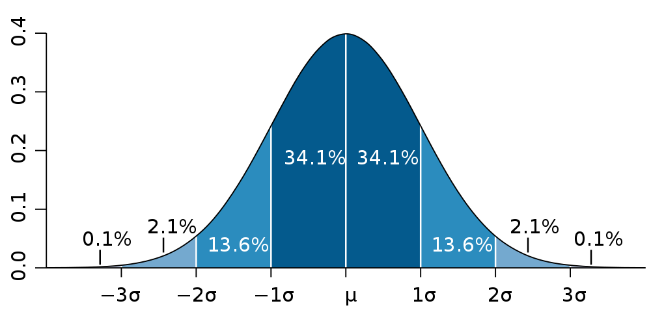
Modelling
normal distribution
the probability of large market movements is largely underestimated
“a 22-sigma has been exceeded with the stock market crashes of 1987 and the interest rate moves of 1992” (Mandelbrot & Taleb, FT article)
Notes:
The VaR is calculated by multiplying the sigma (standard deviation, volatility) of the given financial positions by the size of the positions and by a factor that depends on the specified confidence level.
At the 99% confidence level, for example, you would multiply sigma by a factor of 2.33. Under the normality assumption used by most (but not all) VaR models, the probability of large market movements is largely underestimated and, more specifically, the probability of any deviation beyond 4 sigma (ie 4 standard deviation moves) is basically zero. Unfortunately, in the real world, 4-sigma events do occur, and they certainly occur more than once every 125 years, which is the supposed frequency of a 4-sigma event (at a 99.995% confidence level) under the normal distribution.
Even worse, the 20-sigma event corresponding to the 1987 stock crash is supposed to happen not even once in trillions of years

Slide 11
Modelling
Big banks may introduce hundreds of new products to the market every year, as a response to customer demand and global competition
… each of these must be risk-managed for their full life span which with swaps can be 30 years or more
… means individual modelling for pricing, statistical distribution estimation with volatility & correlation modelled too, compounding portfolio risks, more required data (incl. HF data), higher data complexity

Slide 12
Modelling
Regulations: BIS paper on model transparency
“A solid understanding of a vendor model allows a supervisor to assess the conditions under which the model can be used by a given institution …“
“whether the methods on which a model is based are simple or complex, it is important that users be able to acquire a solid understanding of those methods in order to evaluate the suitability of the model for specific business applications under consideration“
“… to provide guidance on whether there are some situations in which the model should not be applied, or should be applied only with extreme caution”

Slide 13
Modelling
Regulations: BIS paper on model transparency
“Comparison of alternative models – models based on different methods or different reference data – can be a highly constructive and valuable component of model evaluation”
“[Stress testing] difficulties arise because key inputs or relationships cannot be modified by the user. In other cases, the model requires certain relationships to be maintained between variables, and it is difficult or impossible for the user to assess whether these relationships are being maintained as assumptions associated with a stress scenario are applied to the model”

Slide 14
Modelling
US Securities and Exchange Commission (SEC), May 2010:
“We are proposing to require the filing of a computer program (the ‘‘waterfall computer program,’’ as defined in the proposed rule) of the contractual cash flow provisions of the securities in the form of downloadable source code in Python, a commonly used computer programming language that is open source and interpretive”
“… with the waterfall computer program and the asset data file, investors would be better able to conduct their own evaluations of ABS and may be less likely to be dependent on the opinions of credit rating agencies”

Slide 15
Modelling: Other thoughts!
“… computer programs, rather than mathematics, are the best way to describe and explain the complex systems that are widespread in nature”, The Economist (2011 June 4-10) in article “Alpha geek [Dr. Wolfram]”
“in the specific case of the global financial markets, there is an urgent need to develop major national strategic modelling and predictive simulation capabilities, comparable to national-scale meteorological monitoring and modelling capabilities”, The Flash Crash of May 6th 2010: WTF?, Dave Cliff (2010)

Slide 16
Computer demo

Slide 17
A computer demo
A well-known and widely used method of utilising computer power – rather than mathematical-financial modelling - is to use statistical Monte Carlo methods in option pricing
this translates directly into use in risk management where many, many price paths are generated for risk management modelling
It is shown that the option pricing calculation is simple when the computer is used to simulate the needed data for the options’ pay-off function (”model”)

Slide 18
Double-click on the pdf picture to get higher resolution

Slide 19
DSLs – discussion topics
How can DSLs be utilised in banking?
How far can this approach be taken?
What kind of computations will be needed?
What data is needed for the computations?
How is transparancy ensured?
What are the steps to be taken in research for doing this?
Who are the different stakeholders?
… other ideas for topics
Notes:
+ DSL
+ Functional prog.
+ visualisation
+ machine learning
+ etc.

Slide 20
Appendix

Slide 21
Risk Management
“A structured process to identify, assess/measure, manage, control and report potential events or situations, to provide reasonable assurance regarding the achievement of the bank's objectives”
Typical financial risk types cover credit risk, market risk, liquidity risk and real estate risk
Proper risk management of banks is important not only for shareholders and customers but also for the whole economy, for society
However risk taking is a natural and inherent part of the world of banking and finance, with wanted & sometimes unwanted risks
Notes:
Quantitative and qualitative aspects
Static & dynamic risk measures

Slide 22
Thank you!
http://www.hiperfit.dk
http://wiki.portal.chalmers.se/cse/pmwiki.php/GSDP/DSL4EE
http://www.gsdp.eu
Contact: sinan.gabel@nordea.com

