Slide 1

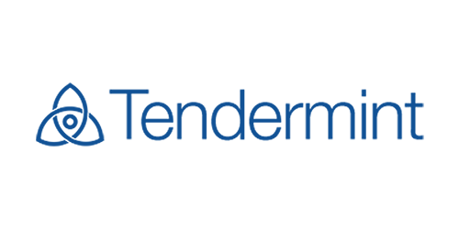
Building and Testing
Byzantine Fault Tolerant
State Machines
Ethan Buchman
Interchain Foundation
https://interchain.io/
Informal Systems
https://informal.systems
Budapest, 2019

Slide 2



Acknowledgements
Significant material in this presentation came directly or indirectly from:
Zarko Milosevic
Research Scientist
Interchain Foundation
Sunny Aggarwal
Research Scientist
All in Bits Inc.
Peng Zhong
Chief Design Officer
All in Bits Inc.

Slide 3
Contents
Blockchain Consensus
Blockchain Applications
ABCI
ABCI Apps in Go: Cosmos SDK
ABCI Apps in JS: Lotion JS and Agoric
Governance & Proof of Stake

Slide 4
Blockchain Consensus

Slide 5
Blockchain Consensus
Bitcoin and Ethereum solves (a variant) of BFT consensus problem in novel network and adversarial setting:
  High number of nodes (thousands)
  Wide area network
  Open, permissionless network, i.e., not a single administration domain
  Byzantine fault tolerant
  No direct connectivity between nodes, i.e., nodes communicate over p2p gossip network

Slide 6
Satoshi’s Invention
Optimize BFT using hash-linked transaction batches
  “Blockchain”
  Batching amortizes the cost of BFT over many transactions
  Hash links provide cheap integrity checks for clients
Economic incentives for safety and liveness
  “Proof-of-Work”
  Use economics to secure a synchrony assumption and a random lottery to hedge its failure
  Byzantine behaviour has high opportunity cost
  Variable set of anonymous participants

Slide 7
Blockchain Consensus Yesterday (PoW)
Pros
Simple to understand, prove, and implement correctly
Based on cryptographic puzzle
Economic security
Cons
Probabilistic and Eventual Agreement
  Is a committed transaction really committed?
Low throughput
High latency
Not energy efficient

Slide 8
Blockchain Consensus Today (Tendermint)
Pros
Adapt classic BFT consensus algorithms for the new system model
High performance
Instant finality
Energy efficient
Shift economic concerns to state machine layer
Support state machines written in any language (!)
Support efficient proofs for clients
Cons
More complex
Thresholds for consensus

Slide 9
Tendermint consensus algorithm
Proceeds in a sequence of rounds
  Round contains multiple communication steps (similar to PBFT view)
Every round has a dedicated proposer
  Proposer defined by a deterministic function
  Proposer could change every round (similar to Spinning, Veronese et al, 2009)
  https://github.com/cwgoes/tm-proposer-idris
  https://github.com/tendermint/tendermint/blob/master/docs/spec/reactors/consensus/proposer-selection.md
Single execution path
  There is no separate recovery protocol
  Similar to normal case of PBFT
Novel termination mechanism
  Relies on gossip based communication
  Message size does not depend on system size
  Does not require additional information exchange between processes

Slide 10
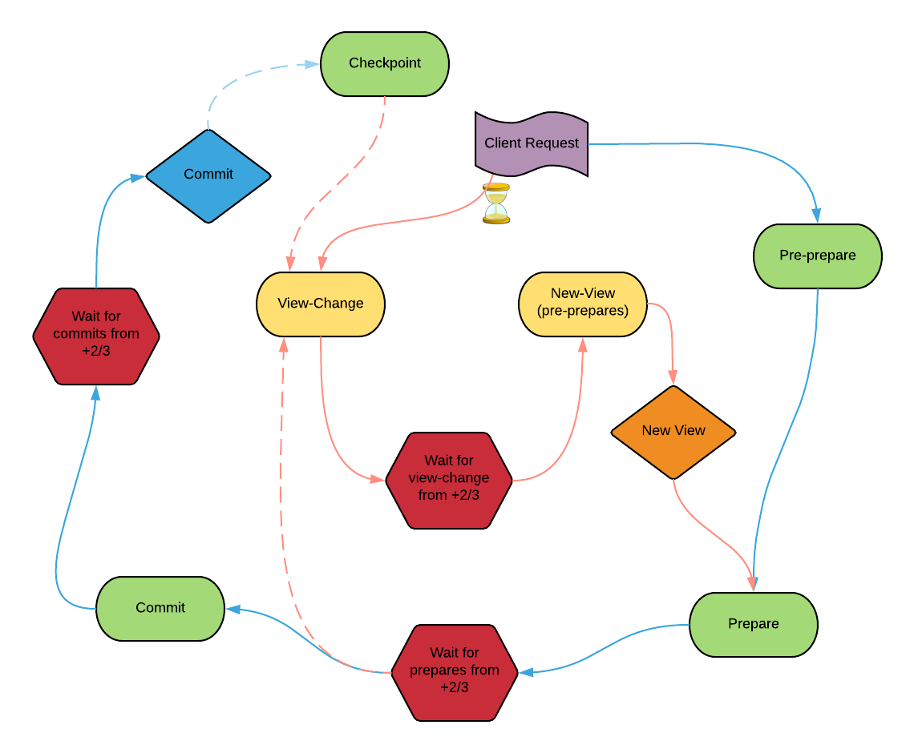
PBFT

Slide 11
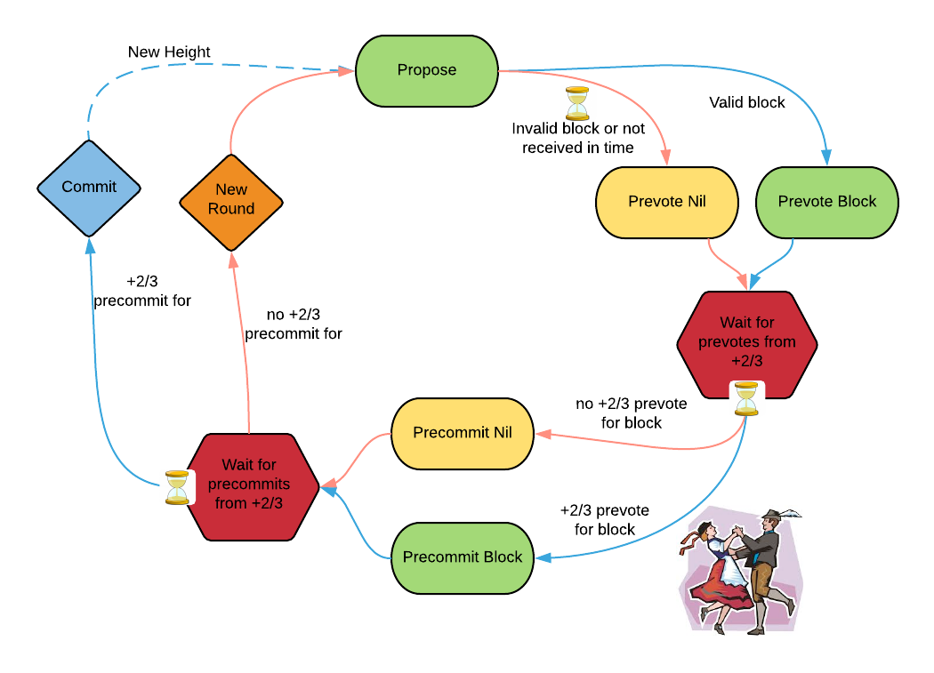
Tendermint

Slide 12
Tendermint/Cosmos History:
Tendermint: Consensus without mining
  2014 - Whitepaper by Jae Kwon
Tendermint: Byzantine Fault Tolerance in the Age of Blockchains
  2016 - MSc Thesis by Ethan Buchman
Cosmos: A Network of Blockchains
  2016 - Whitepaper by Kwon and Buchman
The Latest Gossip on BFT Consensus
  2018 - Technical Report by Buchman, Milosevic, Kwon
  https://arxiv.org/abs/1807.04938
  https://github.com/tendermint/spec

Slide 13
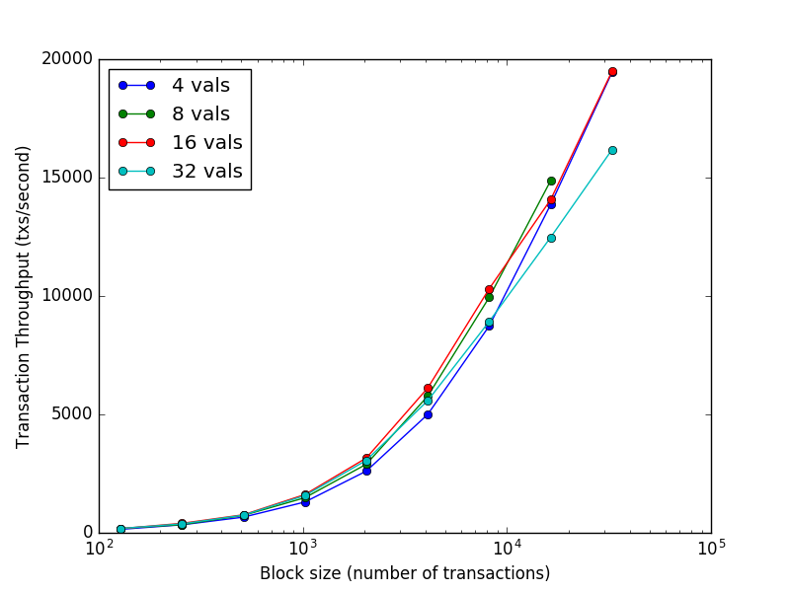
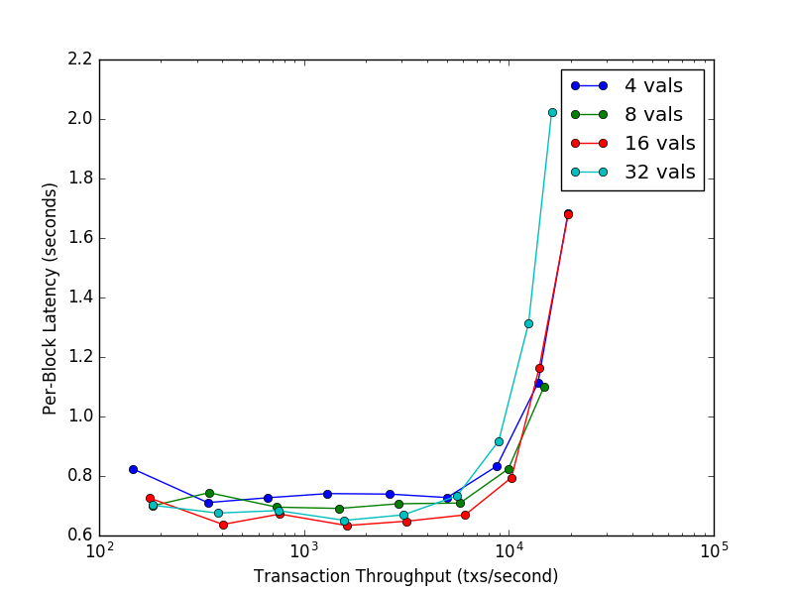
Tendermint Performance (2016)
7 datacenters on 5 continents (AWS - c3.8xlarge)
https://github.com/tendermint/network_testing (deprecated, sorry)

Slide 14
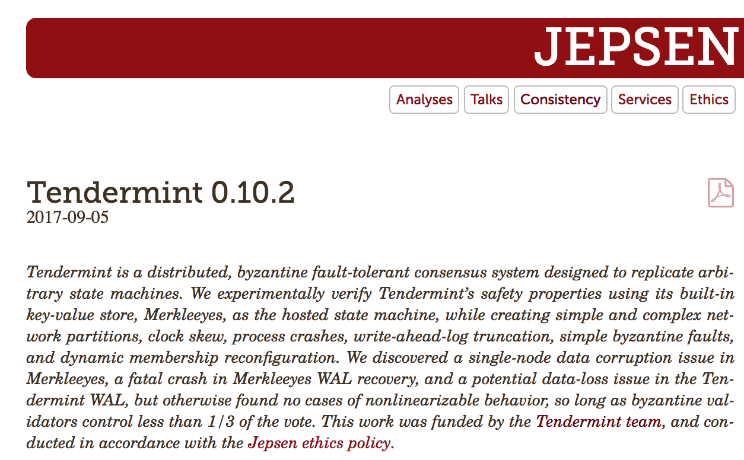
Robustness (2017)
https://jepsen.io/analyses/tendermint-0-10-2

Slide 15

Testnets (2018)
https://medium.com/tendermint/2018-year-in-review-the-top-5-most-epic-cosmos-testnets-that-will-restore-your-faith-in-3b060974f9a7

Slide 16

Adversarial Cosmos Testnet (2019)
https://github.com/cosmos/game-of-stakes
https://forum.cosmos.network/
https://riot.im/app/#/room/#gameofstakes:matrix.org

Slide 17


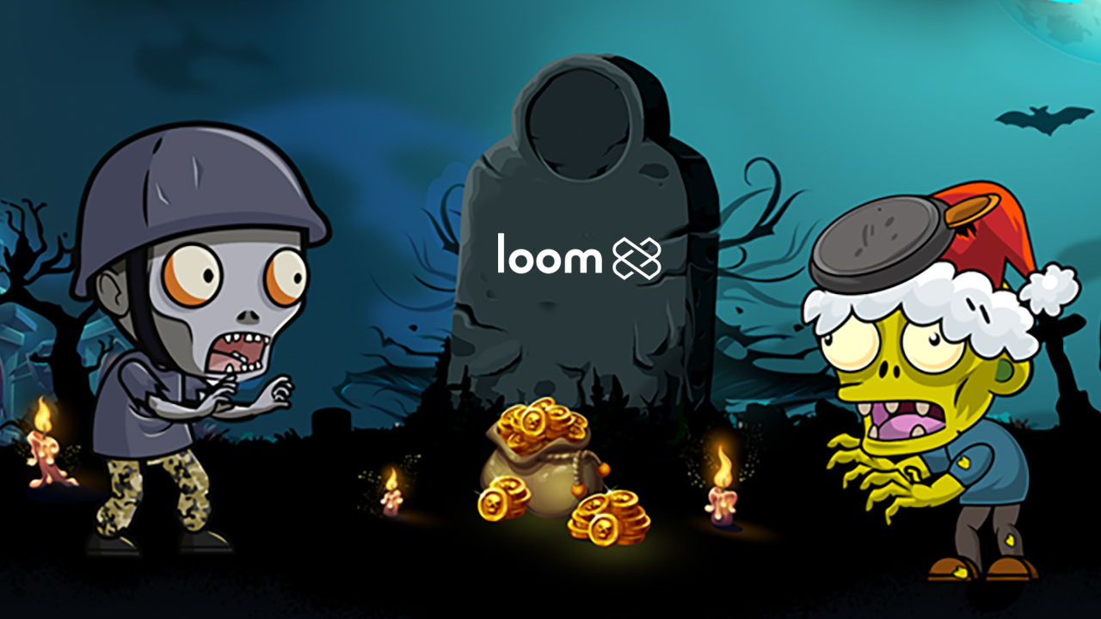
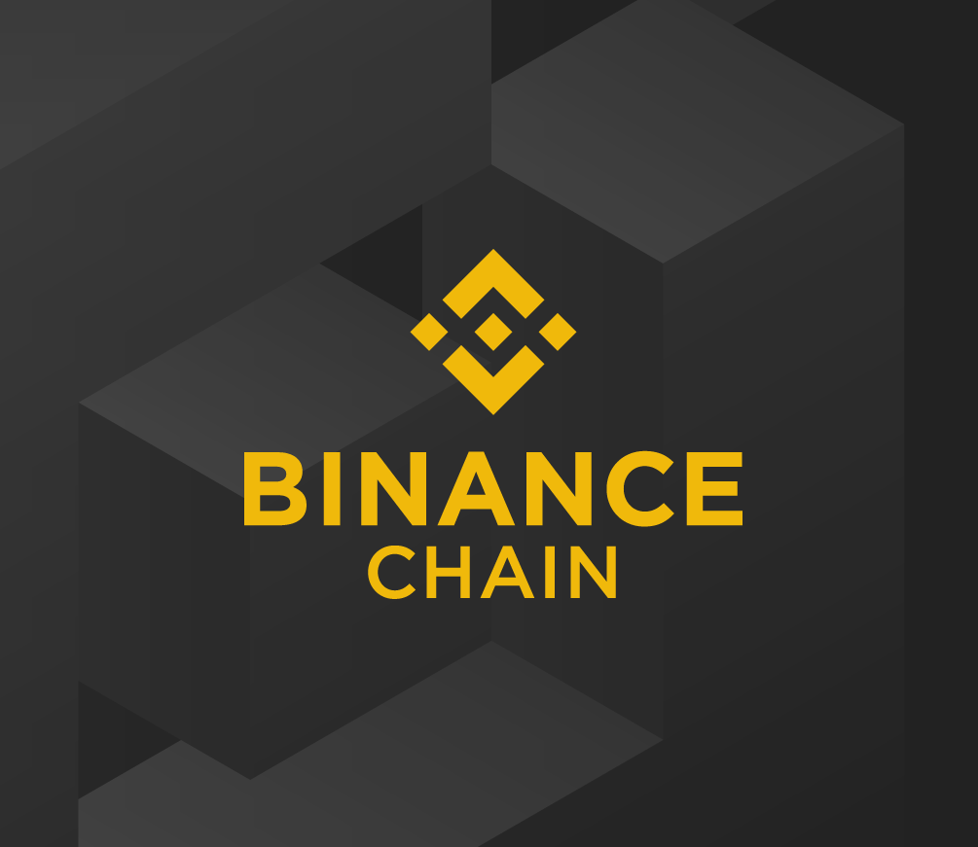
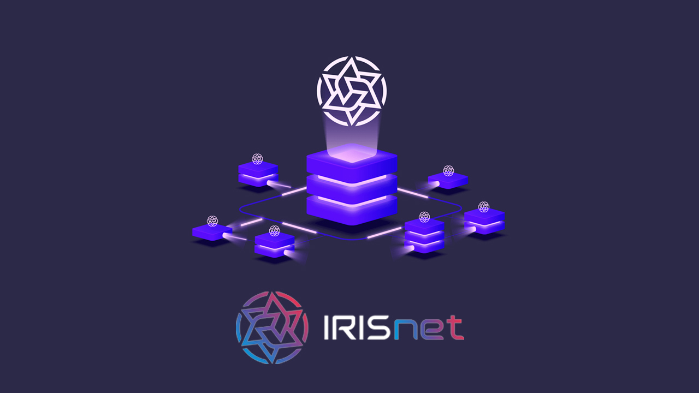
Mainnets (2019)
Over $5B in collective market cap

Slide 18
Open Research Challenges
https://interchain.io/careers https://interchain.io/funding/
Formal verification of Tendermint algorithms and implementation
Optimal gossip protocol for
  Transaction broadcasting
  Votes dissemination and fast round synchronisation
Optimal algorithm for blockchain and state synchronisation
Use of advanced cryptography (eg. aggregate signatures) for improving performance and scalability
Pipelining blocks and opportunities for concurrent execution
Interaction between application-level staking logic and Tendermint behaviour
Light client performance and advanced cross chain communication

Slide 19
Blockchain Applications

Slide 20


Somebody Else’s State Machine
Eg. Zookeeper, Bitcoin
Application
Consensus
Networking

Slide 21



Somebody Else’s State Machine
Eg. Ethereum, Aion, Tezos
dApp
dApp
dApp
Application (EVM)
Consensus
Networking

Slide 22

Your State Machine
Eg. built on Tendermint
Application Blockchain Interface (ABCI):
State Machines in any
Programming Language
Application
ABCI
Consensus
} Tendermint
Networking

Slide 23

Your State Machine
Eg. built with an ABCI Application Framework
Cosmos-SDK
Plugin
Plugin
Plugin
ABCI
Consensus
} Tendermint
Networking

Slide 24
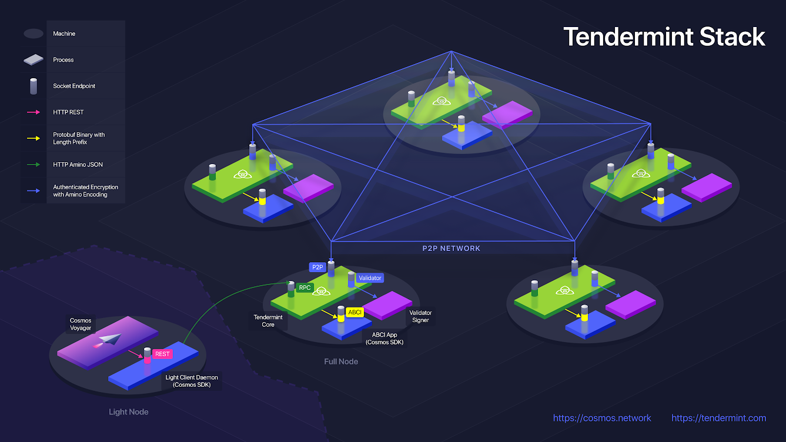
Full Stack

Slide 25



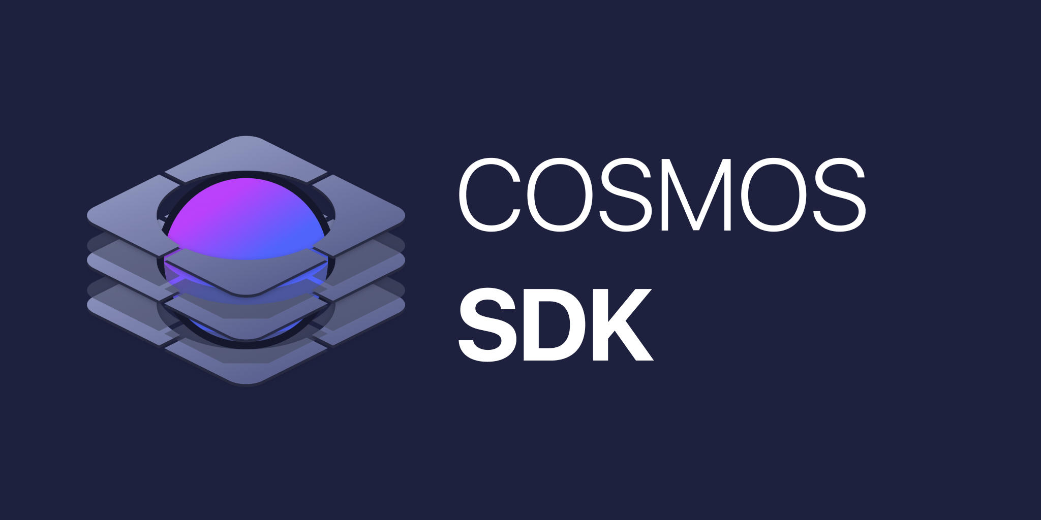








ABCI Ecosystem
https://tendermint.com/ecosystem

Slide 26
VMs & Smart Contract Languages
Why?
Restricted and “secure” environment for running untrusted code
Determinism and termination
Easy interoperability between contracts in the same language / VM
Why not?
Maturity, ecosystem, tooling, etc.
Attack surface
Customization, performance tuning
Scalability
VM | Developer | Language
Ethereum VM
Aion VM
Tezos VM
Pact Smart Contract Language

Slide 27

VMs & Smart Contract Languages ...
… over ABCI!
dApp
dApp
dApp
Application (EVM)
ABCI
Consensus
} Tendermint
Networking

Slide 28
ABCI Virtual Machines
https://tendermint.com/ecosystem
Virtual Machine | Project | Framework | Developer
EVM | https://github.com/cosmos/ethermint | Cosmos-SDK | https://chainsafe.io/
WASM | https://github.com/cosmos-gaians | Cosmos-SDK | https://github.com/cosmos-gaians
Secure EcmaScript | https://github.com/Agoric/cosmic-swingset | Cosmos-SDK + Agoric SwingSet | https://agoric.com/
Pact | ( https://github.com/f-o-a-m/hs-abci-server ) | hs-abci-server | https://foam.space/ + https://kadena.io/
Move | https://github.com/open-libra/movemint | rust-abci | https://www.openlibra.io

Slide 29
Cross Chain Interoperability
Eg. Cosmos Network
Your Application
Ethermint
Cosmos Hub
Tendermint
Core
Tendermint
Core
IBC
IBC
Tendermint
Core
Binance Chain
CosmWASM
IBC
IBC
Tendermint
Core
Tendermint
Core

Slide 30
ABCI

Slide 31



Application Blockchain Interface (ABCI)
APPLICATION PLATFORMS
CGI
SOCKET PROTOCOLS
ABCI
SECURITY & NETWORKING
PLATFORMS
Tendermint

Slide 32
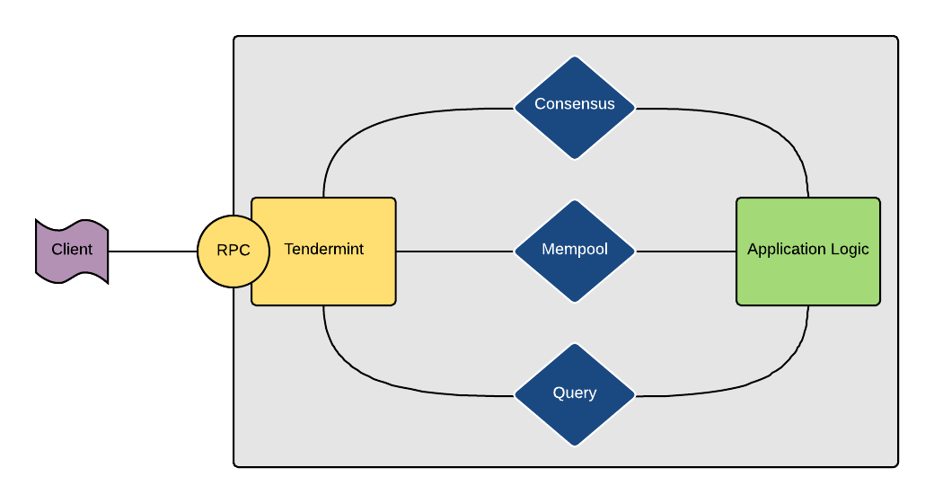
Application Blockchain Interface (ABCI)

Slide 33
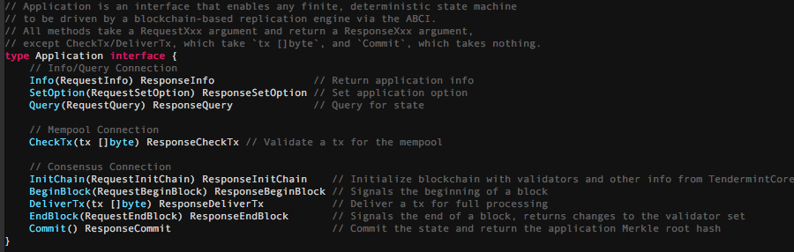
Application Blockchain Interface (ABCI)

Slide 34
Cosmos SDK

Slide 35


Cosmos SDK
Ruby on Rails for Blockchains
Abstract away low-level ABCI concerns
Golang
  Tiny language, static and interface types, high performance, compiles everywhere, standardized formatting, built-in testing, etc.
Composable modules
Object-Capability based security - “Principle of Least Authority”

Slide 36
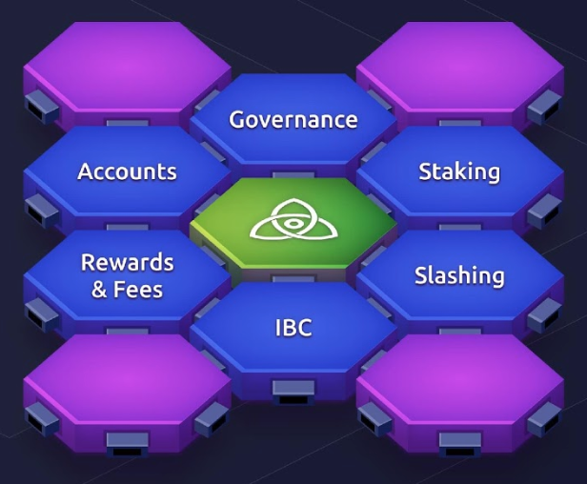
Cosmos SDK
Ruby on Rails for Blockchains - batteries included

Slide 37
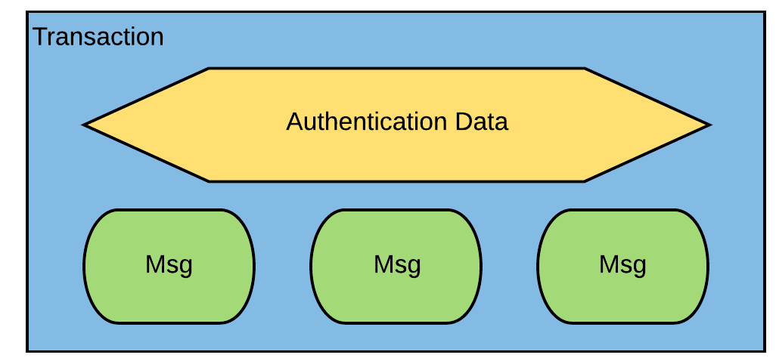
Txs and Msgs

Slide 38
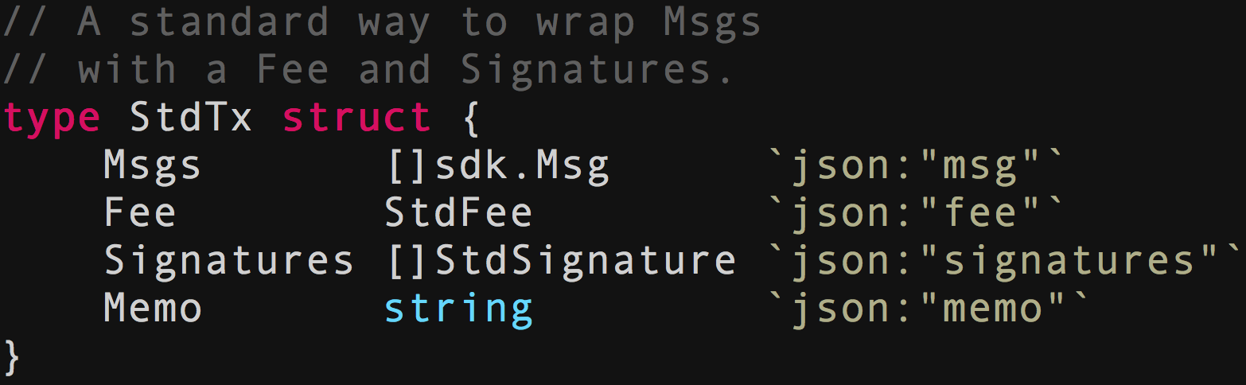
Txs and Msgs

Slide 39
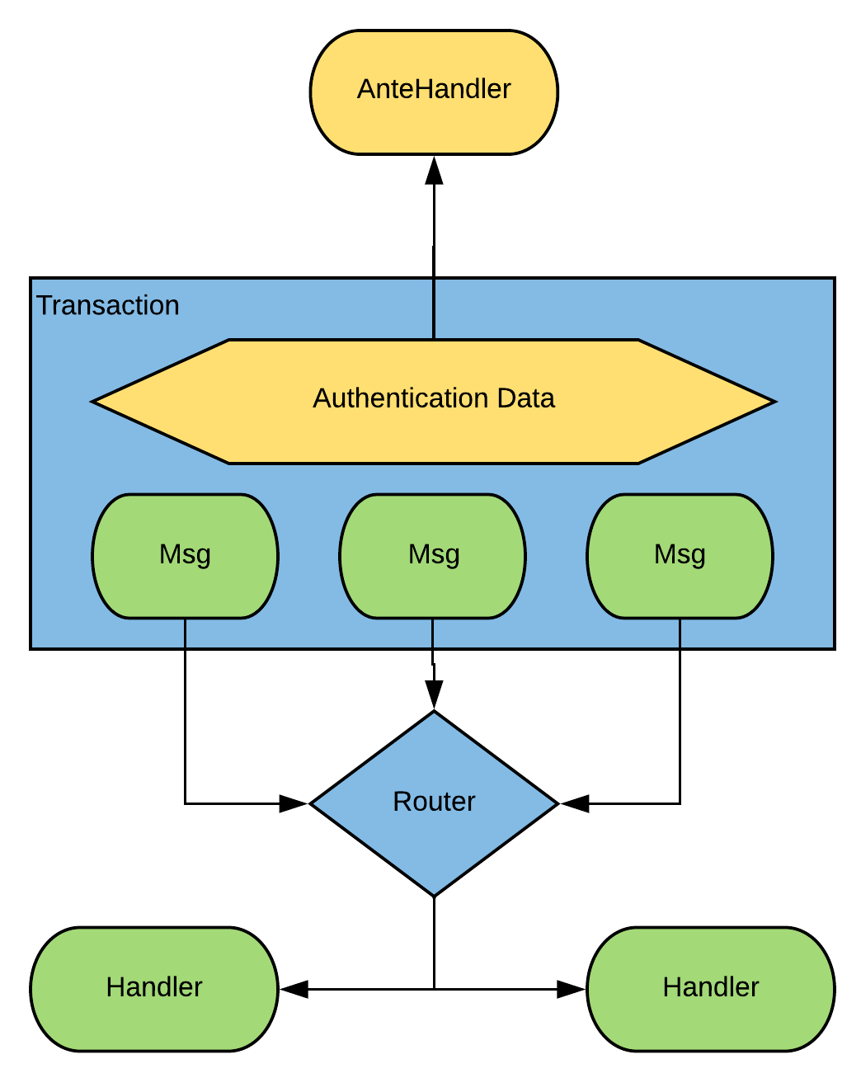
Handlers and AnteHandler

Slide 40
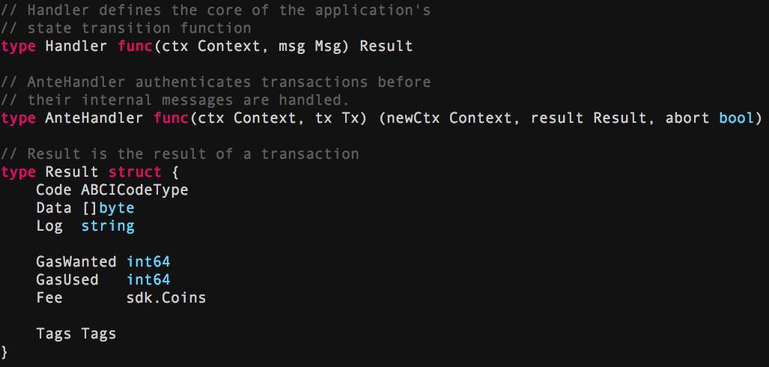
Handlers, AnteHandler, Result

Slide 41
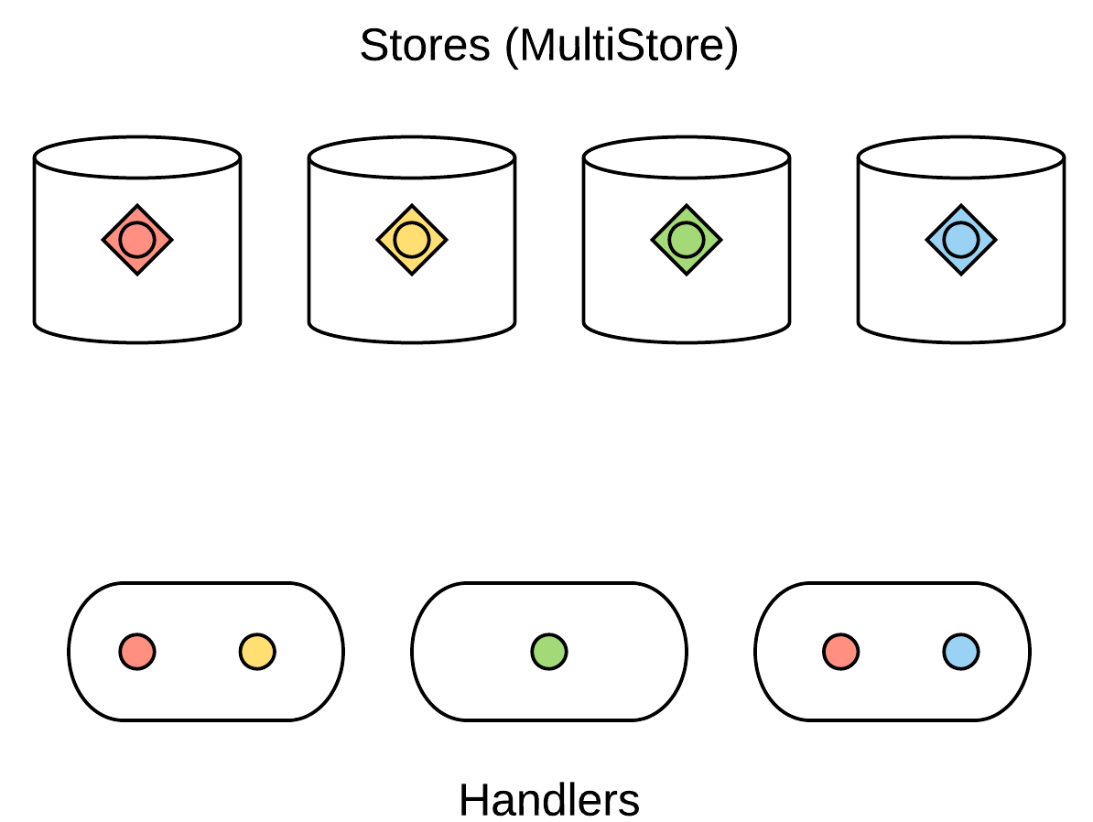
Object-Capability Stores

Slide 42
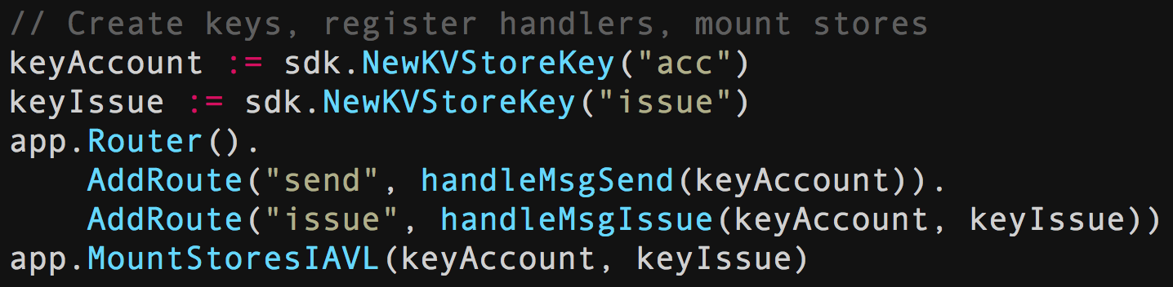
Object-Capability Stores

Slide 43
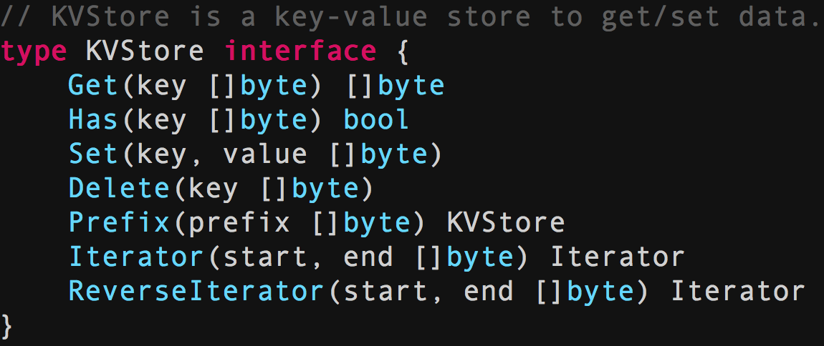

Simple Key-Value Store

Slide 44
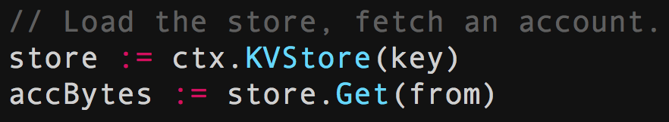
Simple Key-Value Store

Slide 45
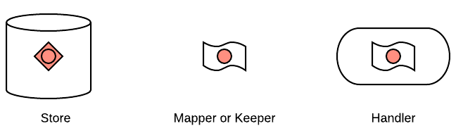
Mappers and Keepers

Slide 46
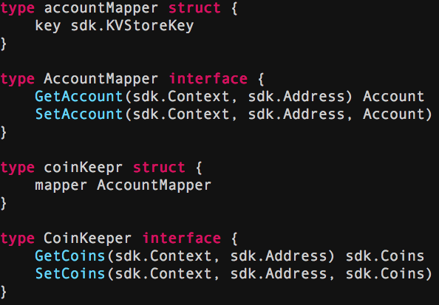
Mappers and Keepers

Slide 47
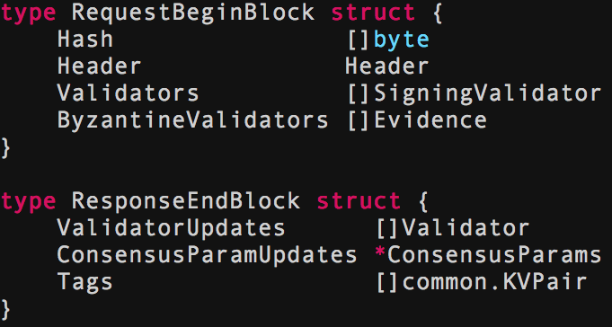
BeginBlock & EndBlock

Slide 48
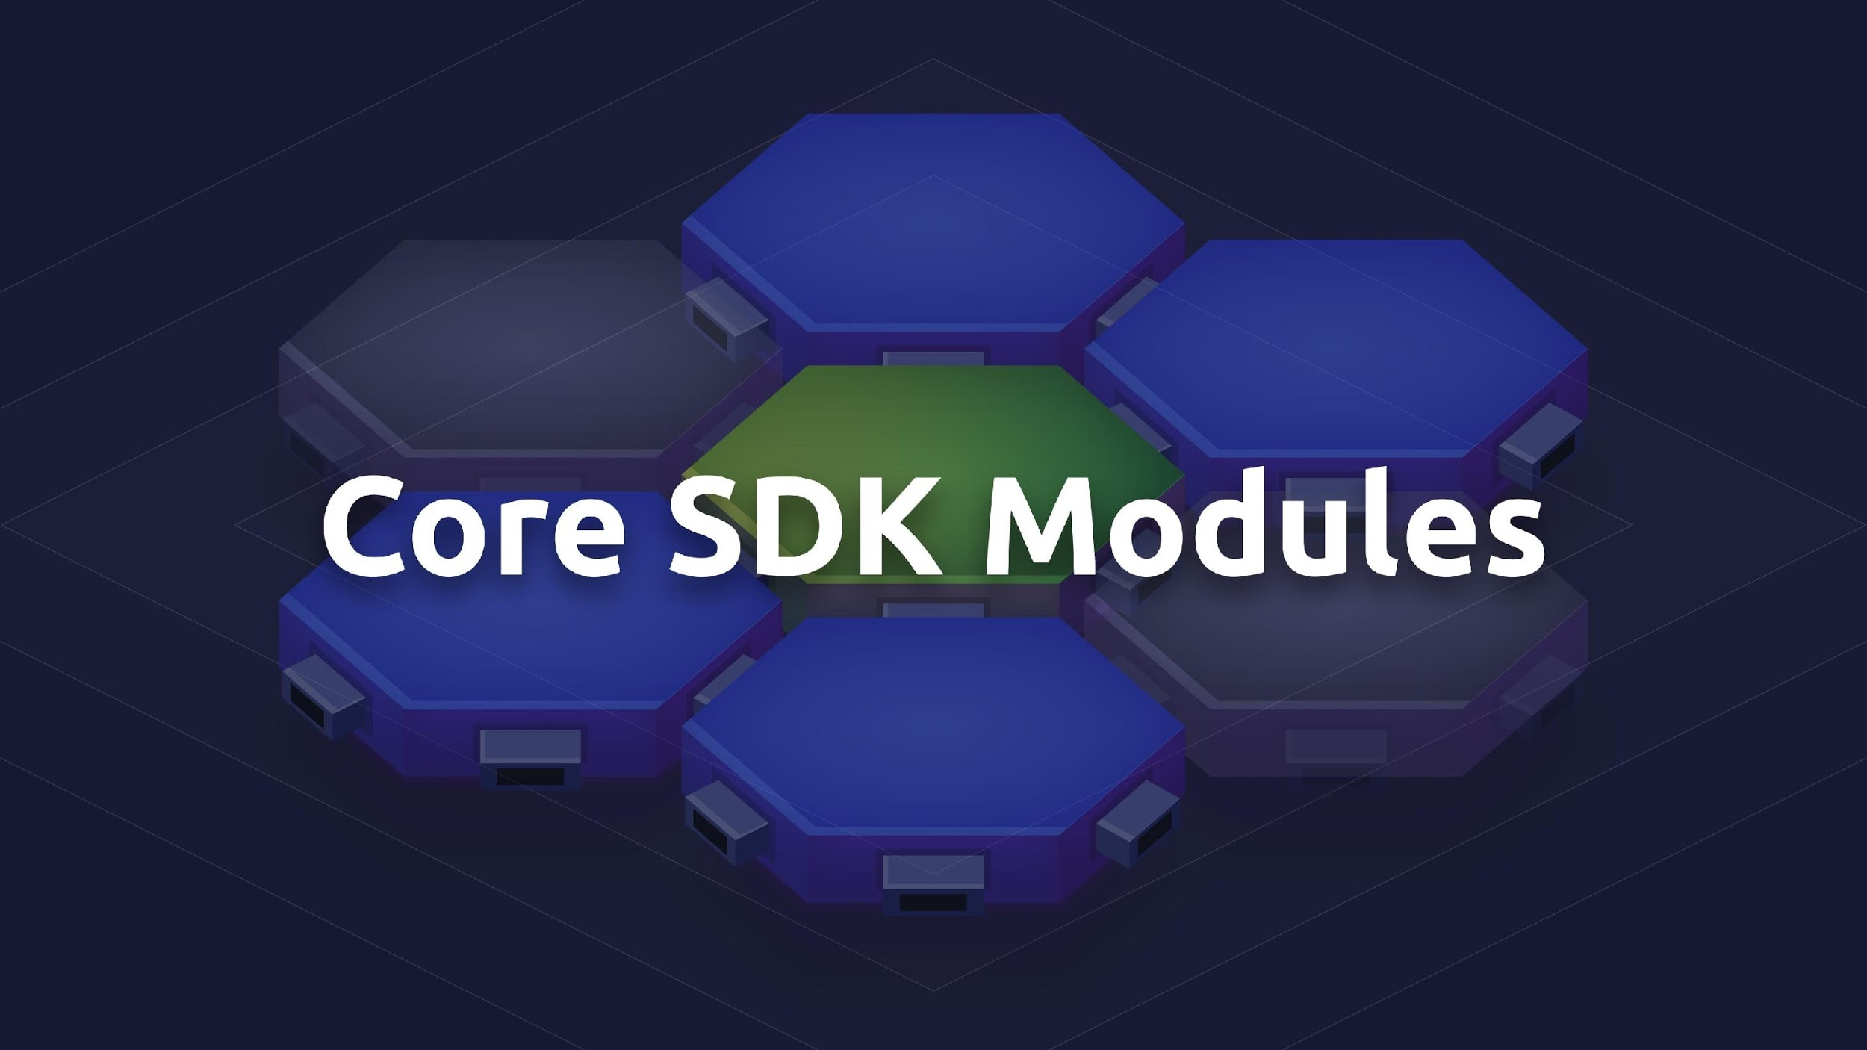

Slide 49
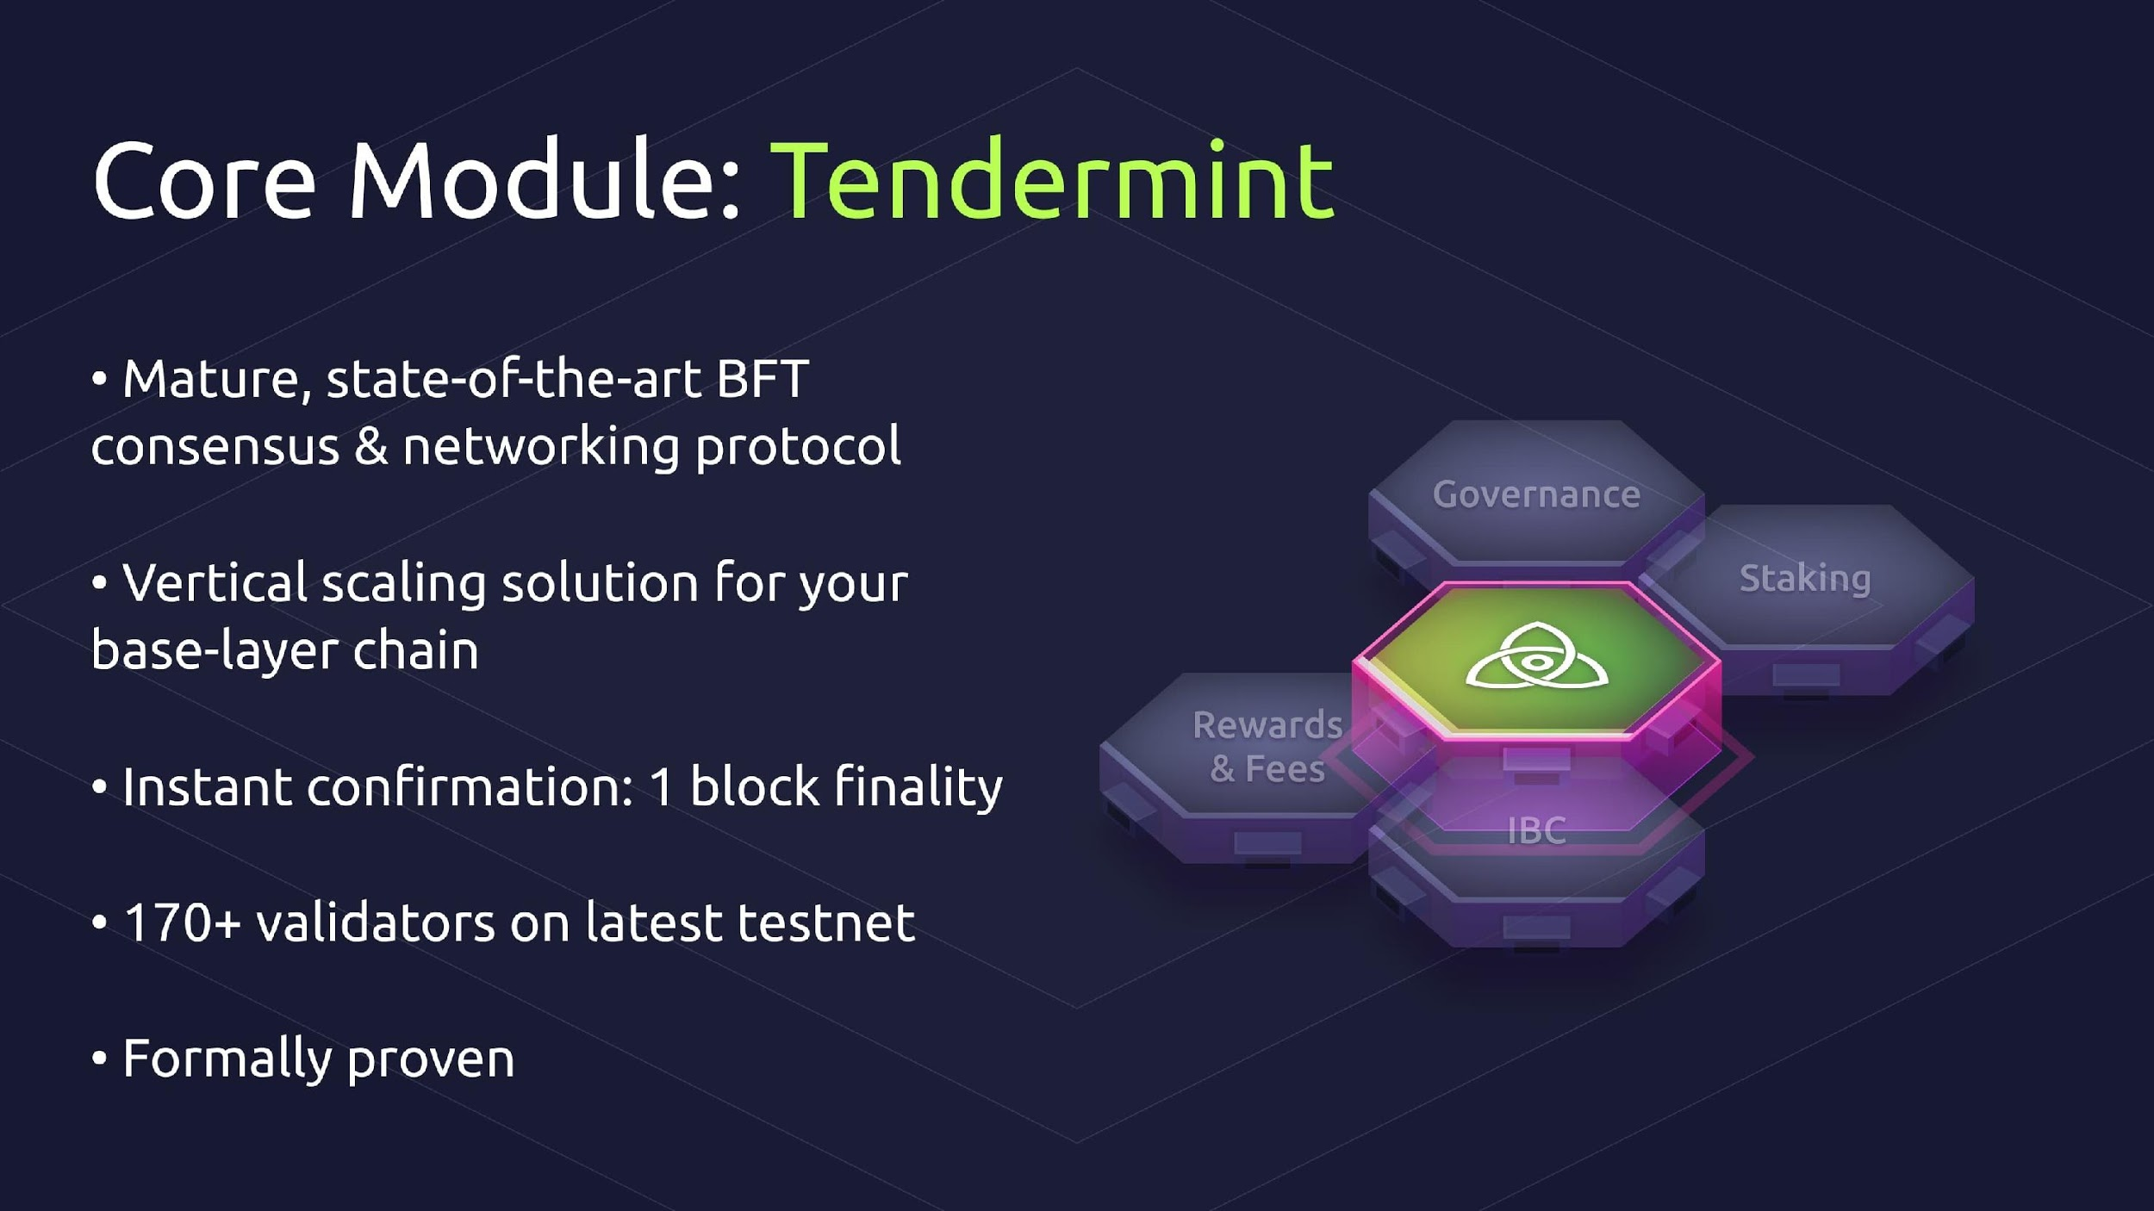

Slide 50
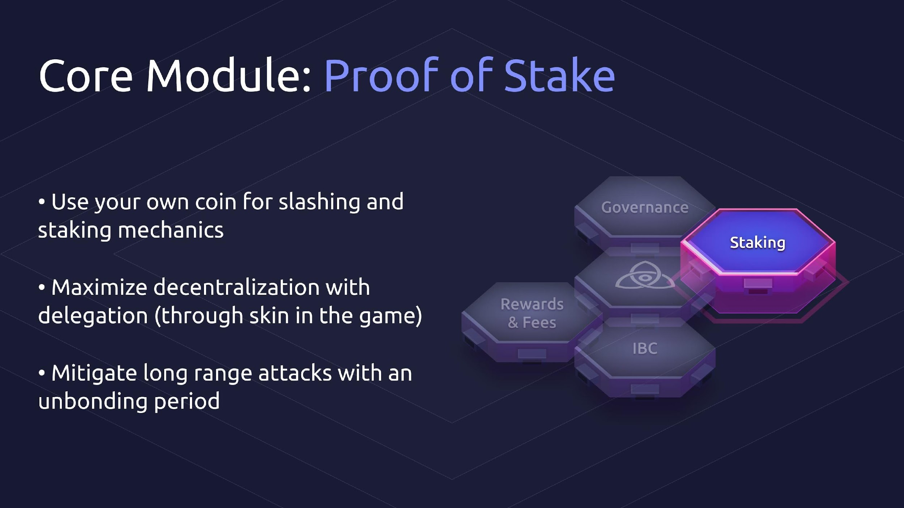

Slide 51
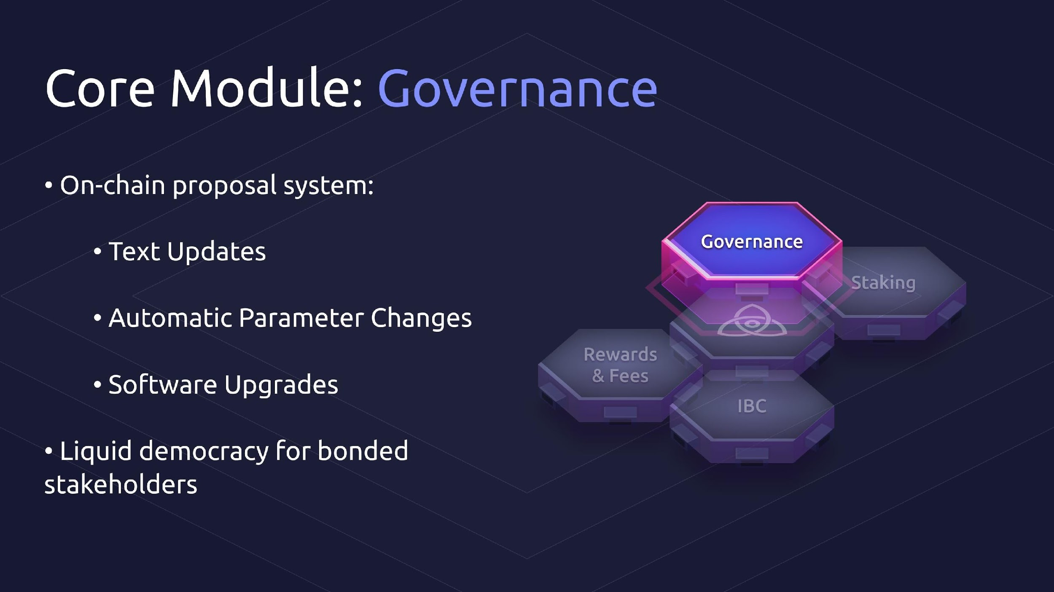

Slide 52
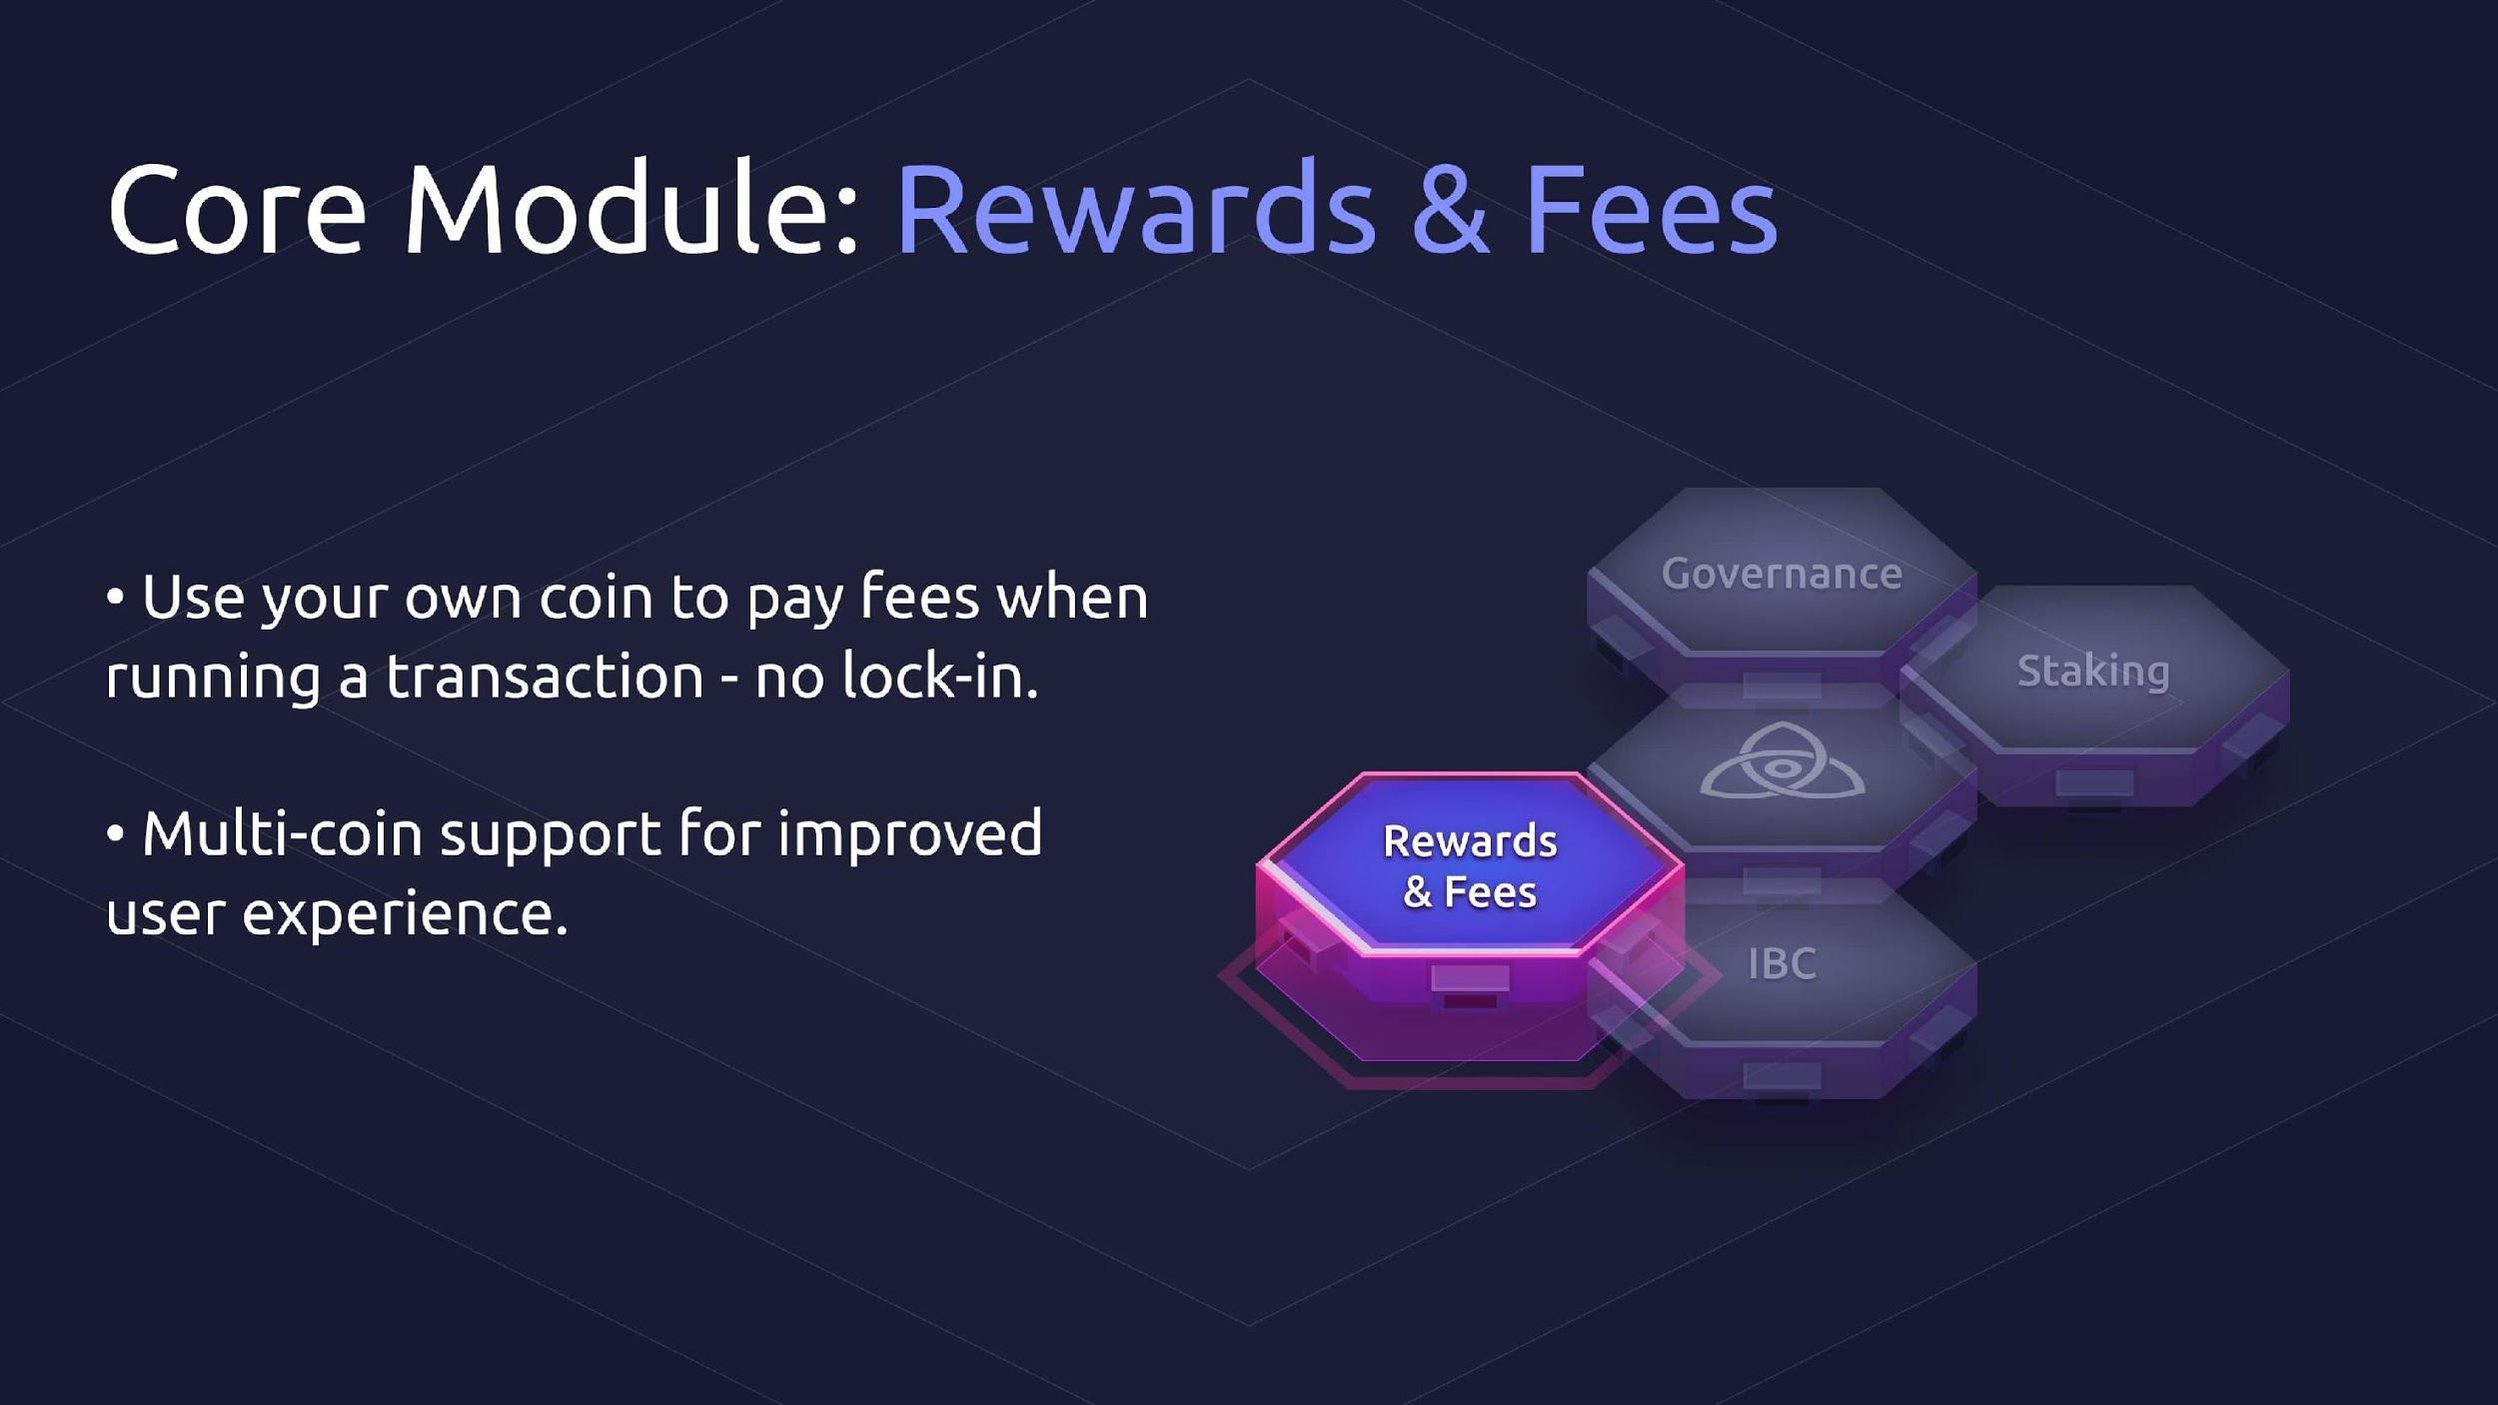

Slide 53
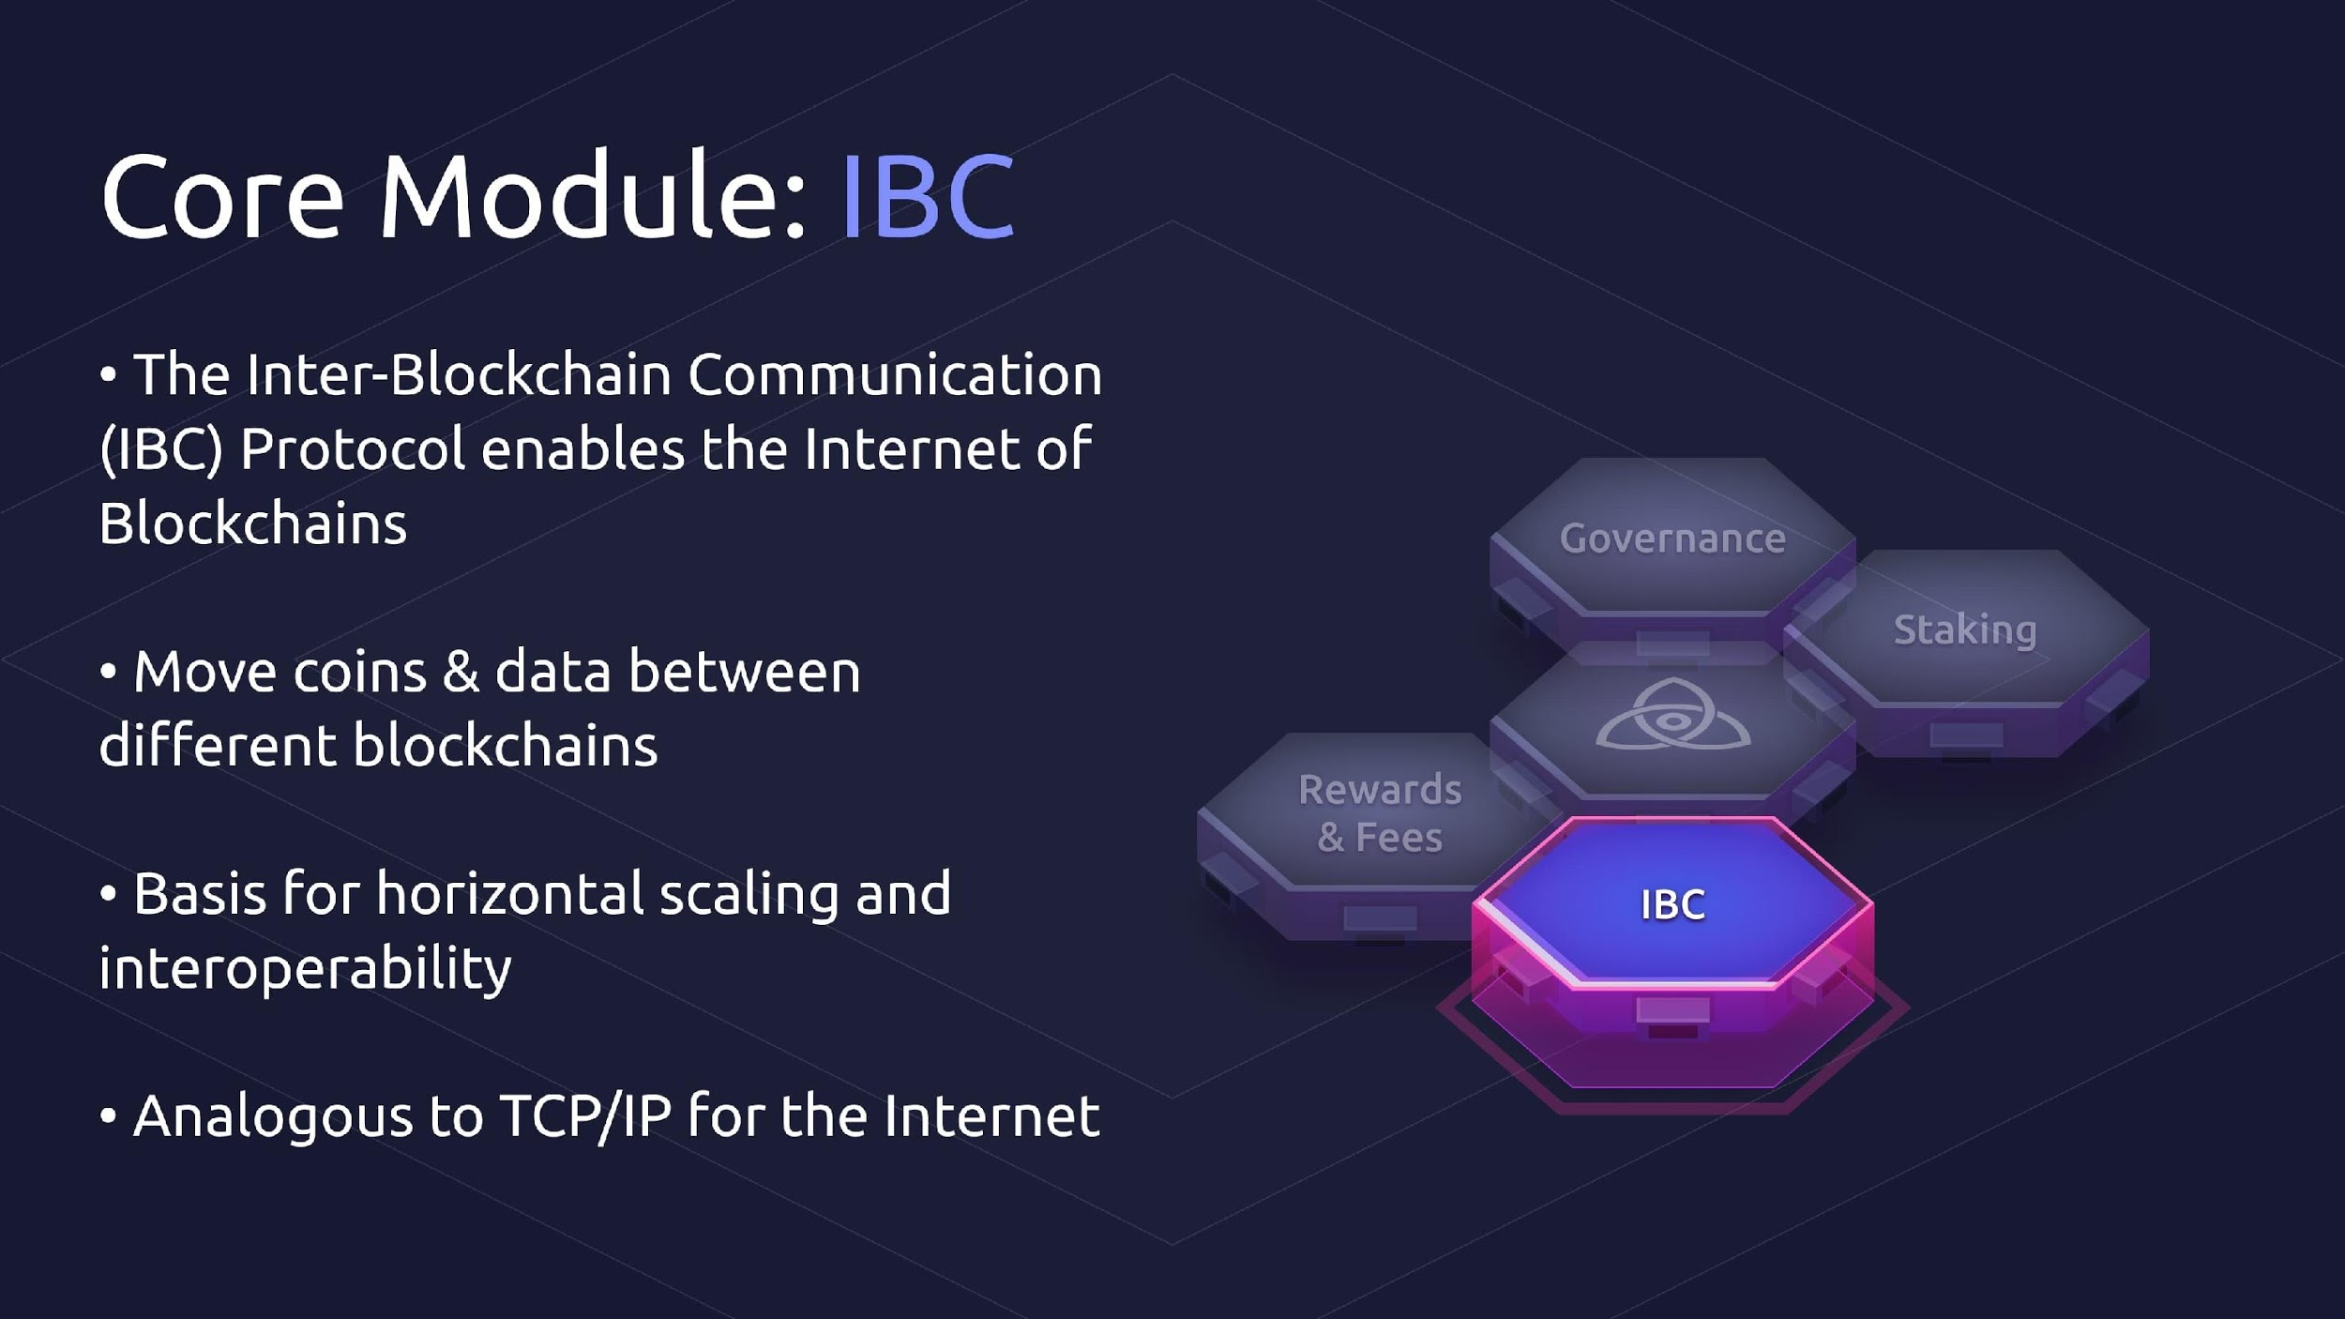

Slide 54
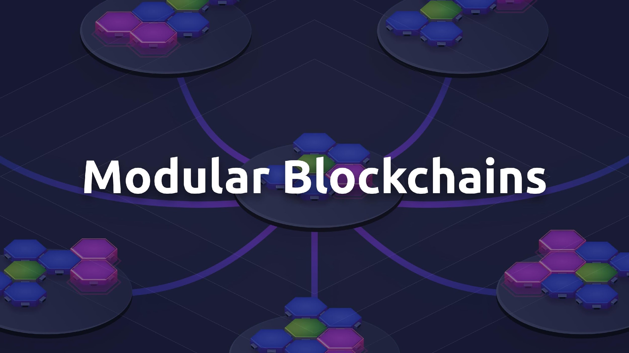

Slide 55
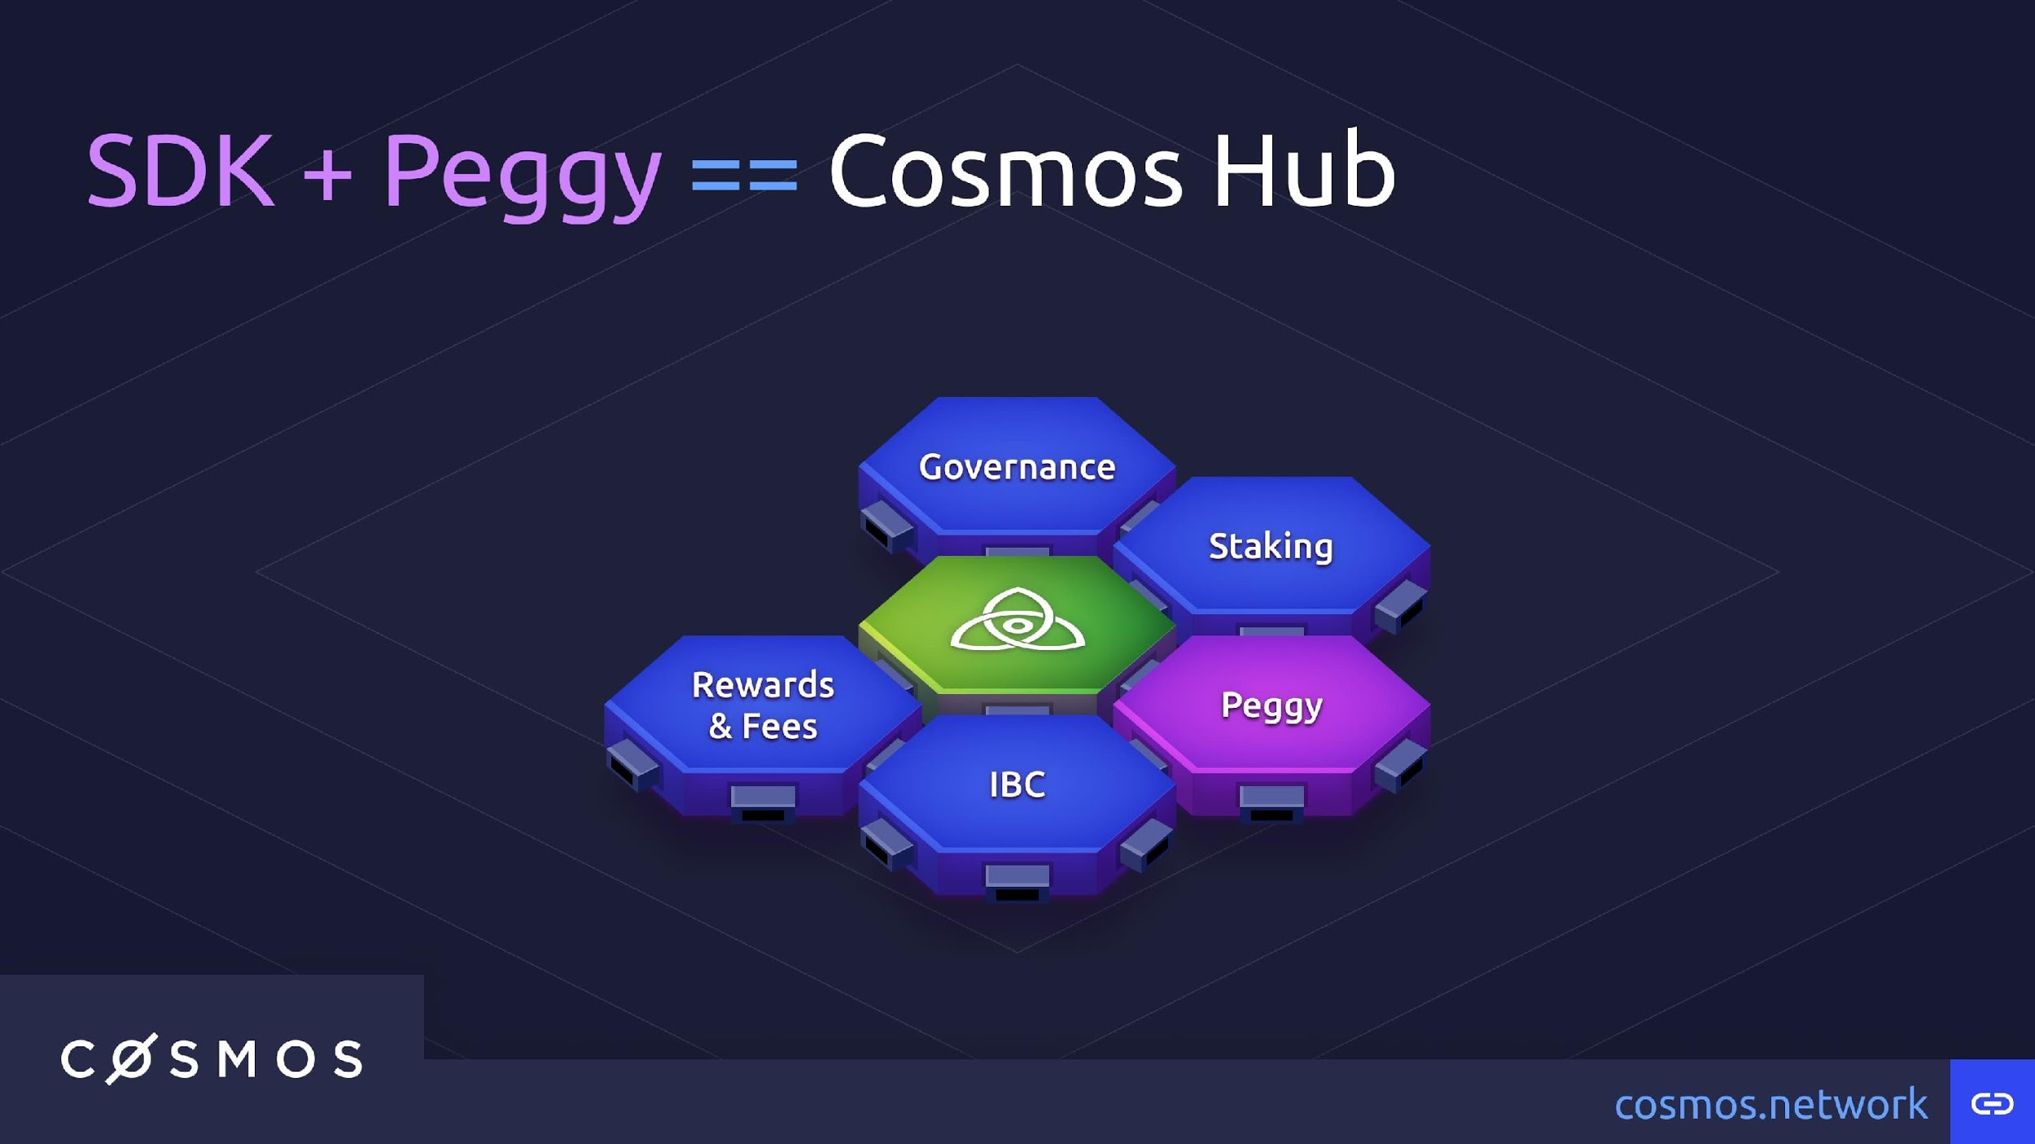

Slide 56
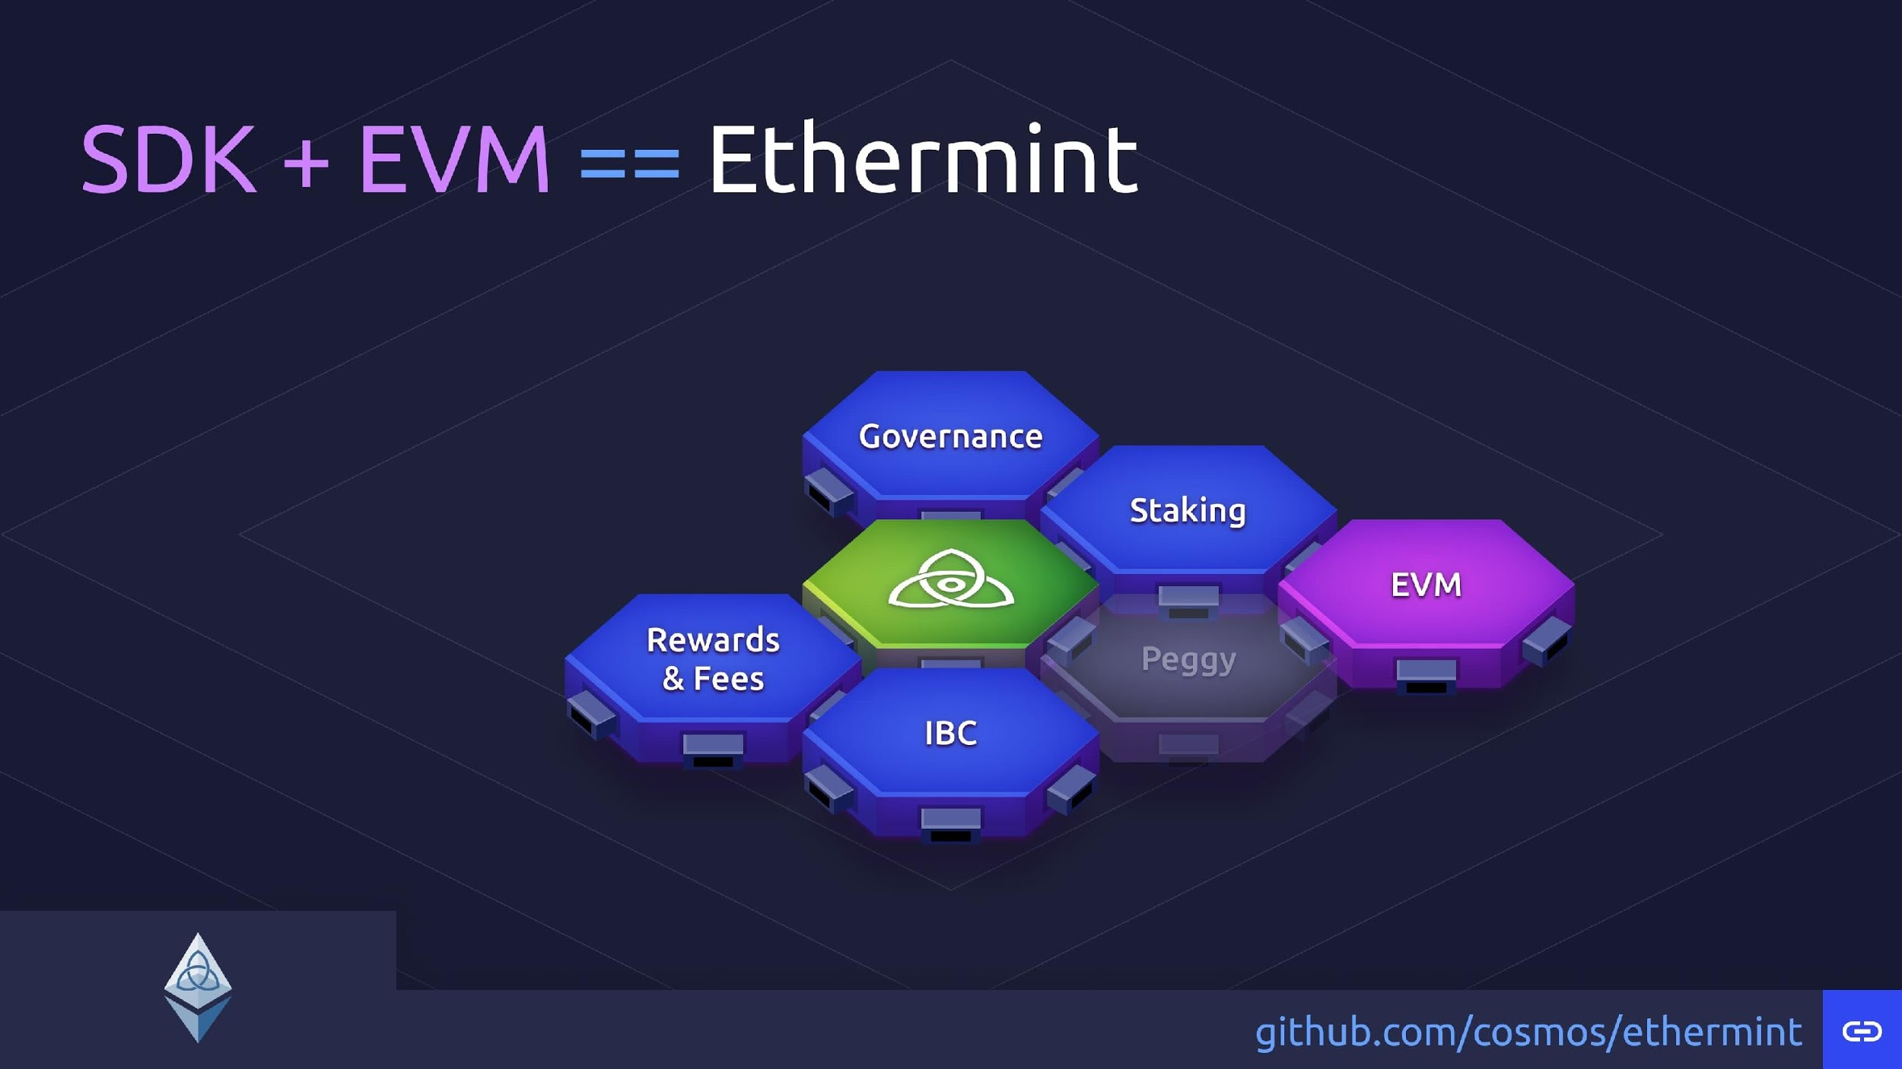

Slide 57
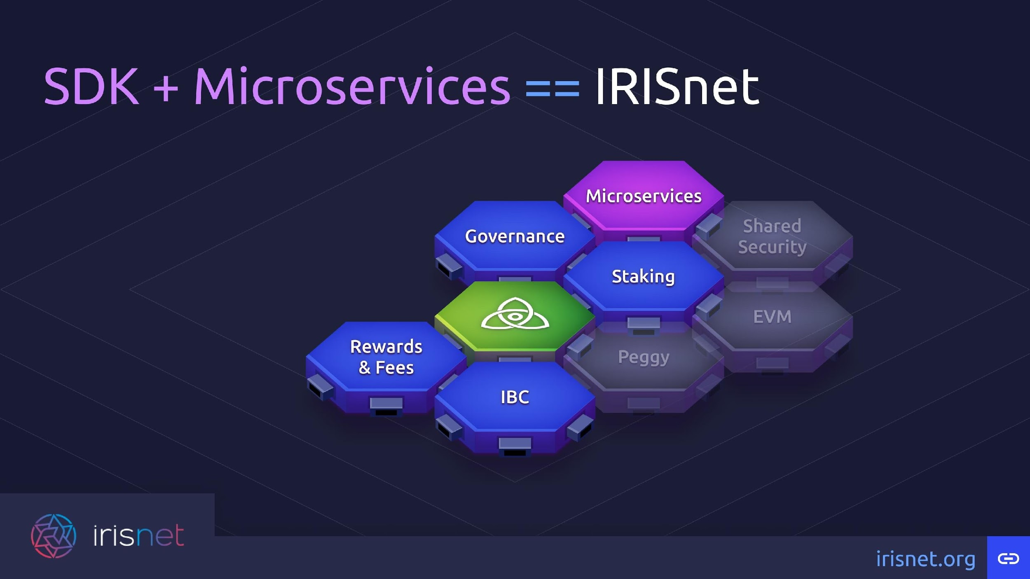

Slide 58
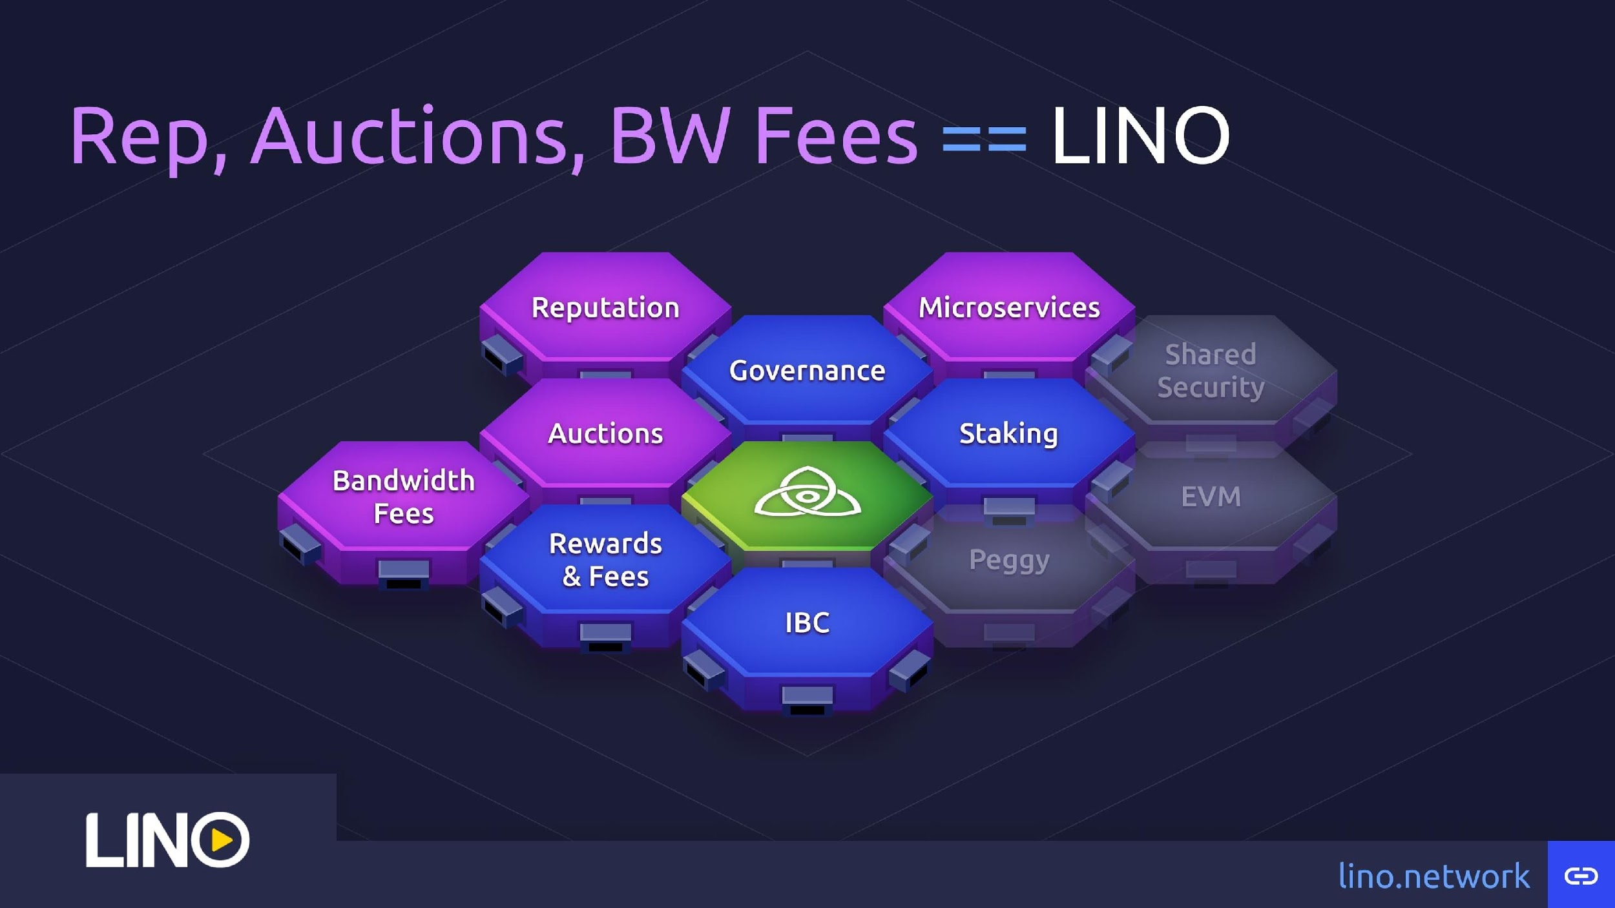

Slide 59
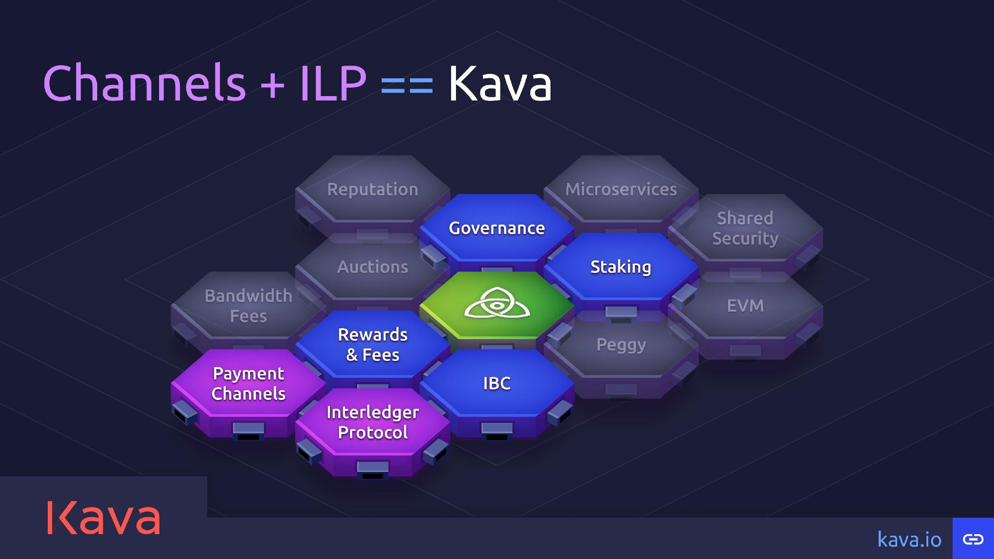

Slide 60
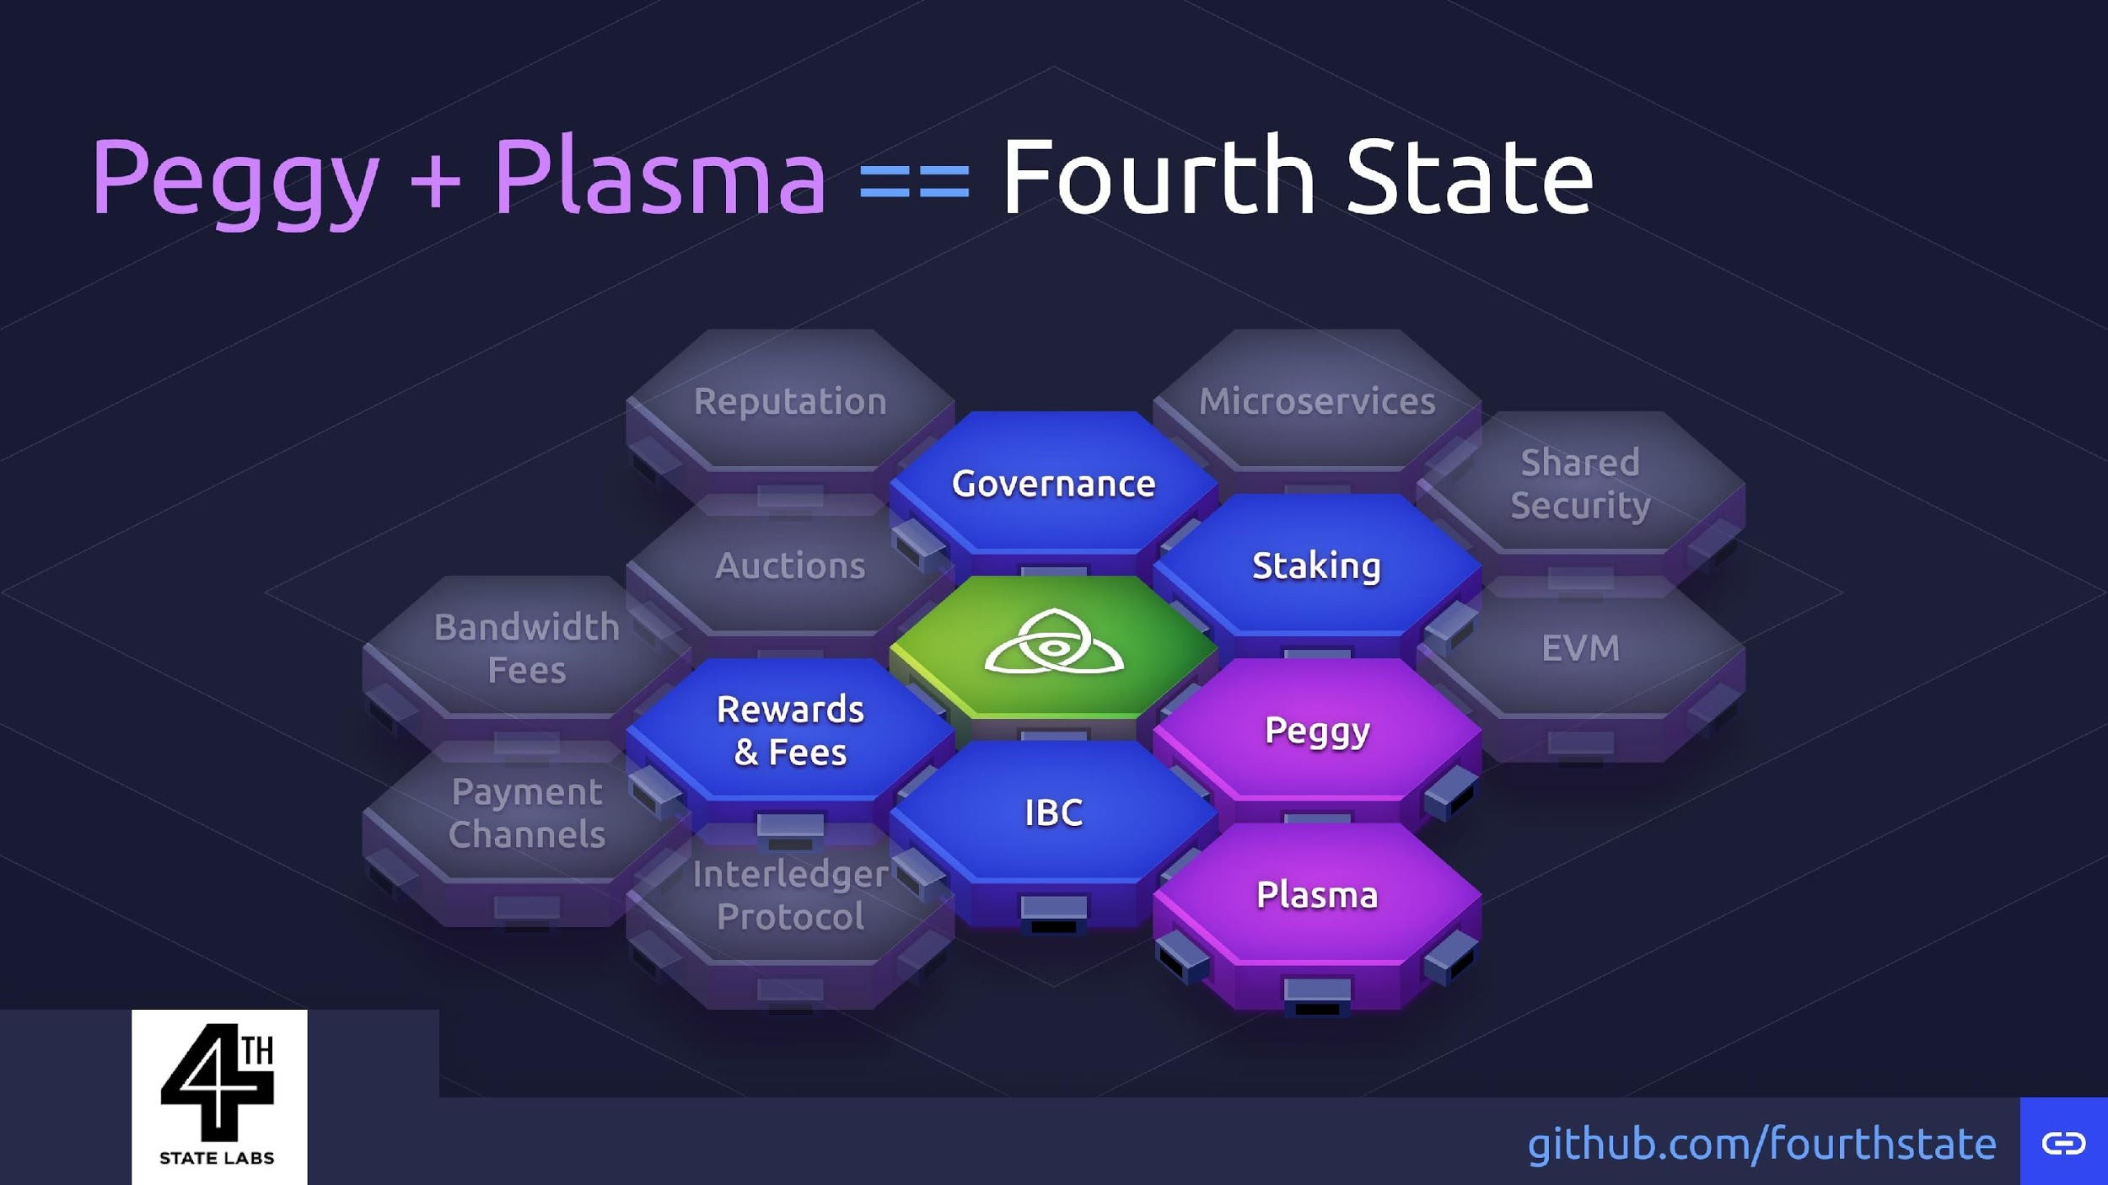

Slide 61
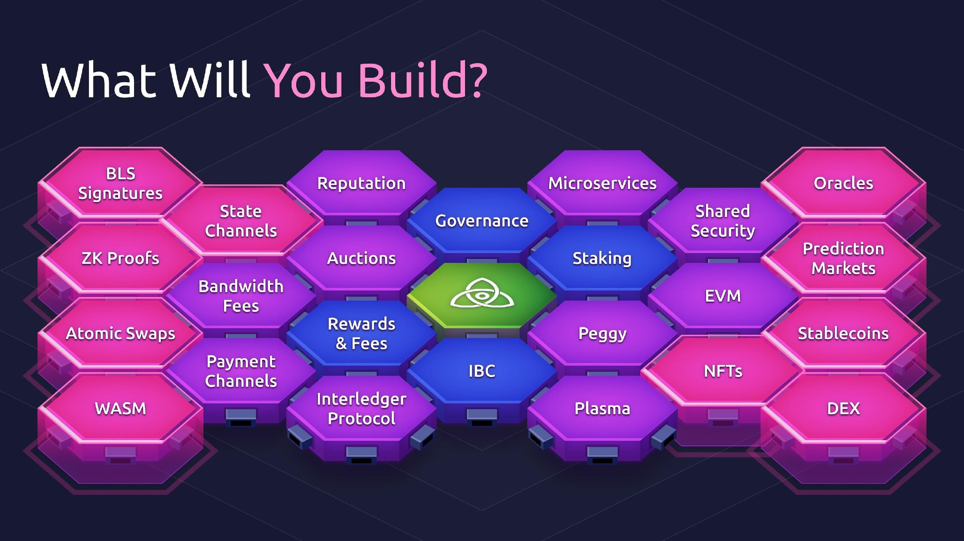

Slide 62
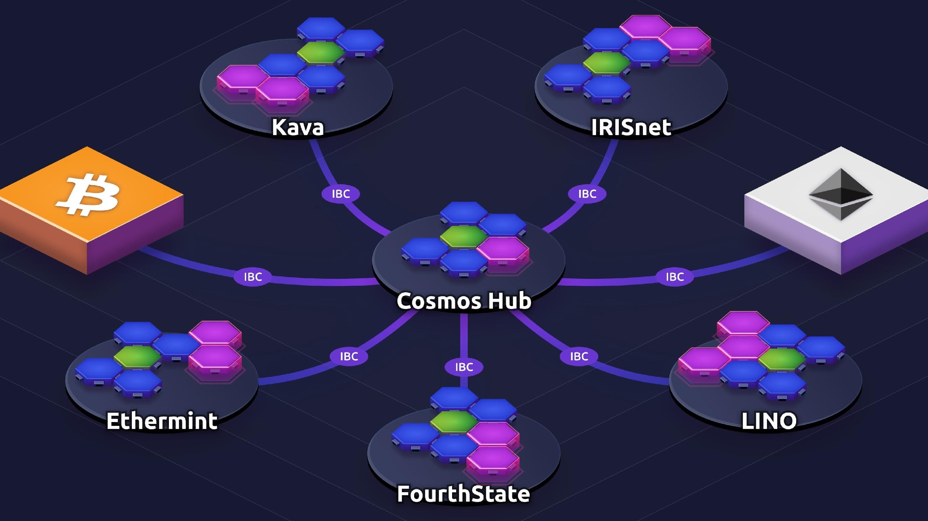

Slide 63
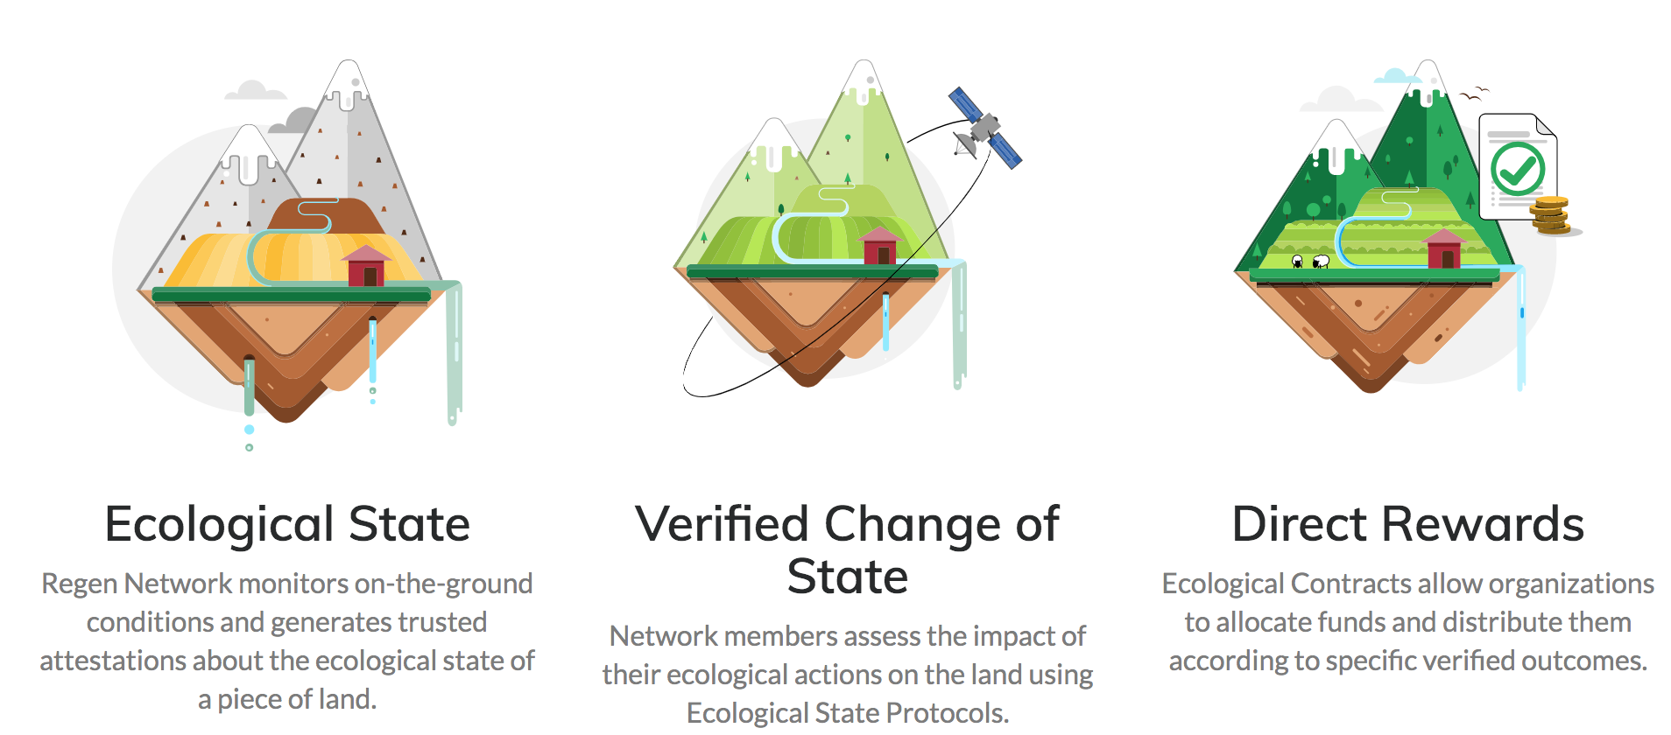
Application: Regen Network
https://www.regen.network/

Slide 64

Application: TruStory
https://www.trustory.io/

Slide 65
Lotion JS

Slide 66
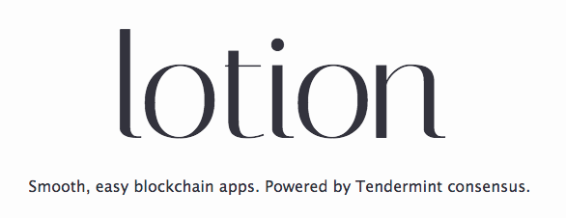
Lotion JS
https://lotionjs.com

Slide 67
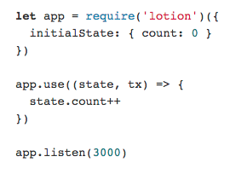
Simple Lotion App

Slide 68
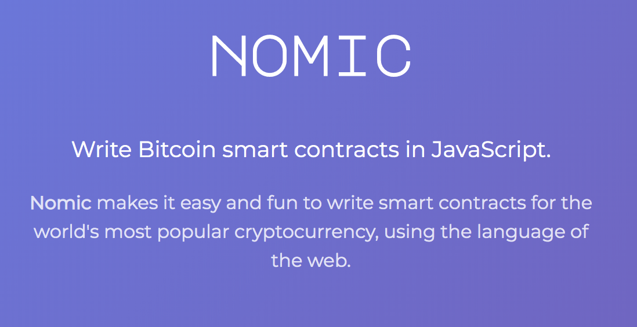
JS Smart Contracts for Bitcoin!
https://nomic.io/

Slide 69
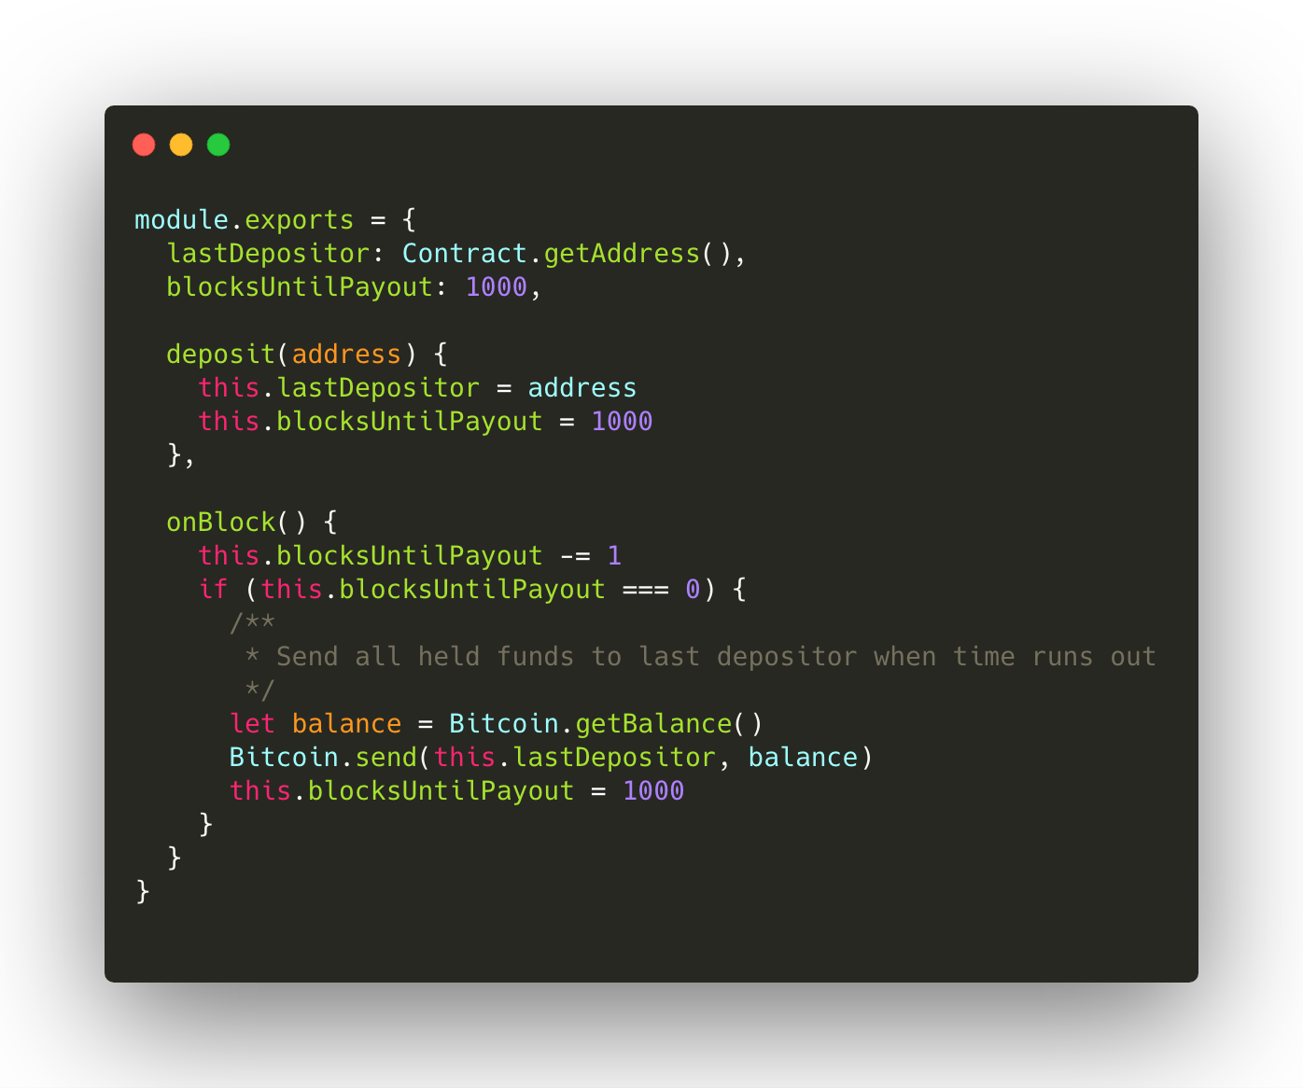
JS Smart Contracts for Bitcoin!
https://github.com/nomic-io/bitcoin-peg/blob/master/bitcoinPeg.md

Slide 70
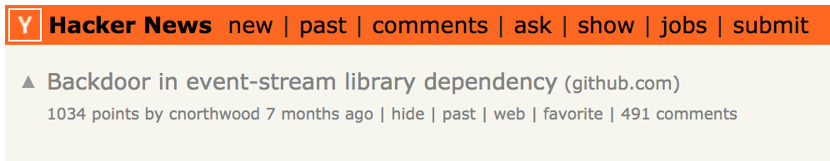
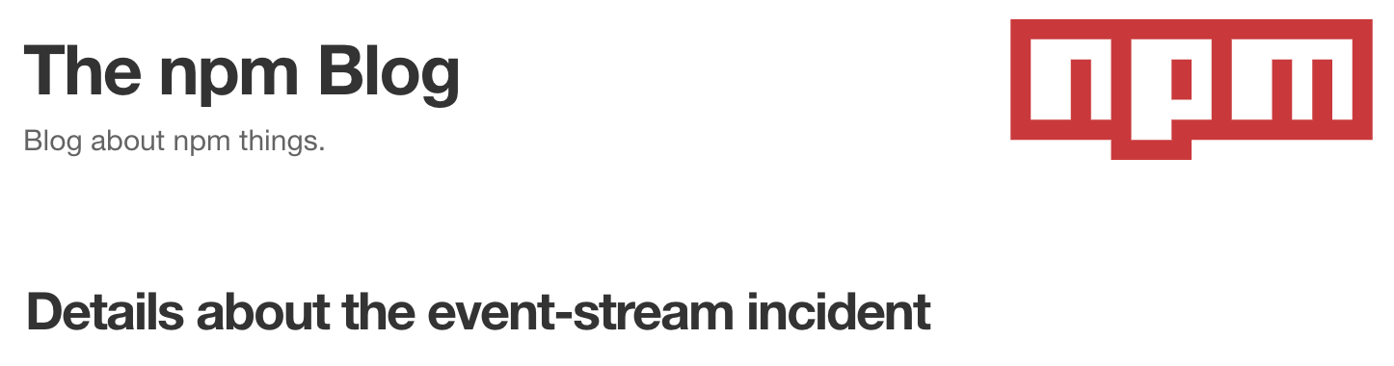
But Javascript is Insecure!

Slide 71
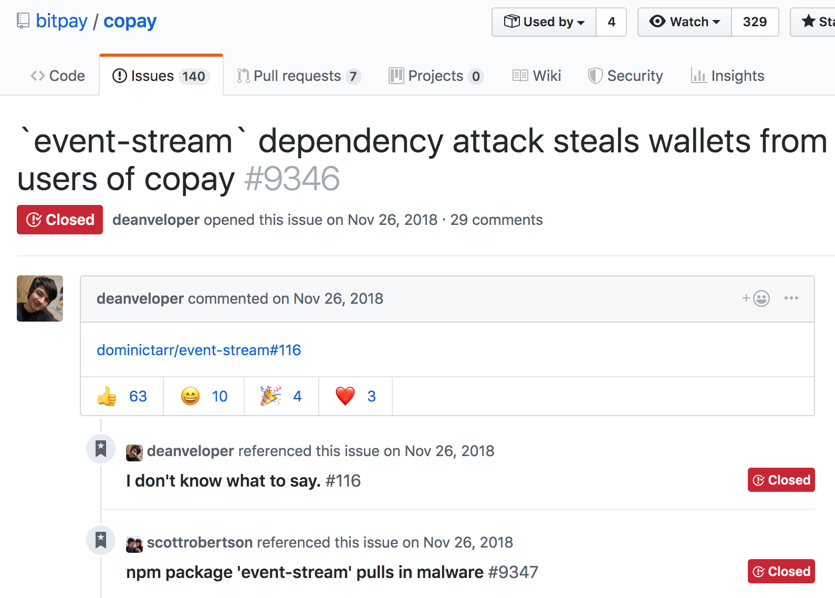
But Javascript is Insecure!

Slide 72

https://www.destroyallsoftware.com/talks/wat

Slide 73
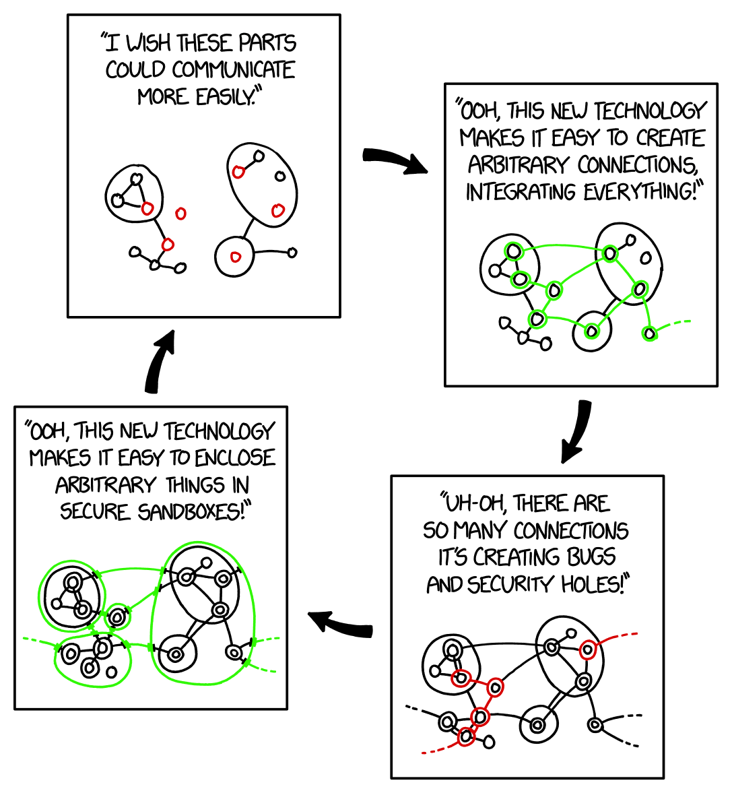
https://xkcd.com/2044/

Slide 74


Slide 75
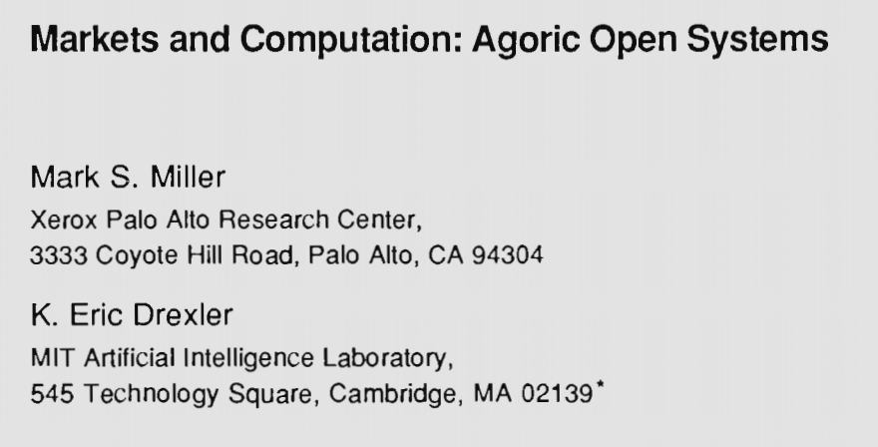


Origins of Smart Contracts
Mark S. Miller

Slide 76

Principle of Least Authority
https://agoric.com/event-stream-exploit-was-preventable-pola/

Slide 77

Principle of Least Authority
https://medium.com/agoric/pola-would-have-prevented-the-event-stream-incident-45653ecbda99

Slide 78

Object Capabilities
http://erights.org/elib/capability/overview.html

Slide 79



Securing Javascript
https://agoric.com/

Slide 80


Securing Javascript

Slide 81

Agoric Stack
https://agoric.com/

Slide 82

Agoric Stack
https://agoric.com/

Slide 83
Governance & Proof of Stake

Slide 84


Slide 85
Conclusion

Slide 86
Key Takeaways (Tendermint)
Tendermint BFT
  Simple, robust, gossip based
Tendermint Apps
  State machines in any language via ABCI
  Go, JS, Rust, Python, Haskell, Erlang, etc.
  Many VMs coming

Slide 87
Key Takeaways (Cosmos, Go)
Cosmos
  “Internet of Blockchains”
  Application Specific Blockchains connected via IBC
  Sovereignty, Diversity, Security, Scalability, Interoperability
Cosmos-SDK
  “Ruby on Rails” for blockchains
  Modular framework for experimenting with economic systems in Go
Cosmos Hub
  Largest & Most Advanced Bonded Proof of Stake
  Hub for interoperability between blockchains

Slide 88
Key Takeaways (Javascript)
LotionJS
  Simple JS framework for building Tendermint blockchains
  Pegs to Bitcoin facilitate Bitcoin smart contracts in JS
Agoric
  JS can be secure!
  Smart Contracts in JS via Object Capabilities
  Tight integration with Cosmos-SDK and Cosmos ecosystem

Slide 89
Key Takeaways (Organizations)
Interchain Foundation
  Apply for funding or a job!
  https://interchain.io/careers
  https://interchain.io/funding
Informal Systems
  R&D spin out from the Interchain Foundation
  Coming soon!
  https://informal.systems

Slide 90



If you like the sound of my voice ...
Software Engineering Daily
“Consensus Systems with Ethan Buchman”
Epicenter Podcast
“Launching the Internet of Blockchains”
Rebuild Conference
“Stakeholders &
State Machines”

Slide 91

Thank You!
https://interchain.io
https://interchain.io/careers
https://interchain.io/funding
https://informal.systems
https://cosmos.network
https://tendermint.com

