Slide 1
Invited Talk, ApPLIED Workshop @ DISC 2019, Budapest

Slide 2
To Build, Or Not To Build,
That Is The Question …
Nitin Vaidya
Georgetown University

Slide 3
Outline
Brief overview of past work
Some thoughts on building testbeds
PG-13

Slide 4
Caveat
I don’t always follow my own advice

Slide 5
Brief History of Time
ECE @ UMass Ph.D
➔ CS @ Texas A&M
➔ ECE @ UIUC
➔ CS @ Georgetown
Fault-tolerant
computing
➔ Wireless
networks … systems
➔ Distributed
algorithms … theory

Slide 6
Fault-Tolerance

Slide 7
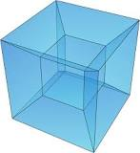
Checkpointing & Rollback Recovery

Slide 8
Coordinated Checkpoints
Application messages
Control messages

Slide 9
Coordinated Checkpoints
Based on
Chandy-Lamport Snapshot

Slide 10
Coordinated Checkpoints

Slide 11
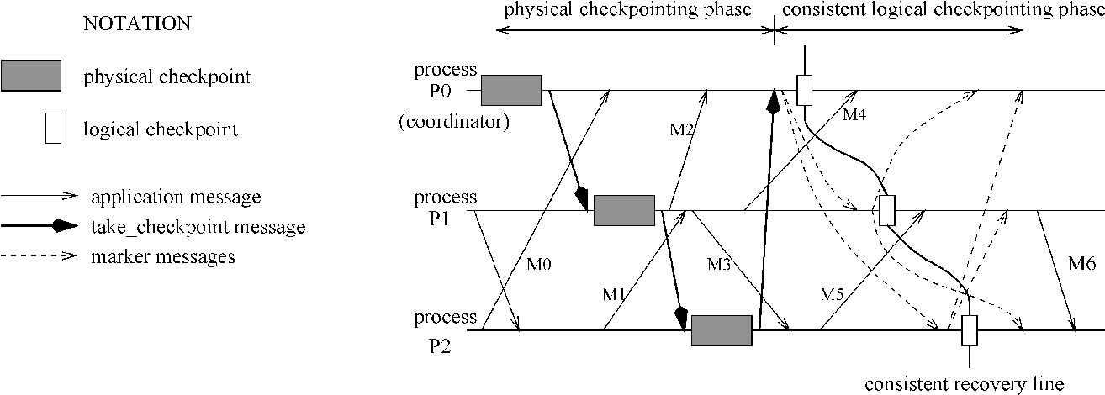
Consistent Logical Checkpoints
Staggered Checkpointing

Slide 12
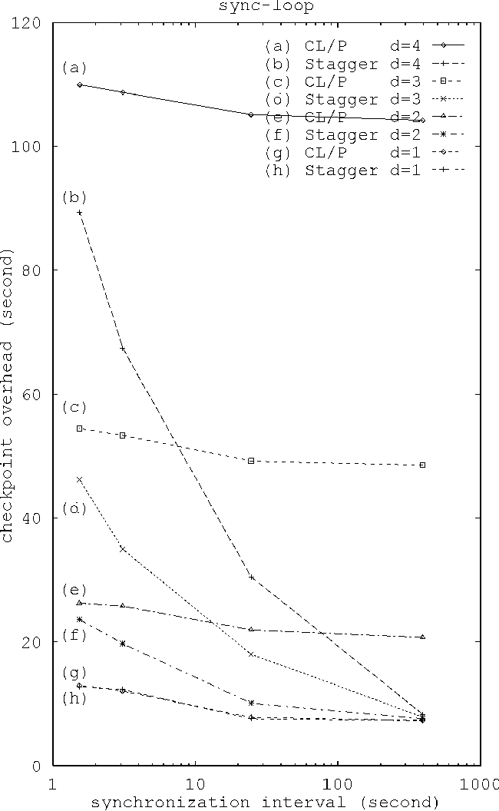
Theirs
Ours

Slide 13
Multi-Level Checkpointing
Different (cost) checkpoints for different faults

Slide 14
Mesh Networks

Slide 16
Multi-Channel Systems
Available spectrum
Spectrum divided into channels
1
2
3
4
…
c

Slide 17

Practical Scenario
1
1
c–m unused channels
at each node
m
m
m+1
c

Slide 18
Practical Scenario
1
1
c–m unused channels
at each node
m
m
How does mesh
performance scale with
c and m ?
m+1
c

Slide 19
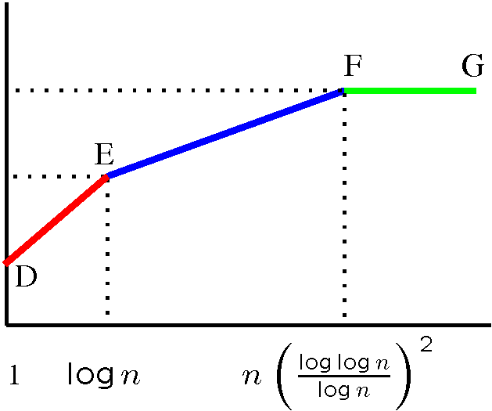
Net-X: Multi-Channel Mesh
Theory to Practice
capacity
channels
Capacity
bounds

Slide 20
Net-X: Multi-Channel Mesh
Theory to Practice
D
Fixed
capacity
E
F
B
A
Switchable
C
channels
Capacity
bounds
Insights on
protocol design

Slide 21
Net-X: Multi-Channel Mesh
Theory to Practice
D
Fixed
capacity
E
F
B
A
Switchable
C
channels
Capacity
bounds
Insights on
protocol design
OS improvements
Software architecture
User
Applications
Multi-channel
protocol
IP Stack
ARP
Channel Abstraction Module
Interface
Device Driver
Interface
Device Driver

Slide 22
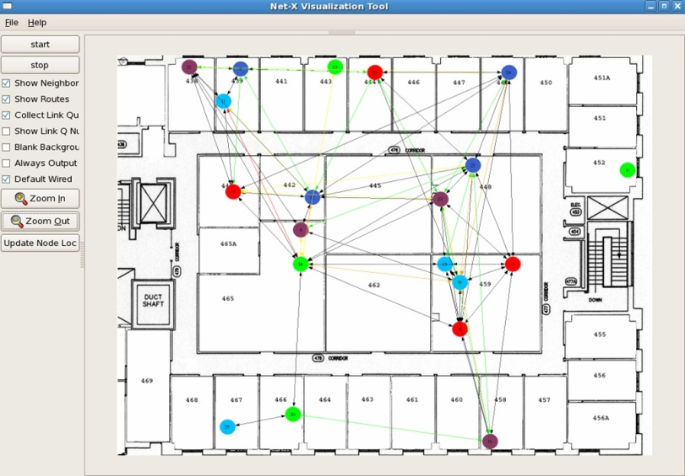
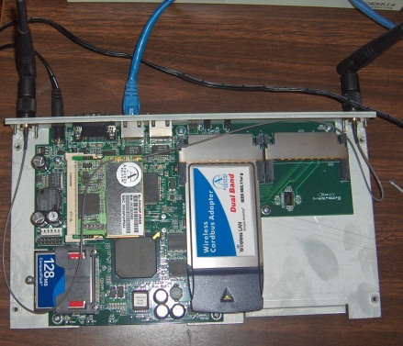
Net-X: Multi-Channel Mesh
Theory to Practice
D
Fixed
capacity
E
F
B
A
Switchable
C
channels
Capacity
bounds
Insights on
protocol design
Net-X
testbed
OS improvements
Software architecture
User
Applications
Multi-channel
protocol
IP Stack
ARP
Channel Abstraction Module
Interface
Device Driver
Interface
Device Driver
Linux box

Slide 23
Distributed Algorithms
“Local Computations”

Slide 24
Average Consensus

Slide 25

Average Consensus
Initially, state = input
b
b = 3b/4+ c/4
c
c = a/4+b/4+c/2
a
a = 3a/4+ c/4

Slide 26
Average Consensus
2
b = (6/4+1/4)=7/4
1
c = (2/4+6/4+1/2) = 10/4
6
a = (18/4+1/4) = 19/4

Slide 27
Average Consensus
Values converge to average of inputs
2
b = (6/4+1/4)=7/4
1
c = (2/4+6/4+1/2) = 10/4
6
a = (18/4+1/4) = 19/4

Slide 28
Implementing Local Algorithms
Too much work to implement (in wireless networks)
Software environment to make life easier
Programmer provides pseudo-code
Rest automated

Slide 29
To Build, Or Not To Build,
That Is The Question …

Slide 30
Staggered Checkpointing
Theirs
Ours

Slide 31
Staggered Checkpointing
Waste of time
Theirs
Ours

Slide 32
Average Consensus
Software Toolkit for Local Computations
2
b = (6/4+1/4)=7/4
1
c = (2/4+6/4+1/2) = 10/4
6
a = (18/4+1/4) = 19/4

Slide 33
Average Consensus
Software Toolkit for Local Computations
2
b = (6/4+1/4)=7/4
Utilitarian, but research value limited
1
c = (2/4+6/4+1/2) = 10/4
6
a = (18/4+1/4) = 19/4

Slide 34
Net-X: Multi-Channel Mesh
Theory to Practice
D
Fixed
capacity
E
F
B
A
Switchable
C
channels
Capacity
bounds
Insights on
protocol design
Net-X
testbed
OS improvements
Software architecture
User
Applications
Multi-channel
protocol
IP Stack
ARP
Channel Abstraction Module
Interface
Device Driver
Interface
Device Driver
Linux box

Slide 35
Net-X: Multi-Channel Mesh
Theory to Practice
D
Fixed
capacity
E
F
B
A
Switchable
C
channels
Best Case Scenario
Capacity
bounds
Insights on
protocol design
Net-X
testbed
OS improvements
Software architecture
User
Applications
Multi-channel
protocol
IP Stack
ARP
Channel Abstraction Module
Interface
Device Driver
Interface
Device Driver
Linux box

Slide 36
Multi-Channel Systems
Available spectrum
Spectrum divided into channels
1
2
3
4
…
c

Slide 37
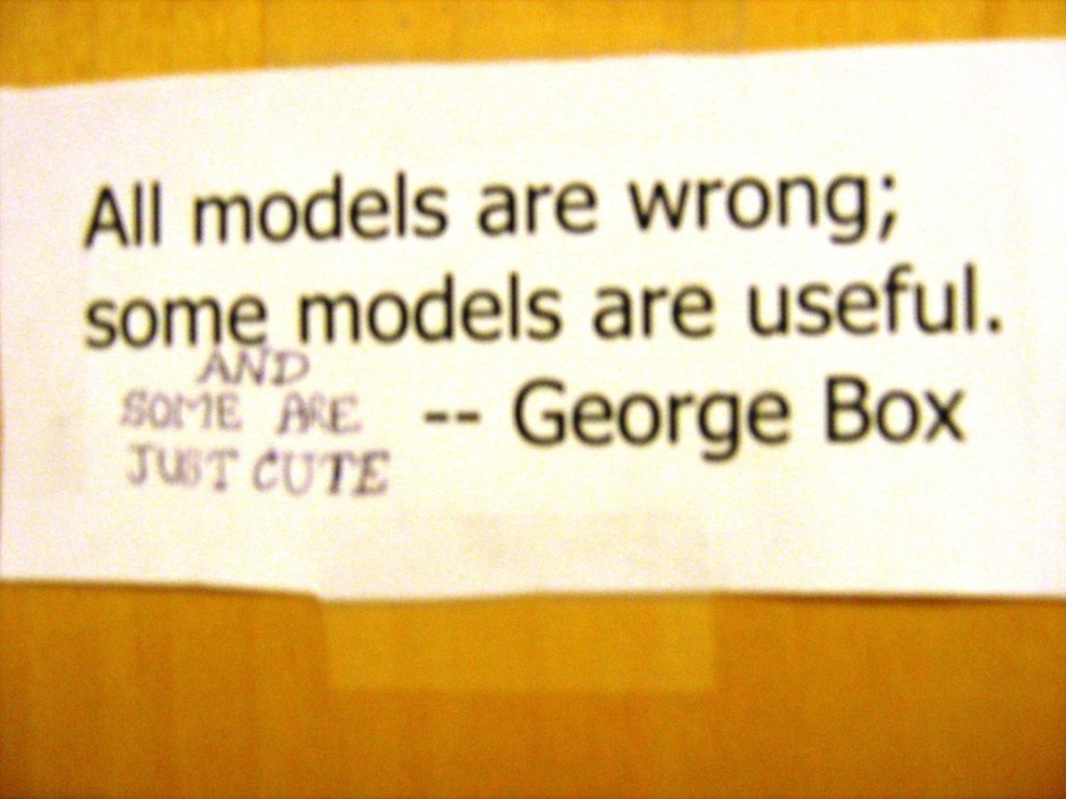
Multi-Channel Systems
Available spectrum
Spectrum divided into channels
1
2
3
4
…
c

Slide 38
1
1
Adjacent
Channel
Interference
m
m
m+1
c

Slide 39
D
Fixed
capacity
E
F
B
A
Switchable
C
channels
Capacity
bounds
Insights on
protocol design
Net-X
testbed
OS improvements
Software architecture
User
Applications
Multi-channel
protocol
IP Stack
ARP
Channel Abstraction Module
Interface
Device Driver
Interface
Device Driver
Linux box

Slide 40
D
Fixed
capacity
E
F
B
A
Switchable
C
channels
Capacity
bounds
Insights on
protocol design
Net-X
testbed
OS improvements
Software architecture
User
Applications
Multi-channel
protocol
IP Stack
ARP
Channel Abstraction Module
Interface
Device Driver
Interface
Device Driver
Linux box

Slide 41
When To Build

Slide 42

When To Build
Theory
Systems
Picture from Wikipedia

Slide 43
When To Build
When results are not predictable from theory
For theory & simulations to suffice,
need accurate system & workload models

Slide 44
When To Build
When results are not predictable from theory
For theory & simulations to suffice,
need accurate system & workload models
➔ Academic architects rarely build physical systems
anymore

Slide 45
Bad Reasons To Build

Slide 46
Bad Reasons To Build
So we can publish the paper

Slide 47
Bad Reasons To Build
So we can publish the paper
Much of the
“systems”
literature

Slide 48
Bad Reasons To Build
So we can publish the paper
Make simple ideas appear “substantive”
Much of the
“systems”
literature

Slide 49
Bad Reasons To Build
So we can publish the paper
Make simple ideas appear “substantive”
Everybody is doing it
… so what’s wrong with you?
Much of the
“systems”
literature

Slide 50
Bad Reasons To Build
So we can publish the paper
Make simple ideas appear “substantive”
Everybody is doing it
… so what’s wrong with you?
Much of the
“systems”
literature
Funding
agencies
prone to this

Slide 51
“The MSR Effect” *

Slide 52
“The MSR Effect” *
* Disclaimers:
Replace your favorite lab here
Some of my best friends are at MSR

Slide 53
“The MSR Effect”
In the good old days, industry research labs aspired
to do relevant but academic quality research
    Fundamental research
    Long timescales
    “Independence” from products

Slide 54
“The MSR Effect”
In the good old days, industry research labs aspired
to do relevant but academic quality research
    Fundamental research
    Long timescales
    “Independence” from products
Today …
Research labs dominate many conferences
Academics aspire to emulate industry labs
➔ “Systems” communities have succumbed to this

Slide 55
How to unwind this clock?

Slide 56
Break Artificial Boundaries
Theory
Systems

Slide 57
Minimalism
Often less is more
Don’t build just because you can
There may be better things to do with your time
and resources

Slide 58
Litmus Test
Would you be willing to publicly post
the exact problem statement ?
… before developing the solution
If not, find something better to do

Slide 59
Thanks!
disc.georgetown.domains

