Slide 1
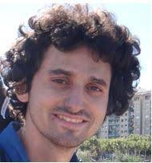



Transactional Libraries
Idit Keidar, Technion
with
Alexander Spiegelman, Guy Golan-Gueta, Gal Assa, and Hagar Meir

Slide 2
Agenda
Motivation
  Concurrent Data Structure Libraries (CDSLs) vs Transactional Memory
Introducing: Transactional Data Structure Libraries (TDSL)
Example TDSL algorithm
  Skiplist
  Additional objects
  Fast abort-free singletons
Library composition & nesting
Evaluation

Slide 3


Multi-Threading is Everywhere
Notes:
Multi core machines
Too much data for sequential programs
Many clients
Concurrent is fast

Slide 4
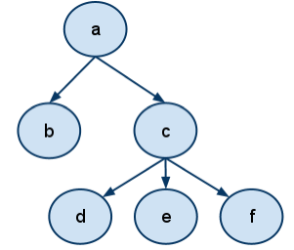
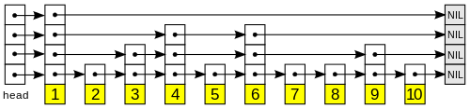
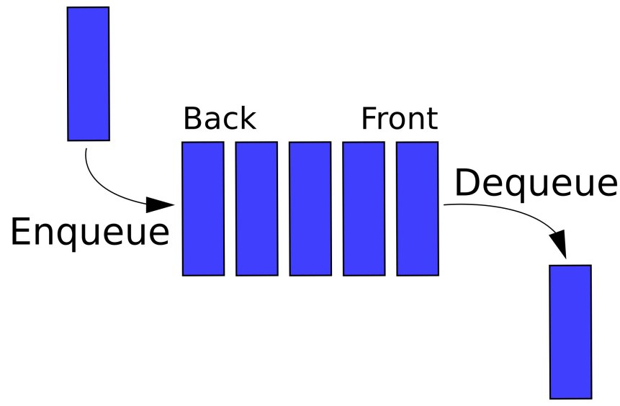
Data Structures (DS)
Essential building blocks in modern SW
  Map, skiplist, queue, etc.

Slide 5


But Are They “Thread Safe”?
Correct under concurrency?
OR
?
Notes:
לדוגמא רוצים למנוע שמכניסים שני איברים במקביל ורואים רק אחד

Slide 6
“Thread-Safe” Concurrent DS Libraries
Widely used in real life software
Numerous research papers
  Concurrent Skipklist
  [Herlihy, Lev, Luchangco, Shavit: A simple optimistic skiplist algorithm] [Fraser: Practical lock freedom] …
  Concurrent queue
  [Michael, Scott: Simple, fast, and practical nonblocking and blocking concurrent queue algorithms] [Gramoli, Guerraoui: Reusable concurrent data types]
  Concurrent binary tree
  [Bronson, Casper, Chafi, Olukotun: A practical concurrent binary search tree] [Drachsler, Vechev, Yahav: Practical concurrent binary search trees via logical ordering]
Notes:
API example

Slide 7
Concurrent Data Structure Libraries (CDSLs)
Each operation executes atomically
Custom-tailored implementation preserves semantics
  balance←map.get (key=Yoni)
  newBalance← balance + deposit
  map.set(key=Yoni, newBalance)
  repQ.enq(“Yoni’s balance=new”)
App
App
App
map
queue
Notes:
API example

Slide 8
Are They Really Thread Safe??
  balance ←map.get (key=Yoni)
  balance ←map.get(key=Yoni)
  newBalance← balance + deposit
  newBalance← balance + deposit
  map.set(key=Yoni, newBalance)
  map.set(key=Yoni, newBalance)
  repQ.enq(“Yoni’s balance=new”)
  repQ.enq(“Yoni’s balance=new”)
  Oops! Atomic operations are not enough
Notes:
API example

Slide 9
Software Transactional Memory (STM)
TL2, TinySTM, SwissTM,…
Transactions (TXs) = atomic sections including multiple DS operations
  Begin_TX balance←map.get(key=Yoni)
  newBalance ← balance + deposit
  map.set(key=Yoni, newBalance)
  repQ.enq(“Yoni’s balance=new”)
  End_TX
App
end
map
queue
abort
begin
STM
Notes:
API example
DS does not have to be concurrent.

Slide 10
CDSL vs STM
Why?
 | CDSL | STM
Performance | ✓ | ✗
Exploit DS semantics | ✓ | ✗
Used in practice | ✓ | ✗
Generality | ✗ | ✓
Composability | ✗ | ✓

Slide 11
STM Overhead Explained
Common STM solution:
  Each object has a version
  TX reads a “consistent snapshot”
    Validates versions have not changed by commit time
    Otherwise aborts
  TX updates occur during commit
Sources of overhead:
  Global version clock (GVC) ⇒ contention
  Read- and write-sets ⇒ tracking and validation overhead
  Conflicts ⇒ aborts

Slide 12
Agenda
Motivation
  Concurrent Data Structure Libraries (CDSLs) vs Transactional Memory
Introducing: Transactional Data Structure Libraries (TDSL)
Example TDSL algorithm
  Skiplist
  Additional objects
  Fast abort-free singletons
Library composition & nesting
Evaluation

Slide 13
TDSL: Bringing Transactions into CDSL
App
App
App
  STM programmability:
  TXs span any number of operations
  Legacy “singleton” operations:
  fast, abort-free
end
abort
begin
  Custom-tailored, performance of CDSL
Transactional Library
  Missing:
  Generality of STM
map
queue

Slide 14
Why TDSL?
Power of transactions
Optimizations using DS semantics and structure
  Use semantics to reduce overhead aborts
  E.g., read-set reduction, non-transactional index
Different CC mechanisms for different DSs
  Optimistic maps, sets
  Pessimistic queues
Fast abort-free singletons
  As fast as in CDSL
  No contention on global version clock
  Support legacy code
Notes:
Split to titles of next slides

Slide 15
TDSL Benefit 1: Programmability
Support for legacy code
  Fast, abort-free singletons
Power of transactions
  Begin_TX val←map.get(key=Yoni)
  new← val+deposit
  map.set(key=Yoni,new)
  repQ.enq(“Yoni’s balance=new”)
  End_TX
App
App
App
Transactional Library
map
queue

Slide 16
TDSL Benefit 2: Semantic Optimization
Use known transactional solutions
But, take advantage of semantics & structure of each DS to reduce aborts & overhead
  Reduce read-set
  Do some of the work non-transactionally
Notes:
The idea is to support TXs but avoid unnecessary aborts.

Slide 17
Example of Abort Reduction
Two concurrent put operations
Put(23) traverses the list, reads nodes that put(4) updates
  Conflict, STM would abort at least one
  But no semantic conflict
4
23
2
5
9
17
34
Notes:
We will see in a few slides that in standard STM one of this operations will abort.

Slide 18
Example of Abort Reduction
Two concurrent put operations
Put(23) traverses the list, reading nodes put(4) updates
  Conflict, STM would abort at least one
  But no semantic conflict
4
23
2
5
9
17
34
Notes:
For example: linklist
We will see in a few slides that in standard STM one of this operations will abort.

Slide 19
TDSL Benefit 3: Mix & Match
Maps allow lots of concurrency
  Amenable to optimistic, fine-grain synchronization
Queues do not
  Pessimistic synchronization better
  Coarse-grain
STM picks one
Our TDSL can mix & match
App
App
App
Transactional Library
optimistic
map
pessimistic queue
Notes:
The idea is to support TXs but avoid unnecessary aborts.

Slide 20
Agenda
Motivation
  Concurrent Data Structure Libraries (CDSLs) vs Transactional Memory
Introducing: Transactional Data Structure Libraries (TDSL)
Example TDSL algorithm
  Skiplist
  Additional objects
  Fast abort-free singletons
Library composition & nesting
Evaluation

Slide 21
Skiplist Roadmap
Add STM-like transaction support to simple linked list
  Based on TL2 STM algorithm
Optimization: remove redundant validation and tracking
  Use semantics and structure
Optimization: shorten transactions
  Non-transactional index
  Lazy GC

Slide 22
Step 1: Standard STM
Take a simple linked list
Add TL2 mechanism to support TXs:
  Add a version to each node
  Get versions from global version clock (GVC)
  Maintain read-set with read versions
  Defer updates, track in write-set
  To commit: lock write-set, validate read-set, increment GCV, update, release locks
2
5
9
17
34

Slide 23
Step 1: Standard STM
  insert(10):
read-set
write-set
10
2
5
9
9
10
17
Local memory
Read
Shared memory
Validate
GVC
2
5
9
17
34

Slide 24
Step 2: Reduce Read-Set
Exploit structure and semantics
  insert(10):
read-set
write-set
10
9
9
10
Local memory
Read
Shared memory
Validate
GVC
2
5
9
17
34

Slide 25

Step 3: Non-Transactional Index
Imagine we could guess the right node
So, we could be faster and save aborts during the traversal
GVC
2
5
9
17
34

Slide 26
Step 3: Non-Transactional Index
getSmaller
  Returns some node with a smaller key
  For performance, not much smaller
Implemented as (concurrent) skiplist
  For example
App
add(n)
remove(n)
getSmaller
(key)
Index

Slide 27
Step 3: Non-Transactional Index
  insert(10):
App
10
getSmaller(10)
return 5
  Start traverse from 5
Index
GVC
2
5
9
17
34
Notes:
After we read the global clock

Slide 28
Step 3: Non-Transactional Index
Updated outside the TX (if completes successfully)
  Reduces aborts, overhead
But:
  May return nodes with smaller keys than predecessor
    ⇒ longer traversals
  May return removed nodes

Slide 29
Handling Removed Nodes
Add deleted bit per node
Commit sets this bit instead of removing the node
  Use epoch-based memory reclamation
Check deleted bit of node returned from index
  If true, call getSmaller with returned node’s key
  Eventually converges
After adding a node to the index, check if it is deleted, and if yes, remove it

Slide 30
Agenda
Motivation
  Concurrent Data Structure Libraries (CDSLs) vs Transactional Memory
Introducing: Transactional Data Structure Libraries (TDSL)
Example TDSL algorithm
  Skiplist
  Additional objects
  Fast abort-free singletons
Library composition & nesting
Evaluation

Slide 31
Queues
Optimistic dequeue likely to lead to aborts
  Instead, use single lock and version per queue
Pessimistic coarse-grain dequeue
  Lock queue on first dequeue, release at commit time
  Read from shared queue, track locally (write-set)
Optimistic enqueue
  Enqueue locally (in write-set)
Commit
  Lock queue (if needed) and update based on write-set

Slide 32
Stacks
Optimistic while tx has pushed more than it popped
  Push to write-set
  Pop from write-set
Pessimistic if at any time tx has popped more than it pushed
  Lock stack
  Push to write-set
  Pop – read from shared stack, track locally
Coarse-grain

Slide 33
Logs
Optimistic read(pos), hasNext(pos)
  If hasNext(pos) returns false - track in read-set “last = pos”
  No other tracking
Pessimistic append(val)
  Lock the entire log
  Track appends in write-set until commit time

Slide 34
Producer-Consumer Pools
Fine-grain: multiple slots
Each with its own lock
Pessimistic produce/consume
  Lock only the affected slot
  Track locally until commit
Optimistic consume from earlier produce
  Produce and consume cancel each other out

Slide 35
Composition
One GVC shared among all objects
  Any number of skiplists, queues, stacks, logs, pools
Commit:
  Lock all write sets or respective objects
  Validate all read sets
  Increase GVC
  Update objects and release locks
Notes:
להגיד: מימשנו גם queue.

Slide 36
Agenda
Motivation
  Concurrent Data Structure Libraries (CDSLs) vs Transactional Memory
Introducing: Transactional Data Structure Libraries (TDSL)
Example TDSL algorithm
  Skiplist
  Additional objects
  Fast abort-free singletons
Library composition & nesting
Evaluation

Slide 37
Fast Singletons
Challenges:
  TDSL transactions are faster than general transactions
  but slower than custom-tailored CDSLs
  GVC a contention point
  Legacy code might not be compatible with aborts
Goal: make TDSL singletons just like CDSL operations
  Fast, abort-free, avoid global contention point
  Yet preserve transaction semantics – linearizability, opacity

Slide 38
Singletons: Avoiding GVC Contention
GVC is needed for opacity –
  All of a transaction’s writes have the same version
  All reads see a consistent snapshot as of some version
Singletons read/write at a unique point in time
  GVC gratuitous
  But must make concurrent transactions aware of singleton updates

Slide 39
Singleton Updates
Add singleton bit per node
  Last update by singleton?
Read version from GVC without incrementing it
Use index
Do not defer work to “commit time”
  No read- and write- sets
  Lock, validate unchanged/unlocked/undeleted, update, unlock
  In case of failure, restart (do not abort)

Slide 40
Transaction Adjustments
Transactions validate that no node in read-set has
  a version equal to the transaction’s snapshot version &
  a true singleton bit
If yes, abort and increment GVC before retrying

Slide 41
Fast Abort-Free Singletons: Summary
Use the index
Do not increment GVC
  No contention
  As fast as in CDSL
  Make transactions aware of singletons using designated fields
Notes:
להזכיר למה זה חשוב לנו.
ממה התחלנו בעצם..

Slide 42
Agenda
Motivation
  Concurrent Data Structure Libraries (CDSLs) vs Transactional Memory
Introducing: Transactional Data Structure Libraries (TDSL)
Example TDSL algorithm
  Skiplist
  Additional objects
  Fast abort-free singletons
Library composition & nesting
Evaluation

Slide 43
Composing TDSLs – Revised API
TX-begin
Divide TX-commit into
  TX-lock
  TX-verify
  TX-finalize
TX-abort

Slide 44
Static Composition
L1.BeginTX
L2.BeginTX
Operations in L1 and L2
L1.lock
L2.lock
L1.verify
L2.verify
L1.finalize
L2.finalize

Slide 45
Dynamic Composition Requires Validation
L1.BeginTX
Operations in L1
L2.BeginTX
L1.verify
Operations in L1, L2
L1.lock
L2.lock
L1.verify
L2.verify
L1.finalize
L2.finalize

Slide 46
Nesting – Limit Scope of Abort
TXbegin()
[Parent code]
nTXbegin()
[Child code]
nTXend()
[Parent code]
TXend()
On abort – retry parent
On abort – retry parent
On abort – retry child or parent
On commit – migrate changes to parent
On commit – apply changes to shared state
Notes:
We do closed nesting

Slide 47
Example: Nested Queue
to return from deq
head
tail
 |  | . . .
shared queue
parent
queue
child
queue
deq()

Slide 48
Example: Nested Queue
to return from deq
head
tail
 |  | . . .
shared queue
parent
queue
child
queue
deq()

Slide 49
Example: Nested Queue
to return from deq
head
tail
 |  | . . .
shared queue
parent
queue
child
queue
deq()

Slide 50
Example: Nested Queue
to return from deq
head
tail
 |  | . . .
shared queue
parent
queue
child
queue
deq()

Slide 51
Example: Nested Queue
to return from deq
head
tail
 |  | . . .
shared queue
parent
queue
child
queue
deq()

Slide 52
Example: Nested Queue
to return from deq
enq( )
head
tail
 |  | . . .
shared queue
parent
queue
child
queue

Slide 53
Example: Nested Queue
to return from deq
enq( )
head
tail
 |  | . . .
shared queue
parent
queue
child
queue

Slide 54
Agenda
Motivation
  Concurrent Data Structure Libraries (CDSLs) vs Transactional Memory
Introducing: Transactional Data Structure Libraries (TDSL)
Example TDSL algorithm
  Skiplist
  Composition of multiple objects
  Fast abort-free singletons
Library composition & nesting
Evaluation

Slide 55


Singletons
As good as baseline
our skiplist rotating nohotspot fraser optimistic baseline
Do not support transactions
Notes:
We use synchrobench.

Slide 56
Singletons
Notes:
חשוב לציין שאנחנו בדיוק כמו הbase line. היינו יכולים להחילף את האינדקס בכל אחד מהמימושים האלו.

Slide 57
Transactions
We have less overhead
We have less aborts
our skiplist SeqTL2 FriendlyTL2
Notes:
משויים מול מימוש שמשתמש ב.STM
בזכות חסכון ב overhead.

Slide 58
Transactions
Notes:
משויים מול מימוש שמשתמש ב.STM
בזכות החיסכון ב aborts.

Slide 59
Transactions (Aborts)
our skiplist SeqTL2 FriendlyTL2
Notes:
משויים מול מימוש שמשתמש ב.STM
בזכות החיסכון ב aborts.

Slide 60
Intruder
Testing multiple skiplists and queues in a real application
cannot support intruder
our skiplist SeqTL2 FriendlyTL2

Slide 61
Nesting in NIDS Benchmark
Network Intrusion Detection System
  Producers model network-interfacing processes (stubs)
  Consumers require CPU and DRAM resources
producer task
consumer task (atomic)
capture packet
extract header
stateful IDS
match signature
create output
produce
consume
put / get
append
processed fragments map
fragment pool
packet map
processed fragments map
processed fragments map
output log

Slide 62
The Impact of Nesting
Nesting logging reduces wasted work
No nesting –many aborts
Nesting both reduces aborts but induces overhead
Nesting packet map insertion helps when contended
Notes:
TL2 6 times slower than the worst

Slide 63
Conclusion
New concept for concurrent programing
  Composable DSs supporting TX as well as fast singletons
Support for nesting
A prototype library with a host of DSs
  Map (based on skiplist), queue, stack, log, pool
We hope that the community will adopt this concept
  Build and use more such libraries

