Slide 1

Supporting Lock-Free Composition of Concurrent Data Objects
Daniel Cederman and Philippas Tsigas

Slide 2
Overview
Supporting
of
LOCK-FREE
Composition
CONCURRENT DATA OBJECTS

Slide 3
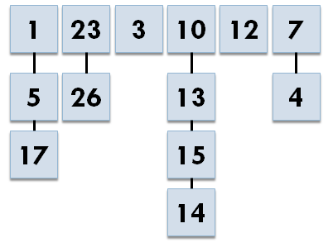
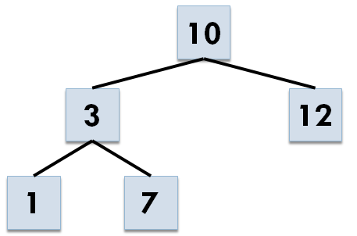
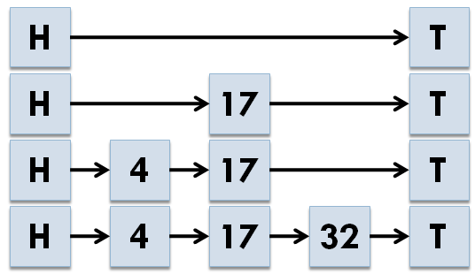
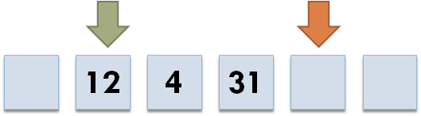
Concurrent Data Objects
For example …
Hashtables
Data structures shared between processes
Trees
Skiplists
Queues
and other …

Slide 4
Synchronization
Synchronization is required for concurrency
Mutual exclusion
  Locks limits concurrency
  Busy waiting – repeated checks to see if lock has been released or not
  Convoying – processes stack up before locks
A better approach is to use data structures
that are …

Slide 5
Overview
CONCURRENT DATA OBJECTS
LOCK-FREE
Composition

Slide 6
Lock-free
Lock-freedom is a progress guarantee
In practice it means that
  A fast process doesn’t
  have to wait for a slow
  or dead process
  Can’t be designed with
  blocking parts
  No deadlocks
Shown to scale better than blocking approaches
Definition
For all possible executions, at least one concurrent operation will succeed in a finite number of its own steps

Slide 7
Libraries using Lock-free Data Objects
Java Concurrency Package
Threading Building Blocks by Intel
.NET Parallel Extensions
NOBLE Non-Blocking Library
…

Slide 8
Overview
CONCURRENT DATA OBJECTS
LOCK-FREE
Composition

Slide 9
Composition
C
Tree
Queue
D
A
B
C
Dequeue
Insert
C
F
?
Tree
Queue
D
Dequeue
A
B
C
Insert
C
F

Slide 10
Lock-free Libraries
Java Concurrency Package
Intel Threading Building Blocks
Parallel Extensions for .NET
NOBLE
…

Slide 11
Challenge
Providing efficiency and correctness
while dealing with
  Specialized designs
  Few common algorithmic components
  Complex proofs of correctness
We target a large class of concurrent data objects

Slide 12
Concurrent Data Objects
Hashtables
Trees
Skiplists
Queues
and other …
Have operations for insertion and removal of elements
Can be composed to
form move operations

Slide 13
Contributions
We provide a framework that consists of three parts
  Properties used to identify compatible objects
  Steps needed to adapt object
  Algorithmic design of operation for performing
  lock-free moves between adapted objects

Slide 14
Characterization
Have operations equivalent to insert and remove
These operations are linearizable
…
…

Slide 15
Linearizability
Linearizable if for any concurrent history there
exists a correct sequential history where …
Operation A
Operation C
Operation B
Operation D
A happens before B,
if A finished before B started
Either C happens before D
or D happens before C,
if C and D are concurrent

Slide 16
Linearization Points
Linearization point
Linearization point
Operation A
Operation C
Operation B
Operation D
Linearization point
Linearization point

Slide 17
Linearization Points
Operation A
Operation C
Operation B
Operation D

Slide 18
Characterization
Have operations equivalent to insert and remove
These operations are linearizable
…
…

Slide 19
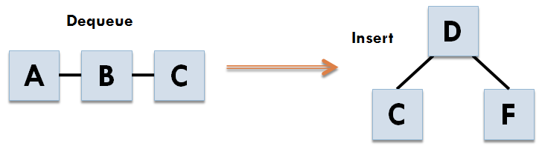
Composition
Remove Element from A
Insert Element into B

Slide 20
Composition
Remove - prolog
Remove - epilog
Insert - prolog
Insert - epilog

Slide 21
Composition
Remove - prolog
Insert - prolog
Insert - epilog
Remove - epilog
Element to remove must be accessible here!

Slide 22
Characterization
Have operations equivalent to insert and remove
These operations are linearizable
The element to remove is accessible before the linearization point
…

Slide 23
Composition
Remove - prolog
Insert - prolog
Insert - epilog
Remove - epilog
Linearization point is often a successful compare-and-swap

Slide 24
Composition
Remove - prolog
Insert - prolog
Insert - epilog
Remove - epilog
Prolog
if(CAS(…))
Only fails if other process succeeds
Epilog

Slide 25
Composition
Remove - prolog
Insert - prolog
Insert - epilog
Remove - epilog
Remove
Insert
DCAS
Failed!
Failed!
Failed!
Combined using a double-word compare-and-swap
Success!
Failed!
Failed!
Failed!
Success!
Failed!
Success!
Success!
Success!

Slide 26
Characterization
Have operations equivalent to insert and remove
These operations are linearizable
The element to remove is accessible before the linearization point
The linearization point for a successful operation is a successful compare-and-swap
Can be composed to move operations

Slide 27
Compatible Concurrent Data Objects
There are a wide variety of commonly used lock-free data structures that supports these requirements
  Queues [PODC ‘96]
  Lists [PODC ‘04]
  Skip-Lists [IPDPS ‘03]
  Priority Queues [JPDC ‘05]
  Hash-tables [SPAA ‘02]
  Dictionaries [SAC ‘04]
  Stacks [Treiber ‘86]
  …

Slide 28
Move Operation
Remove operation
Move support
Insert operation
Prolog
SCAS₁
Prolog
SCAS₂
Reverts to normal compare-and-swap if used outside move operation
Epilog
Epilog
Performs double-word compare-and-swap
Can only fail if other process succeeds

Slide 29
Case Study - Stack
bool pop(value)
while(true)
ltop = top;
if(ltop == 0) return false;
value = ltop.value;
if(cas(top, ltop, ltop.next))
return true;
Not a successful operation
Accessible before linearization point
Successful operation connected to a successful CAS

Slide 30
Case Study - Stack
bool pop(value)
while(true)
ltop = top;
if(ltop == 0) return false;
value = ltop.value;
if(scas(top, ltop, ltop.next, value))
return true;
The scas is called with the value to move

Slide 31
Generic Move Operation

Slide 32
Performance Evaluation
The evaluation was performed on a machine with an Intel Core i7 950 3GHz processor and 6GB DDR3-1333 memory
4 Cores with Hyper-Threading
Enqueue
Dequeue
Enqueue
Dequeue
Move

Slide 33
Queue – Insert and Remove

Slide 34
Queue – Move Operations

Slide 35
Queue – Insert/Remove/Move

Slide 36
Queue – Before/After Adaptation

Slide 37
Summary
We provide a framework that consists of three parts
  Properties used to identify compatible objects
  Steps needed to adapt object
  Algorithmic design of operation for performing
  lock-free moves between adapted objects
Adaptation does not affect standard operations

Slide 38
Thank you!
For more information:
www.cse.chalmers.se/research/group/dcs

