Slide 1
Towards a Software Transactional Memory for Graphics Processors
Daniel Cederman, Philippas Tsigas and Muhammad Tayyab Chaudhry

Slide 2
Overview
Software Transactional Memory (STM) has long been suggested as a possible model for parallel programming
However, its practicality is debated
By exploring how to design an STM for GPUs, we want to bring this debate over to the graphics processor domain

Slide 3
Introduction

Slide 4
Problem Scenario
Binary Tree
12
10
12
3
20
1
7
12

Slide 5
Problem Scenario
Binary Tree
12
10
17
12
3
20
17
1
7
17
12
?
17

Slide 6
Pseudocode
find position in tree;
Step 1
Step 2
insert element;
Tree might change here!

Slide 7
Software Transactional Memory
STMs provides a construction that divides code into transactions that are guaranteed to be executed atomically

Slide 8
Modified Pseudocode
atomic {
find position in tree;
Step 1
insert element;
}
Just one step!

Slide 9
Scenario with Transactions
Transaction A
Transaction B
12
17
10
10
12
20
17
20
12
17
Concurrent

Slide 10
Scenario with Transactions
Committed
Transaction B
10
10
20
20
12
17
Concurrent

Slide 11
Scenario with Transactions
Committed
Aborted
10
10
20
20
12
17
Concurrent

Slide 12
STM Design
Progress Guarantees
Lock Scheme
Lock Granularity
Log or Undo-Log
Conflict Detection Time
…

Slide 13
One Lock
No concurrency
Busy waiting
Convoying
Done
yet?
Done
yet?
Done
yet?

Slide 14
Multiple Locks
Better concurrency
Difficult
Deadlocks
Process A
Y
X
B
Z
C
A
W
D
Q
R
Process B
S
N
T
U
L
Notes:
hard to predict. often too coarse

Slide 15
Dynamic Locks
25
Transaction Log
15
10
Read
10
25
15
20
Read
20
25
Read
30
15
30
Write
30
25
Write
20

Slide 16
Two STM Designs
A Blocking STM
A Non-Blocking STM
Transactions that fail to acquire a lock are aborted
Busy waits, but avoids deadlocks
Transactions that fail to acquire a lock can steal it or abort the other transaction
No busy wait
Based on STM by Tim Harris and Keir Fraser "Language support for lightweight transactions", OOPSLA 2003
Notes:
Two implementations that mainly differ in the progress guarantees they make

Slide 17
Lock Granularity
Object
Word
Stripe
Tradeoff between false conflicts and the number of locks
Wide memory bus makes it quick to copy object
Object A
Object B
int var1;
int var2;
int var3;
int var4;
int var5;
int var1;
int var2;
int var3;
int var4;
int var5;

Slide 18
Log or Undo-Log
Log Changes
Log Original Content
Better with high contention
No visibility problem
Optimistic
Faster when no conflict
Problem with visibility
The visibility problem is hard to handle
in a non-managed environment

Slide 19
Conflict Detection Time
Acquire locks immediately
Acquire locks at commit time
Conflicts detected early
More false conflicts
Late conflict detection
Locks are held shorter time
Holding locks longer will lead to more transactions
aborting long transactions in the non-blocking STM

Slide 20
CUDA Specifics
Minimal use of processor local memory
Better left to the main application
SIMD instruction used where possible
Mostly used to coalesce reads and writes
No Recursion
Rewritten to use stack

Slide 21
More CUDA Specifics
No Functions
Rewritten to use goto statements
Possible Scheduler Problems
Bad scheduling can lead to infinite waiting time
No Dynamic Memory during Runtime
Allocates much memory

Slide 22
Experiments

Slide 23
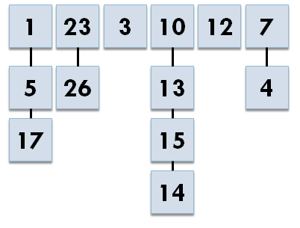
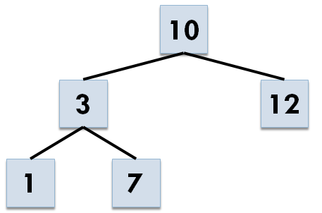
Experiments
Queue (enqueue/dequeue)
Many conflicts expected
Hash-map (inserts)
Fewer conflicts, but longer transactions as more items are inserted
Binary Tree (inserts)
Fewer conflicts as the tree grows

Slide 24
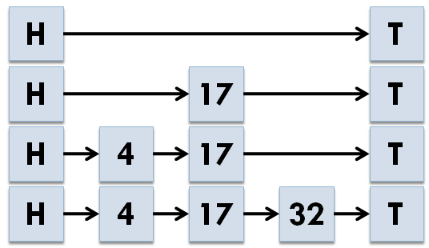
Experiments
Skip-List
Insert/Lookup/Remove
Scales similar to tree
Comparison with lock-free skip-list
H. Sundell and P. Tsigas, Scaleable and lock-free concurrent dictionaries, SAC04.

Slide 25
Contention Levels
We performed the experiments using different levels of contention
High Contention (No pause between transactions)
Low Contention (500ms of work distributed randomly)

Slide 26
Backoff Strategies
Lowers contention by waiting before aborted transactions are tried again
Increases the probability that at least one transaction is successful

Slide 27
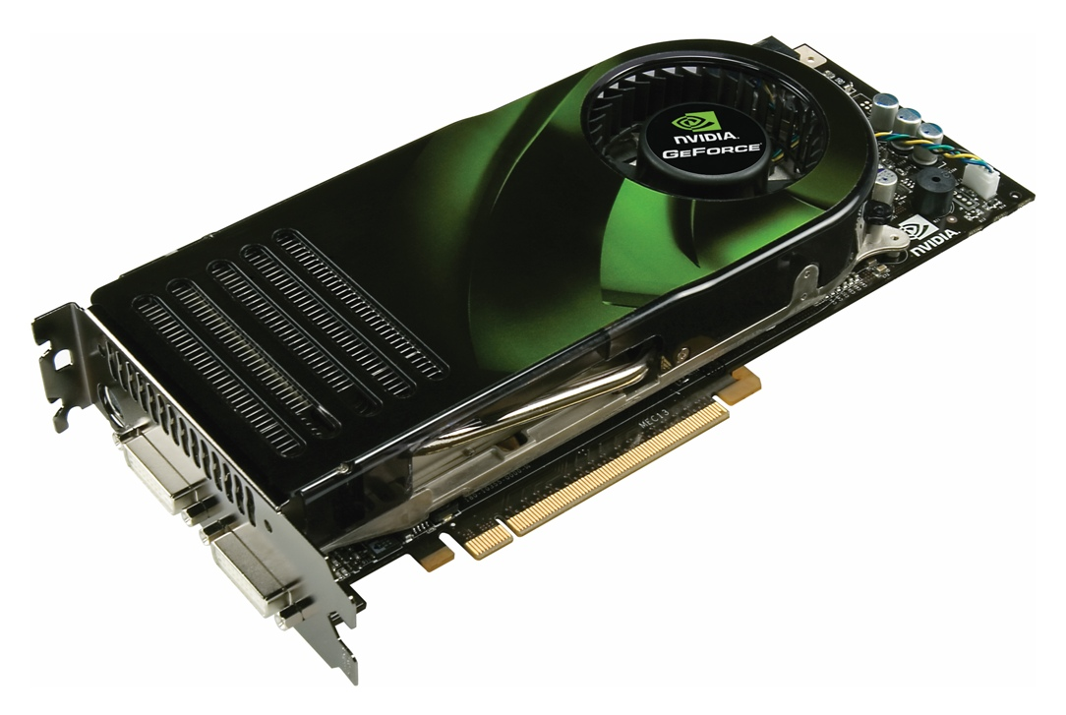
Hardware
Nvidia GTX 280 with 30 multiprocessors
1-60 thread blocks
32 threads in each block

Slide 28
Backoff Strategy (Queue, Full Con)
Notes:
Should have the highest amount of aborted. Other less extreme, but expo is best

Slide 29
Blocking Queue (Full Contention)
Notes:
Didn’t make much change in the actual result

Slide 30
Queue (Full Contention)

Slide 31
Binary Tree (Full Contention)

Slide 32
Hash-map (Full Contention)
Notes:
High number of aborts

Slide 33
Hash-Map Aborts (Full Contention)
Long and expensive
transactions!

Slide 34
Skip-List (Full Contention)

Slide 35
Lock-Free Skip-List (Full Contention)

Slide 36
Conclusion
Software Transactional Memory has attracted the interest of many researchers over the recent years
We have evaluated a blocking and a non-blocking STM design on a graphics processor
The non-blocking design scaled better than the blocking
For simplicity you pay in performance
The debate is still open!

Slide 37
Thank you!
For more information:
http://www.cs.chalmers.se/~dcs

