Slide 1

CluB: A Cluster Based Framework for Mitigating Distributed Denial of Service Attacks
Zhang Fu, Marina Papatriantafilou, Philippas Tsigas
Chalmers University of Technology, Sweden
ACM SAC 2011
ACM SAC 2010

Slide 2
Outline
Background
Cluster-Based Mitigation Framework
Properties
Conclusion and Future Work
ACM SAC 2011

Slide 3
Outline
Background
Cluster-Based Mitigation Framework
Properties
Conclusion and Future Work
ACM SAC 2011
Notes:
One Crux issue is how to evaluate different solutions, We need a standard benchmark.

Slide 4
DDoS Attacks
Flooding packets to the victim to deplete key resources (bandwidth).
ACM SAC 2011
Notes:
Explain some capabilities or more related work

Slide 5
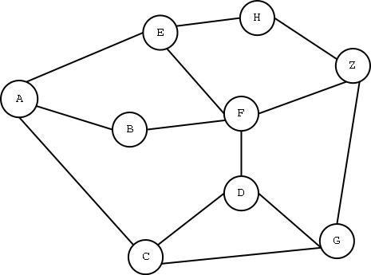

Solutions in the literature
IP Traceback [sigcomm 2000]
Secure Overlay [sigcomm 2002]
Network Capability [sigcomm 2005]
ACM SAC 2011

Slide 6

Targets of the network DDoS are not only end hosts, but also the core network.
Who has the responsibility and the
knowledge to control the traffic ?
We have capabilities
ACM SAC 2011

Slide 7
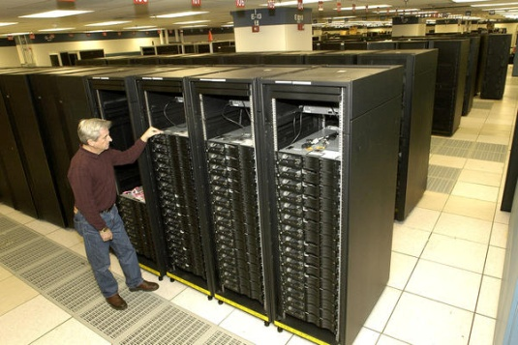
Centralized Control VS Distributed Control
Unique unbounded power entity
Every node gets involved in the control
Two sides of the trade-off:
Either impractical or serious drawbacks
ACM SAC 2011
Notes:
Not god. Some glue to passport

Slide 8

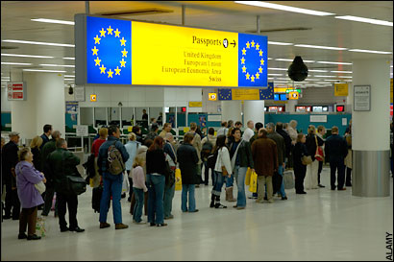
Human analogy: Exit and Entry Control
A citizen of one country needs a passport and a visa to go to another country.
ACM SAC 2011
Notes:
Have country and EU.

Slide 9

Exit and Entry Control:
Can also define different levels of granularity
ACM SAC 2011

Slide 10
Outline
Background
Cluster-Based Mitigation Framework
Properties
Conclusion and Future Work
ACM SAC 2011
Notes:
One Crux issue is how to evaluate different solutions, We need a standard benchmark.

Slide 11
CluB: A Cluster Based Framework for Mitigating DDoS Attacks
Challenges
  How the permissions are issued?
  How the permission-control is carried out?
  How the permission is implemented?
Deals with the DDoS problem, filtering malicious traffic in a distributed manner
  adjusts the granularity of control (e.g. Autonomous System level).
  Each cluster can adopt its own security policy.
  Packets need valid tokens to exit, enter, or pass by different clusters.
ACM SAC 2011

Slide 12
Architecture of CluB
Coordinator
Checking routers
  Egress checking
  Ingress checking
  Backbone routers
  Clusters have secret codes to generate valid tokens for the packets
  Token generation is against replay attacks.
ACM SAC 2011

Slide 13


Architecture of CluB
ACM SAC 2011

Slide 14
Architecture of CluB
ACM SAC 2011

Slide 15
Architecture of CluB
ACM SAC 2011

Slide 16

Architecture of CluB
The secret code of each cluster changes periodically.
To avoid making checking routers targets of DDoS attacks, they change periodically.
ACM SAC 2011

Slide 17
Properties
  Effectiveness: analytically show the limit for probability that malicious packets reach the victim
    With 32-bit authentication codes , < 10⁻¹⁸
C₂
C₁
C₃
C₄
  Robustness: we analytically bound the impact of directed flooding attacks to checking routers.
ACM SAC 2011

Slide 18
Controlling the Granularity of Clusters
Security
Processing load
Traffic Stretch
Path Diversity
ACM SAC 2011

Slide 19
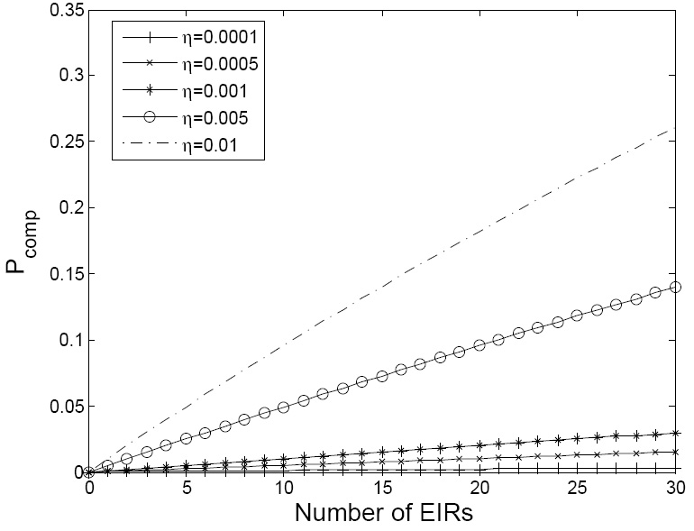
Security and Processing Load
High processing load need more checking routers.
More checking routers raise security risk.
ACM SAC 2011

Slide 20
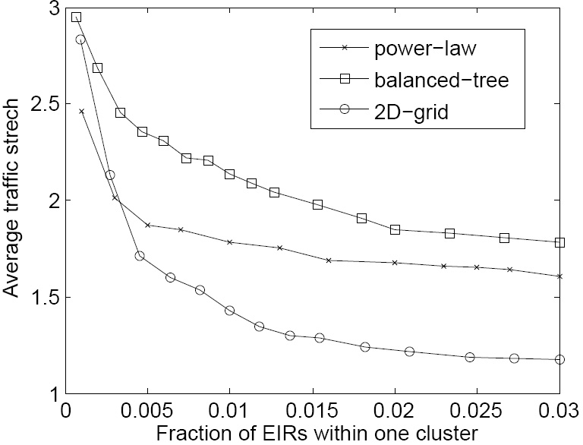
Traffic Stretch
Fewer checking routers will bring higher traffic stretch.
The tour for checking
ACM SAC 2011
Notes:
A figure stretch

Slide 21
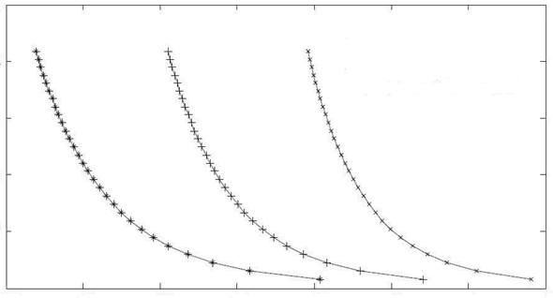
Path Diversity
Assumption:
Bigger cluster size implies more physical links between neighbor clusters
Security risk
Probability of path changing
Bigger cluster size will reduce the path diversity, however, may raise the security risk.
ACM SAC 2011
Notes:
Explain more

Slide 22
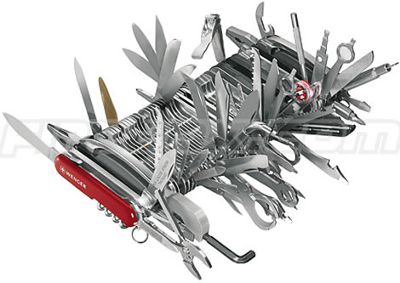
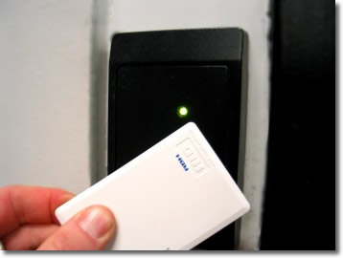
Conclusion and Future Work
Integrated solutions may be needed to achieve better filtering against malicious traffic.
  Accurate identification
  Efficient filtering
Trade-offs between efficiency/overhead and security level.
ACM SAC 2011
Notes:
May be or might be?

Slide 23
Conclusion and Future Work
Holistic study of the parameters.
Partial deployment investigation.
Change and adjust the structures and sizes of the clusters dynamically.
ACM SAC 2011

Slide 24
The End
Thank You
ACM SAC 2011

Slide 25
