Slide 1
Cache-Aware Lock-Free Queues for Multiple Producers/Consumers and
Weak Memory Consistency
Anders Gidenstam
Håkan Sundell
Philippas Tsigas
School of business and informatics
University of Borås
Distributed Computing and Systems group,
Department of Computer Science and Engineering,
Chalmers University of Technology

Slide 2
Outline
Introduction
  Lock-free synchronization
  The Problem & Related work
The new lock-free queue algorithm
Experiments
Conclusions

Slide 3
Synchronization on a shared object
Lock-free synchronization
  Concurrent operations without enforcing mutual exclusion
  Avoids:
    Blocking (or busy waiting), convoy effects, priority inversion and risk of deadlock
  Progress Guarantee
    At least one operation always makes progress
P1
P2
Op B
Op B
Op B
Op A
P4
P3

Slide 4
Correctness of a concurrent object
Desired semantics of a shared data object
  Linearizability [Herlihy & Wing, 1990]
    For each operation invocation there must be one single time instant during its duration where the operation appears to take
    effect.
    The observed effects
    should be consistent
    with a sequential
    execution of the operations
    in that order.
O₁
O₂
O₃

Slide 5
Correctness of a concurrent object
Desired semantics of a shared data object
  Linearizability [Herlihy & Wing, 1990]
    For each operation invocation there must be one single time instant during its duration where the operation appears to take
    effect.
    The observed effects
    should be consistent
    with a sequential
    execution of the operations
    in that order.
O₁
O₂
O₃
O₁
O₃
O₂

Slide 6
System Model
Processes can read/write single memory words
Synchronization primitives
  Built into CPU and memory system
  Atomic read-modify-write (i.e. a critical section of one instruction)
    Examples: Compare-and-Swap, Load-Linked / Store-Conditional
CPU
CPU
Shared Memory

Slide 7
System Model: Memory Consistency
A process’
  Reads/writes may reach memory out of order
  Reads of own writes appear in program order
  Atomic synchronization primitive/instruction
    Single word Compare-and-Swap
    Atomic
    Acts as memory barrier for the process’ own reads and writes
      All own reads/writes before are done before
      All own reads/writes after are done after
      The affected cache block is held exclusively
CPU
core
CPU
core
Store buffer
Store buffer
cache
cache
Shared Memory
(or shared cache)

Slide 8
Outline
Introduction
  Lock-free synchronization
  The Problem & Related work
The new lock-free queue algorithm
Experiments
Conclusions

Slide 9
The Problem
Concurrent FIFO queue shared data object
  Basic operations: enqueue and dequeue
  Desired Properties
    Linearizable and Lock-free
    Dynamic size (maximum only limited by available memory)
    Bounded memory usage (in terms of live contents)
    Fast on real systems
Tail
Head
F
A
B
C
D
E
G

Slide 10
Related Work:
Lock-free Multi-P/C Queues
[Michael & Scott, 1996]
  Linked-list, one element/node
  Global shared head and tail pointers
[Tsigas & Zhang, 2001]
  Static circular array of elements
    Two different NULL values for distinguishing initially empty from dequeued elements
  Global shared head and tail indices, lazily updated
[Michael & Scott, 1996] +
Elimination [Moir, Nussbaum, Shalev & Shavit, 2005]
  Same as the above + elimination of concurrent pairs of enqueue and dequeue when the queue is near empty
[Hoffman, Shalev & Shavit, 2007] Baskets queue
  Linked-list, one element/node
  Reduces contention between concurrent enqueues after conflict
  Needs stronger memory management than M&S (SLFRC or Beware&Cleanup)
N-1
0

Slide 11
Outline
Introduction
  Lock-free synchronization
  The Problem & Related work
The new lock-free queue algorithm
Experiments
Conclusions

Slide 12
The Algorithm
…
…
Basic idea:
  Cut and unroll the circular array queue
  Primary synchronization on the elements
    Compare-And-Swap
    (NULL1 -> Value -> NULL2 avoids the ABA problem)
  Head and tail both move to the right
    Need an “infinite” array of elements
  u

Slide 13
The Algorithm
globalTailBlock
globalHeadBlock
*
Basic idea:
  Creating an “infinite” array of elements.
  Divide into blocks of elements, and link them together
    New empty blocks added as needed
    Emptied blocks are marked deleted and eventually reclaimed
    Block fields: Elements, next, (filled, emptied flags), deleted flag.
  Linked chain of dynamically allocated blocks
    Lock-free memory management needed for safe reclamation!
    Beware&Cleanup [Gidenstam, Papatriantafilou, Sundell & Tsigas, 2009]

Slide 14
The Algorithm
globalTailBlock
globalHeadBlock
*
Thread B
headBlock
head
Thread local storage
  Last used
    Head block/index for Enqueue
    Tail block/index for Dequeue
  Reduces need to read/update global shared variables
tailBlock
tail

Slide 15
The Algorithm
globalTailBlock
globalHeadBlock
scan
*
Thread B
headBlock
head
Enqueue
  Find the right block
  (first via TLS, then TLS->next or globalHeadBlock)
  Search the block for the first empty element
tailBlock
tail

Slide 16
The Algorithm
globalTailBlock
globalHeadBlock
Add with CAS
*
Thread B
headBlock
head
Enqueue
  Find the right block
  (first via TLS, then TLS->next or globalHeadBlock)
  Search the block for the first empty element
  Update element with CAS (Also, the linearization point)
tailBlock
tail

Slide 17
The Algorithm
globalTailBlock
globalHeadBlock
scan
*
Thread B
headBlock
head
tailBlock
Dequeue
  Find the right block
  (first via TLS, then TLS->next or globalTailBlock)
  Search the block for the first valid element
tail

Slide 18
The Algorithm
globalTailBlock
globalHeadBlock
Remove with CAS
*
Thread B
headBlock
head
tailBlock
Dequeue
  Find the right block
  (first via TLS, then TLS->next or globalTailBlock)
  Search the block for the first valid element
  Remove with CAS, replace with NULL2 (linearization point)
tail

Slide 19
The Algorithm
globalTailBlock
globalHeadBlock
*
Maintaining the chain of blocks
  Helping scheme when moving between blocks
  Invariants to be maintained
    globalHeadBlock points to
      The newest block or the block before it
    globalTailBlock points to
      The oldest active block (not deleted) or the block before it

Slide 20
Maintaining the chain of blocks
globalTailBlock
globalHeadBlock
*
Updating globalTailBlock
  Case 1 “Leader”
    Finds the block empty
    If needed help to ensure globalTailBlock points to tailBlock (or a newer block)
Thread A
headBlock
head
tailBlock
tail

Slide 21
Maintaining the chain of blocks
globalTailBlock
globalHeadBlock
*
*
Updating globalTailBlock
  Case 1 “Leader”
    Finds the block empty
    …Helping done…
    Set delete mark
Thread A
headBlock
head
tailBlock
tail

Slide 22
Maintaining the chain of blocks
globalTailBlock
globalHeadBlock
*
*
Updating globalTailBlock
  Case 1 “Leader”
    Finds the block empty
    …Helping done…
    Set delete mark
    Update globalTailBlock pointer
    Move own tailBlock pointer
Thread A
headBlock
head
tailBlock
tail

Slide 23
Maintaining the chain of blocks
globalTailBlock
globalHeadBlock
*
*
Updating globalTailBlock
  Case 2: “Way out of date”
    tailBlock->next marked deleted
    Restart with globalTailBlock
Thread A
headBlock
head
tailBlock
tail

Slide 24
Maintaining the chain of blocks
globalTailBlock
globalHeadBlock
*
*
Updating globalTailBlock
  Case 2: “Way out of date”
    tailBlock->next marked deleted
    Restart with globalTailBlock
Thread A
headBlock
head
tailBlock
tail

Slide 25
Minding the Cache
globalTailBlock
globalHeadBlock
Blocks occupy one cache-line
Cache-lines for enqueue v.s. dequeue are disjoint (except when near empty)
Enqueue/dequeue will cause coherence traffic for the affected block
Scanning for the head/tail involves one cache-line
Thread A
headBlock
head
tailBlock
tail

Slide 26
Minding the Cache
globalTailBlock
globalHeadBlock
Blocks occupy one cache-line
Cache-lines for enqueue v.s. dequeue are disjoint (except when near empty)
Enqueue/dequeue will cause coherence traffic for the affected block
Scanning for the head/tail involves one cache-line
Cache-lines
Thread A
headBlock
head
tailBlock
tail

Slide 27
Scanning in a weak memory model?
globalTailBlock
globalHeadBlock
Scanning for empty
Scanning for first item to dequeue
Key observations
  Life cycle for element values (NULL1 -> value -> NULL2)
  Elements are updated with CAS thus requiring the old value to be the expected one.
  Scanning only skips values later in the life cycle
    Reading an old value is safe (will try CAS and fail)

Slide 28
Outline
Introduction
  Lock-free synchronization
  The Problem & Related work
The lock-free queue algorithm
Experiments
Conclusions

Slide 29
Experimental evaluation
Micro benchmark
  Threads execute enqueue and dequeue operations on a shared queue
    High contention.
  Test Configurations
    Random 50% / 50%, initial size 0
    Random 50% / 50%, initial size 1000
    1 Producer / N-1 Consumers
    N-1 Producers / 1 Consumer
  Measured throughput in items/sec
    #dequeues not returning EMPTY

Slide 30
Experimental evaluation
Micro benchmark
  Algorithms
    [Michael & Scott, 1996]
    [Michael & Scott, 1996] +
    Elimination [Moir, Nussbaum, Shalev & Shavit, 2005]
    [Hoffman, Shalev & Shavit, 2007]
    [Tsigas & Zhang, 2001]
    The new Cache-Aware Queue [Gidenstam, Sundell & Tsigas, 2010]
  PC Platform
    CPU: Intel Core i7 920 @ 2.67 GHz
    4 cores with 2 hardware threads each
    RAM: 6 GB DDR3 @ 1333 MHz
    Windows 7 64-bit

Slide 31
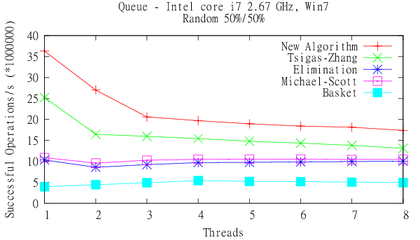
Experimental evaluation (i)

Slide 32
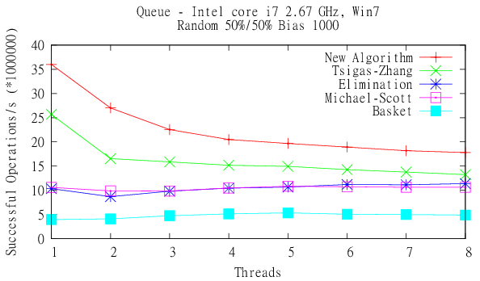
Experimental evaluation (ii)

Slide 33
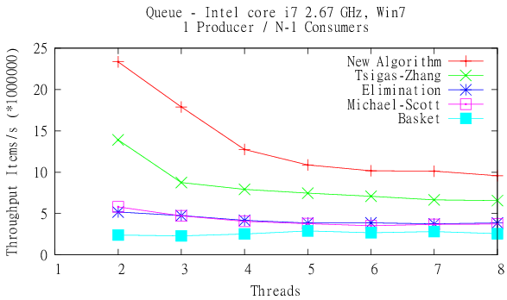
Experimental evaluation (iii)

Slide 34
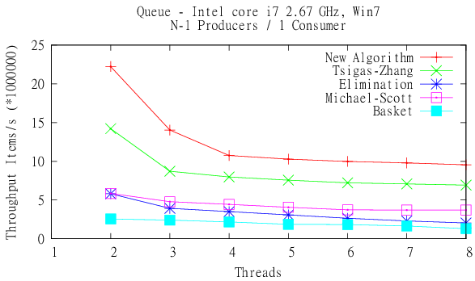
Experimental evaluation (iv)

Slide 35
Conclusions
The Cache-Aware Lock-free Queue
The first lock-free queue algorithm for multiple producers/consumers with all of the properties below
  Designed to be cache-friendly
  Designed for the weak memory consistency provided by contemporary hardware
  Is disjoint-access parallel (except when near empty)
  Use thread-local storage for reduced communication
  Use a linked-list of array blocks for efficient dynamic size support

Slide 36
Thank you for listening!
Questions?

Slide 38
Experimental evaluation
Scalable?
  No. FIFO order limits the possibilities for concurrency

Slide 39
The Algorithm
globalTailBlock
globalHeadBlock
*
Basic idea: “infinite” array of elements.
  Primary synchronization on the elements
    Compare-And-Swap (NULL1 -> Value -> NULL2 avoids ABA)
  Divided into blocks of elements
    New empty blocks added as needed
    Emptied blocks are removed and eventually reclaimed
    Block fields: Elements, next, (filled, emptied), deleted.
  Linked chain of dynamically allocated blocks
    Lock-free memory management needed for safe reclamation!
    Beware&Cleanup [Gidenstam, Papatriantafilou, Sundell & Tsigas, 2009]

Slide 40
The Algorithm
globalTailBlock
globalHeadBlock
Thread A
headBlock
head
tailBlock
tail

Slide 41
System Model: Memory Consistency
A process’
  Reads/writes may reach memory out of order
  Reads of own writes appear in program order
  Atomic synchronization primitive/instruction
    Single word Compare-and-Swap
    Acts as memory barrier for own reads and writes
      All own reads/writes before are done before
      All own reads/writes after are done after
      The affected cache block is held exclusively
CPU
core
CPU
core
Store buffer
Store buffer
Cache-coherency
cache
cache
Shared Memory
(or shared cache)

Slide 42
Maintaining the chain of blocks
globalTailBlock
globalHeadBlock
*
Updating globalTailBlock
  Case 1 Leader
    Finds the block empty
    If no next => queue empty (done)
Thread A
headBlock
head
tailBlock
tail

